Slide 1
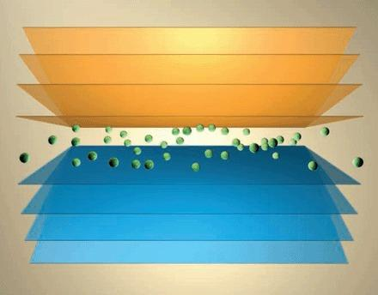
Characterization and Modeling of complexion engineered microstructures
Complexions for Informed Design
Greg Rohrer and Tony Rollett

Slide 2
Outline
Mesoscale characterization and Modeling of complexion engineered microstructures
2. Characterizing and modeling Interface distributions in nanoscale materials

Slide 3
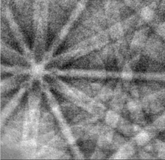
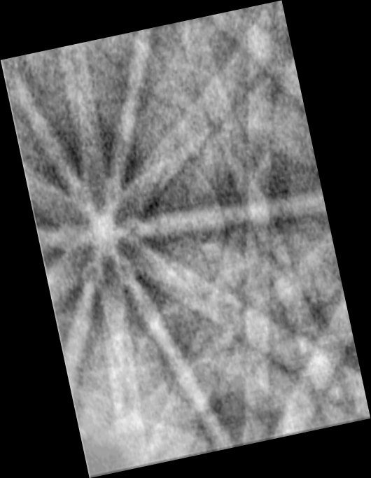
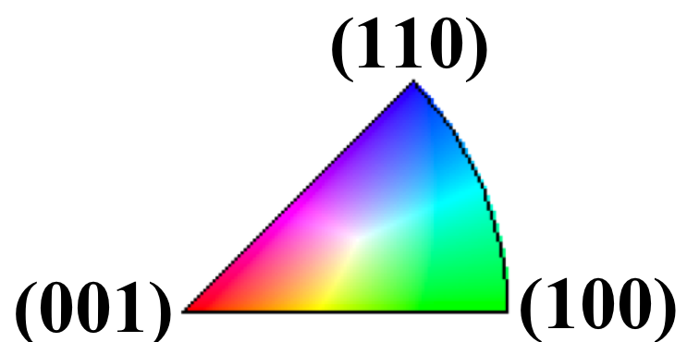
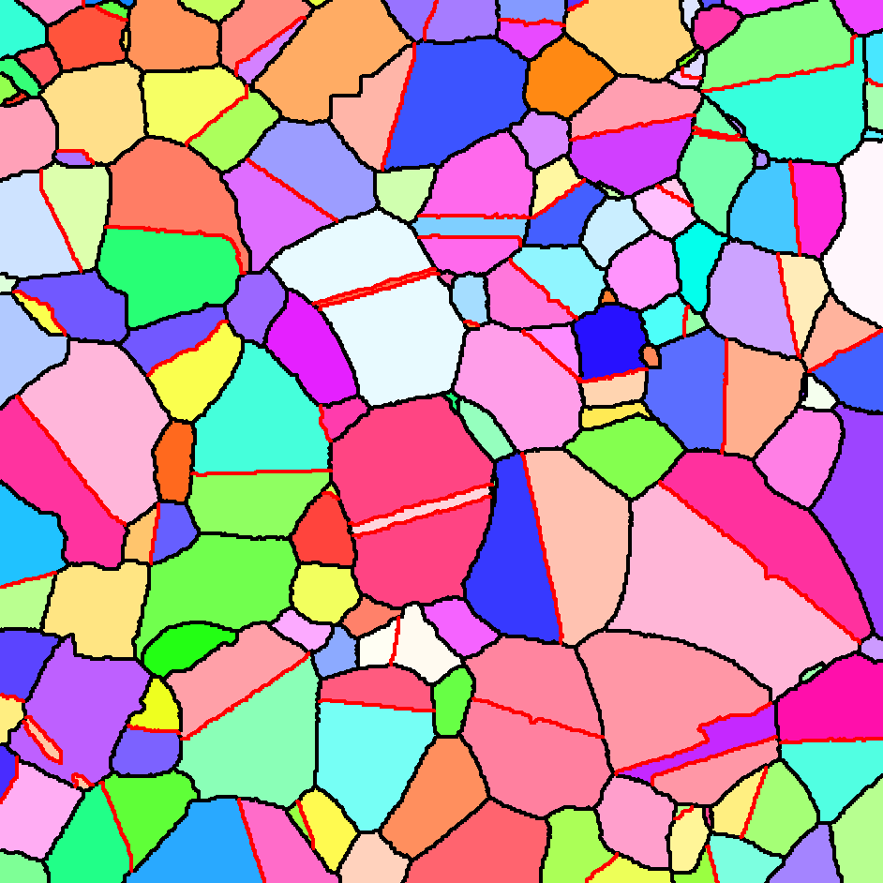
All Measurements Based on Orientation Mapping in the SEM
FE SEM source
camera
e-
Sample,
60°-70° tilt
backscatter Kikuchi diffraction pattern
Electron backscattered diffraction pattern, indexed by computer
Inverse pole figure map (TiO₂) displays accumulated orientations.
100μm
Notes:
I think everybody here is aware of EBSD … this is to remind you that this is how we make all of our measurements.
Furthermore, this provides four of the five grain boundary grain boundary characteristics. By using DB FIB, we can measure the remaining parameter.
The way this works ..

Slide 4
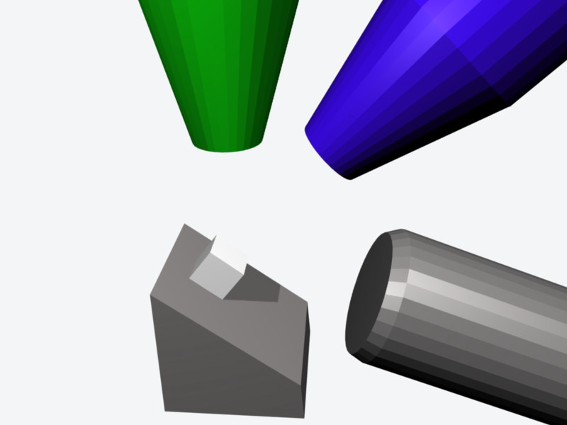
Automated Serial Sectioning in the FIB
Nova 600 NovaLab
DB-FIB SEM
map orientations with EBSD
remove thin slice with ion beam
Repeat
Notes:
There is both an electron column and an ion column.
Begin with an EBSD scan, rotate to a glancing angle position, and mill off a thin layer, then repeat.
In this way, it is possible to build up a three dimensional orientation map of the structure.
A short movie shows:

Slide 5
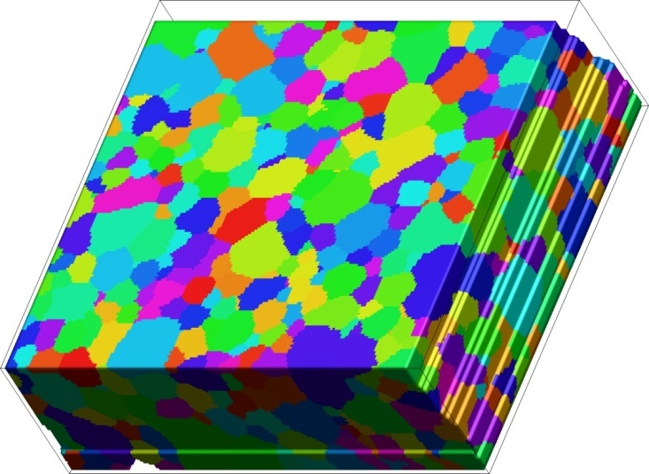
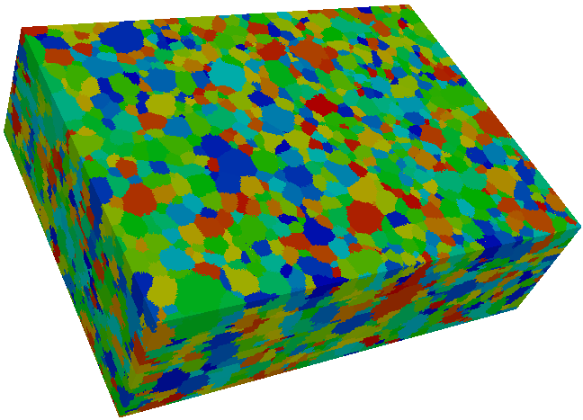
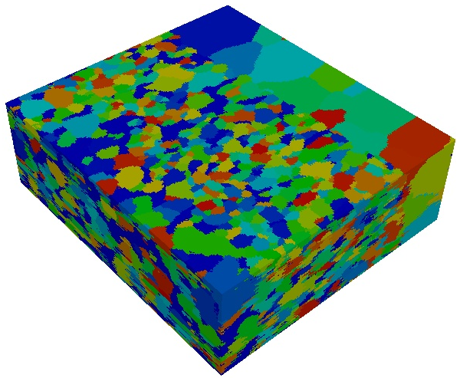
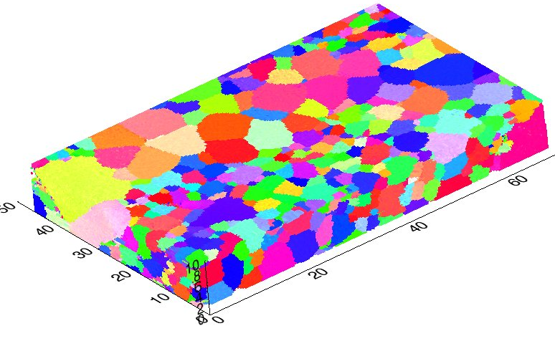
Some of the Materials Studied
10 μm
Yttria
20 μm
Yttria-Stabilized Zirconia
3 μm
Strontium Titanate
SOFC
Notes:
The methods are applicable to a range of metals and ceramics. One thing we do with these data is measure the relative GB energies. This is accomplished by analyzing TJ geometries

Slide 6
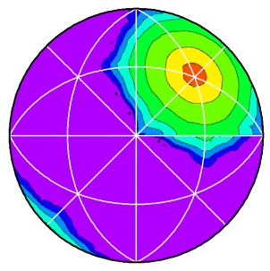
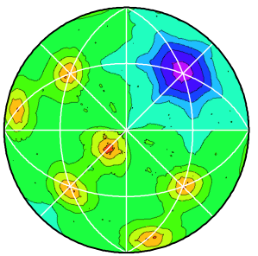


Distribution of GB planes and energies in the bicrystal reference frame - Ni
Σ3 – Grain Boundary
Grain Boundary Plane Distribution
Grain Boundary Energy Distribution
(a)
(b)
[010]
[100]
ln(λ(n|60°/[111]), MRD)
γ(n|60°/[111]), a.u.

Slide 7
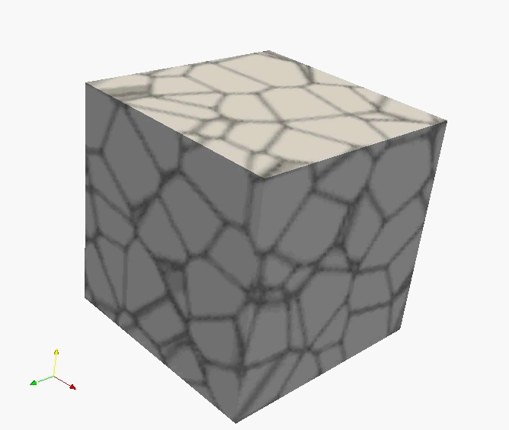
Accurate simulations of microstructure evolution
Test models for transition from normal to complexion state.
  Detailed modeling of solute-boundary interaction for isolated grains, and polyxtal networks.
  Models use information about solute-GB interaction from atomistic scale simulations & theory.
Test ideas about how mixtures of normal and complexion state boundaries influence grain growth.
  Larger scale models with constitutive descriptions of normal↔complexion transitions based on atomistic and detailed mesoscale modeling

Slide 8
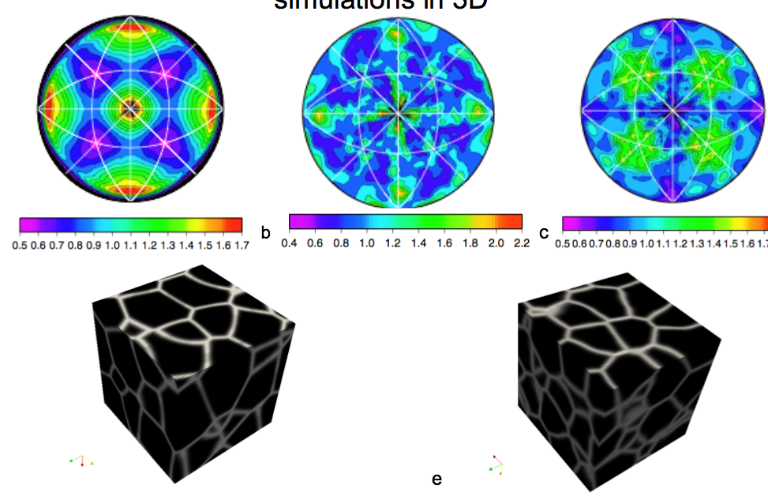
Results of Simulations of Ni
Assumed Energy Distribution
Interface distribution assuming isotropic energies
Interface distribution assuming anisotropic energies
Note differences in dihedral angles

Slide 9
Systems To Study in MURI
Initial work:
Ni-Bi (this will connect with ongoing research at Lehigh and Clemson)
Next Priority:
Metal Complexionized Ceramics (This will start after successful synthesis by Lehigh)
Exploratory systems:
WC-Co (Model metal-ceramic system that has evidence of complexions)
Sn and Sb-doped ZnO (exploratory system that has evidence for complexions)
YSZ (collaborating with the Clemson and Illinois groups)
Σ9: pure
Σ9: Bi-doped

Slide 10
Outline
Mesoscale characterization and Modeling of complexion engineered microstructures
2. Characterizing and modeling Interface distributions in nanoscale materials

Slide 11
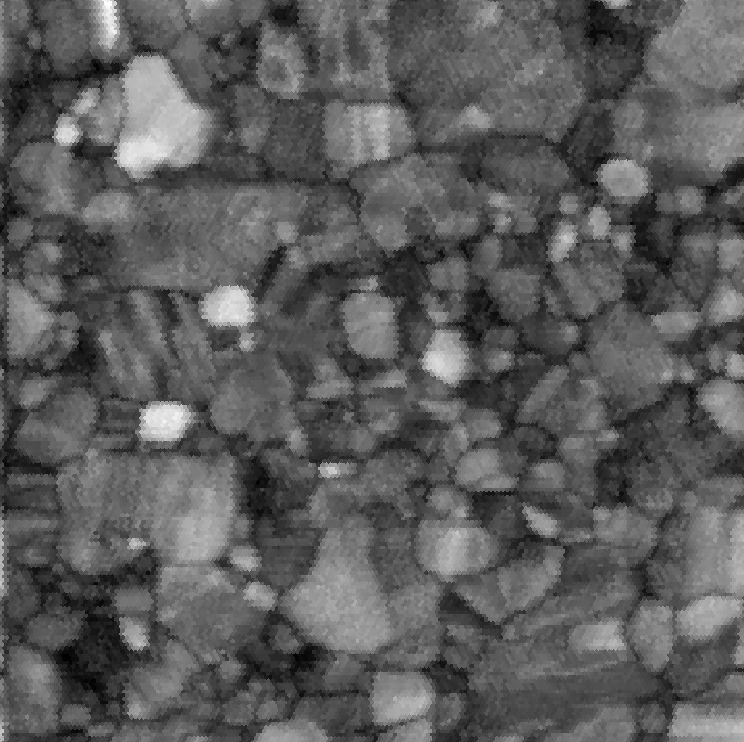
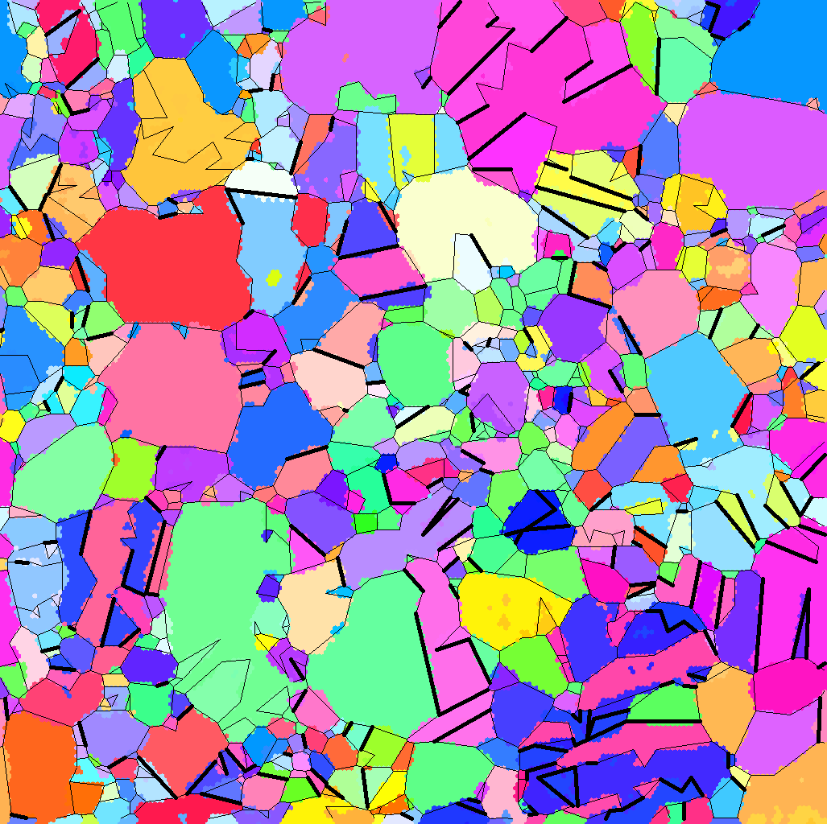
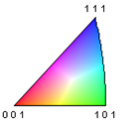
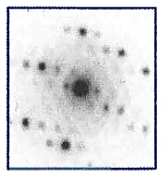
Orientation Mapping at the Nanoscale
Accurate orientation mapping of a Cu thin Film with a man grain size of 86 nm!
200 nm
200 nm
Inverse pole figure map with reconstructed boundaries.
NanoMegas has developed a commercial package known as ASTAR that combines nanoprobe with precession diffraction.
Courtesy of: A. Darbal and K. Barmak

Slide 12
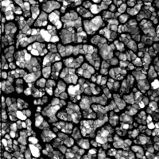
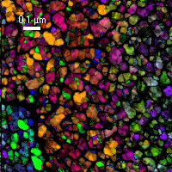
Orientation Mapping at the Nanoscale
Confidence Map
Orientation Map
Fe:Pt thin file hard disc drive material
Courtesy of: S. Granz, M. Kryder

Slide 13
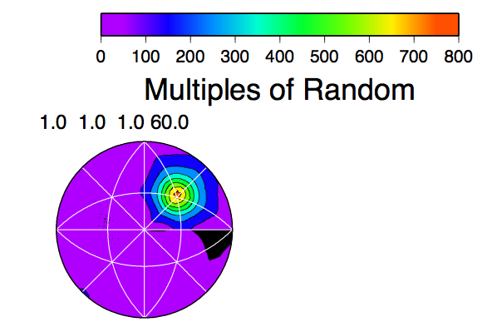
Nanoscale Interface Data
• Compute Interface distributions
• Compute grain boundary energies
• Use as input for Phase Field Models
Σ3 boundaries in a thin Cu film
Computed based data from Darbal and Barmak

Slide 14
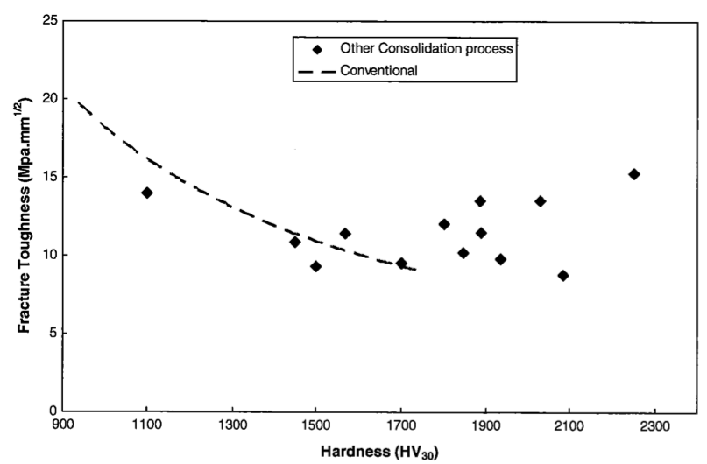
Systems of interest
Nanosized WC/Co
• Extend to other systems produced by SPS
Y₂O₃-doped aluminas
SiO₂-doped aluminas
Metal complexionized ceramics
Z. Z. Fang, X. Wang, T. Ryu, K. S. Hwang, and H. Y. Sohn, "Synthesis, sintering, and mechanical properties of nanocrystalline cemented tungsten carbide - a review," International Journal of Refractory Metals & Hard Materials, 27 [2] 288-99 (2009).

Slide 15
Summary
1. Characterization and Modeling of complexion engineered microstructures
- Techniques
3D mesoscale interface structure studies (GBCD measurements)
Grain Boundary Energy Measurements (towards complexion selection rules)
Modeling Microstructure evolution (phase field method)
- Systems (possible)
Ni-Bi, Metal Complexionized Ceramics, WC-Co, ZnO-Sn,Sb, YSZ
2. Characterizing Interface Distributions in nanoscale materials
- Techniques
Use emerging TEM-based orientation mapping (nanomegas system)
3D structural studies of the GBCD and GBED
Modeling Microstructure evolution (phase field method)
- Systems
WC-Co, Ytrria and silica doped aluminas
3. Work accomplished by two MSE graduate students integrating characterization and modeling.

Slide 16
Extras

Slide 17
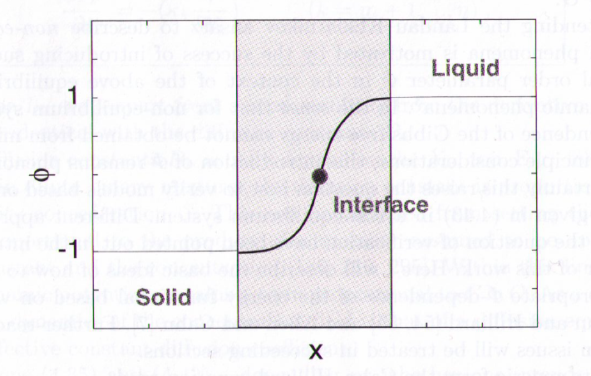
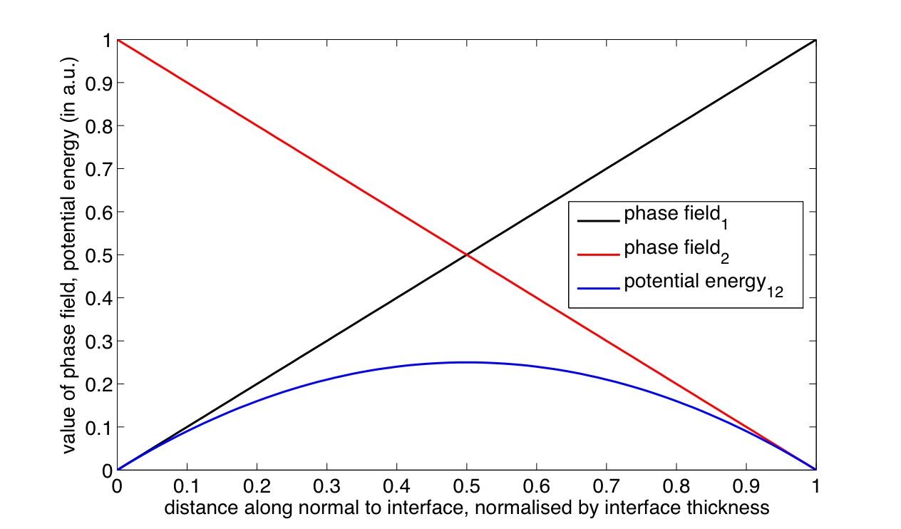
Phase Field Model Formulation
For grain i,
f^{pot}(ϕ) defined such that it is at a
minima within each grain interior
Steinbach, Physica D 134 (1999) 385–393.
Diffuse interface approach in materials science, ed. Emmerich, p40
Notes:
Overview of phase field formulation, taken from Debashis’s overview

Slide 18
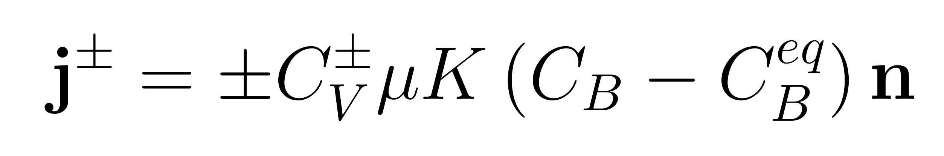
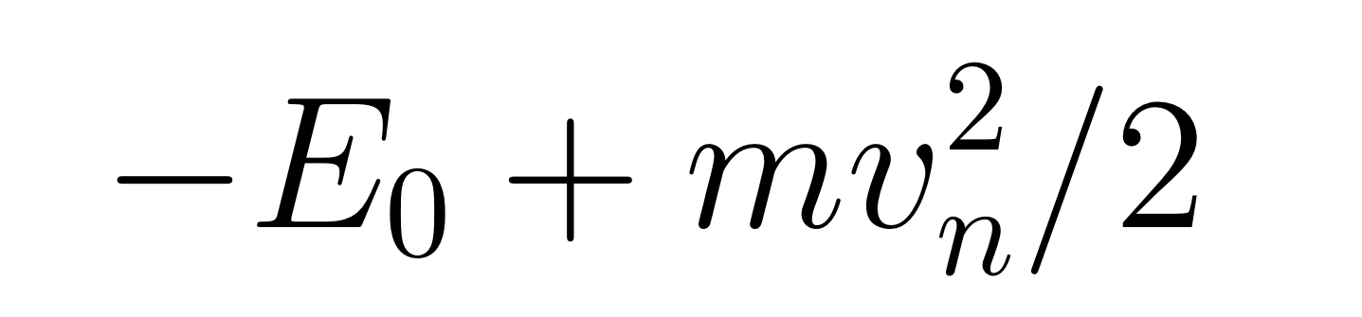
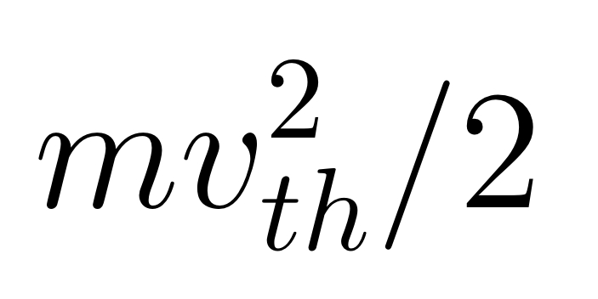
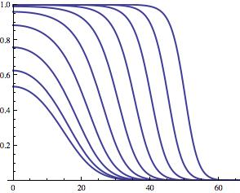
Solute drag
What is the equilibrium segregation C_{B}^{eq} as a function of boundary velocity?
Energy
Approximate the boundary as a two-state system
Bound state
Unbound state
The canonical distribution from statistical mechanics then implies that
v_{th}
C_{B}
v_{n}
Notes:
• This slide is from Seth’s Overview and is intended to illustrate the way in which solute-boundary interactions depend on the interaction of solute atoms with GBs. The point is that information obtained from the atomistic modeling will be incorporated in the mesoscale models via such equations and analysis.
• The equilibrium bound solute content [Γ_{eq}, equation (50)] as a function of boundary velocity, plotted for 5 < v_{D} < 50, assuming Γ − ∆Γ = ε₂ − ε₁ = 1 and β = 0.01. The value Γ_{eq} (v = 0) decreases with increasing v . Notation: Γ = Γ₁ +Γ₂, β = 1/k_{B}T, and Z = exp(−βε₁)+exp(−βε₂).

Slide 19
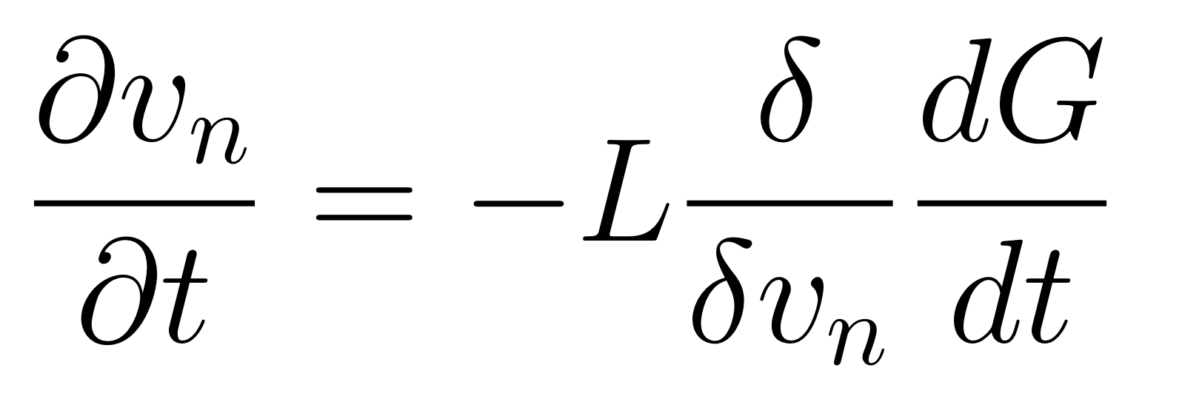
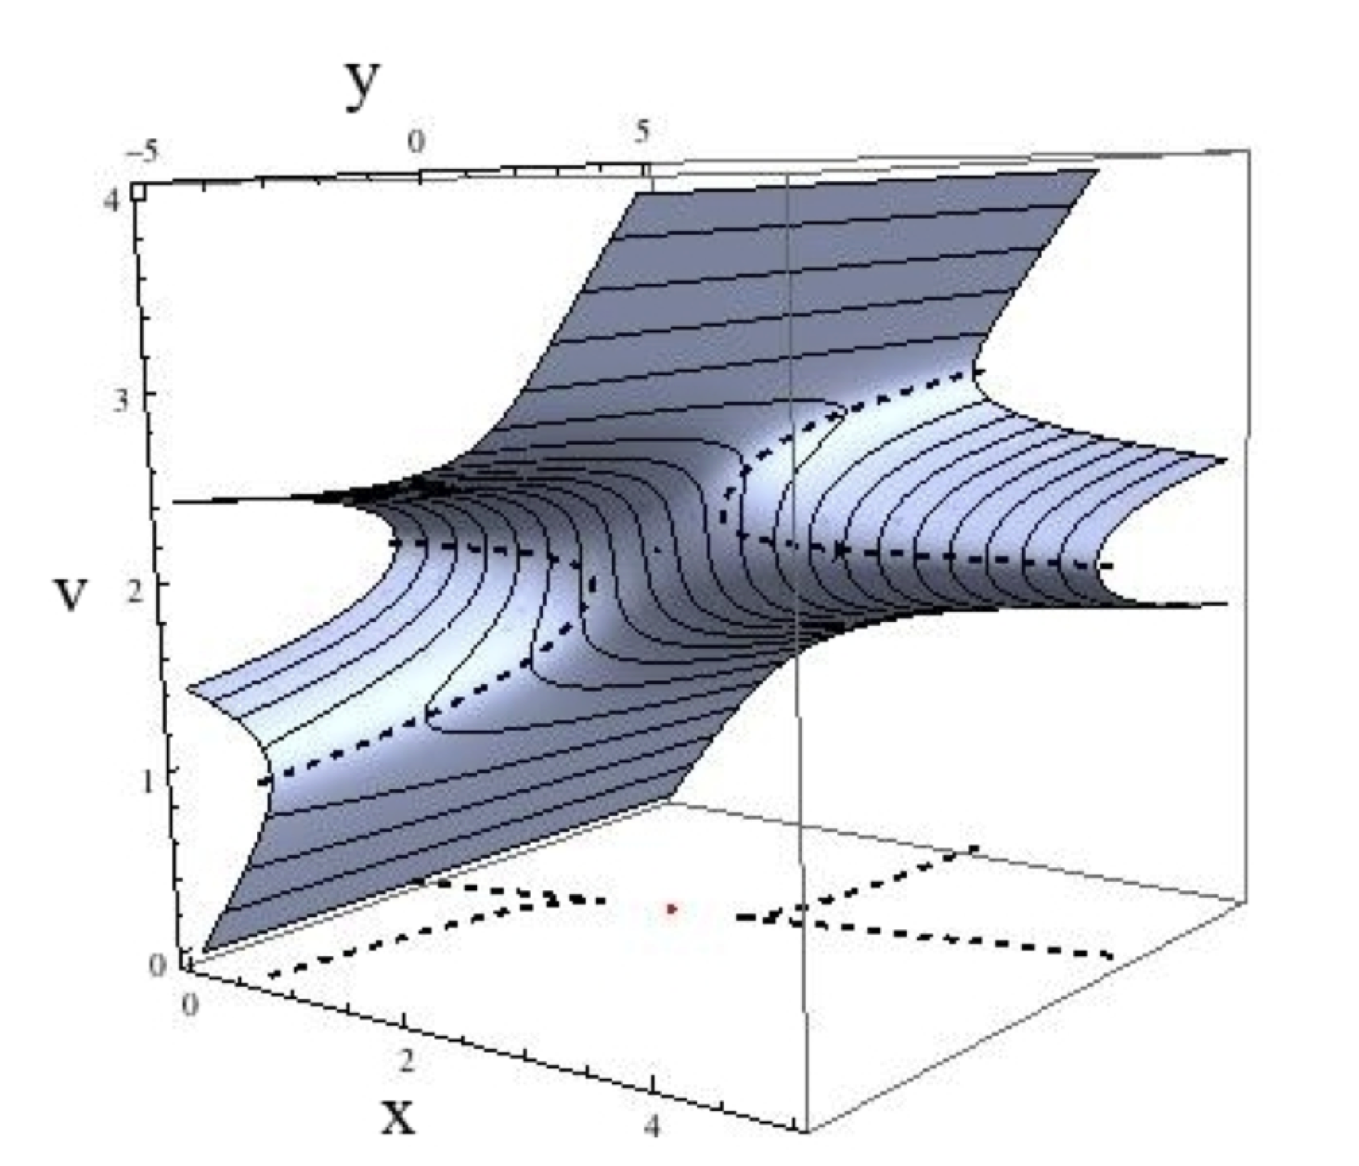
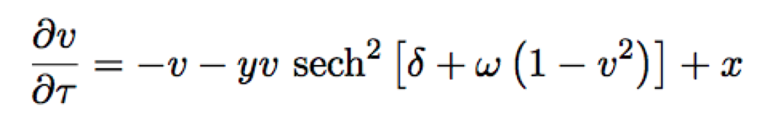
Solute drag
Rate of change of boundary velocity, v, with respect to driving force, τ.
Notes:
• This slide illustrates the peculiarities of how velocity depends on driving force during solute drag, where the driving force itself depends on velocuty as well as the history of the boundary as it interacts with the solute field. This illustration is for the steady state, however, in order to be able to perform the analysis semi-analytically. It basically leads to the same result as noted by Cahn and others but with more detail about transitions from one branch to another.
• Steady-state manifold. The set of points {x, y, v} in phase space that satisfy dv/dt = 0, where dv/dt is given by equation (63). The dashed lines on the plane v = 0 are projections of the dashed lines that have been plotted on the surface of the manifold. Bifurcations occur in this model along the curved dashed lines, marking the boundary between unstable and stable manifolds. Contours on the plotted surface represent lines of constant x. This plot was generated using Mathematica, with parameters in equation (63) set to δ = 2.25 and ω = 0.75.

