Slide 1
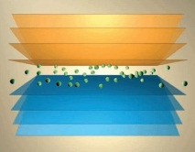
Metal Complexionized Ceramics (MCC’s)
Rationale
Exploit metallic gb complexions (within ceramics) to achieve a new class of bulk materials with unique combinations of properties (e.g. mechanical, electrical)
  MCC Polycrystals
  Nanophase MCCs
Approach
Model bicrystal experiments to determine types and stability ranges of different metallic complexions
Property characterization
Processing of MCC’s

Slide 2
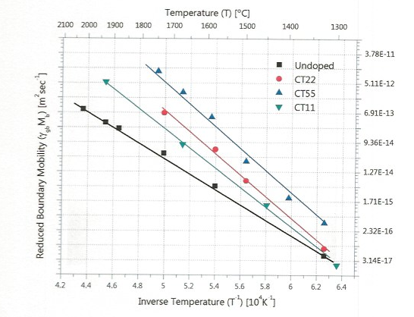


Cu,Ti Co-Doped Alumina: Effect of Concentration on GB Mobility
500 ppm Cu, 500 ppm Ti
200 ppm Cu, 200 ppm Ti
100 ppm Cu, 100 ppm Ti
Undoped
Behera Ph.D. Thesis (Lehigh, 2010)

Slide 3
Model Bicrystal Studies
Determine types and stability range of different metallic complexions
Materials Systems
Alumina – Metal
Sapphire (basal, a-plane, r-plane, m-plane)
Cu, Cu-Ti, Ni
Processing Strategies
Reduction of MO layer
Evaporation of metallic film on substrate, hot-press to form bicrystal
Metal infiltration into hot-pressed sapphire bilayer
Heat-treatment to generate different complexions
sapphire

Slide 4
Sapphire-Alumina Polycrystal Sandwich Structures
Heat-treatment
sapphire
P
Survey large number of high angle grain boundaries for special behavior
Characterization of IC’s
  Structure (HRTEM)
  Composition, bonding (Electron energy loss)
  Electrical conductivity (SPM - Conduction Mode)
  Mechanical properties (Nano-indentation)
Modelling

Slide 5
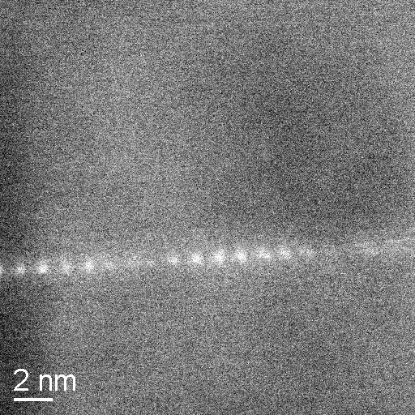
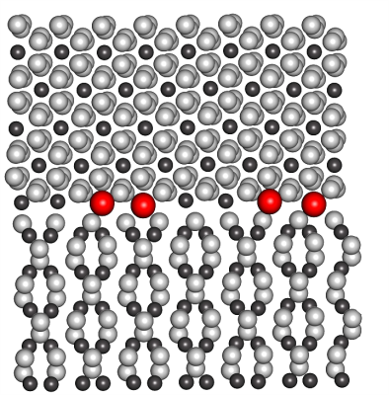
Imaging of Grain Boundaries at the Atomic Scale
In-situ Annealing Studies
(Nd)
Type I
JEM-ARM200F (aberration corrected) .08 nm resolution (delivery early 2012)
Protochip hot-stage (up to 1200 ºC)

Slide 6
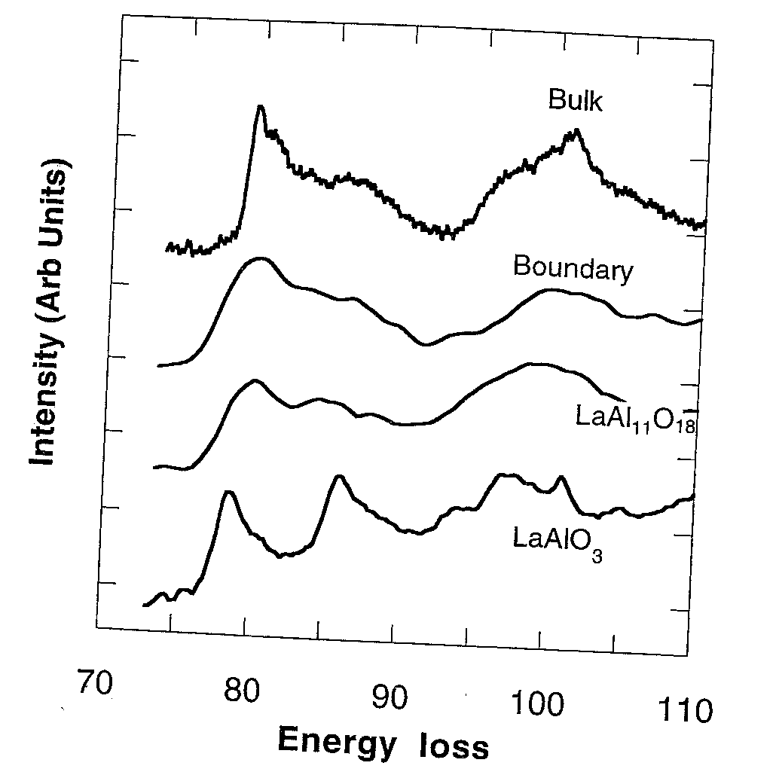
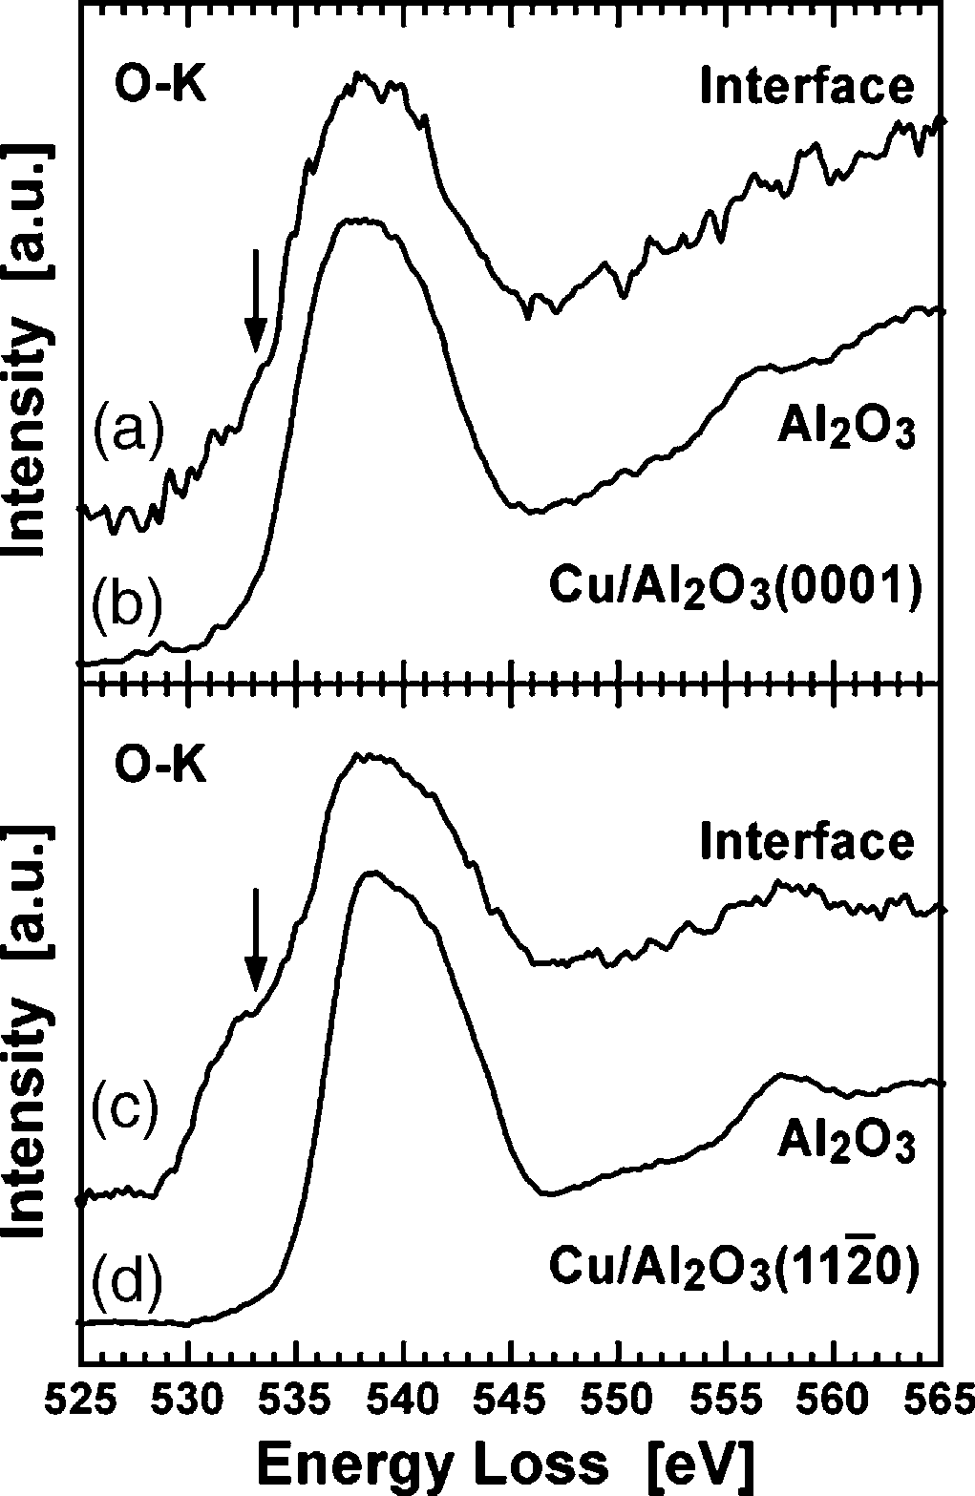
ELNES: Electron Energy Loss Near Edge Structure
Alumina 500 ppm La: Al L_{2,3} Edge
Cu-O bonding
Bruley, Cho, Chan Harmer and Rickman, JACerS 82(1999)2865
Sasaki et al. Appl. Surf. Sci. 241 (2005) 87-90
Fine structure in EELS spectrum reflects local bonding
e.g. Cu-Cu-Al-O-Al vs Cu-Cu-O-Al-O

Slide 7
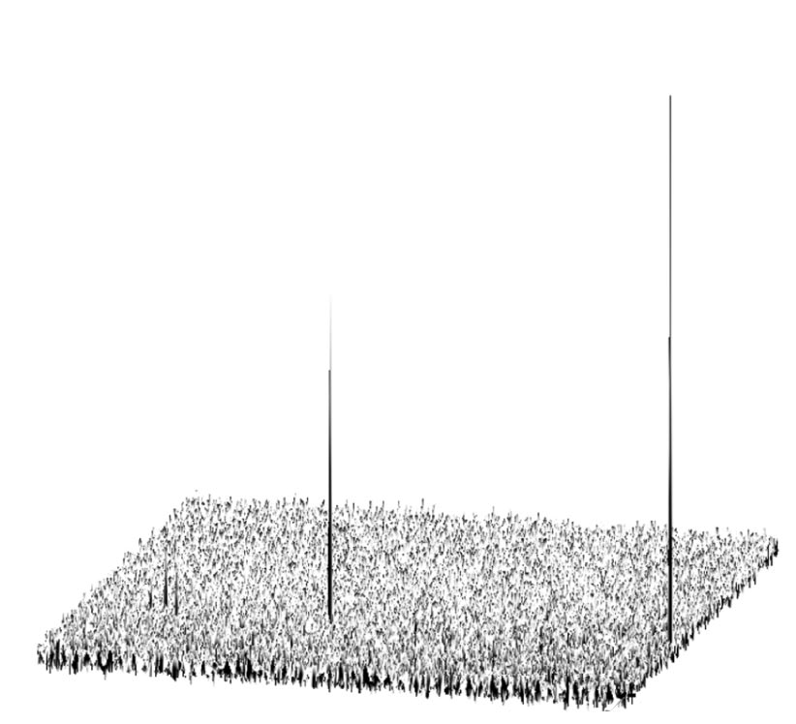
Scanning Probe Microscopy - Conduction Mode
1.0
0.5
Spike in conductivity corresponding to Ti ‘nanowires’
Ti atoms localized at dislocations
Electrical current (nA)
Sapphire
Nakamura et al, Nature of Materials (2003)
1 μm
SPM will be used to probe conductivity of specific boundary complexions
Correlate with bulk thermal conductivity measurements

Slide 8
Bulk Nanophase MCCs
Potential for unique property combinations due to relatively high proportion of boundary area
Evolution of grain size in yttria in a two-step sintering process.
Challenge (maintaining nanoscale grains)
Exploit special complexions
- Two-step sintering
- Spark plasma sintering

Slide 9
Mechanical Behavior of MCCs
Nano-indentation
- Berkovich indenter
- 10 μN to 10 mN loading
Characterize
- Elastic Modulus
- Cracking behavior
Deformation mechanism
- TEM of indented samples
Potential for unique property combinations due to relatively high proportion of boundary area
Ceramic nanograin
Metallic interphase

