Slide 1
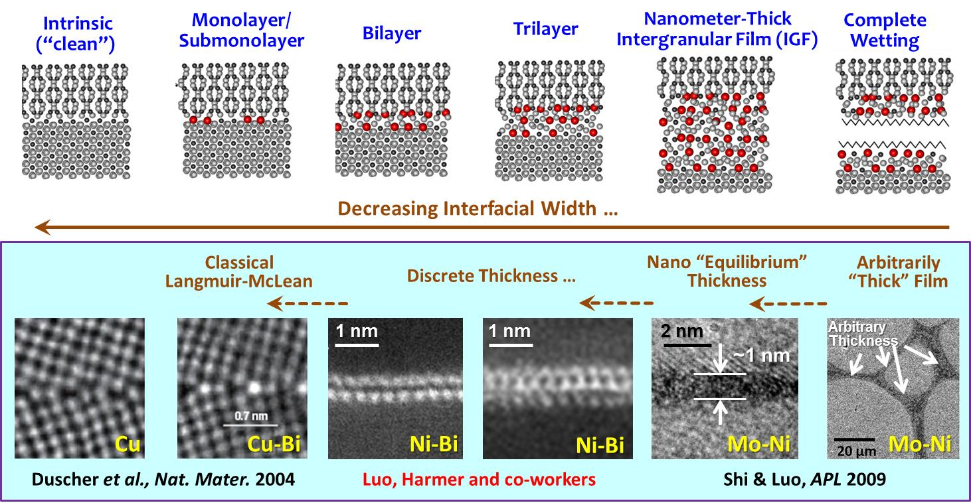
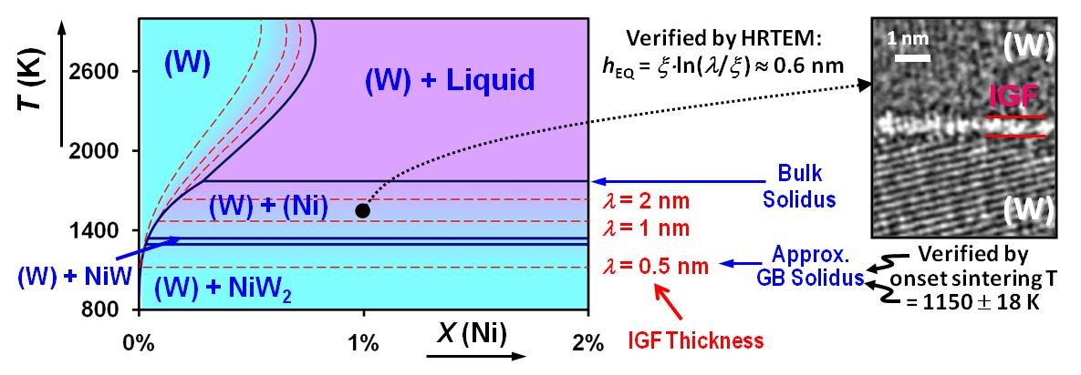
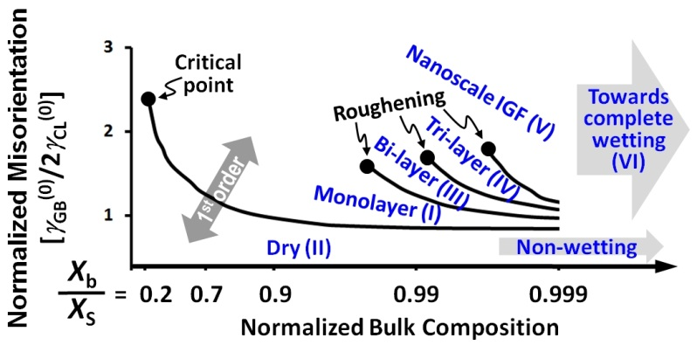
MURI Clemson Tasks
(Jian Luo, co-PI)
Postdoc: Matthew Williams (US citizen)
PhD student: Yuanyao Zhang
1 MS in the 2nd half project
Collaboration on characterization (e.g., HAADF-STEM/Lehigh, 3D microstructure/CMU & diffusion measurements/UIUC ) & multiscale modeling
Experimental Task I:
Embrittlement of Ni & Cu Alloys
Experimental Task II:
Ionic Conductivity of Oxides
Co-dope to control (design);
Synthesis; Characterization
Model System: ZrO₂-Y₂O₃-(SiO₂)-M_{x}O_{y}
Co-dope to control GB resistance
Synthesis of specimens
High-T impedance measurements
HRTEM, HAADF-STEM (Lehigh)…
Task III: Thermodynamic Modeling → “Grain Boundary (GB) Diagrams”
Support other MURI members on various experimental & modeling tasks…

Slide 2
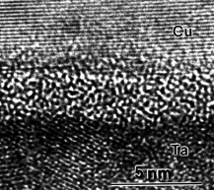
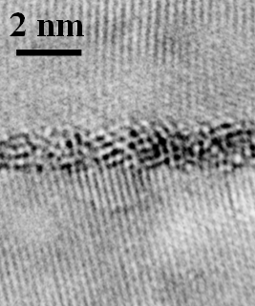
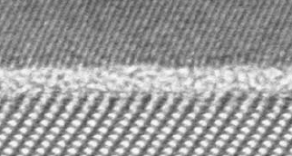
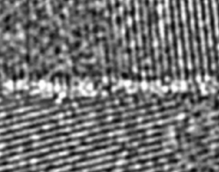

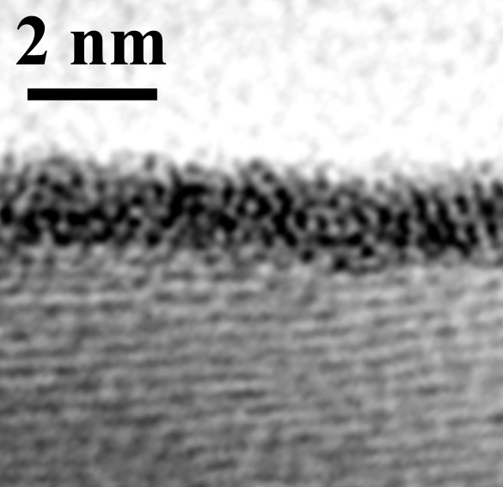
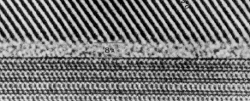
Background: Impurity-based Quasi-Liquid Interfacial Films
Luo, Crit. Rev. Solid State Mater. Sci. 32:67 (2007)
Hetero-Interfaces
Ceramic Grain Boundaries (GBs)
Free Surfaces
TiO₂
2 nm
2 nm
Si₃N₄
Widespread Existence of Similar IGFs:
ZnO
Vapor
SiC, AlN, SIALON, Al₂O₃, (Sr, Ba)TiO₃, ruthenate thick film resistors,
TiO₂, ZrO₂, YBCO, Synroc, etc.
(all with additives)
SiO₂
Si₃N₄
ZnO
Bi₂O₃-enriched
film (w/o SiO₂)
ZnO
SiO₂-enriched film
Oxide-Oxide
Hetero-Interface
T < T_{eutectic}
(Ackler & Chiang,
JAmCerS 1997)
The Most Well-Known Case
(Kleebe et al, JAmCerS 1993)
No SiO₂, T< T_{eutectic}
(Wang & Chiang, JAmCerS 1998)
T< T_{eutectic}
(Luo & Chiang,
Annu. Rev. Mater. Res. 2008)
Intergranular Films (IGFs): Equilibrium Thickness
D. Clarke, J. Am. Ceram. Soc. 1987, 70: 15
Cu
Metals
Ice + Impurities, e.g. NaCl
(Molecular Solids)
Al₂O₃
Cu
2 nm
Ni-enriched film
W
Vapor,
Ice, or
Inert Wall
Surface
(Wettlaufer,
PRL 1999)
GB & interface
(Wettlaufer et al., PRE 2005)
2 nm
Metal-Oxide Interface
(Kaplan et al,
Acta Mater. 2000)
Cu-Ta
b.c.t.-Ta
(metastable)
W
Quasi-Liquid
Ice
(Kwon et. al, APL 1999)
NOT classical solid-state amorphization
T< T_{eutectic}
(Luo, et al., APL 2005)

Slide 3
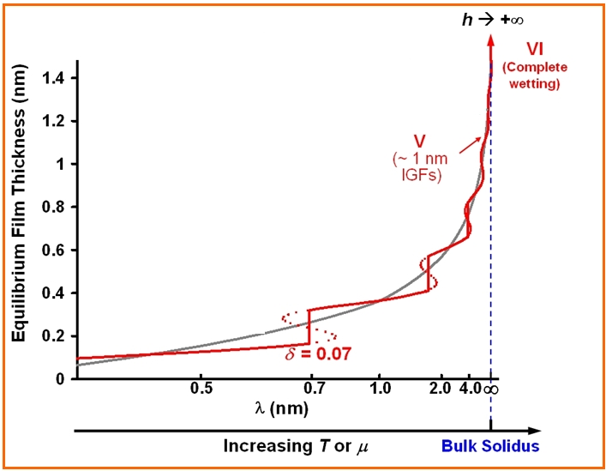
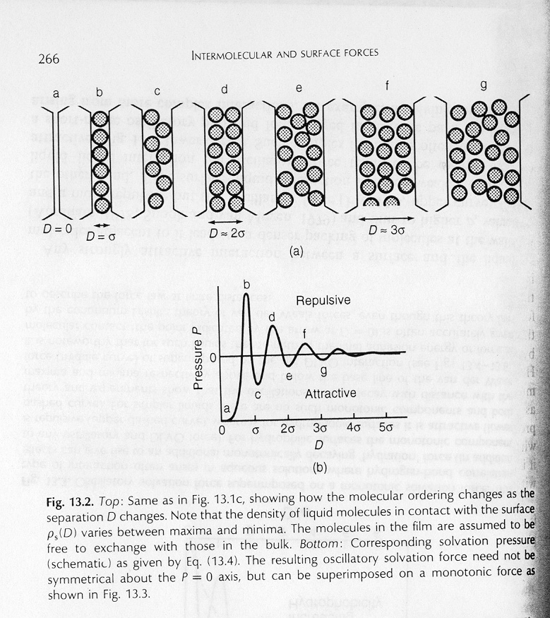
Origin of Dillon-Harmer Complexions in a Phenomenological Model
Luo, Current Opinion in Solid State & Materials Science 2008
Additional discrete
“GB phase”
Introduce an oscillatory force (in colloidal theories):
(Israelachvili, Intermolecular and Surface Forces, 1994)
Complexions in doped Al₂O₃
Dillon, Tang, Carter & Harmer
Acta Mater. 55: 6208 (2007)
Interfacial Width ↓ Adsorption ↓ Structural Order ↑
Simpler Metals
Less equivocal!
Recent Lehigh-Clemson finding fills a gap…

Slide 4
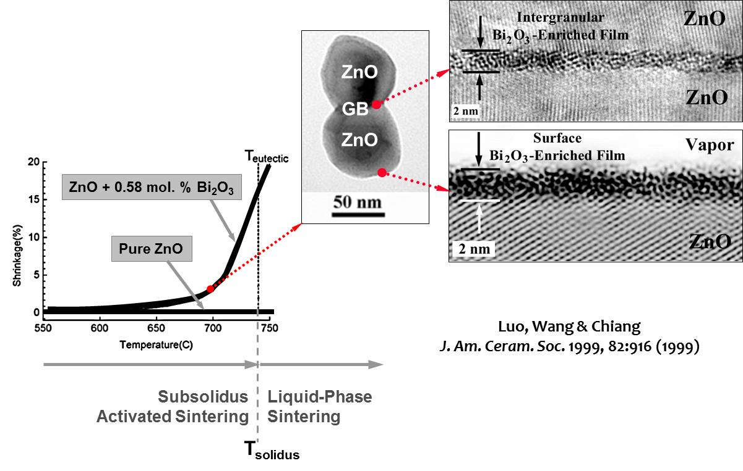
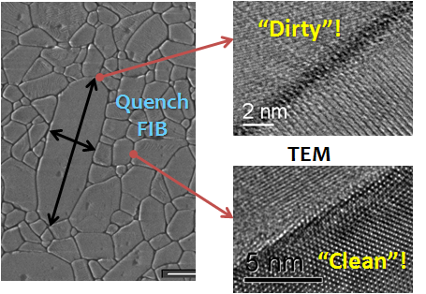
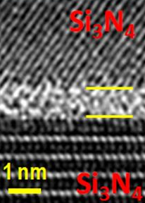
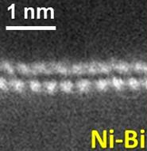
Motivations:
“Old” Materials Science Problems
The classical “materials science trick”
“Cooking”
= Doping + T
How it affects bulk properties √
    Leads to interfacial “phase” behaviors → mysterious phenomena & unpredictable behaviors?
    Our MURI goal: Develop predictive models to help to understand such mysterious phenomena & further develop a new “materials science tool” –
      “Grain Boundary (GB) Complexion/Phase Diagrams”
    Sample problems:
      Embrittlement of Ni & Cu alloys
      Ionic conduction of ZrO₂ based ceramics
  Sintering Aids?
  Liquid-phase sintering (Kingery et al.) √
    50 Yr Mystery: “Solid-state” activated sintering?
Grain Growth
  Solute-drag (Cahn) √
    Mystery: Fast “dirty” GBs in Al-Ga, Al₂O₃?
  50 Yr Mystery: Abnormal grain growth?
“Unpredictable” Properties?
  Mechanical properties of Si₃N₄, SiC etc.
  Grain boundary embrittlement of metals
  Mystery: Liquid metal embrittlement?
  Electronic & Physical Properties:
  ionic conductivity; superconductivity of YBCO; non-linear I-V; electrical or thermal conductivity, etc.
Dillon & Harmer
Lehigh University
Embrittlement?
Related to interfacial “complexions”?
Our HAADF STEM
(Lehigh & Clemson)

Slide 5
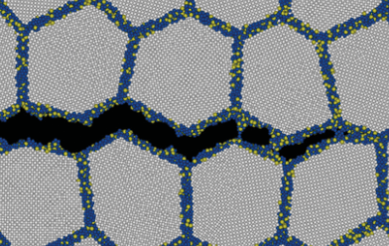
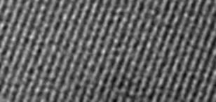
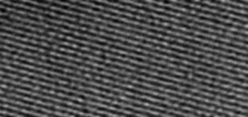
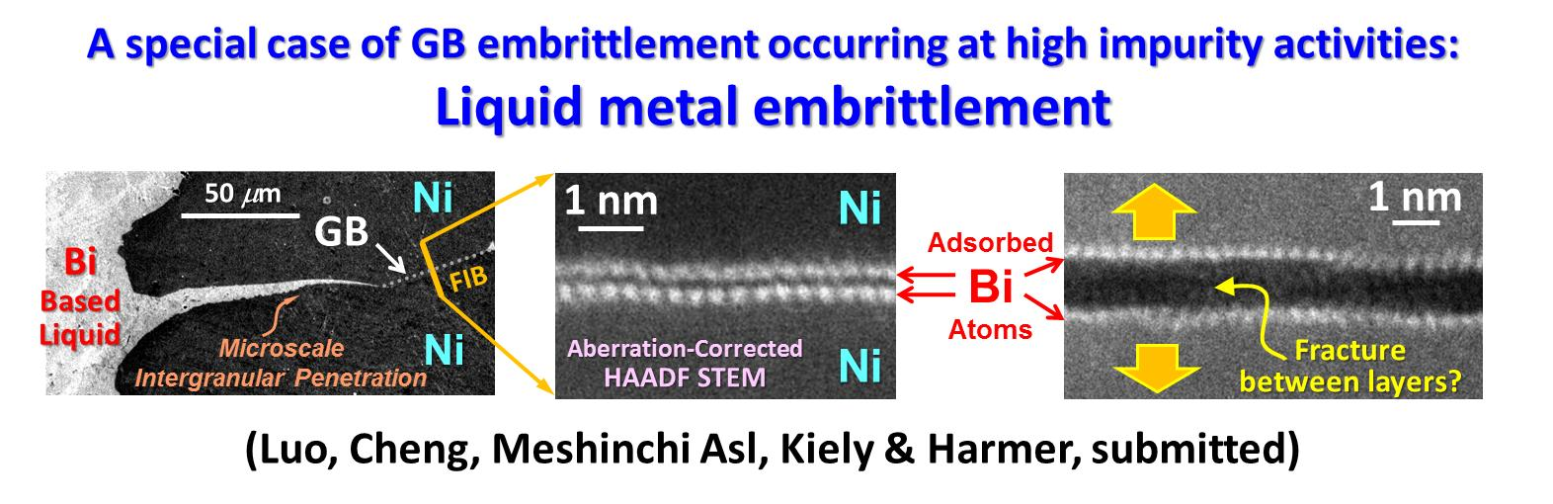
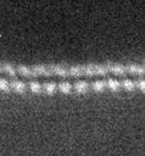
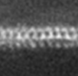
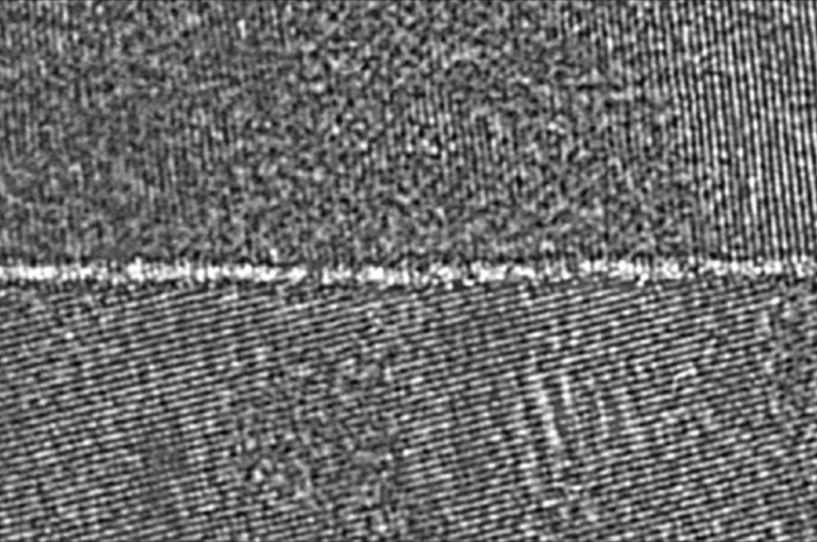
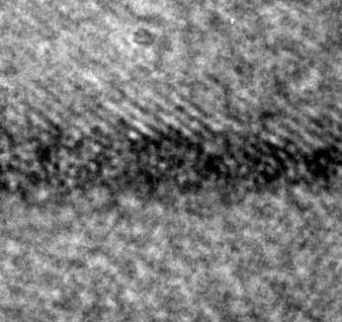
Task I: Re-appraisal of GB Embrittlement in Metals
for high-T’s and/or high dopant/impurity activities?
Classical GB Embrittlement Models
Built on Langmuir-McLean Adsorption
Beyond Monolayer?
Ni-S (Indirect Evidence)
S induced
GB “melting”
Reduction of cohesion due to:
Electronic effect (weakening the bonds);
Atomic size (strain) effect; or
Changing relative γ’s (the Rice-Wang Model)
S segregation
GB “melting” if C_{S}^{GB} > 15%
GB Embrittlement
Atomistic Simulation: Chen et al., PRL 2010
FrAuger: Heuer et al., J. Nuclear Mater. 2002
Discrete Thickness
Nanometer “Equilibrium” Thickness
1 nm
1 nm
2 nm
2 nm
Ni-Bi
Ni-Bi
W-Ni
Mo-Ni
Luo, Cheng, Meshinchi Asl, Kiely & Harmer (submitted)
Acta Mater. 55, 3131 (2007)
APL 94, 251908 (2009)
A Striking Example: GBs can undergo a “phase” transition → drastic changes in properties.

Slide 6
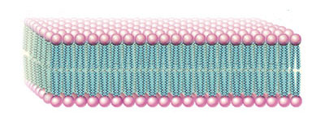
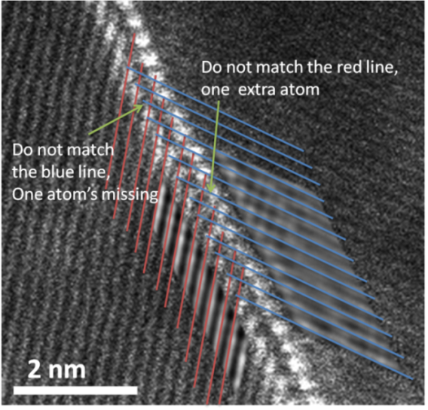
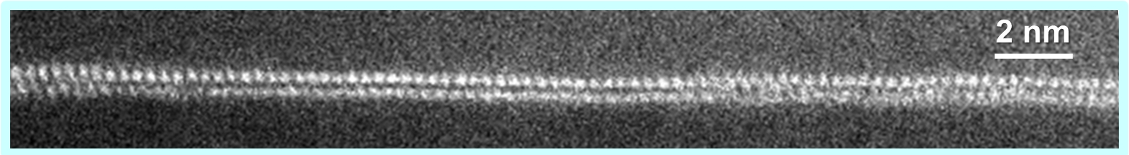
Bilayer Stability
“High-Temperature Lipids”?
Energetically
The Most
Favored!
Verified by HAADF STEM
incoherent
(broken Ni-Ni bonds)
vs.
incoherent
(broken Bi-Ni bonds)
incoherent
(broken Bi-Bi bonds)
Strong Ni-Bi: ½|E_{Ni-Ni}| + ½|E_{Bi-Bi}| < |E_{Ni-Bi}|
Weak Bi-Bi: |E_{Bi-Bi}| << |E_{Ni-Ni}|
Each Bi layer coherently adsorbed on the adjacent Ni grain
Incoherent between the 2 Bi layers
Ni grain
Adsorbed Bi
Ni grain
Adsorbed Bi

Slide 7
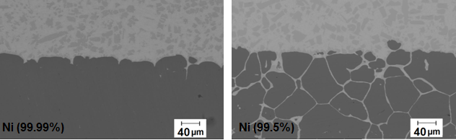
Experimental Task I:
Updated Plan for This MURI Project
Motivation
We now know bilayers form in Ni-Bi and embrittle GBs – So what?
The Key Question: How can we control?
One Strategy: “co-doping” (the classical “MSE trick”!)
Ni-Bi-X and Cu-Bi-X– Adding a small amount of X → how will it change the complexion stability, formation & related properties?
Goal & Approach: “Systematical Experiments” + “Modeling”
→ To develop & validate theories, models and strategies to predict useful trends… Better extendable to other materials…
A Related Example:
Minor impurities can significantly change the intergranular penetration (liquid metal corrosion) – detrimental or beneficial
(unpublished results)
Bi
Bi
0.2 % Mn
0.1 % Fe
0.1 % Si

Slide 8
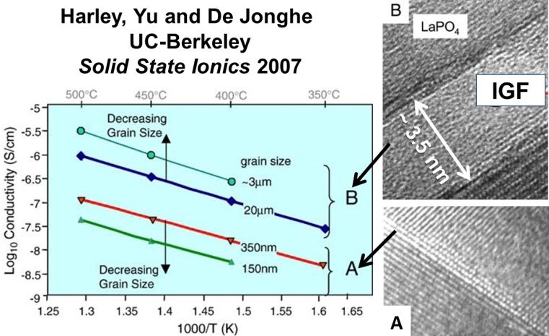
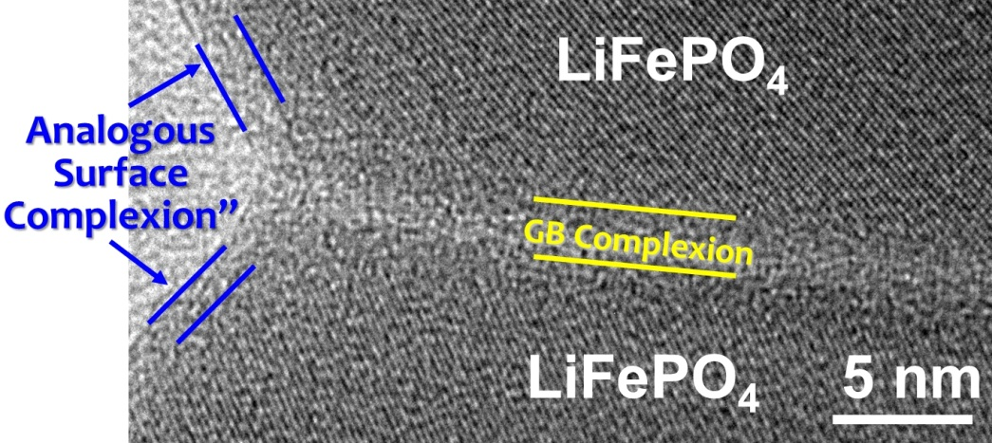
Experimental Task II:
Roles of Complexions in Ionic Conduction
Background & Motivations
Ionic conductors -- important for energy storage & generation.
In ZrO₂-Y₂O₃-(SiO₂), certain GB complexions → severe “blocking effects” to ionic conduction
  Practically, co-doping → alleviate the problem (selected empirically)
Other GB complexion → enhance ion conductivity
Planned Research: Primary Model System: ZrO₂-Y₂O₃-(SiO₂)-M_{x}O_{y}
Synthesis, high-T impedance, HRTEM, HAADF-STEM (Lehigh) → To understand the complexion formation & roles in ionic conduction…
To develop & experimentally validate physics-based predictive models
Enhanced Proton Conduction
Lithium Ion Battery Cathodes???
Kayyar, Qian & Luo,
APL 95: 211905 (2009)

Slide 9
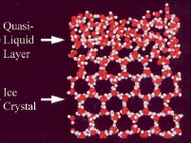
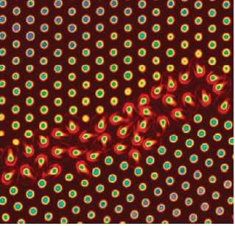
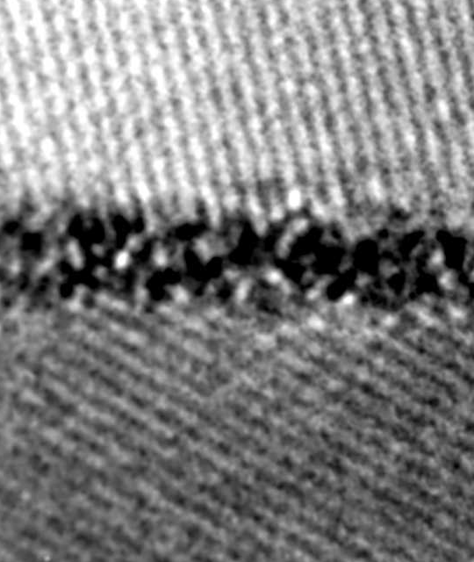
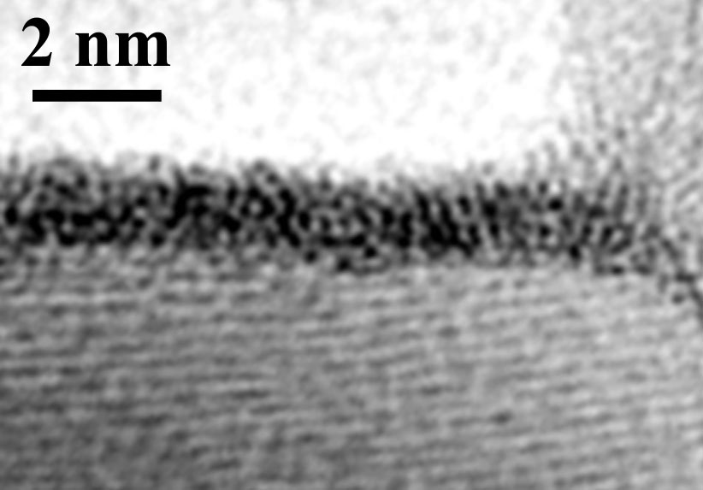
Quasi-Liquid Interfacial Films
Unary Systems:
Surface Premelting √
GB Premelting ???
Late 1980’s: Balluffi & co-workers suggested no GB premelting up to 0.999T_{melt} in Al!
Thermodynamically stable at
T < T_{melting}
Ice Surface (MD simultaion)
Dash et al, Rev. Modern Phys. 2006
GB premelting in a colloidal crystal
Alsayed et al, Science 2005
Multicomponent?
Enhanced by concurrent adsorption
Coupled GB premelting & prewetting?
Impurity–enhanced!
Bi₂O₃-doped ZnO
Ni-doped W
Vapor
ZnO
W
Bi₂O₃-enriched film
Ni-enriched film
Thermodynamically stable at
T < T_{solidus}
… can be more complex
… persist at T > T_{solidus} due to attractive vdW forces in ceramics
ZnO
1 nm
1 nm
ZnO
1 nm
W
ΔT ≡ T_{eutectic} – T = 140°C
ΔT = 40°C
ΔT = 95°C
Luo et al., Langmuir 2005
Wang & Chiang, JAmCerS 1998
Luo et al, APL 2005

Slide 10
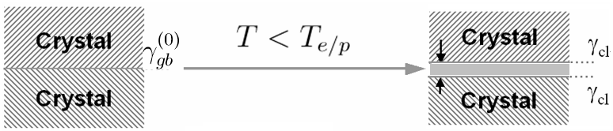
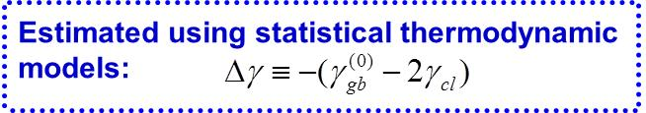
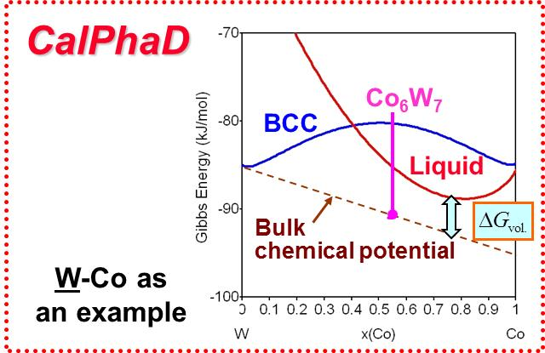
Thermodynamic Principle
solidus
h (undercooled liquid)
forming
undercooled liquid
disjoining potential
(interfacial “forces”)
A subsolidus quasi-liquid film is thermodynamically stable if:
Define & quantify:
Representing
the thermodynamic tendency to stabilize a quasi-liquid film

Slide 11
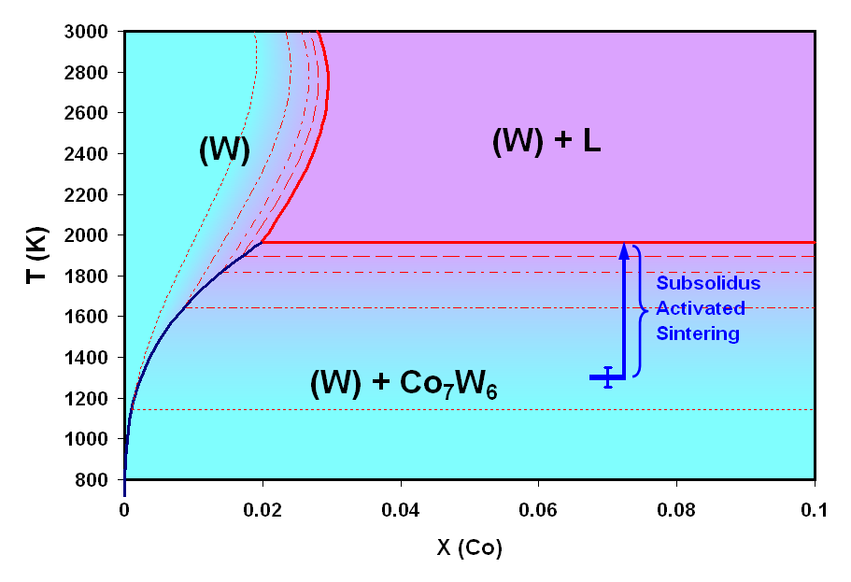
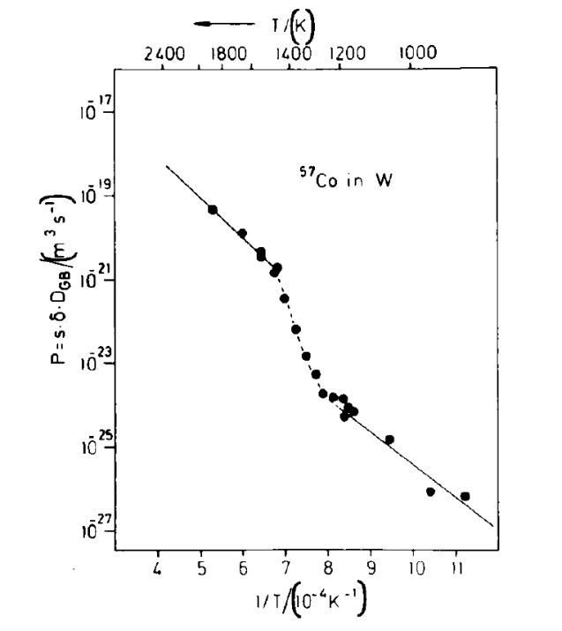
Computed Lines of Constant λ: GB Diagrams
Luo & Shi, Appl. Phys. Lett. 92:10190 (2008)
Prior Work Supported by AFOSR-HTAM
W-Co
(An Example)
Bulk Solidus
λ = 4 nm
0.8 nm
λ = 2 nm
λ = 1 nm
Approx.
GB Solidus
(~1 monolayer of quasi-liquid film)
λ = 0.5 nm
Measured onset sintering T
vs. predicted GB disordering T
GB diffusivity of
⁵⁷Co in W
Lee, Klockgeter, & Herzig,
C. Phys. 51, C1-569 (1990)
Validated experimentally by
Direct HRTEM
Indirect Auger analysis
GB diffusivity measurements
Sintering data
1200-1400K!
 | Observed (K) | Predicted (K)
W-Pd | 1090 ± 23 | <1141
W-Ni | 1150 ± 18 | 1121-1470
W-Co | 1301 ± 49 | 1140-1644
W-Fe | 1308 ± 50 | 1273-1664
W-Cu | No effect | No IGF

Slide 12
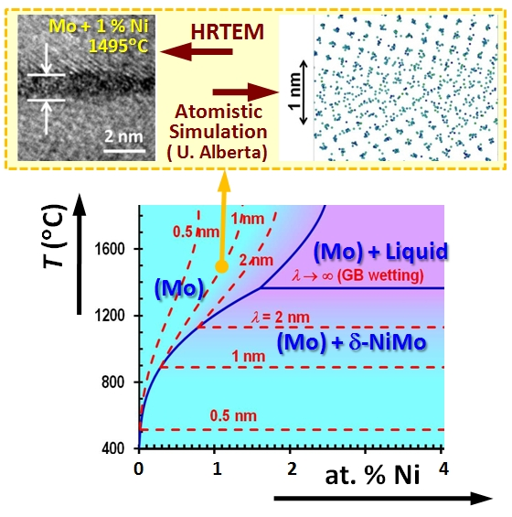
Counterintuitive Prediction: Decreasing GB Diffusivity w. Increasing T?
Shi & Luo, Phys. Rev. Lett. 105:236102 (2010)
Decrease with increasing T
T (°C)
Increase with increasing T
Any novel applications?
e.g., increasing creep resistance with increasing T
Critically support of our model!
Prior Work Supported
by AFOSR-HTAM

Slide 13
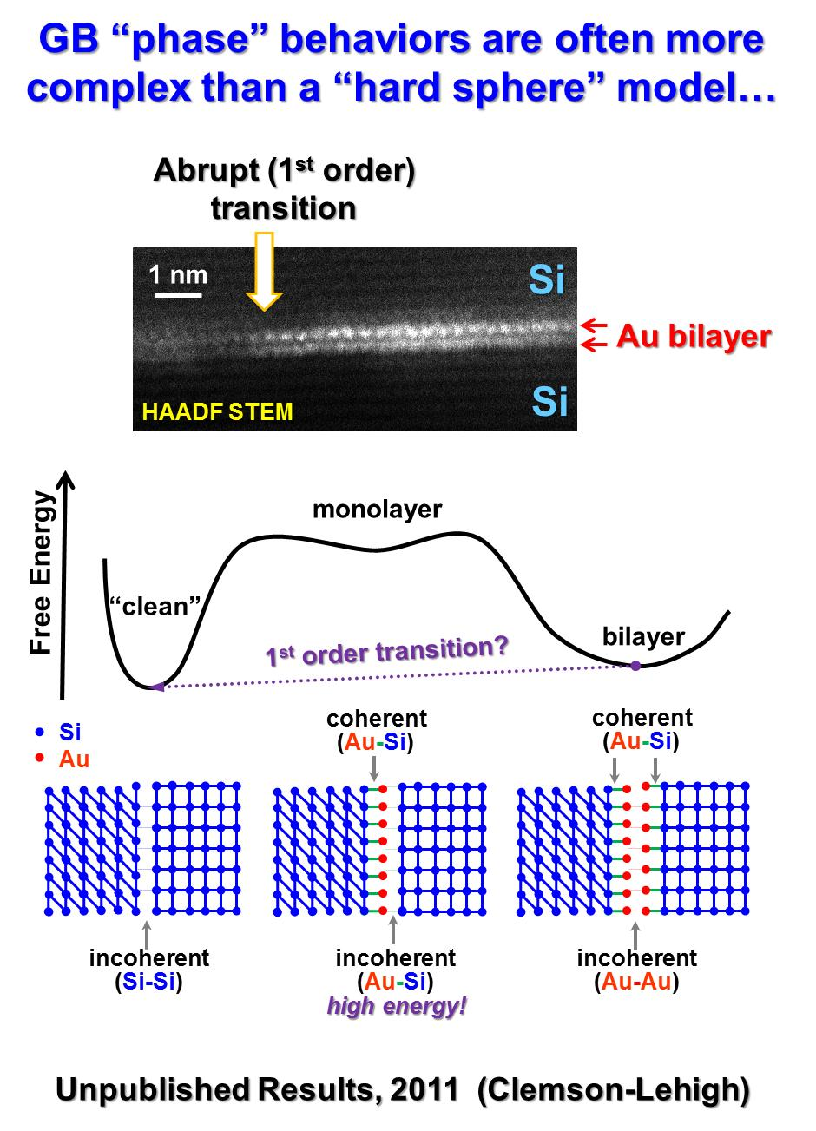
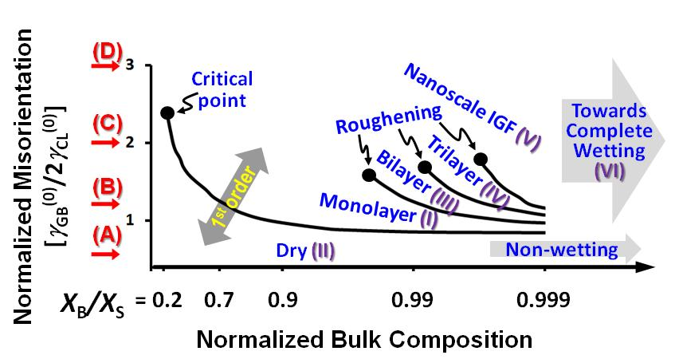
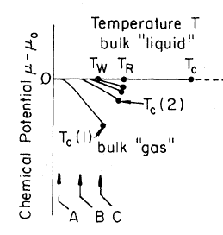
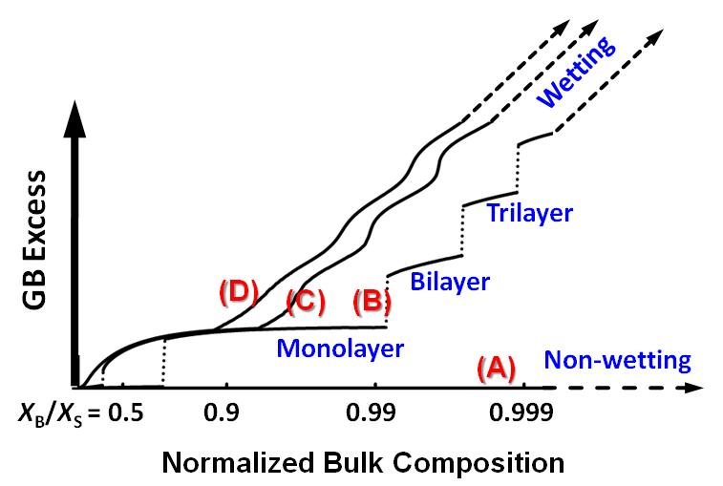
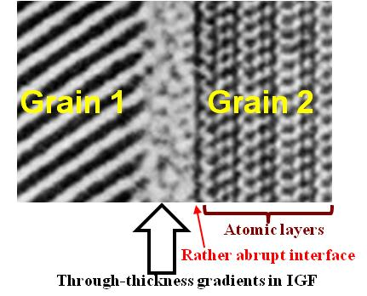
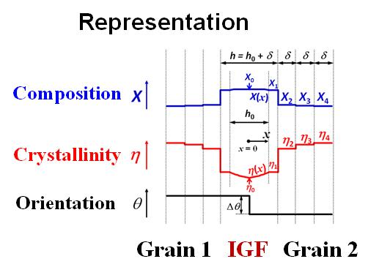
Detailed Interface Forces → Real GB “Phase” Diagrams
However, “λ” diagrams are more practically useful
A GB Complexion Diagram
Analogous
“Surface Diagram” for Multilayer Gas Adsorption
Pandit, Schick, Wortis
Phys. Rev. B, 26: 5112 (1982)
Luo, App. Phys. Lett. 95: 071911 (2009)

Slide 14
Construct GB “Phase” Diagrams
Prior work : Straumal et al., Interf. Sci. 2004; Tang, Carter, Cannon, PRL 2006; Dillon, Tang, Carter, Harmer, Acta Mater. 2007
Computed λ: thermodynamic tendency for GBs to disorder
Quantitative
GB “phase” diagrams
Details of interfacial forces
Design:
  Fabrication protocols utilizing appropriate GB structures to achieve optimal microstructures
  Heat treatments to tune the final GB structures for desired performance
Interfacial Coefficient:
Activated Sintering:
Bulk phase diagrams are inadequate for predicting optimal fabrication recipes!
Liquid-like GBs at 60-85 % of bulk T_{solidus}
Applications Beyond Sintering?
Normal & abnormal grain growth
Creep
Corrosion
Oxidation
Liquid metal & GB embrittlement
GB resistance to ion conduction
R. M. Cannon et al.
For example:
  Utilizing liquid-like GB structures for low T sintering
  A heat treatment to “dry” GBs for remediate embrittlement?
Gupta, Yoon, Meyer & Luo, Acta Mater. 55:3131 (2007)
Luo & Shi, Appl. Phys. Lett. 92:101901 (2008)

Slide 15
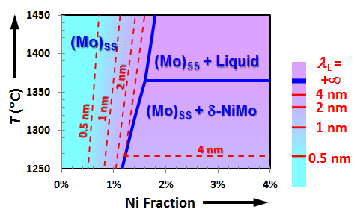
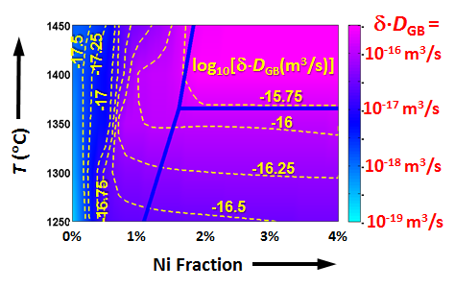
Clemson Task III:
Thermodynamic Theories & Modeling
Built on Our Prior Experimentally-Proven Models & Methods
Computed
λ-Diagram
Measured
GB Diffusivities
Prior Work Supported by AFOSR-HTAM
Shi & Luo, Phys. Rev. B, in press (2011)
New Challenges & Proposed Research for This MURI
To develop thermodynamic models for discrete complexions
  Primary MURI model system: Ni & Cu based alloys
  New Application: Embrittlement
To extend our models from metals to more complex ceramics
  Primary MURI model system: ZrO₂ based (w/electrostatic space charges)
  New Application: Ionic Conduction
Both cases: To control w/ co-doping (new thermodynamics needed!)
MURI collaboration essential: To be integrated w/ multiscale modeling & other characterization; To extend to other materials studied in this MURI.

Slide 16
MURI Clemson Tasks
(Jian Luo, co-PI)
Postdoc: Matthew Williams (US citizen)
PhD student: Yuanyao Zhang
1 MS in the 2nd half project
Collaboration on characterization (e.g., HAADF-STEM/Lehigh, 3D microstructure/CMU & diffusion measurements/UIUC ) & multiscale modeling
Experimental Task I:
Embrittlement of Ni & Cu Alloys
Experimental Task II:
Ionic Conductivity of Oxides
Co-dope to control (design);
Synthesis; Characterization
Model System: ZrO₂-Y₂O₃-(SiO₂)-M_{x}O_{y}
Co-dope to control GB resistance
Synthesis of specimens
High-T impedance measurements
HRTEM, HAADF-STEM (Lehigh)…
Task III: Thermodynamic Modeling → “Grain Boundary (GB) Diagrams”
Support other MURI members on various experimental & modeling tasks…

