Slide 1
AGENDA
AGENDA
8:15-8:30 |  | Self introductions
8:30-8:45 |  | David Shifler, Introductory remarks
8:45-9:30 |  | Martin Harmer, Overview of MURI project
9:30-11:45 |  | Presentations by individual MURI team members plus guest scientist, Alexis Lewis.
Note: Anthony Rollett from Carnegie Mellon University will be in Europe, but will participate remotely.
 | 9:30-9:45 | Andrea Harmer, Kutztown University
 | 9:45-10:00 | Helen Chan, Lehigh University
 | 10:00-10:15 | Jeffrey Rickman, Lehigh University
 | 10:15-10:30 | Michael Widom, Carnegie Mellon University
10:30-10:45 |  | Break
 | 10:45-11:00 | Jian Luo, Clemson University
 | 11:00-11:15 | Greg Rohrer, Carnegie Mellon University
 | 11:15-11:30 | Shen Dillon, University of Illinois
 | 11:30-11:45 | Alexis Lewis, Naval Research Laboratory
12:00-1:00 |  | Lunch and discussion, Tower Room, Mountaintop Campus
1:00-1:45 |  | Alan Pense, * Tour of ATLSS national earthquake testing laboratory and composite ship building laboratory, Mountaintop Campus.
1:45-2:15 |  | Private meeting for review team -ATLSS Conference Room B144
2:15-2:30 |  | Feedback and discussion
2:45-3:00 |  | Demonstration of Spark Plasma Sintering, 3rd floor Whitaker Lab
3:00-3:30 |  | Tour of Electron Microscopy Laboratory, 1st floor Whitaker Lab
3:30 |  | Depart

Slide 2
Tailoring of Atomic-Scale Interphase Complexions for Mechanism-Informed Material Design
Office of Naval Research Multidisciplinary University Research Initiative Project
Kickoff Meeting, Thursday June 23rd 2011
ONR Topic Chief: David Shifler
Martin P. Harmer

Slide 3
Outline
• Participants in MURI Program
• Introduction to Interphase Complexions (IC’s) Concept
• Examples of IC’s in Ceramic and Metal Systems
• Objectives and Goals of the MURI Program
• Thrust 1: Creation of New Classes of Materials with Tailored Properties
• Thrust 2: Exploitation of Complexions in the Processing of Bulk Nano- grain Materials
• Thrust 3: Exploitation of Complexions in Controlling Properties in Strategic Engineering Materials
• Management/Future Meetings
• Recruitment
• MURI-Related Affiliations

Slide 4
Participating Institutions
Lehigh University
  Martin P. Harmer (PI), Helen M. Chan, Jeffrey M. Rickman, Ed Webb
Carnegie Mellon University
  Gregory S. Rohrer, Anthony D. Rollett, Michael Widom
Clemson University
  Jian Luo
University of Illinois Urbana-Champaign
  Shen J. Dillon
Kutztown University of Pennsylvania
  Andrea J. Harmer

Slide 5
Bulk A
Bulk B
Complexion
Complexion
com·plex·ion noun \kəm-ˈplek-shən\
Atomic scale (0.2 – 2 nm) thermodynamically stable interface-stabilized phase (interphase) that does not exist in bulk form.
“The Phase Behavior of Interfaces”, Science, 332 [6026] 182-183 (8 April 2011).

Slide 6
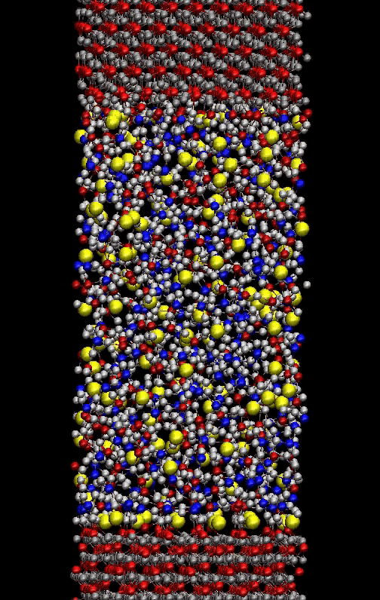
Complexions: Characteristics
Complexions are transformable like phases (crystallography, chemistry, temperature important).
Characteristic thickness with varying degree of disorder (6 distinct layering transitions) – new taxonomy.
Superimposable onto bulk phase diagrams – Complexion Diagrams.
Different complexions have vastly different kinetics and probably physical properties.
Courtesy of Steve Garofalini
“Interfacial Kinetic Engineering: How Far Have We Come Since Kingery’s Inaugural Sosman Address?”,
J. Am. Ceram. Soc., 93 [2] 301–317 (2010)

Slide 7
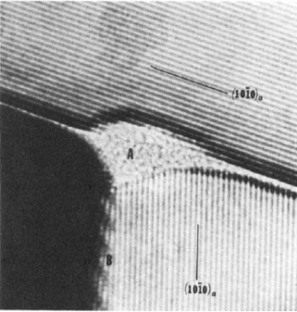
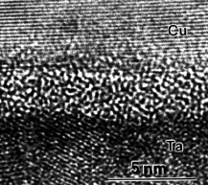
Example - Intergranular Films (IGF)
Ceramic Grain Boundaries (GBs)
Free Surfaces
Widespread Existence of Similar IGFs:
2 nm
Si₃N₄
SiC,
AlN,
SIALON,
Al₂O₃,
(Sr, Ba)TiO₃,
ruthenate thick film resistors,
TiO₂, ZrO₂, YBCO,
Synroc, etc.
(all with additives)
Vapor
ZnO
SiO₂-enriched film
Si₃N₄
ZnO
Bi₂O₃-enriched
film (w/o SiO₂)
ZnO
Kleebe et al, J. Am. Cer. Soc. 1993
T< T_{eutectic}
Equilibrium thickness
D. Clarke,
J. Am. Ceram. Soc. 1977
T< T_{eutectic}
(Luo & Chiang,
Annu. Rev. Mater. Res. 2008)
No SiO₂, (Wang & Chiang, J. Am. Cer. Soc. 1998)
Hetero-Interfaces
Metals
Ice + Impurities, e.g. NaCl
(Molecular Solids)
TiO₂
2 nm
Cu
Cu
2 nm
W
Ni-enriched film
Cu-Ta
Vapor,
Ice, or
Inert Wall
SiO₂-enriched film
SiO₂
Al₂O₃
b.c.t.-Ta
(metastable)
Quasi-Liquid
2 nm
W
Ice
Oxide-Oxide
Hetero-Interface
(Ackler & Chiang,
J. Am. Cer. Soc. 1997)
Metal-Oxide Interface
(Kaplan et al,
Acta Mater. 2000)
(Kwon et. al, APL 1999)
NOT classical solid-state amorphization
T< T_{eutectic}
Surface
(Wettlaufer, PRL 1999)
GB & interface
(Wettlaufer et al., PRE 2005)
(Luo, et al., APL 2005)

Slide 8
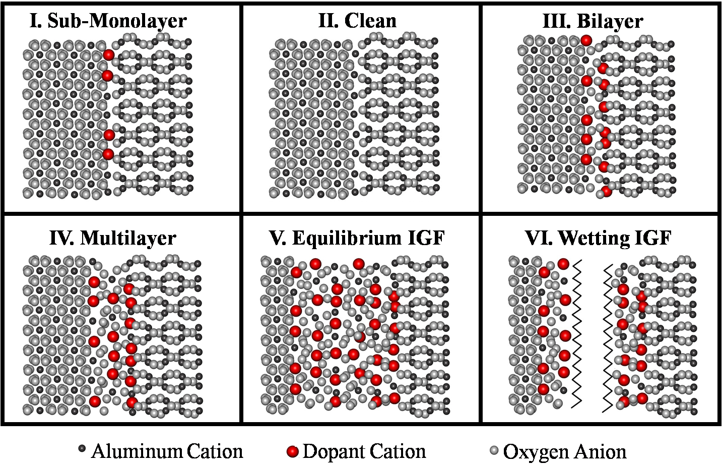
Schematic of Complexion Types
S.J. Dillon, M. Tang, W.C. Carter, M.P. Harmer, Acta Mater. 2007

Slide 9
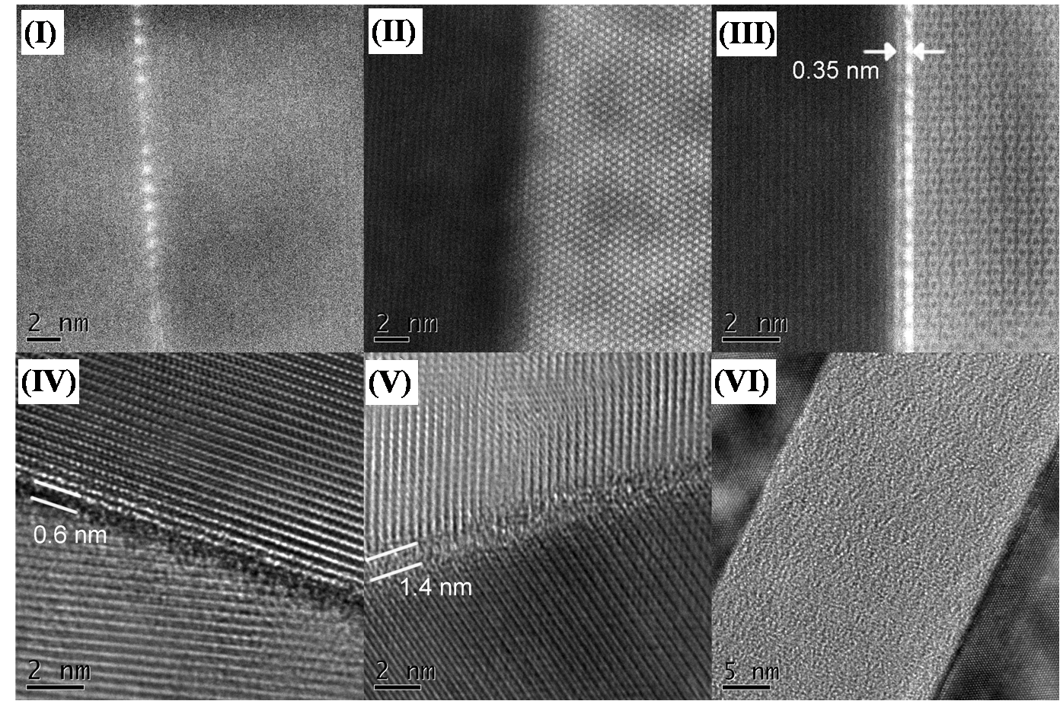
Complexions - High Resolution Electron Microscopy
Submonolayer segregation
Intrinsic, “clean”
Bilayer segregation
Trilayer segregation
Intergranular film
True Wetting Film
S.J. Dillon, M. Tang, W.C. Carter, M.P. Harmer, Acta Mater. 2007

Slide 10
Transport Properties of Complexions (Alumina)
S.J. Dillon, M. Tang, W.C. Carter, M.P. Harmer, Acta Mater. 2007

Slide 11
Copper Oxide Doped Titania-complexion Type III, Bilayer
0.4 nm
HAADF-STEM (smoothed and deconvoluted)
HRTEM
Courtesy of ShuaiLei Ma

Slide 12
Copper Oxide Doped Titania-complexion Type IV, Trilayer
0.6 nm
HAADF-STEM (smoothed and deconvoluted)
HRTEM
Courtesy of ShuaiLei Ma

Slide 13
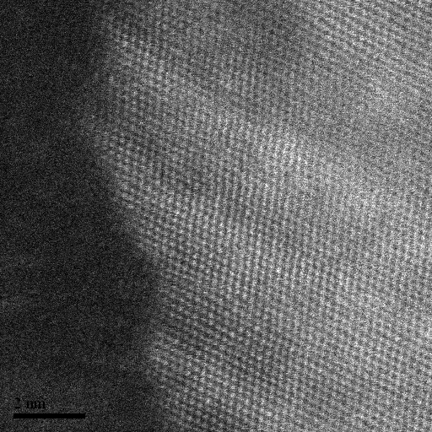
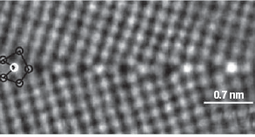
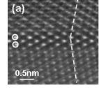
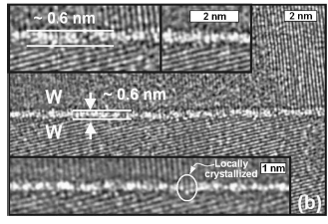
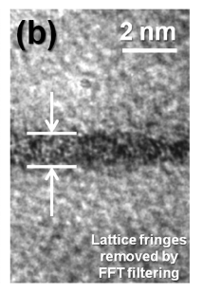
GB Complexions In Metal Systems
?
2nm
2nm
Cu-Bi¹
Ni
VI. Wetting IGF
IV. Trilayer
Al-Ga²
W-Ni³
Mo-Ni⁴
1. G. Duscher et al. Nature Materials, 2004
2. W. Sigle et al. Applied Physics Letters, 2006
3. J. Luo et al. Applied Physics Letters, 2005
4. X. Shi et al. Applied Physics Letters, 2009

Slide 14
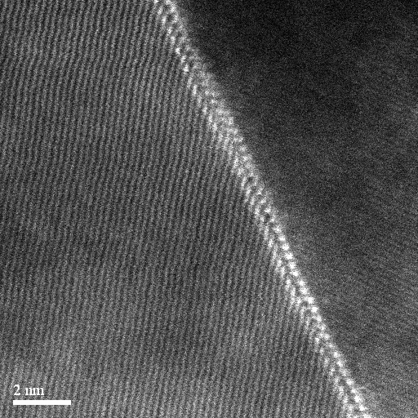
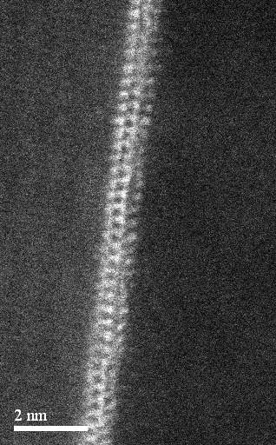
GB Complexions in Ni-Bi Alloys
1 nm
J. Luo, H. Cheng, K. Meshinchi Asl, C. J. Kiely, M. P. Harmer, submitted to Science

Slide 15
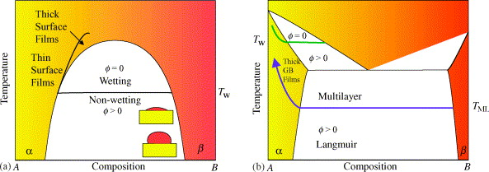
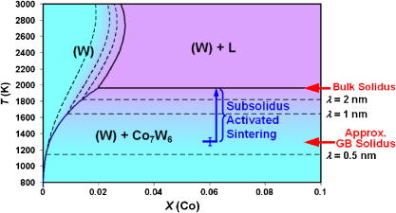
Thermodynamic Modelling
Stability Condition
α
α
α
β
α
C. Bishop et al., Mat. Sci. Eng. A., 2006.
No Atomistic/First Principles Calculations of IC’s and their transitions to date
J. Luo, X. Shi, Appl. Phys. Lett., 2008.

Slide 16
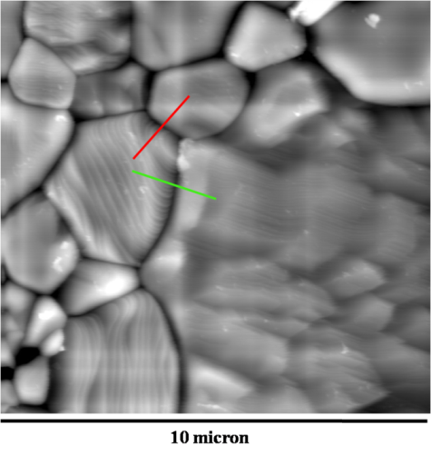
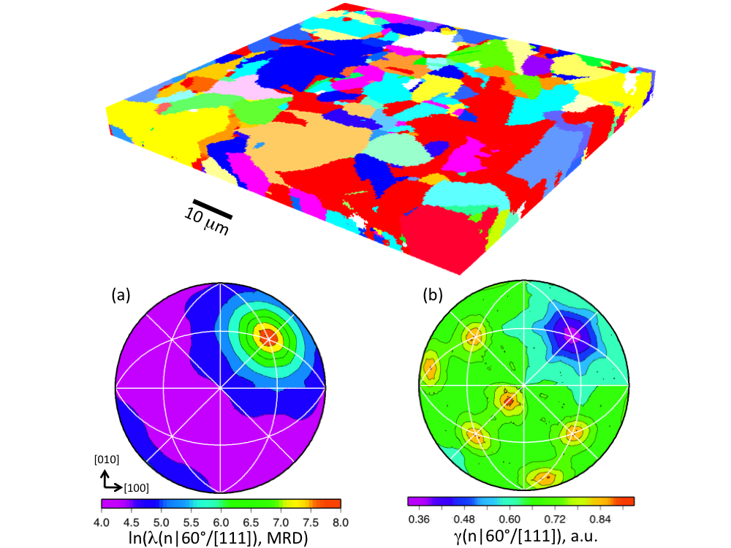
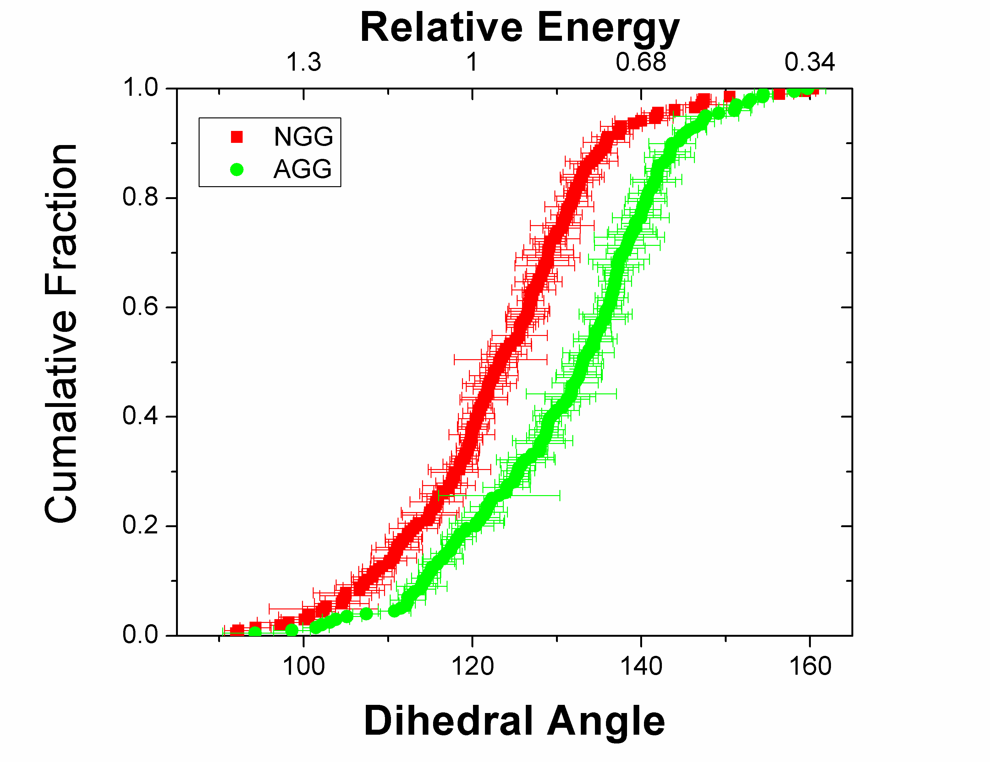
Selection Rules
2W
Complexion formation favored by:
• High energy grain boundaries in the host
• Compositions near deep eutectics
• Systems that produce second phases with large interphase boundary energies
• Alloy systems with low solubility and high segregation
Ψ_{s}
Surface
d
β
Crystal 2
Crystal 1
16

Slide 17
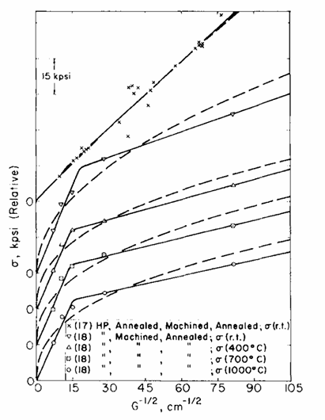
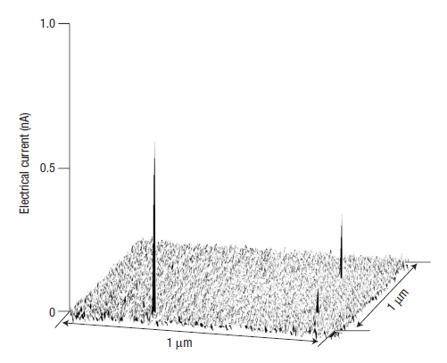
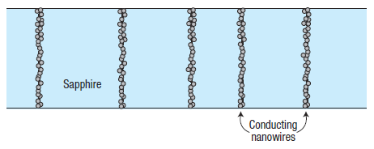
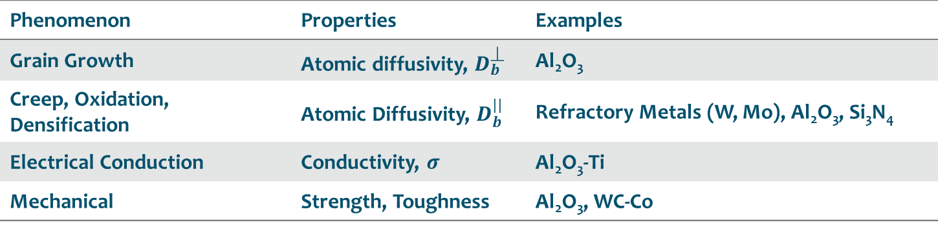
Tailorable Properties - Examples
Phenomenon | Properties | Examples
Grain Growth | Atomic diffusivity, $D_{b}^{}$ | Al₂O₃
Creep, Oxidation, Densification | Atomic Diffusivity, $D_{b}^{||}$ | Refractory Metals (W, Mo), Al₂O₃, Si₃N₄
Electrical Conduction | Conductivity, $σ$ | Al₂O₃-Ti
Mechanical | Strength, Toughness | Al₂O₃, WC-Co
S.C. Carniglia, J. Am. Cer. Soc., 1972
Nakamura et al, Nature Materials (2003)

Slide 18
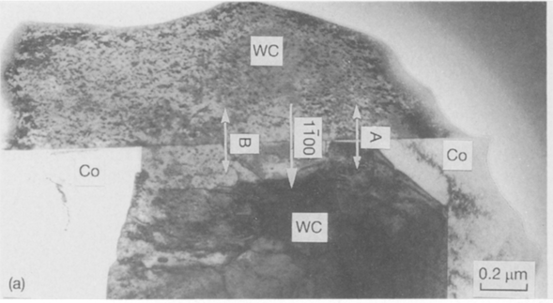
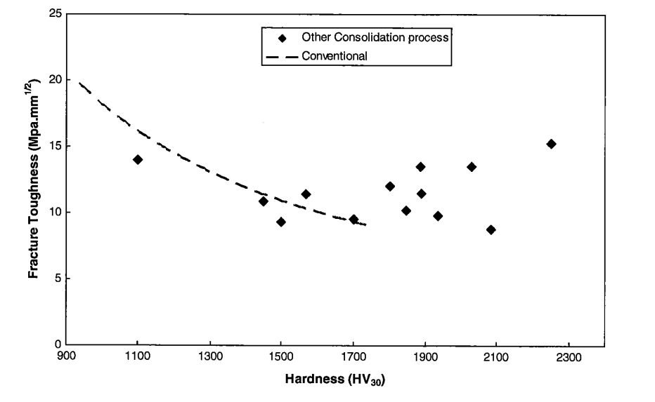
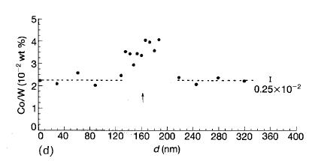
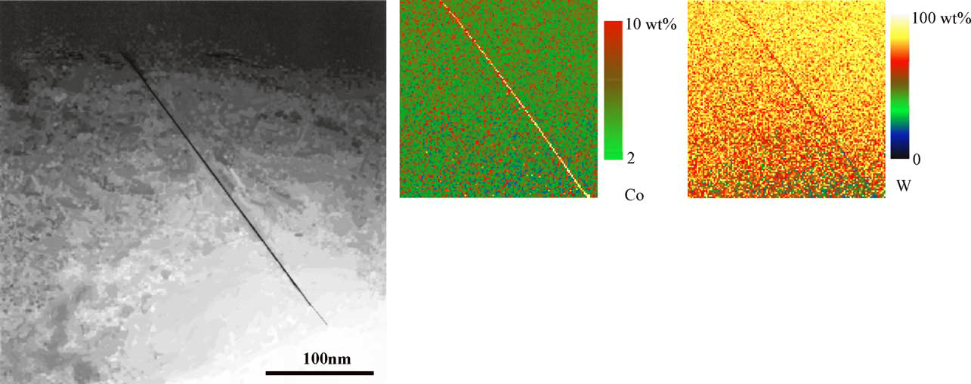
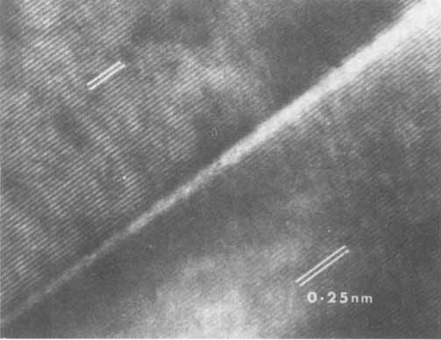
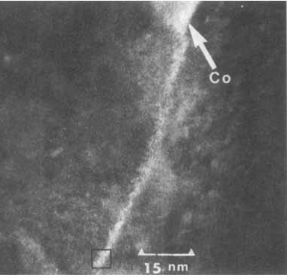
WC - Co Complexion-Property Relationship?
J. Vicens et al, J. Mat. Sci., 1994
Z. Z. Fang et al, Int. J. Refr. Met. & Hard Mat., 2009
V. Jayaram et al, J. Am. Cer. Soc., 1983
E. Breval et al, Mat. Sci. & Engg., 2005

Slide 19
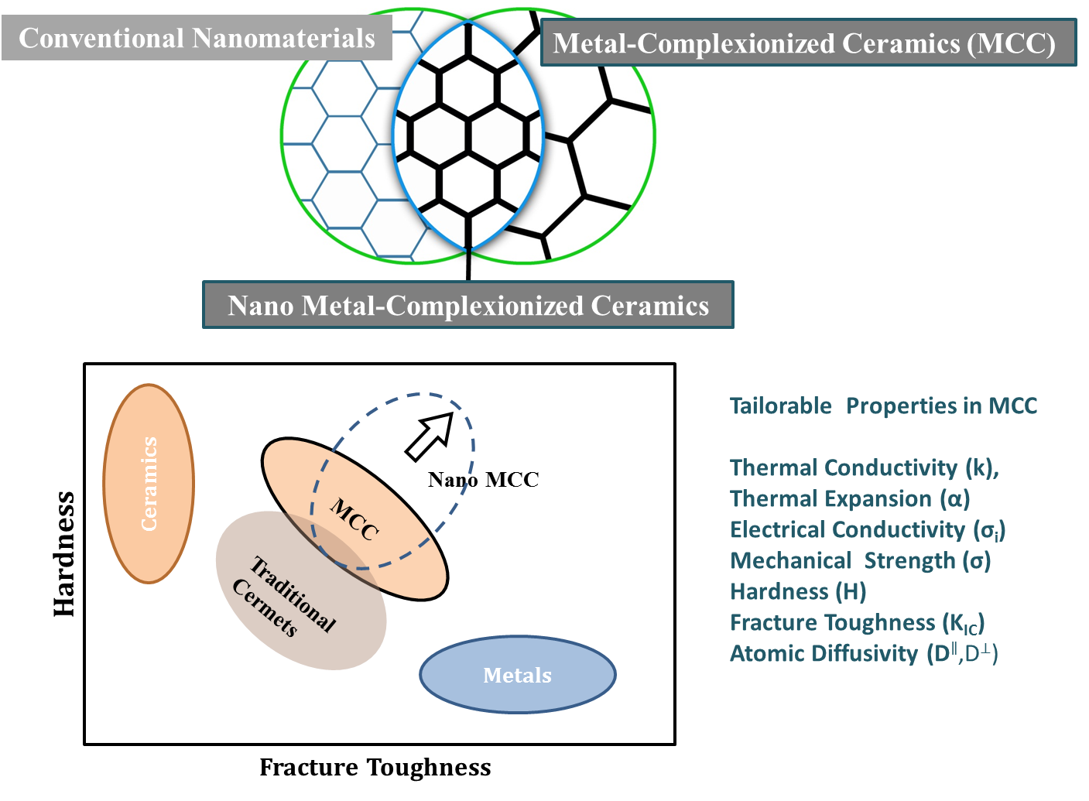
Proposed Approach

Slide 20
Creation of New Classes of Materials with Tailored Properties
THRUST 1: OBJECTIVES
• Establish a set of “Selection Rules” for metal-complexionized ceramics (MCC).
• Develop complexion phase diagrams for MCC.
• Correlate individual complexion types with each of their associated physical properties (thermo-mechanical, diffusivity).
• Develop Ashby-type property maps incorporating important grain size (nanoscale) effects.
• Correlate individual boundary effects with distributions in polycrystalline microstructures.
• Develop processing strategies for controlling polycrystalline grain structures (e.g. unimodal vs. multi-modal, nano grain size vs. micron grain size etc).

Slide 21
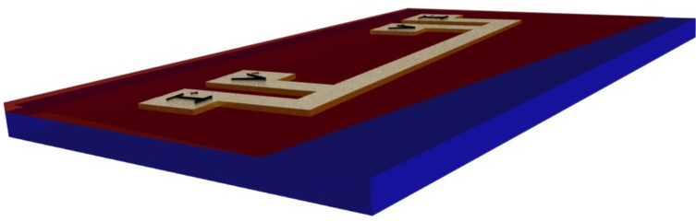
Creation of New Classes of Materials with Tailored Properties
THRUST 1: TECHNICAL APPROCH
MCC material system: Alumina – (Cu, Cu-Ti, Ni)
Bicrystals
Model Sandwich Structures
Nanophase MCCs
Characterization
HREM (structure, chemistry), ELNES (local bonding)
SPM - Conduction Mode (conductivity of individual IC’s)
Nano-indentation
GB character and energy distribution
Thermal Properties
SIMS, GB diffusivity

Slide 22
THRUST 1: MODELLING
Creation of New Classes of Materials with Tailored Properties
First-Principles Calculations
Atomic Level Modelling & Simulations
Ab-Initio
Monte Carlo, Molecular Dynamics
Developing Interatomic Potentials
-- Phase Stability
-- Segregation Energies
-- GB Energies
-- Diffusion Barriers
-- Transport Properties
-- Mechanical Behavior
Interphase Thermodynamic Modelling
Mesoscale Simulations
Phenomenological, Sharp-Interface Model
Potts Model, Phase-field Method
-- Abnormal Grain Growth
-- Compute Complexion Phase Diagrams

Slide 23
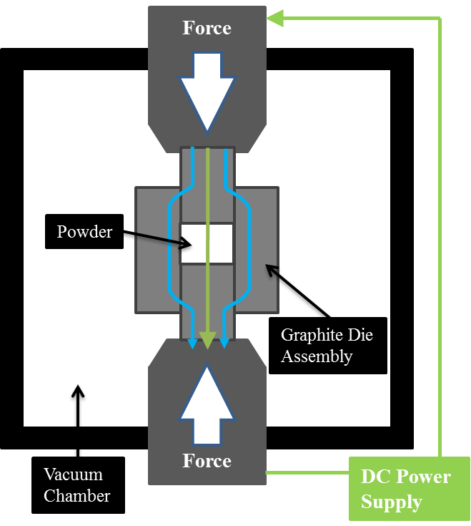
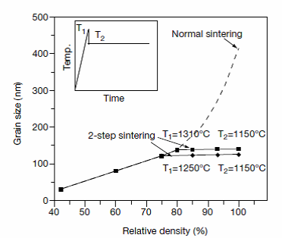
Exploitation of Complexions in the Processing of Bulk Nano-grain Materials
THRUST 2
Determine the critical role of IC’s in the application of fabrication processes for producing bulk nano-grain materials.
Two Step Sintering
Spark Plasma Sintering

Slide 24
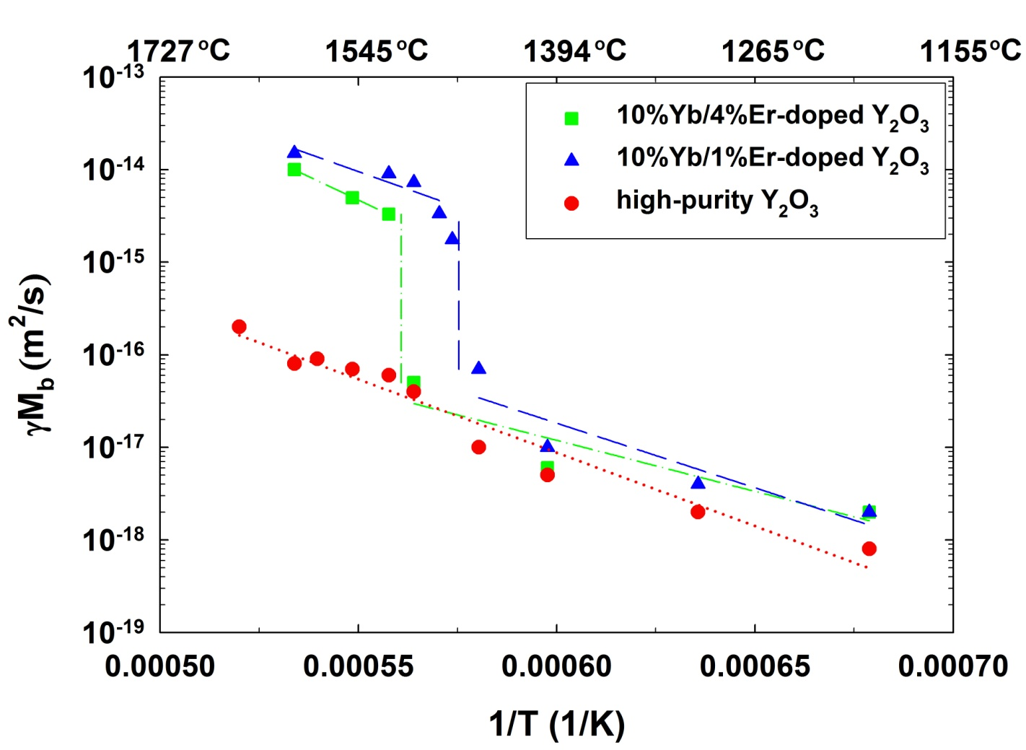
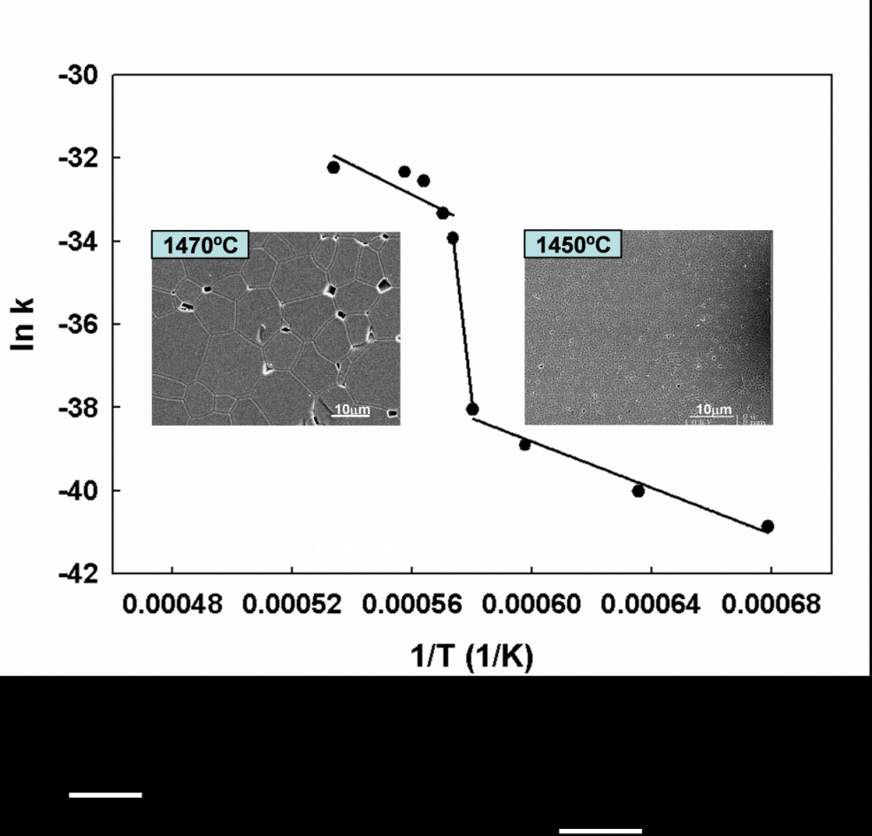
Exploitation of Complexions in the Processing of Bulk Nano-grain Materials
THRUST 2
Material Systems for Thrust 2
Model Systems: | Alumina – silica/yttria
New Materials: | Nano metal-complexionized ceramics
Challenging Conventional Materials: | WC-Co, YSZ

Slide 25
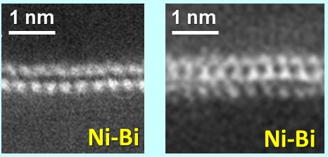
Exploitation of Complexions in Controlling Properties in Strategic Engineering Materials
THRUST 3
Revisit WC-Co
Embrittlement of Ni & Cu Alloys
Systematic investigation of grain boundary mobility and the formation and stability of complexion as a function of temperature chemistry
Develop interphase engineered nano MCC of WC-Co.
Systematic Co-doping
Characterization
Other Systems
Ionic Conductivity of Oxides
Sn and Sb doped ZnO
Al-B₄C
····
Model System: ZrO₂-Y₂O₃-(SiO₂)-M_{x}O_{y}
Co-dope to control GB resistance
Synthesis of specimens
High-T impedance measurements
HRTEM, HAADF-STEM (Lehigh)…

Slide 26
Management
http:\\muri.cc.lehigh.edu
MURI Research Group Meetings
Monthly teleconference
Biyearly face to face meetings: December and Mid-June
Annual ONR Review Meeting
Bear Creek International Conference on Interfaces October 2-6, 2012
Reporting Requirements?

Slide 27
US Student/PostDoc Recruitment
LEHIGH UNIVERSITY
Abigail Lawrence (US citizen), Michael Kracum (US citizen), Denise Yin (US citizen), Patrick Cantwell (US citizen), Suxing Wu (US citizen),
Animesh Kundu
CLEMSON UNIVERSITY
Yuanyao Zhang, Matthew Williams (US citizen)
CARNEGIE MELLON UNIVERSITY
Stephanie Bojarski (US citizen)
UNIVERSITY of ILLINOIS AT URBANA-CHAMPAIGN

Slide 28
MURI-RELATED AFFILIATIONS
DOD PARTNERSHIPS
ARL
James Sands
Michael (Mick) Maher
Gary Gilde
ARO
David Stepp
Doug Kiserow
ARDEC Picatinny
John Theis
Stacey Kerwein
Chris Haines
AFOSR/WPAFB
Ali Sayir/Randall Hay
NRL
Alexis Lewis
POTENTIAL INDUSTRY PARTNERS
Material Complexions Inc.
TA&T
Thermal Technologies Inc
Dupont
GE

