Slide 1
Office of Naval Research Multidisciplinary University Research Initiative Project
Pre-Review Meeting, May 17th 2011
ONR Topic Chief: David Shifler
Developing Thermodynamic Theories & Models
  Putting our models/efforts in a broader context of existing prior models
    Classical GB segregation models;
    GB “phase” transitions;
    Prewetting/premelting type models;
    Some of our prior efforts/models
  Predictive?
  Unified, big picture: how different models connect?
  Connect to atomistic/DFT?
Experimental Efforts
  Metallic Systems: Ni-Bi, Cu-Bi and Fe-Bi
  Ionics: YSZ and BZY

Slide 2
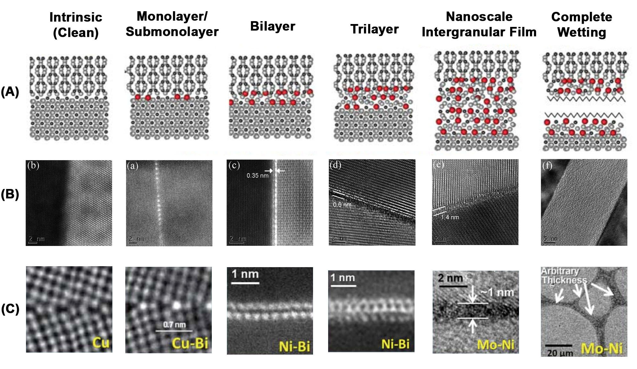
The Bigger Picture…
Well-Known
“Moist”
(R.M. Cannon)
Prewetting and/or Premelting
“Equilibrium” Nano Thickness
Complete Wetting
“Arbitrary” Thickness
Well-Known
Discrete Thickness
Continuous h ~ nm
h → +∞
Ceramic
Metal

Slide 3
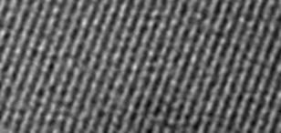
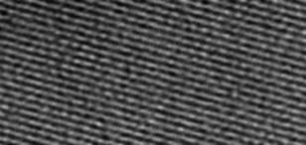
The Classical Grain Boundary (GB) Segregation (= Adsorption) Models
McLean-Langmuir Adsorption
Assume: both bulk & GB phases are ideal solution
“monolayer”? – in reality, not necessarily in the same layer
Assuming GB as a separate “phase” in equilibrium with the bulk phase
Lejcek-Hofmann (for non-ideal solutions); still fixed # of adsorption sites
Hondros-Seah (BET like multilayer adsorption)
Assuming that adsorbates are pure B
All developed via surface-GB analogies…

Slide 4
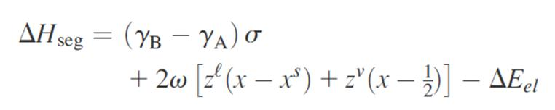
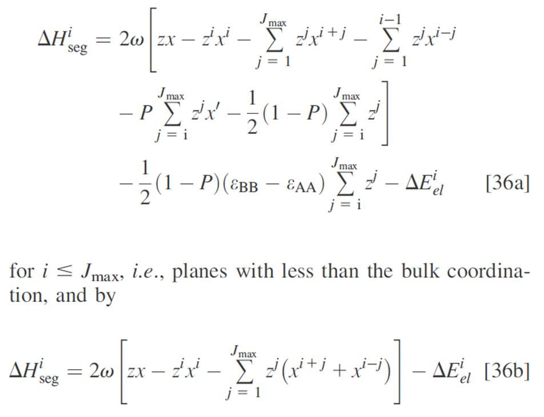
Segregation Energy/Enthalpy
Surface Segregation (Wynblatt and Ku)
“Regular-Solution Correction”
GB Segregation (Wynblatt and Chatain)
GB Core:
Elastic Energy
Fraction of broken bonds
Inside:

Slide 5
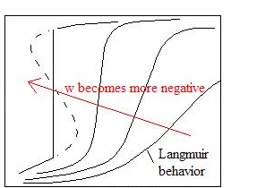
GB (Chemical) Phase Transition in the Classical Model
Fowler-Guggenheim (1939)
Attractive adsorbate-adsorbate interactions → 1-order interfacial “phase” transition…
“Monolayer”
Γ
Hart et al. (1960’s) used a similar model to explain tempering embrittlement.
1st order if
Intrinsic
(nominally “clean”)
X_{C}

Slide 6
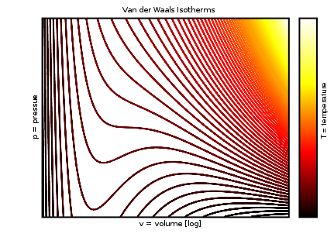
GB (Chemical) Phase Transition in the Classical Model
Fowler-Guggenheim (1939)
Attractive adsorbate-adsorbate interactions → 1-order interfacial “phase” transition…
van der Waals Equation
(Nobel Prize 1910)
“Monolayer”
Γ
1st order if
Intrinsic
(nominally “clean”)
X_{C}
Attractive molecule-molecule interactions → 1st -order phase transition…

Slide 7
GB (Chemical) Phase Transition in the Classical Model
Fowler-Guggenheim (1939)
Attractive adsorbate-adsorbate interactions → 1-order interfacial “phase” transition…
Regular Solutions
“Monolayer”
Γ
1st order if
Intrinsic
(nominally “clean”)
1-order “phase” transition if…
X_{C}

Slide 8
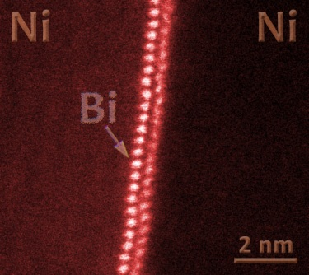

The Ni-Bi and Si-Au Cases
Au Bilayer
Si
Si
R_{Ni} = 1.35Å; R_{Bi} = 1.6Å;
|E_{Ni-Ni}| >> |E_{Bi-Bi}|
Strong Segregation System
R_{Si} = 1.1Å; R_{Au} = 1.35Å;
|E_{Si-Si}| > |E_{Au-Au}|
Repulsive Adsorbate-Adsorbate Interactions
Strong A-B:
½|E_{A-A}| + ½|E_{B-B}| < |E_{A-B}|
Ω_{Miedema} = -14.8 kJ/mol
Ω_{Miedema} = -59.2 kJ/mol

Slide 9
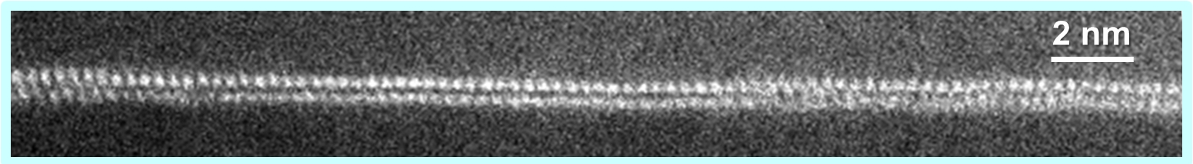
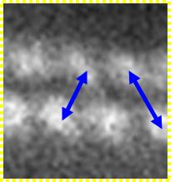
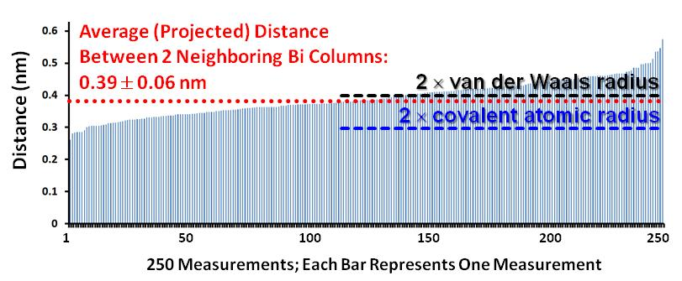
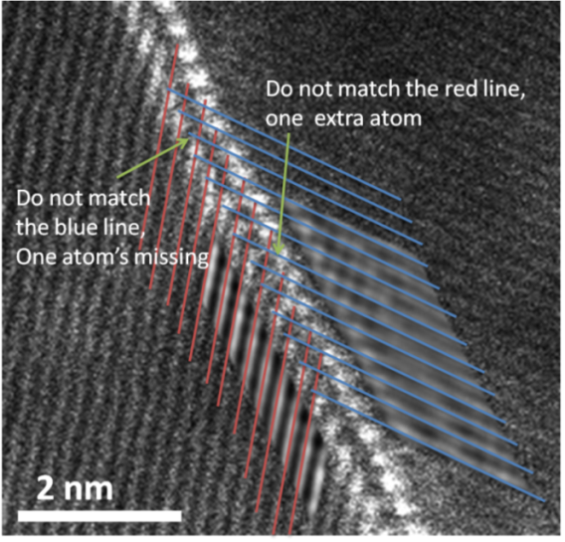
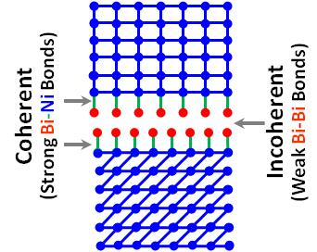
Ni grain
Adsorbed Bi
Ni grain
Adsorbed Bi
Bilayer Structure
→ Embrittlement
Verified by HAADF STEM
Energetically
The Most Favored!
Virtually no relaxation
Like a Bi-Bi GB?
Strong Ni-Bi: ½|E_{Ni-Ni}| + ½|E_{Bi-Bi}| < |E_{Ni-Bi}|
Weak Bi-Bi: |E_{Bi-Bi}| << |E_{Ni-Ni}|
Each Bi layer coherently adsorbed on the adjacent Ni grain
Incoherent between the 2 Bi layers

Slide 10
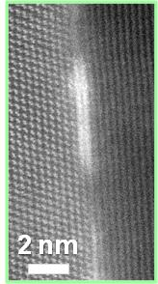


“Clean”
Intrinsic GB
Si
Si
Au Bilayer
discontinuity
in GB excess
Si
Si
1st order GB “phase” transition
Si
Si
Strong Si-Au:
½|E_{Si-Si}| + ½|E_{Au-Au}| < |E_{Si-Au}|
In collaboration with
Lehigh
Ma & Harmer
Ma et al.
Scripta Mater.
2012
Miedema model

Slide 11
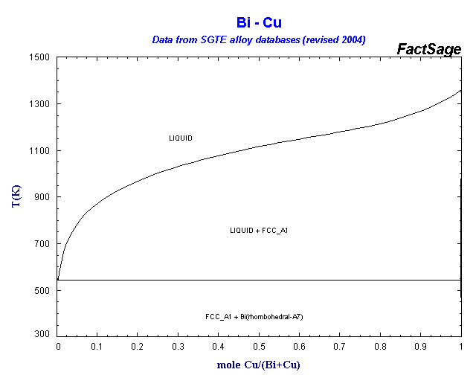
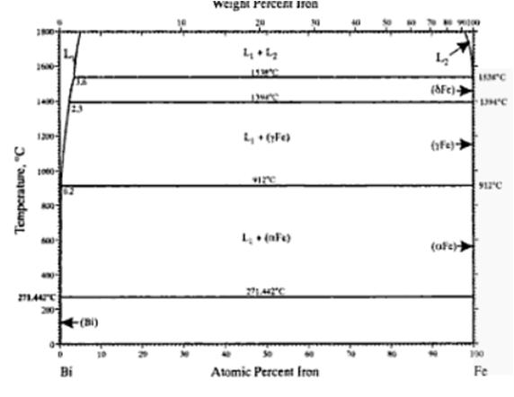
Predictive Thermodynamic Model? To Some Extend!
Ni-Bi
Cu-Bi
Fe-Bi
Ω_{Ni-Bi} = -14.8 kJ/mol
Ω_{Cu-Bi} = +14.2 kJ/mol
Ω_{Cu-Bi} = +72.3 kJ/mol
A Designed Experiment
Homologous Temperature T_{anneal}/T_{melt} = 0.5637
T_{anneal} = 700 °C
T_{anneal} = 492 °C
T_{anneal} = 746 °C
Bilayers ubiquitous
Bilayers observed, but in a narrow window
Bilayer NOT observed

Slide 12
Why no classical 1st order adsorption transition in Fe-Bi?
Zhiyang’s STEM → “Clean” GB
Fe-Bi
“Monolayer”
Γ
1st order if
Intrinsic
(nominally “clean”)
X_{C}
Ω_{Cu-Bi} = +72.3 kJ/mol
Limited solubility of Bi in Fe
1-order “phase” transition if…

Slide 13
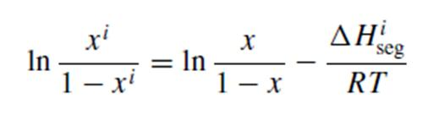
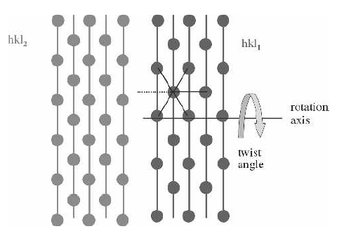
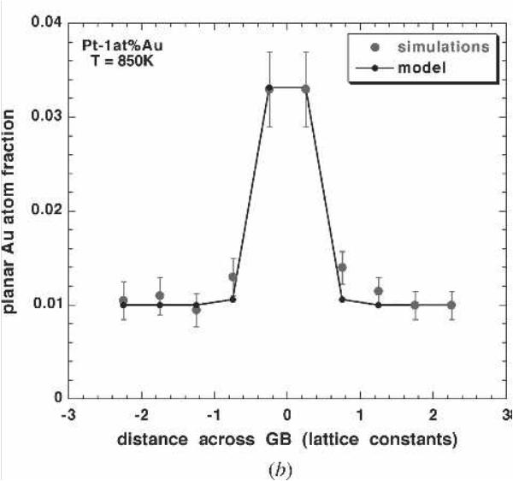
A Sophisticated GB Segregation Model
Wynblatt and Chatain [JMS 2005; 2006, MMA 2007]
Same Crystal Structure
Segregation Enthalpy
GB Core:
Weak Segregation Systems?
A weak “bilayer” in Pt-Au
Inside:
3 % Au

Slide 14
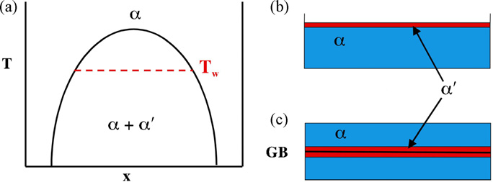
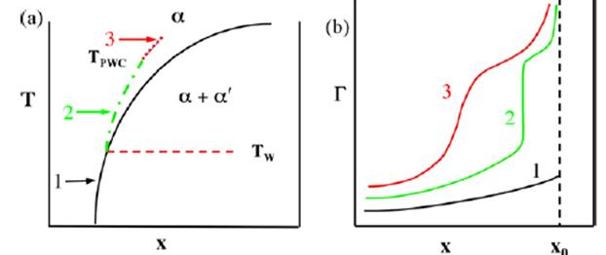
A Solid-State GB Prewetting Transition Predicted
Wynblatt, Chatain, Mater. Sci. Eng. A 2008
Solid Miscibility Gap

Slide 15
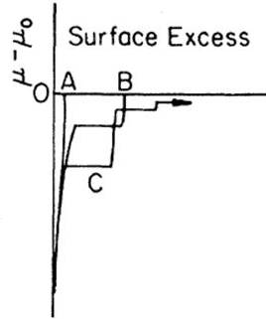
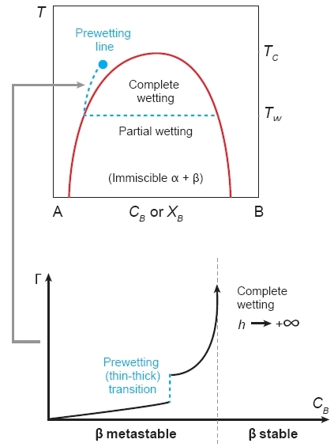
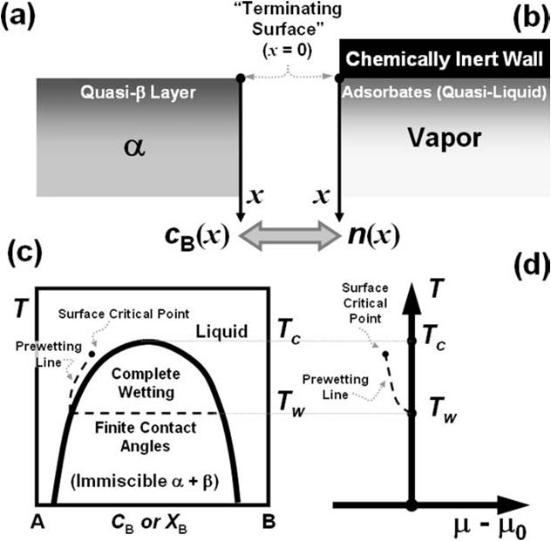
Background – for the Student Audience
Prewetting & Multilayer Adsorption
Cahn, J. Chem. Phys. 66: 3667 (1977)
Multilayer Adsorption
“Strong” Substrate → Layering
Pandit, Schick, Wortis
Phys. Rev. B, 26, 5112 (1982)
Critical-Point Wetting Model (Cahn)
De-mixed binary liquids
D
T_{C}
D
T_{R}
C
bilayer
T_{w}
B
monolayer
A
μ - μ₀
Surface Excess
Binary Liquid
Multilayer Gas Adsorption
Mathematically Isomorphic

Slide 16
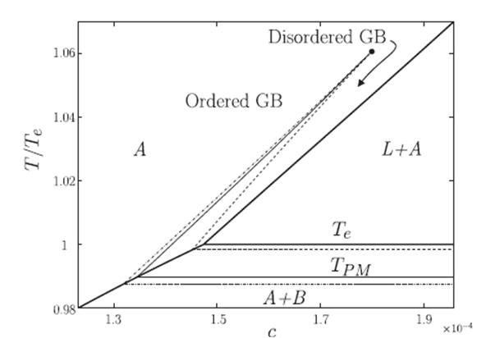
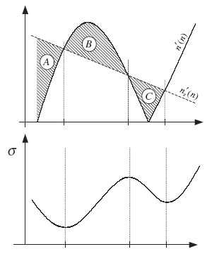
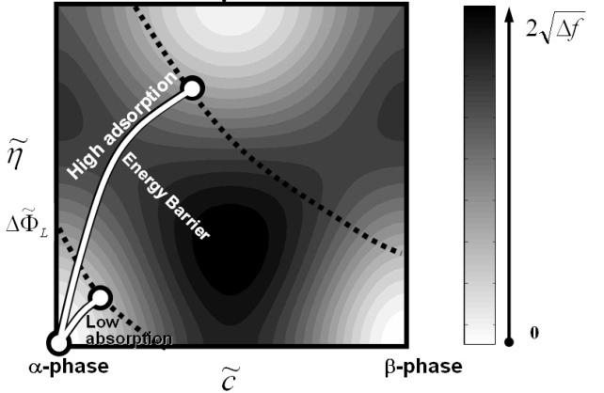
Origin of 1st-Order Transition: A Generalized Cahn Model
Prewetting & Critical-Point Wetting
for binary de-mixed liquids
Cahn, J. Chem. Phys. 66:3667 (1977)
Binary (solid-liquid) eutectic systems
For GBs: Tang, Carter & Cannon, PRL 2006
For Surfaces: Luo, Tang, Cannon, Carter & Chiang, MSEA 2006
Δf : vol. free energy
Ψ : surface term
c : concentration
κ_{c} : gradient (∇c) energy coefficient
Include additional field variables
η : crystallinity
θ : orientation
κ_{η} : gradient (∇η) energy coefficient
Cahn’s graphical construction
IGF
Quasi-β surface phase
dry
c
thin
thick

Slide 17
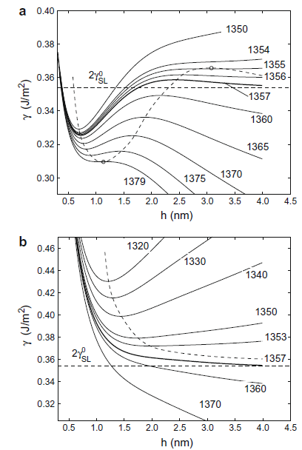
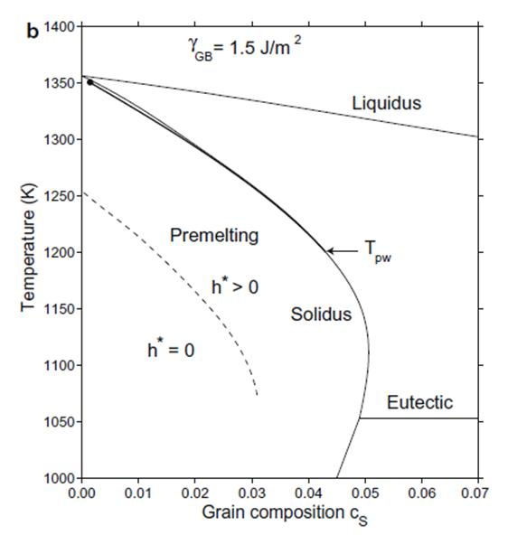
A Further Elaboration (CalPhaD Data Used)
Mishin et al., Acta Mater. 2009
Cu-Ag
GB Energy vs. Interfacial Width
A Low-Energy GB
A High-Energy GB

Slide 18
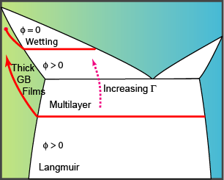
T
Prewetting
Premelting
liquid
High adsorption
β-like layer
Liquid-like
Low adsorption
Perfect
wetting
+
α
Crystal
finite contact angle
α + β
(immiscible)
β is not a stable bulk phase
Liquid is not a stable bulk phase
Both are “wetting phenomena occurring when the phase that does the wetting is not yet a stable bulk phase.”
Cahn, "Critical Point Wetting," J. Chem. Phys. 66, 3667 (1977)
A
Composition
B
B-enriched, liquid-like
Crystal
Plus
additional interfacial forces, e.g., dispersion forces and electrical double-layer forces
=
Luo, Tang, Cannon, Carter & Chiang, Mater. Sci. & Eng. A 422, 19 (2006)
Crystalline Grain
B-enriched, liquid-like
Crystalline Grain
A
B
Tang, Carter, Cannon, PRL 97, 075502 (2006)

Slide 19
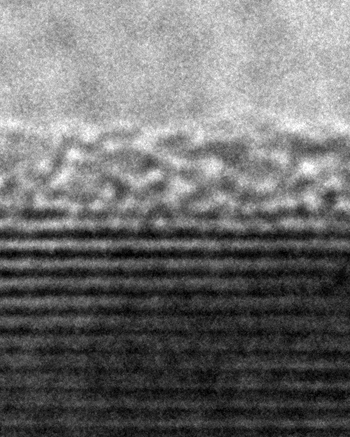
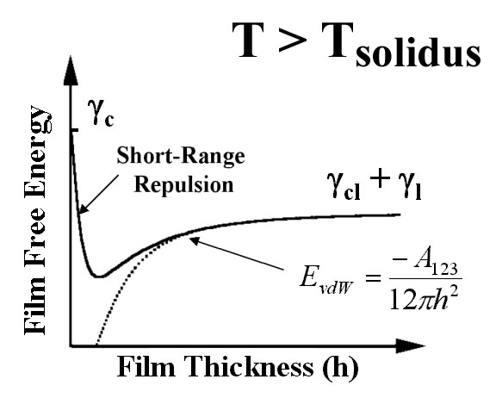
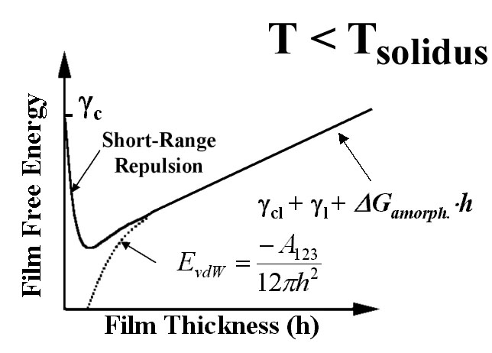
The Sharp Interface Model
Vapor
h
Excess film free energy:
for IGFs
Crystal
1 nm
If h ~ 1 nm
Interfacial forces:
vdW London
dispersion
Structural or chemical
Electrostatic
If T < T_{solidus}
Volumetric free energy for forming an undercooled liquid from bulk phases:
High-T colloidal forces + a “premelting-like” ΔG_{vol} term for T < T_{solidus}
Analogous to Clarke model for IGFs [J. Am. Ceram. Soc. 70:15 (1987); 76:1201 (1997)]

Slide 20
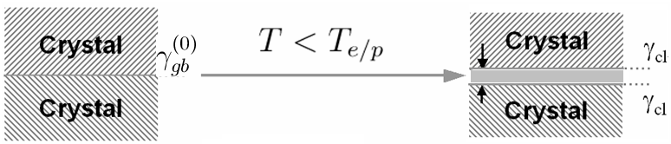
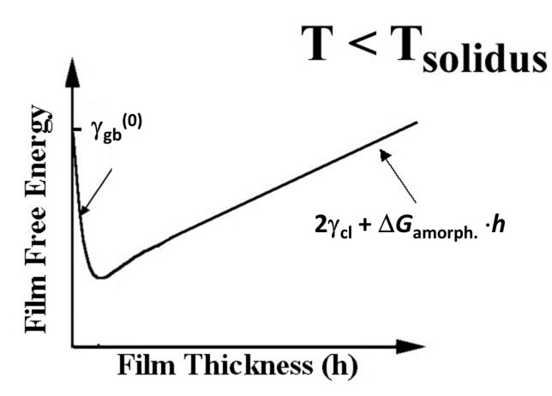
Thermodynamic Principle
solidus
h (undercooled liquid)
forming
undercooled liquid
A subsolidus quasi-liquid film is thermodynamically stable if:
The Excess Free Energy:
Interfacial Interactions
Short-range
Structural Oscillatory
vdW & Electrostatic (more significant for Ceramic)
Due to
Interfacial coefficient
h_{EQ}

Slide 21

Interfacial Coefficient/Potential
Interfacial (Derjaguin) Disjoining Potential
= 2γ_{cl} (rigorously)
Interfacial coefficient
an exponentially-decaying short-range interaction;
a long-range interaction that represents a London dispersion force;
an oscillatory structural interaction leads to layering transitions and produces discrete monolayer, bilayer, trilayer etc. (“hard sphere potential”);
a repulsive short-range force and an attractive long-range force produce an “equilibrium” thickness (indicated by the purple arrow) above the solidus line;
a first-order wetting transition; and
a first-order prewetting transition.

Slide 22
A Phenomenological Thermodynamic Model
Combining
The Excess Free Energy:
Interfacial Interactions
Interfacial Coefficient
Short-range
Long-range
Structural (Oscillatory)
vdW and Electrostatic (Ceramic)
Energetically-Favorite IF:
Level I:
Define & quantify:
Omit the details in f(h)
Multiple Levels of Modeling
Level II:
Consider f(h) or σ_{interfacial}(h)
Level III:
Diffuse-Interface or Atomistic

Slide 23
λ vs. Film Thickness (h_{eq})
Normalizing
an exponentially-decaying short-range interaction;
a long-range interaction that represents a vdW London dispersion force;
(d), (e), (f) …

Slide 24
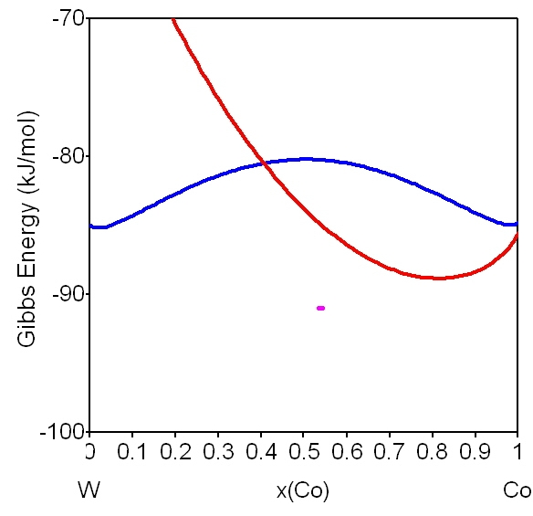
Our Prior Approach – Predictability Demonstrated!
Luo & Shi, Appl. Phys. Lett. 92:101901 (2008)
Thermodynamically stable if:
Miedema type “macroscopic atom” model
(Benedictus-Böttger-Mittemeijer Model)
Define & quantify:
Benedictus, Böttger, Mittemeijer, Phys. Rev. 54: 9109 (1996)
A recent review: Jeurgens, Wang, Mittemeijer, Int. J. Mat. Res. 100:1281 (2009)
CalPhaD
Representing
the thermodynamic tendency to stabilize a quasi-liquid film
Co₆W₇
Thermodynamic Functions
(for W-Pd, W-Ni, W-Co, W-Fe): Guillermet, Metall. Trans. A 1989; Gustafson, Metall. Trans. A, 1987; Gustafson, Z. Metallkd. 1988; Gustafson, et al, Z. Metallkd. 1987; Lee et al., Calphad 1986.
BCC
λ scales the film thickness
Liquid
Bulk
chemical potential

Slide 25
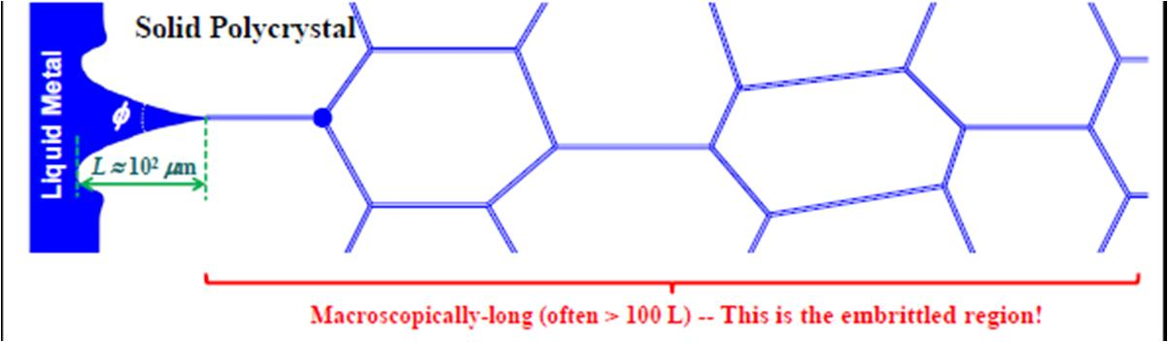
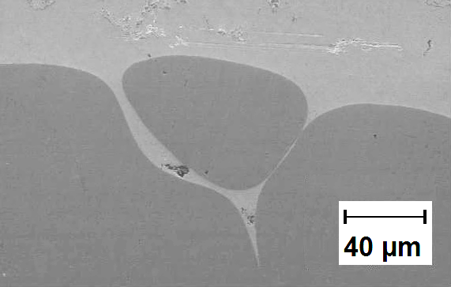
Applicable to Ni-Bi?
T (K)
Complete Wetting?
(after long annealing, 16 hrs)
1100 °C
700 °C
Early Argument: No GB complete wetting because vdW is always attractive and longest range force (PRL 1980?)

Slide 26
Implication
Reducing μ_{Bi}
Interfacial Potential
λ is not film thickness
Minimizing…
In S-L 2-phase region – bilayer stable or metastable?

Slide 27
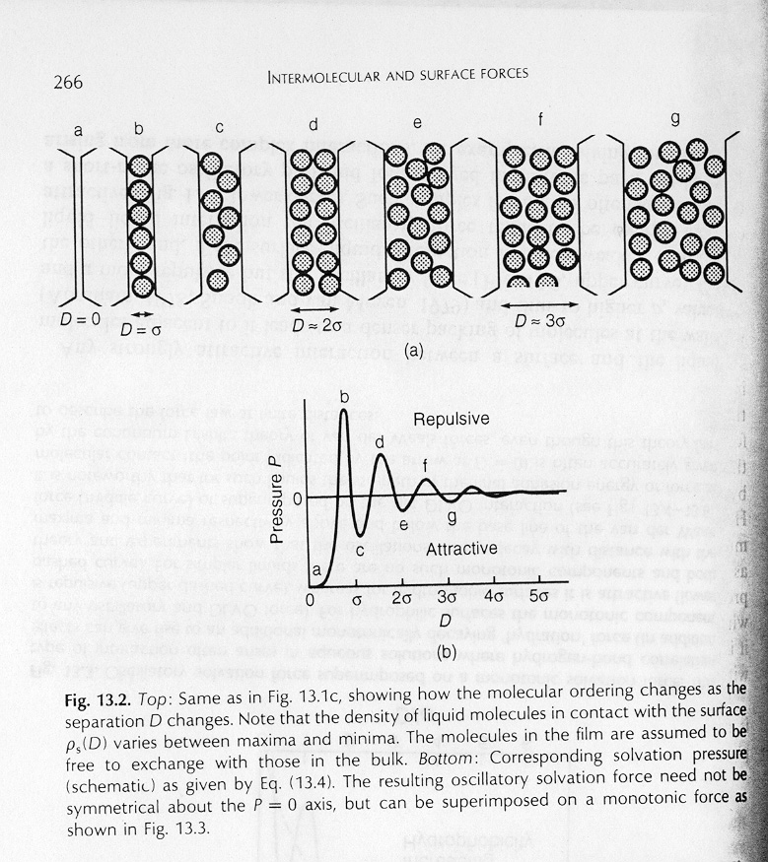
Attempt to Construct A Model for Discrete “GB Phases”
Luo, App. Phys. Lett. 95: 071911 (2009)
Introduce an oscillatory force
(in colloidal theories):
(Israelachvili, Intermolecular and Surface Forces, 1994)
Composition
Crystallinity
Orientation
Grain 1
IGF
Grain 2
Lattice-Gas
Lattice-Gas
Diffuse-Interface
Excess GB energy:
Volumetric free energy (using standard extrapolation methods in CALPHAD modeling)
Excess free energy of the liquid-like GB core (IGF):
Extra interfacial forces:
Tang-Carter-Cannon’s model
PRL 2006

Slide 28
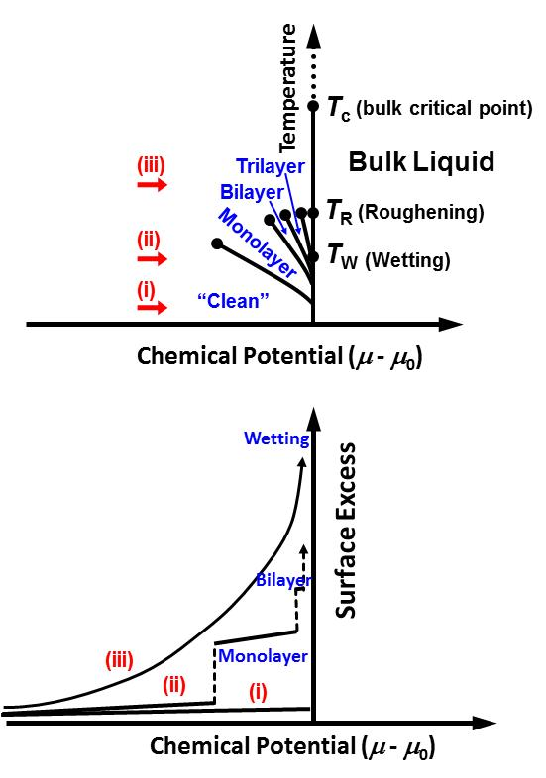
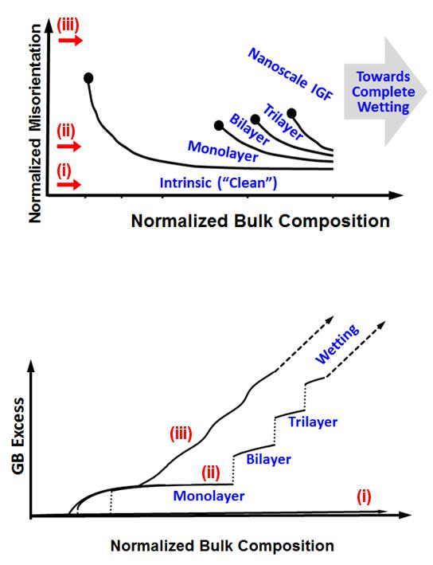
GB “Phase” Diagrams w/ Transition Lines…
However, “λ diagrams” appear to be more practically useful at this stage…
Grain Boundary Phase Behaviors
“Hard Spheres”
Surface Adsorption of
Inert Gas on an Attractive Substrate
Analogous?
Analogous?
Luo, App. Phys. Lett. 95: 071911 (2009)
Pandit, Schick, Wortis, Phys. Rev. B, 26: 5112 (1982)
In reality, atoms at GBs are more complex than hard spheres (noble gas)!

Slide 29
How to Build a Quantitative Model for Ni-Bi and a Model Everything?
Composition can vary layer by layer (but bulk solid prop )
Probability of broken bonds (coherency) adjustable
GB phase
different thermo prop.
thickness can vary
Composition can vary layer by layer
Semi-solid, semi-liquid (η vary layer by layer)
Similar to the Wynblatt-Chatain Model [JMS 2005; 2006, MMA 2007], but assume GB can undergo structural transitions…

Slide 30
The Bigger Picture – Maybe…
Ω ≡ E_{A-B} - (½E_{A-A} + ½E_{B-B})
γ_{A} ∝ |E_{A} |; γ_{B} ∝ |E_{B}|
Classical
L-M
Bilayers prevailing?
Ω ≈ 0
Large ΔE_{el}
Large γ_{A} - γ_{B}
Negative Ω
Large ΔE_{el}
Large γ_{A}
Small γ_{B}
(F-G) 1st-order adsorption transition
Positive Ω > 2kT
Large X_{C}⁰ (small ΔE_{el})
Large X_{C}⁰
Weak segregation (small ΔE_{el})
Nano-IGFs
dominant?
?
Multilayer within lattice
Network glass
Multiple δ
vdW
Solid immiscibility
Ideal case
6 complexions
with μ↑
Small ΔG_{amorph}
“Hard wall-hard sphere”
Single δ
Premelting
+ prewetting
Solid-state prewetting

Slide 31
Updates: Experiments on Metal Systems
Ni-Bi; Cu-Bi; Fe-Bi
Ni-W
HRTEM/STEM at Lehigh
EBSD/GBCD at CMU

Slide 32
Ni-Bi, Cu-Bi, and Fe-Bi Samples
Homologous temperature T_{anneal}/T_{melt} = 0.5637
All of the samples were annealed at specific temperatures for 5 hours and quenched immediately in the water.
New Samples:
sample number | system | [M:Bi] powder w/w ratio | Temperature (℃) | hours | Quench methods
20120209001 | Cu-Bi | 0.014:0.986 | 492 | 5 | water
20120209002
20120229001 | Cu-Bi | 0.014:0.986 | 492
20120229002 | Cu-Bi | 0.014:0.987 | 492
20120307001 | Fe-Bi | 0:1 | 746
20120307002 | Fe-Bi | 0:1 | 746
20120314001 | Fe-Bi | 0:1 | 746
20120314002 | Fe-Bi | 0:1 | 746

Slide 33
TEM-EDX Results of Fe-Bi (Zhiyang Yu)
(lot number 20120307001)
cleaning boundary
with the presence of
bright “Bi” atoms
clean GB, no evidence
of segregation
cleaning boundary
with the presence of
bright “Bi” atoms
EDS point

Slide 34
Hypothesis (Discussed Earlier) – Largely Confirmed
Ni-Bi
Cu-Bi
Fe-Bi
Ω_{Ni-Bi} = -14.8 kJ/mol
Ω_{Cu-Bi} = +14.2 kJ/mol
Ω_{Cu-Bi} = +72.3 kJ/mol
A Designed Experiment
Homologous Temperature T_{anneal}/T_{melt} = 0.5637
T_{anneal} = 700 °C
T_{anneal} = 492 °C
T_{anneal} = 746 °C
Bilayers ubiquitous
Bilayers observed, but in a narrow window
Bilayer NOT observed

Slide 35
Ni-Bi Samples: Temperature Effects
Prior Work: 700 °C & 1100 °C – virtually identical bilayers
Increase to 1400 °C?
Hypothesis: At a higher T, more interfacial disordering?
Moreover, Bi content on the liquidus line drops dramatically above 1300°C
?
New Samples:
sample number | system | [Ni:Bi] in Liquid | T(℃) | hours | Quench
20120125001 | Ni-Bi | 0.143:0.857 | 1100 | 5 | water
20120125002
20120216001 | Ni-Bi | 0.829:0.171 | 1400
20120217001 | Ni-Bi | 0.829:0.171 | 1400
20120217002
Another Direction (Future): Lower T?

Slide 36
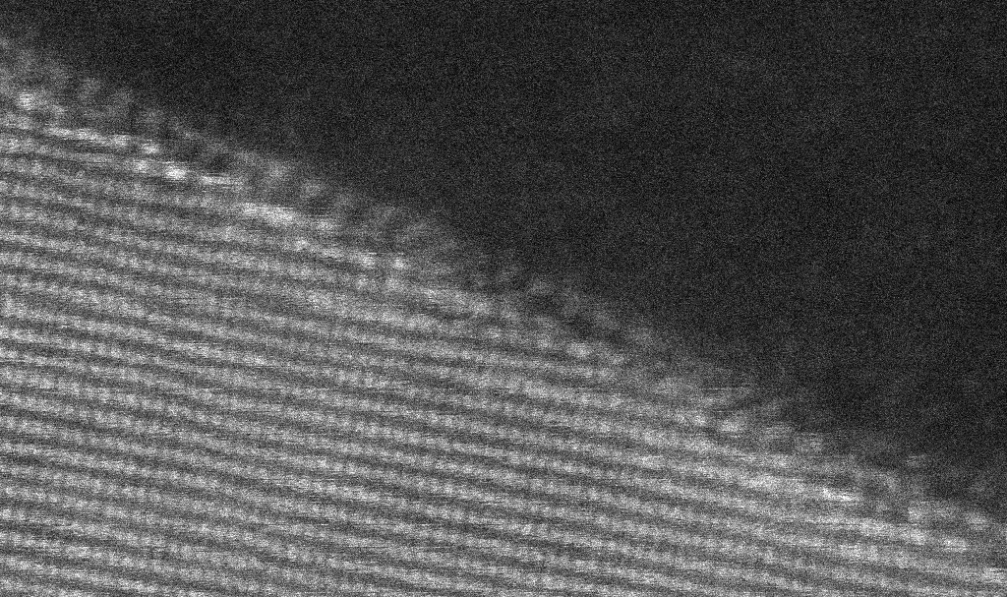
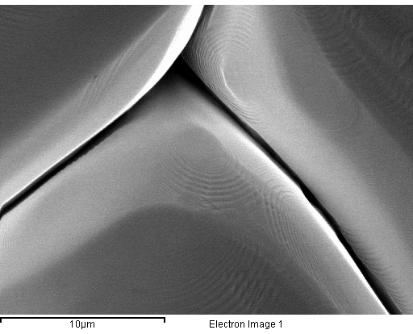
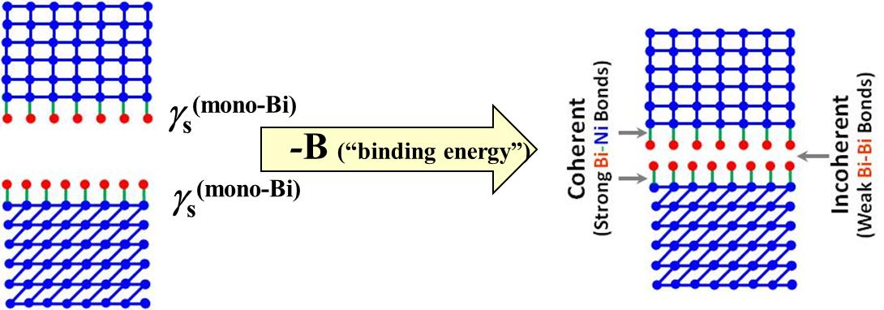
Ziyang’s New STEM on Old Specimens (700 °C)
1) Bi adsorption → faceting
Strong Ni-Bi; Weak Bi-Bi
{35-3}
Bi serves as a “surfactant” → “separate” 1 GB to 2 surfaces, each w/ monolayer
Closed-packed surface orientations are stabilized
High-index grain surface → atomic scale faceting
3) CMU: deep groove
2) bilayer formation
(= small ψ_{S})
Virtually no relaxation
Some Bi-Bi vdW bonds?
Recall CMU earlier results

Slide 37
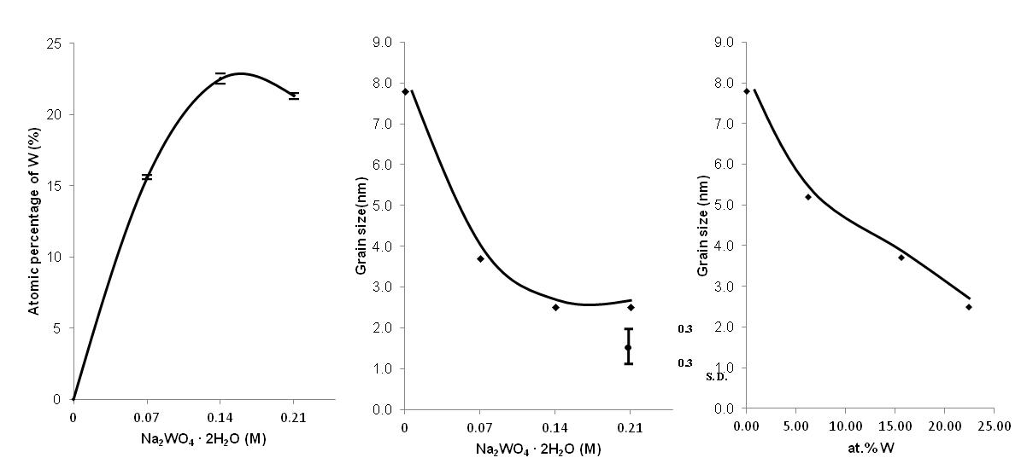
Ni-W Electrodeposition Samples
Matt Re-started and Prepared a Series of Fresh Specimens
H2O 500mL
NiSO₄·6H₂O 7.89g (0.06M)
Na₃C₆H₅O₇·2H₂O 44g (0.3M)
NaBr 7.725g (0.15M)
Na₂WO₄ · 2H₂O 23.25g (0.14M)
NH₄Cl 13.25g (0.5M)
Ni film as working electrode
Pt film

Slide 38
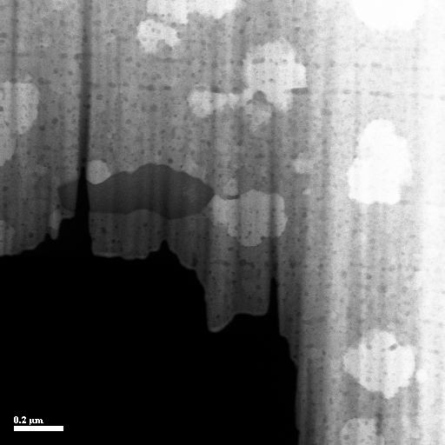
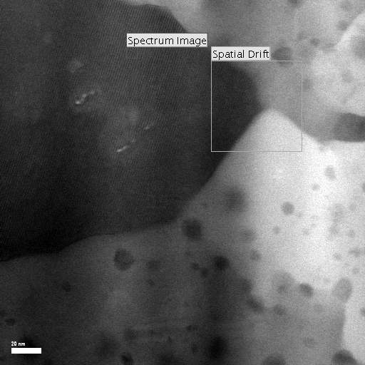
Ni-W Electrodeposition Samples
Matt Re-started and Prepared a Series of Fresh Specimens
Ni + ~20 at. %W (starting XRD grain size = ~ 2.5 nm)
Annealed in Ar-5%H₂ at 700°C for 4 hrs.
STEM/TEM by Patrick…
Some Fe contamination found (probably from the rust in electrical lead) – Procedure corrected

Slide 39
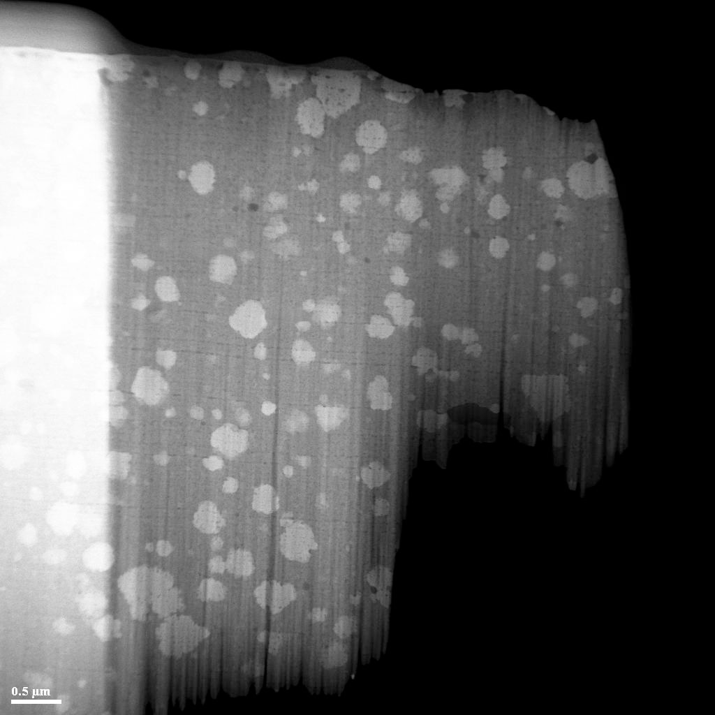
Patrick’s STEM – Interesting Microstructure Evolution Upon Annealing at 700 °C (4 hrs)
To be further investigated…

Slide 40
Ni-W Electrodeposition Samples
Samples are being prepared to examine effect of annealing conditions on grain growth
  No annealing (as-prepared from electrodeposition)
  700°C for 1 hr.
  700°C for 4 hrs.
    re-prepared to provide sample without Fe and O impurities
  700°C for 24 hrs.
EBSD/GBCD at CMU?
(Proposed future research could include the utilization of pulsed electrodeposition to gain more control over the W doping and surface texture)

Slide 41
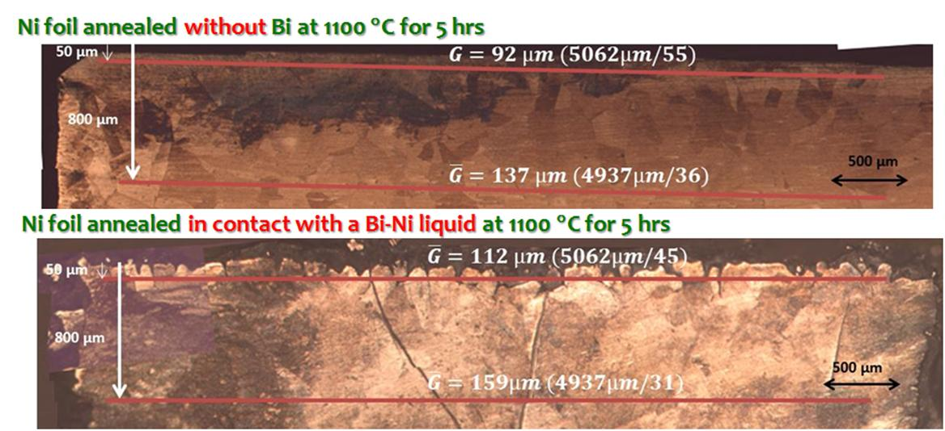
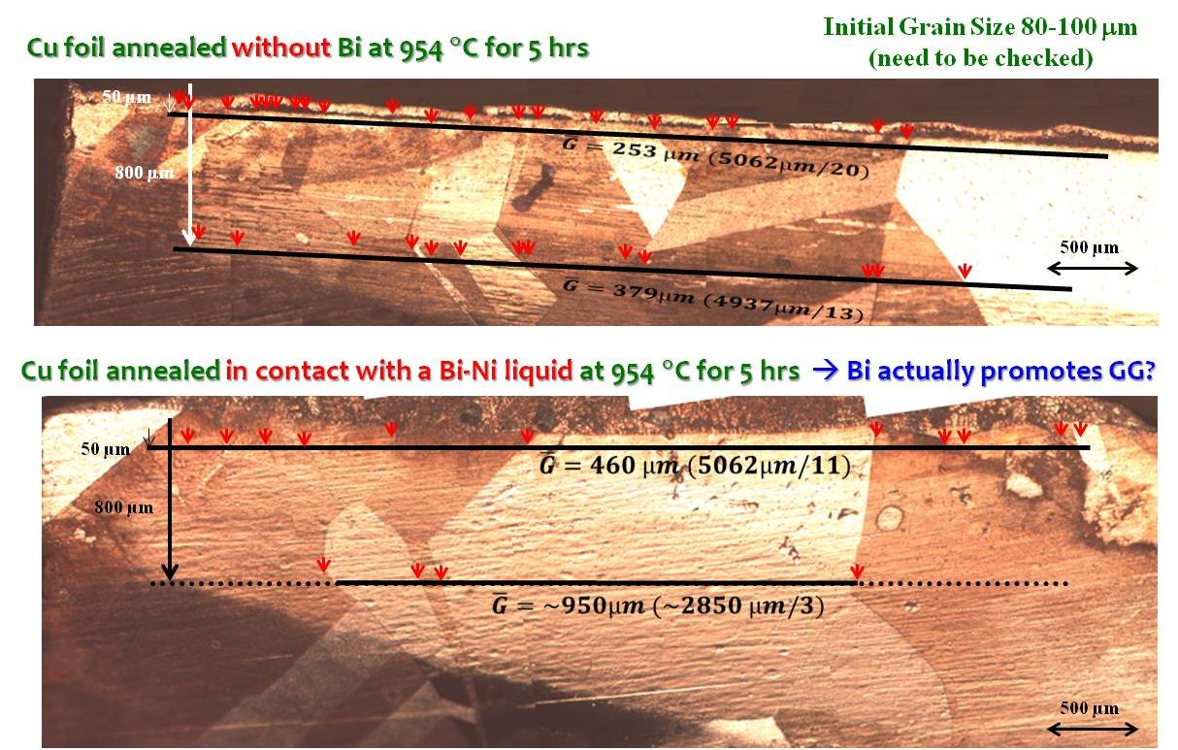
EBSD/GBCD Specimens for CMU
“Large-area” Ni-Bi and Cu-Bi specimens – (Bi promotes GG Preliminary)
Electrodeposited Ni-W vs. Pure Ni (4-Yr Old Specimens)
Now we can fresh specimens (Replacing)…
Future directions – Controlled annealing experiments in conjunction with Patrick’s work

Slide 42
Roles of Complexions in Ionic Conduction?
Dr. Matthew Williams and Dr. Jian Luo
Clemson University
MURI Project
Spring 2012

Slide 43


EIS Setup
One setup can measure EIS on a range of samples from ambient temperature to high temperature range (~1200°C)
supported Pt mesh
Pt wire
High frequency data relates to the grain interior while low frequency data relates to the electrodes
The intermediate frequency data is what is directly influenced by the complexions that make up the grain boundaries
Jung, Y.-S., Lee, J.-H., Lee, J.-H., Kim, D.-Y., J. Electrochem. Soc. 150 (2003) J49 – J53.

Slide 44


Electrical Impedance Analysis
Through the use of EIS, the contribution from the grain and grain boundaries may be deconvoluted
  Left – intermediate temperature setup in air
  Right – controlled-atmosphere high temperature setup (design in progress)
Planned Research is to understand grain boundary complexion formation and their roles in ion conductivity
Babilo, P., Processing and Characterization of Proton Conducting Yttrium Doped Barium Zirconate for Solid Oxide Fuel Cell Applications. dissertation. (2007) Cal Tech.

Slide 45

Start Point:
SiO₂-based Intergranular Films (IGFs) in YSZ – lower O conductivity greatly…
Experimental Task II:
Roles of Complexions in Ionic Conduction
Background & Motivations
Ionic conductors -- important for energy storage & generation.
Many ionic conductors (such as YSZ & BZY) certain GB complexions → severe “blocking effects” to ionic conduction
Additionally, space charges
Guo, X., Waser, R., Progress in Materials Science. 51 (2006) 151 – 210.

Slide 46


GB Transition to Tune Properties
Others are already doing this w/o using the concept of GB phase transition
J-H Lee,
Monatsh Chem. 140 (2009)
1081–1094.

Slide 47

GB Transition to Tune Properties– Via Reducing μ…
Others are already doing this w/o using the concept of GB phase transition
(1) To dope the to reduce the chemical potential of SiO2;
or (2) to co-dope (scavenger) or (3) using long pre-sintering annealing to form precipitates
→dry IGFs
J-H Lee,
Monatsh Chem. 140 (2009)
1081–1094.

Slide 48



Alternative Approach: Conductive IGFs?
Challenge: Glass (or Glass-like IGFs) are usually not good O conductors at all (because O conduction require vacancies).
Attempt in Literature: Using low-melting salts – to form GB conduction “phase”

Slide 49

How About Proton Conduction?
Enhanced Proton Conduction Demonstarted for LaPO₄
Yttria-doped Barium Zirconate (BZY)
Shift to H⁺-conducting cubic perovskite BZY
  Can function as SOFC electrolyte at intermediate temperature range (500 – 700°C)
  Has similar grain boundary conductivity issues, but much less research has been done
Current research is tackling issues with BZY:
  Ba Stoichiometry
    Tendency to evaporate from structure as volatile BaO at high temperatures
  High Grain Boundary Resistance
    Similar conductivity “blocking” at GBs

Slide 50
Yttria-doped Barium Zirconate (BZY)
Matt Williams
Two methods commonly reported:
  Gel-combustion: very similar to production of YSZ
  Solid-State: stand method used for longest time
Zr⁴⁺ + H₂O
Y³⁺ + H₂O
Ba²⁺ + H₂O
Stir
Heat to ignite (>300°C)
Glycine
Heat to form gel (<150°C)
Due to potential for weakly agglomerated, smaller particles - GC method examined first
Pelletize w/ binder
Binder burnoff @ 600°C / 30min.
Calcine ash @ 1250°C / 5hrs.
Sinter @ 1600°C / 24hrs.
BZY
white powder

Slide 51

Synthesis of Yttria-doped Barium Zirconate (BZY)
Matt Williams
XRD comparison of interiors of two halves of sintered pellet
From top to bottom – interior of pellet closet to Ba-deficient surface, interior of pellet closest to middle, and calculated pattern from database
Stars mark impurity peaks present due to Ba-deficient phases near exposed surfaces and edges of the pellet

Slide 52




Another Interesting Idea
To eliminate GBs by column grains in epitaxially grown films
Or, using control AGG to make a single crystal (similar to Al₂O₃)?

Slide 53
Backup and Additional Slides

Slide 54



Slide 55


CMU Experiments on a Second Set of Specimens…
The Effect of Bi on the Surface Morphology of Ni
Ni, 700 °C × 15 h (without Bi)
Ni, 700 °C × 15 h in Bi vapor
A prior study by Wolski & Laporte [MSEA 495 (2008) 138] showed that annealing in contact with Bi liquid and Bi vapor led to similar GB chemistries (measured by Auger), at least for Cu bicrystals)
Two distinct features:
Bi adsorption → faceting
Some extremely deep grooves
Both can be well explained by the model discussed previously

Slide 56



CMU Experiments on a Second Set of Specimens …
Two Distinct Features – Explained by Our Model
1) Bi adsorption → faceting
Ni, 700 °C × 15 h in Bi vapor
Strong Ni-Bi: ½|E_{Ni-Ni}| + ½|E_{Bi-Bi}| < |E_{Ni-Bi}|
Weak Bi-Bi: |E_{Bi-Bi}| << |E_{Ni-Ni}|
Bi serves as a “surfactant”
Closed-packed surface orientations are stabilized because they allow more Bi adsorption to reduce γ → faceting
2) Deep grooves
(= small ψ_{S})
Binding energy
between 2 Bi layers
Virtually no relaxation
Some Bi-Bi vdW bonds?
Small!
Ignore
Anisotropy:

Slide 57


CMU Experiments on a Second Set of Specimens …
Atomic Force Microscopy (AFM)
Using the AFM: determine the relative energy of the grain boundaries
Measure the width and depth of the grain boundary, infer the dihedral angle and the relative grain boundary energy by the equation
D.M. Saylor and G.S. Rohrer, J. Amer. Ceram. Soc. 82 (1999) 1529.

Slide 58
CMU Experiments on a Second Set of Specimens
Measured γ_{gb}/γ_{s}
Binding Energy
Virtually no relaxation
Some Bi-Bi vdW bonds?
1
.
0
0
.
9
Undoped Ni
Mean = 0.2523
Median = 0.2628
Min = 0.06
Max = 0.71
0
.
8
0
.
7
0
.
6
Cumulative Probability
Bi-doped Ni
Mean = 1.04
Median = 1.08
Min = 0.27
Max = 1.61
0
.
5
0
.
4
0
.
3
0
.
2
0
.
1
0
.
0
0
.
0
0
.
5
1
.
0
1
.
5
2
.
0
γ_{gb}/γ_{s}
Ignore anisotropy:

Slide 59


Bilayers: Promote or Inhibit Grain Growth (GG)?
Some Background & Motivations…
On one hand…
On the other hand…
Stabilization of Nanocrystralline Metals via Doping
Concept/Model:
  Weissmuller (1994)
  Liu & Kirchheim (2002)
Pd-Zr
Fe-Zr
Ni-P:
  Kirchheim et al. (2000)
Ni-W:
  Yamasaki (2000)
  Schuh group (~2007ff)
Ni-Cu
  Pellicer et al., 2011
  Cu-Bi (atomistic modeling)
  Mayr et al.
  Millett et al.
Al₂O₃
Wetting
Nano IGF
Intrinsic
Trilayer
Bilayer
Monolayer
Dillon, Tang, Carter & Harmer
Acta Mater. 2007
Mayr & Bedorf
PRB 2007

Slide 60

Stabilization of Nanocrystralline Metals via Doping
The Theories
Kinetic Stabilization
Solute drag
Second phase pinning
Chemical ordering
…
The complexion theory argued that segregation induced interfacial disordering can increase GB mobiles (demonstrated in Al₂O₃, Al-Ga etc.)
competing
Thermodynamic Stabilization (reducing γ_{GB} to ~ 0?)
A slide from the late
Dr. Rowland Cannon
(2004 GRC)
A GB “phase” transition
(beyond monolayer)?

Slide 61

Bi Bilayer Adsorption → Significant Reduction of γ_{GB} (Reducing the Driving Force for Grain Growth)
Miedema-Type Statistical Models
Average general Ni (“clean”)
Experimental: 0.92 J/m²
(700 °C, 99.999 wt. % Ni)
Interfacial energy (Ni & Bi-Ni liquid)
(700 °C)
But NOT complete wetting because…
Gibbs Isothermal
Decrease to ~1/4 due to bilayer adsorption of Bi
Measured average dihedral angle
44.7° (at 700 °C)
φ
Bi-Ni Liquid
First-principle calculations & atomistic simulations will help to confirm…

Slide 62



Bi Bilayers Appear to Promote Grain Growth (Slightly)
Despite a Reduction of the Driving Force (γ_{GB}) by ~4X
Ni foil –
as-received
Ni foil
annealed
without Bi
(1100 °C, 5 hrs)
Ni foil annealed
in contact with a Bi-Ni liquid
(1100 °C, 5 hrs)
Verified independently by CMU w/ specimens annealed in Bi vapor (later slides)
Consistent with Dillon and Harmer’s observations/theory for Al₂O₃.

Slide 63
On-Going Work… Specimens Prepared at Clemson →
EBSD/GBCD Characterization in Progress at CMU
(initial) grain size: ~75μm
Bi-39 at. % Ni liquid
Annealed at 1100 °C, for 5 hrs
in 5 % H₂ balanced by Ar
Ni (free-standing foil, sit on a crucible)
~2 mm
> 2 cm
Then…
Remove the extra solidified Bi-Ni
Cut the unexposed part
Polish off the top layer of ~ 300 μm
Ni foil
Glue it
A ridge substrate

Slide 64


Specimens Prepared at Clemson → HAADF-STEM at Lehigh (Bilayer Observed)
→ GB Diffusivities Measured at UIUC
bilayer observed by HAADF-STEM
(at this exact GB)
Bi-doped Cu (details in the next talk)
in progress…

Slide 65


Promote vs. Inhibit Grain Growth?
Some More Background …
Ni-W?

Slide 66

Comparison: Ni-Bi vs. Ni-W
Miedema Model:
ΔH_{mix}^{(50%Ni-50%Bi)} = -3.7 kJ/mol
ΔH_{mix}^{(50%Ni-50%W)} = -4.67 kJ/mol
1100 °C
Bi
Ni
W
Ni
Low melting;
Strong segregation
High melting;
Weak segregation
Inhibit GG?
Hypothesis?
Promote GG?

Slide 67



Ni-W:
Electrodeposited Specimens Made at Clemson
10um
Thickness : 45 µm
H2O 500mL
NiSO₄·6H₂O 7.89g (0.06M)
Na₃C₆H₅O₇·2H₂O 44g (0.3M)
NaBr 7.725g (0.15M)
Na₂WO₄ · 2H₂O 23.25g (0.14M)
NH₄Cl 13.25g (0.5M)
  Similar to the Yamasaki (2000) recipe
HanSeung Park & Jian Luo

Slide 68
Ni-W:
Electrodeposited Specimens Made at Clemson
0.3
0.3
S. D.
 | at.% W | FWHM | 2-theta | XRD Grain Size
Pure Ni film | 0% | 1.1138 | 44.68 | 7.7nm
0.07M Na₂WO₄·2H₂O | 15.6% | 2.2640 | 43.70 | 3.7nm
0.14M Na₂WO₄·2H₂O | 22.47% | 3.3043 | 44.36 | 2.5nm
0.21M Na₂WO₄·2H₂O | 20.3% | 3.3820 | 44.00 | 2.5nm
HanSeung Park & Jian Luo

Slide 69

Nanocrystalline Ni + ~20%W – Thermal Stability
 | FWHM | 2-theta | XRD Grain Size
As-deposited | 3.3043 | 44.36 | 2.5nm
400 °C, 6 hrs | 1.4329 | 43.76 | 5.9nm
600 °C, 6 hrs | 0.4330 | 43.62 | 19.7nm
Currently On-Going Tasks
(Preliminary Characterizations)
HAADF-STEM at Lehigh
GBCD at CMU
Worthy to be investigated further?
HanSeung Park & Jian Luo

Slide 70


Bilayer-to-Trilayer Transition?
Science 2011
A possible GB (Phase) transition?
The transition to a “clean” GB?

