Slide 1
Tailoring of Atomic-Scale Interphase Complexions for Mechanism-Informed Material Design
Office of Naval Research Multidisciplinary University Research Initiative Project
Review Meeting, Thursday December 15th 2011
ONR Topic Chief: David Shifler
Atomistic Simulations of Ni-based Systems

Slide 2
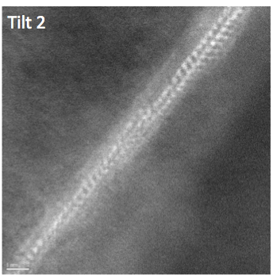
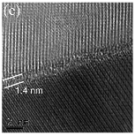
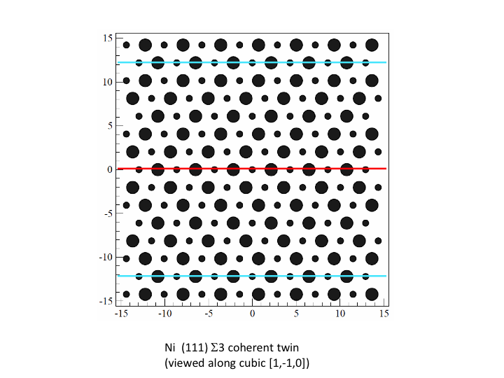
Integration
Ni-Bi
Cu-Bi
J. Luo, et al.
Classical Atomic Scale Models
S. Dillon, et al.
Ni Σ3 GB
Widom group
Intergranular film in Al2O3
S. Dillon, et al.

Slide 3
Classical Atomistic Models
Atoms are explicitly resolved as point wise masses; interactions between atoms are governed by interatomic potential energy functions, which depend upon the current atomic configuration.
Electrons are not explicitly resolved so computational burden is significantly lower than encountered in quantum mechanical atomic models.
Averaging over (i.e. coarse-graining) electronic degrees of freedom introduces approximations so the validation burden is significantly higher than encountered in quantum mechanical atomic models.
Quantum Mechanical Models
Classical Atomic Scale Models
Experiments
For general grain boundaries with large unit cells, we can model structure, thermodynamics, and kinetics with atomic scale resolution.

Slide 4
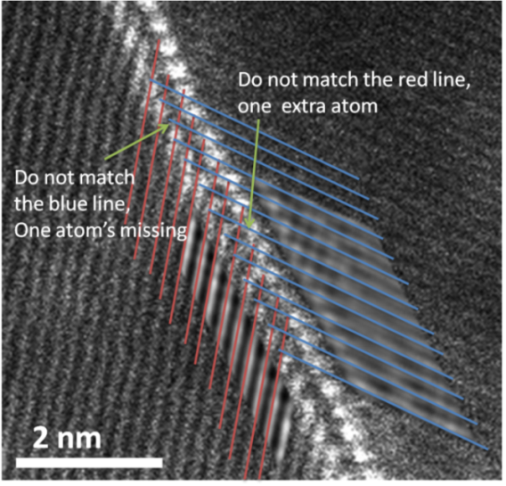
Complexions in Ni-Based Systems
Our goal is to explore thermodynamics and kinetics of Bi bilayer complexions observed at GBs in Ni; evidence presented says Bi adsorption on terminating Ni planes is coherent. However, the Bi layer adsorbed on one Ni crystal plane is not coherent with the adjacent grain.
Under what conditions do verified atomic scale models of the same system predict the bilayer structure?
For this structure, how does the proposed thermodynamic model correlate with computed GB energy contributions?
What are transport properties of such structures? What are the mechanical properties? How do properties respond to stress and temperature?
How do we learn from these systems to engineer new, complexion based engineered materials?
J. Luo, H. Cheng, K. Meshinchi Asl, C. J. Kiely, M. P. Harmer; Science (2011).

Slide 5
Classical Models of Ni/Bi
Standard pair interaction models (Lennard-Jones) fail to describe metallic systems accurately.
The embedded atom method (EAM) and Finnis-Sinclair (FS) models of atomic interaction were both advanced to overcome this shortfall of pair potentials.
A highly validated EAM Ni model exists; however, no companion model for Bi has been developed (i.e. one needs Ni-Ni, Bi-Bi, and Ni-Bi).
A less-validated, though still quite robust, Finnis-Sinclair model exists for the Ni/Bi system.
Our simulation methodologies and associated characterization tools (post-simulation data processing codes) are generic to the applied model
The tools we’re developing are transferable – not just between models of Ni/Bi but also to atomistic simulations of other systems.
We are utilizing both models – and EAM model of Ni/”Bi” and the FS model of Ni/Bi. Model comparison and further validation will be an integration exercise between the Widom (CMU) and Webb (LU) groups.

Slide 6
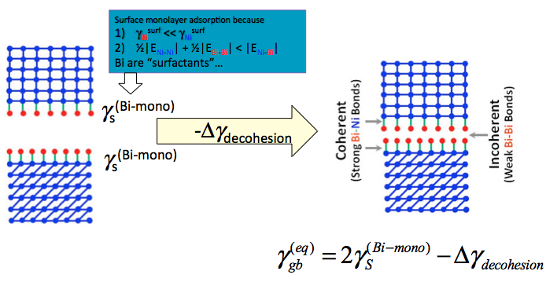
Atomic Scale Studies of Ni/Bi
The thermodynamic theory that has been advanced to describe Bi bilayer stabilization invokes certain energy relationships that can be explored via atomic scale calculations (both quantum and classical levels of theory).

Slide 7
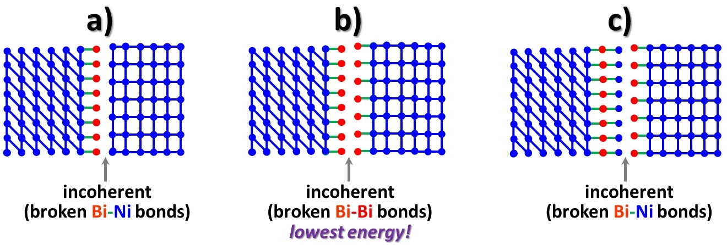
Thermodynamic Model
Atomic scale models will evaluate the thermodynamic assertion that complexion stabilization is achieved as a result of minimizing the energy associated with broken bonds at the grain boundary.

Slide 8
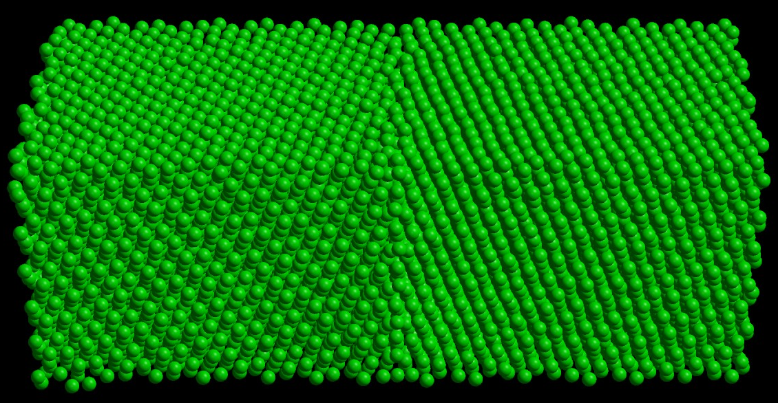
Classical Model Methodology
Determine adsorption properties at free surfaces of Ni as a function of adatom coverage.
Evaluate how adsorption structures change for a model general grain boundary: merge two, rotated free surfaces. How are simple additive rules confirmed and/or challenged.
Compare with more rigorous GB models. Methodology has been advanced for creating low energy GB structures of both tilt and twist types and with varying misorientation/rotation. Such methodology extends to fairly general GBs; however, large unit cells may result.
Σ79 symmetric tilt GB in Ni (misorientation θ = 33.99°)

Slide 9
Graduate Student Update
D. Yin (Ph. D. candidate, MSE – LU); combination of electron microscopy and computational techniques to study complexion phases in metallic systems.
Compile massively parallel classical molecular dynamics code LAMMPS.
Determine equilibrium lattice constant of Ni for varying thermodynamics ensembles (a(T)).
Form free crystalline surface simulation ensembles at relevant T (T = 700 °C, 1100 °C; (001), (110), and (111) surfaces).
Compute binding energy and structure of Bi clusters on free surfaces of Ni at “elevated T”.
energy minimization
Monte Carlo methods
Build GB structures and repeat dopant adsorption studies.
high symmetry special boundaries
low symmetry general boundaries

Slide 10
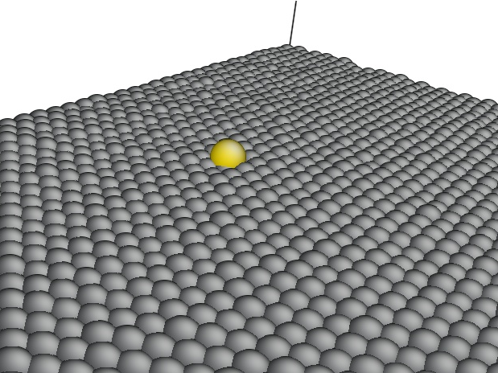
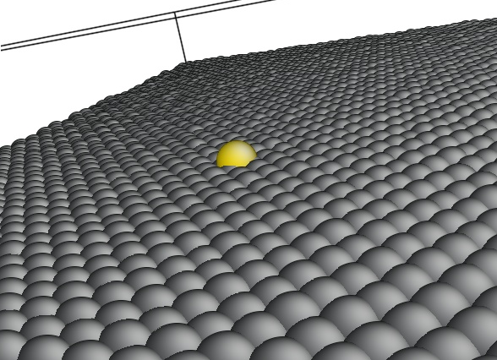
“Bi” on Free Ni Surfaces
Ni is modeled with highly validated EAM potential (i.e. Ni-Ni interactions). For remaining interactions, Bi-Bi is such that the size of the adatom agrees with size of Bi. For interaction strength, E_{Bi-Bi} and E_{Ni-Bi} are model parameters. Simulations so far fix E_{Bi-Bi} and then vary E_{Ni-Bi}, with caveat that E_{Bi-Bi} < E_{Ni-Bi}.
Ni (001)
Ni (111)

Slide 11
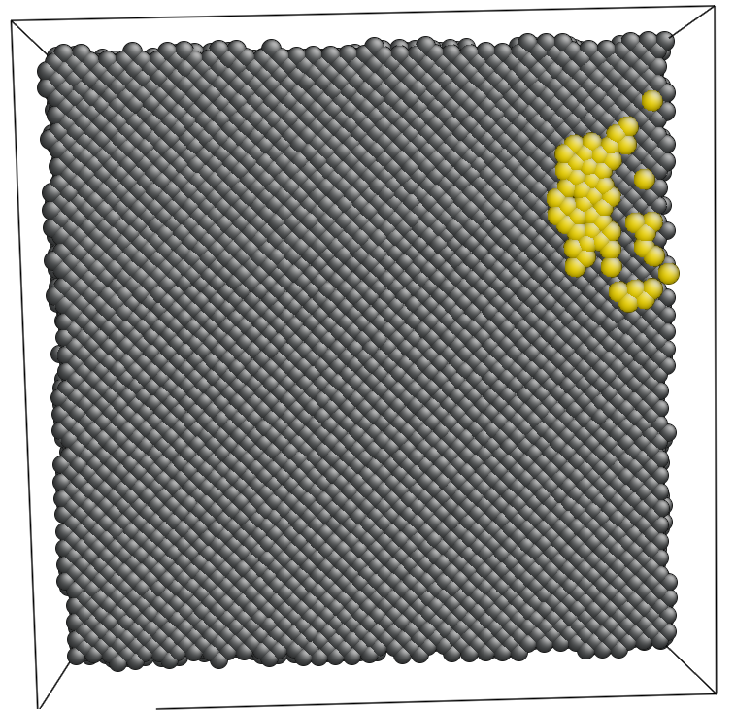
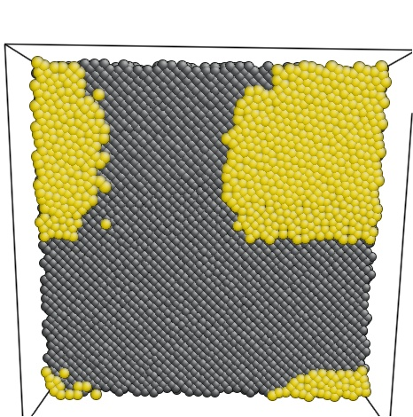
“Bi” on Free Ni Surfaces
Modeling cluster growth (structure, energetics as a function of coverage).
Ni (001)
t ≈ 0.01 μs
t ≈ 0.1 μs

Slide 12
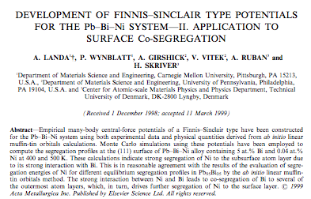
Bi on Free Ni Surfaces
We have almost completed implementing the FS model of Ni-Bi in LAMMPS.
5 at. % Bi and 0.04 at. % Ni (remainder Pb)
Relatively low T compared to our desired state points
Acta Mater. 47 (8) pp. 2477-2484, 1999.
Our model evaluation exercises for free surfaces and GBs are deeply integrated with the Widom group’s optimization exercises.

Slide 13
Bi in Ni GBs
Our first studies are using one special boundary (Σ3) and a small collection of more general GBs (Σ79, Σ273).
Σ79 [111] Symmetric Tilt Boundary
(T = 973 K)
View along tilt axis, [1 1 1]
View along normal to tilt axis, [17 -13 -4] / [17 -4 -13]
Creation Methodology: D. L. Olmsted, S. M. Foiles, E. A, Holm; Acta Mater. 57 (2009) 3694–3703

Slide 14
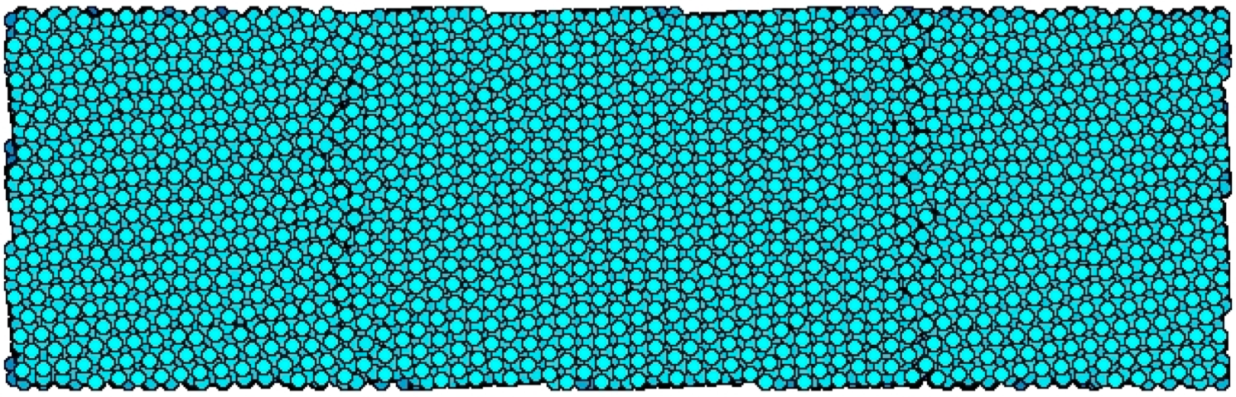
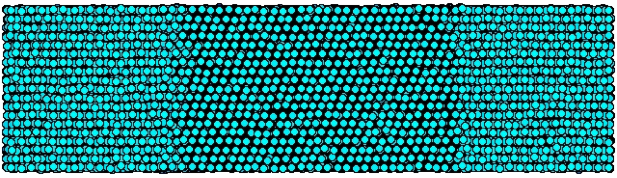
Bi in Ni GBs
Our first studies are using one special boundary (Σ3) and a small collection of more general GBs (Σ79, Σ273).
Σ273 [111] Asymmetric Tilt Boundary
(T = 973 K)
View along tilt axis, [1 1 1]
View along normal to tilt axis, [-16 17 -1] / [-19 11 8]

Slide 15
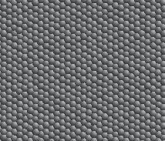
Bi in Ni GBs
We are developing a MC based free surface and GB adsorption structure equilibration code.
Establish grand canonical ensembles to permit insertion/deletion of Bi at Ni GB, type swaps between Ni and Bi, and other standard MC structure exploration trial moves
View along normal to tilt axis, [-16 17 -1] / [-19 11 8]

Slide 16
Some Related Systems
The size ratio of Bi to Cu is quite similar to the size ratio of Pb to Cu; in addition, peculiar surface adsorption behavior has been observed in the Pb/Cu system.
Separate work is investigating adsorption of Pb on Cu(001) and Cu(111) surfaces at elevated temperatures (i.e. T > T_{m} for Pb).
D_{Pb} high for overlayer phases … low for surface alloy phases [1]
‘Foot’ diffuses from islands with R ~ t^{1/2} [2,3]
[1] – J. Moon, et al; Surface Science 488(2001)73-82
[2] – G. Prévot, et al; Phys Rev B 61(2000)10393
Pb
Cu

Slide 17
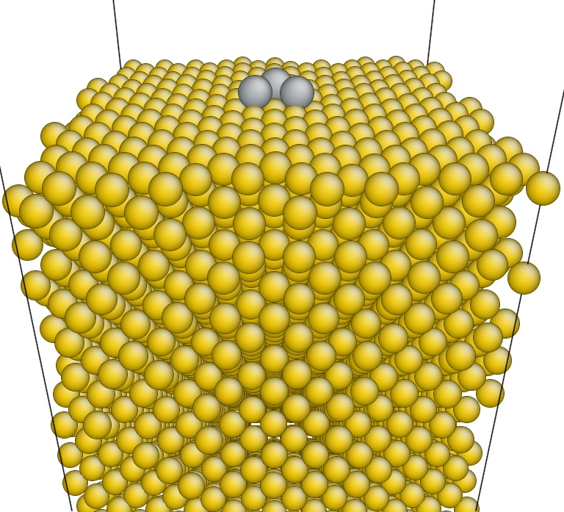
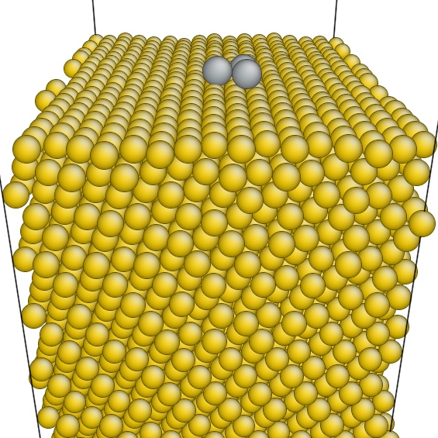
Pb Adatoms on Cu Surfaces
Separate work is investigating adsorption of varying size Pb adatom clusters on Cu(001) and Cu(111) surfaces at elevated temperatures (i.e. T > T_{m} for Pb).

Slide 18
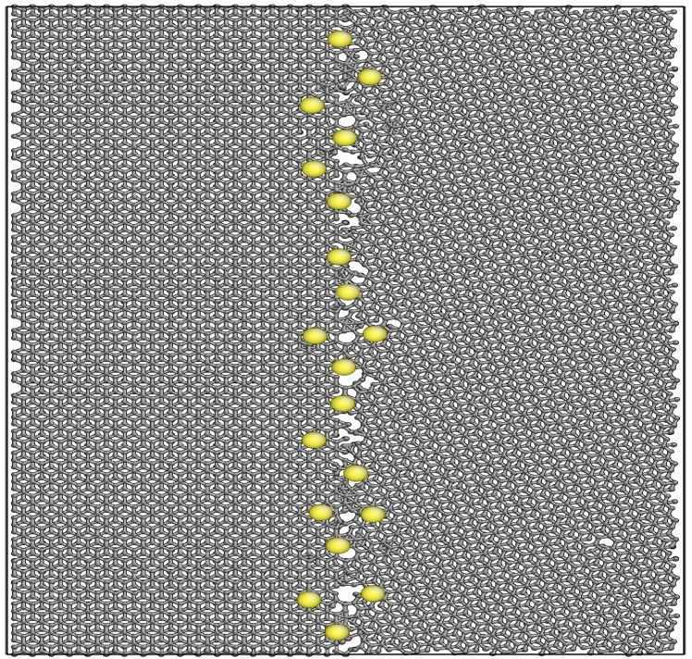
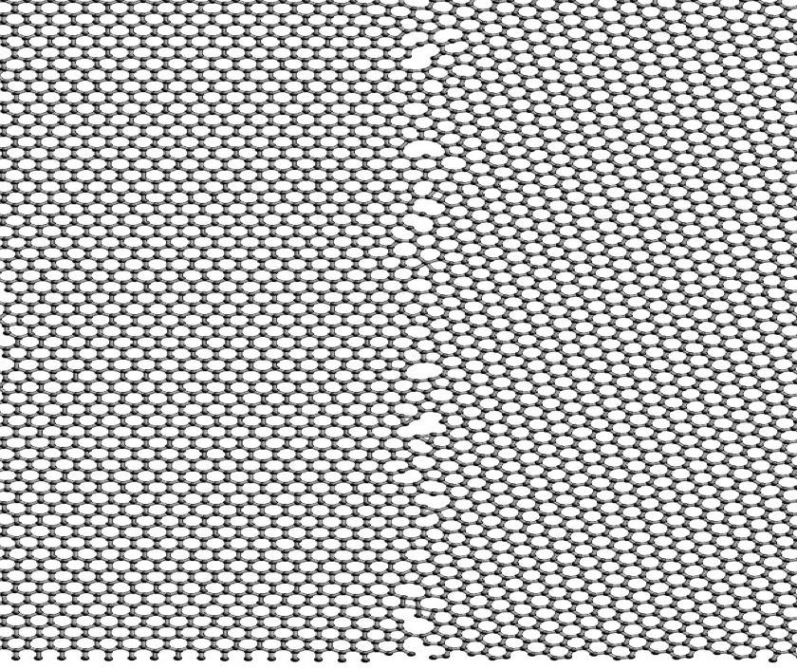
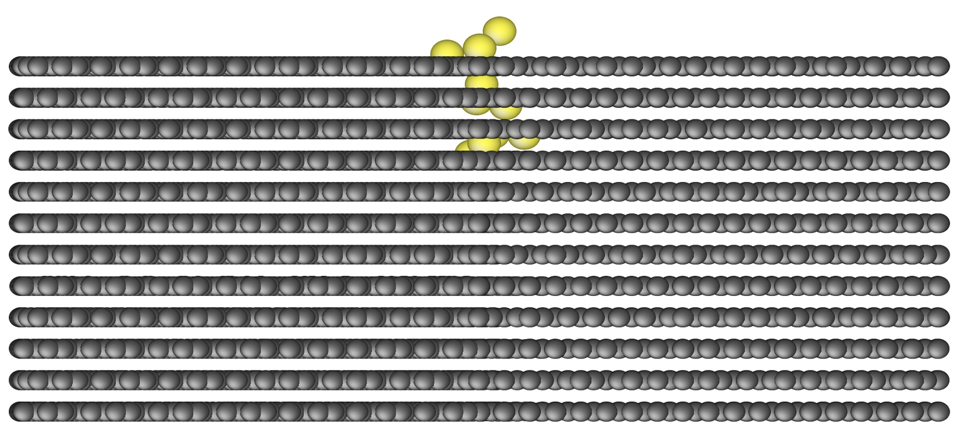
Li ‘Dopants’ in Graphite GBs
Separate work is investigating Li transport in graphite GBs to connect with anodic materials for energy storage applications.
Pre-addition of Li
Li aggregated at GB on free surface
Li entering GB in graphite

Slide 19
Next Six Months (Ni-Bi)
Converge on an optimized Ni-Bi model.
In parallel with this effort, deploy production ready MC free surface and GB adsorption structure equilibration code.
Compute free surface adsorption structures as well as GB structures for both ‘additive’ GBs and a special (Σ3) GB in Ni.
Initiate general GB adsorption studies.

