Slide 1
Tailoring of Atomic-Scale Interphase Complexions for Mechanism-Informed Material Design
Office of Naval Research Multidisciplinary University Research Initiative Project
Review Meeting, Thursday December 15th 2011
ONR Topic Chief: David Shifler
Ni Based Systems

Slide 2
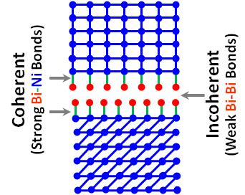
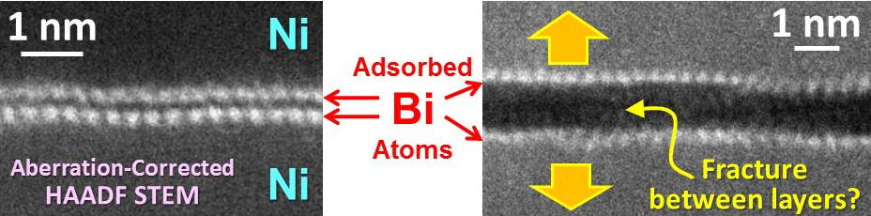
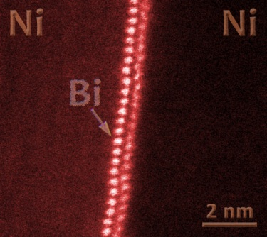
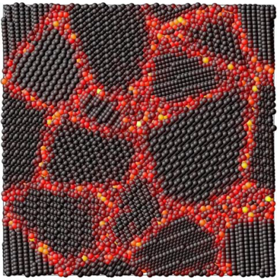
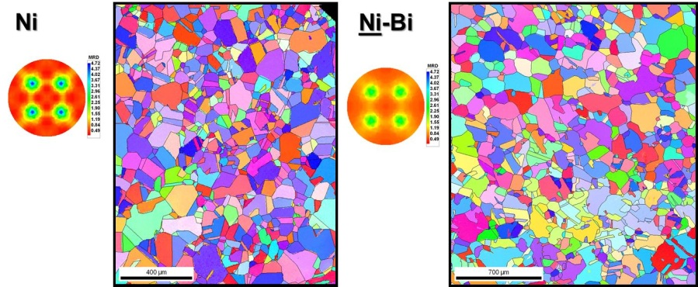
Outline
Updates on “Ni Based System” (Experimental Results from Lehigh-Clemson-CMU-UIUC)
Thermodynamic Models of Segregation: Classical vs. New?
The Unrecognized Roles of Interphases (Complexions)
in Embrittlement
A Bilayer Interfacial Phase
Impacts on Grain Growth (GG)
& GB Character Distribution
Doping: Promoting GG vs. Stabilizing Nano?
nanocrystalline
Ni-W
made by electrodeposition
Mayr & Bedorf PRB 2007
(MD for Cu-Bi)
Key Q’s: The “big picture”? Generalizable to other systems?

Slide 3
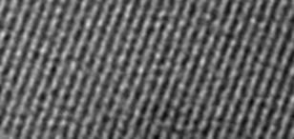
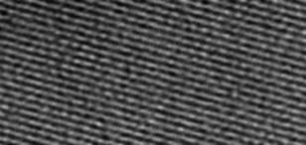
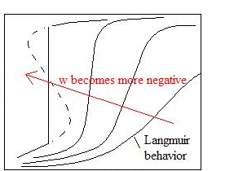
The Classical Grain Boundary (GB) Segregation (= Adsorption) Models
McLean-Langmuir “Monolayer” Adsorption
Fowler-Guggenheim (1939)
“Monolayer”
Γ
1st order if
Intrinsic
(nominally “clean”)
X_{C}
Hondros-Seah (BET like multilayer adsorption)
Continuous transitions; Assuming that adsorbates are pure B
All developed via surface-GB analogies…

Slide 4
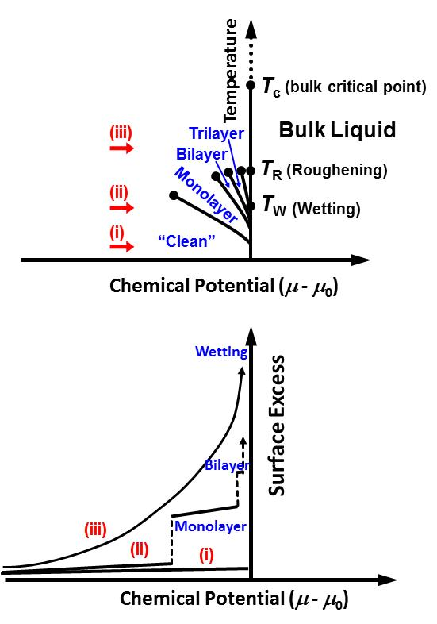
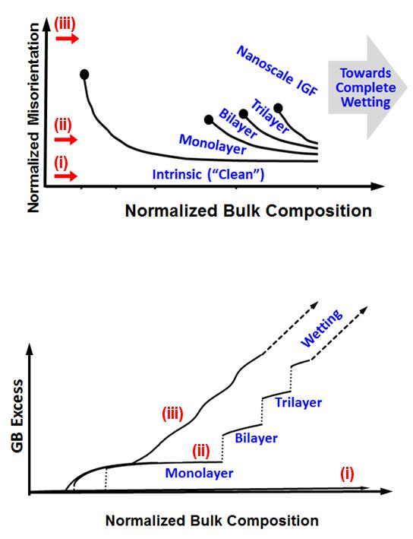
Understanding the Origins of Complexions from…
A Surface-Grain Boundary (GB) Analogy
Surface Adsorption of
Inert Gas on an Attractive Substrate
Analogous?
Grain Boundary Phase Behaviors
Pandit, Schick, Wortis, Phys. Rev. B, 26: 5112 (1982)
Luo, App. Phys. Lett. 95: 071911 (2009)

Slide 5
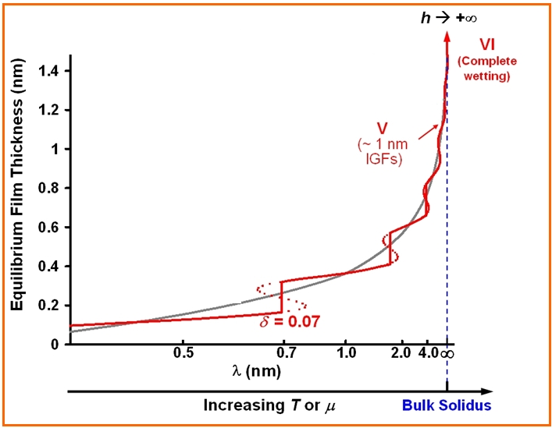
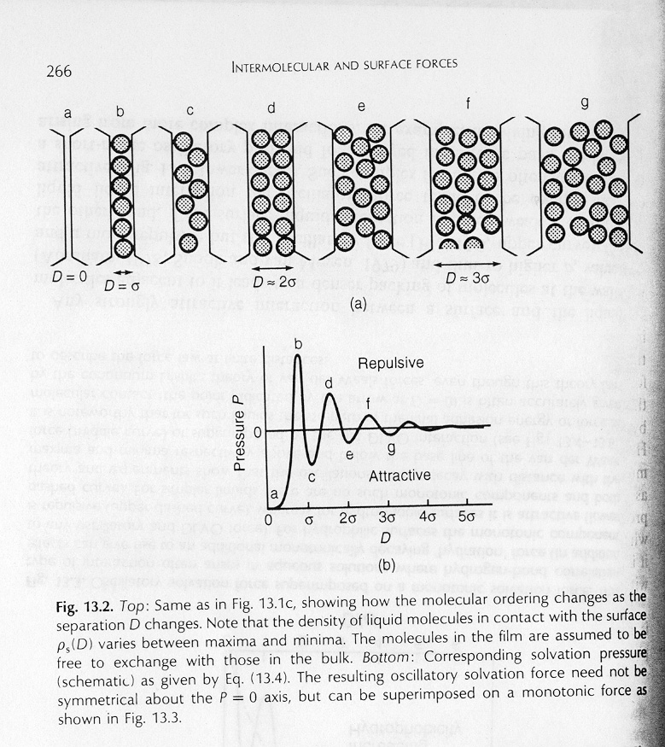
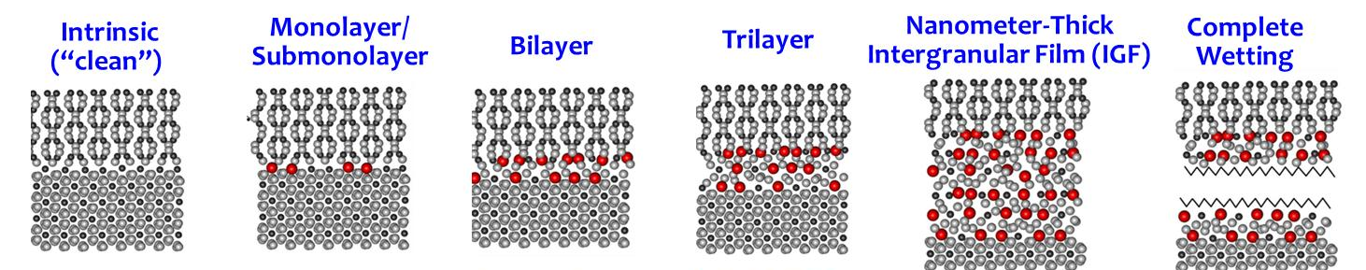
Origin of Complexions – Alternative Interpretation
“All roads lead to Rome”
Introduce a structural oscillatory force (well-known in colloidal theories):
(Israelachvili, Intermolecular and Surface Forces, 1994)
Luo, Current Opinion in Solid State & Materials Science 2008
Additional discrete
“GB phase”
Complexions (generic GB phases)
Dillon, Tang, Carter & Harmer
Acta Mater. 2007
Interfacial Width ↓ Adsorption ↓ Structural Order ↑

Slide 6
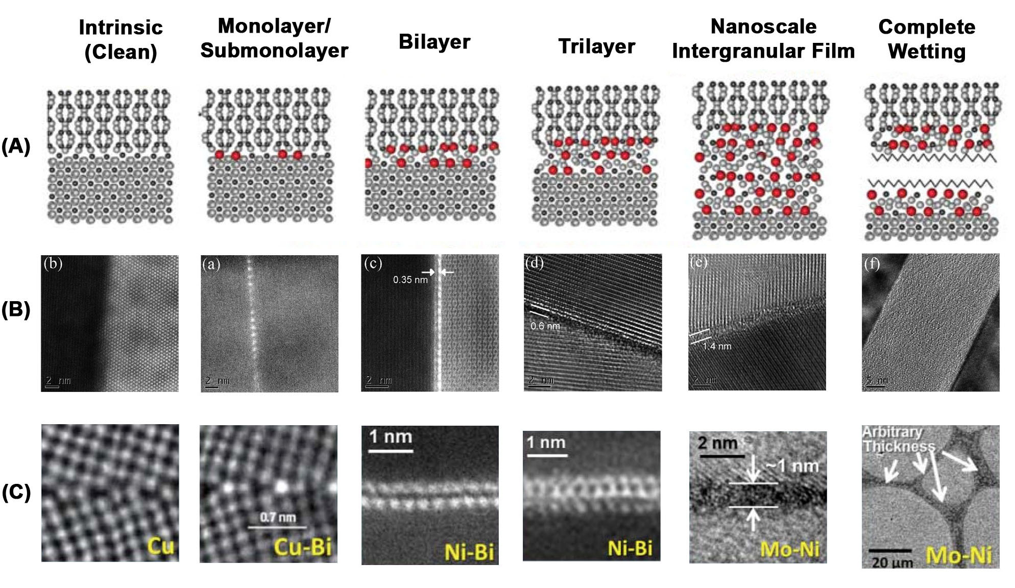
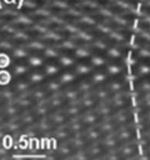
The Knowledge Gap
(Before Our Ni-Bi Study…)
Well-Known
“Moist”
(R.M. Cannon)
Prewetting and/or Premelting
“Equilibrium” Nano Thickness
Complete Wetting
“Arbitrary” Thickness
Well-Known
Discrete Thickness
Continuous h ~ nm
h → +∞
Ceramic
?
?
Metal
Al-Ga
(Special GB,
Ga implanted)
Interfacial Width ↓ Adsorption ↓ Structural Order ↑
All are GB embrittlement systems…

Slide 7
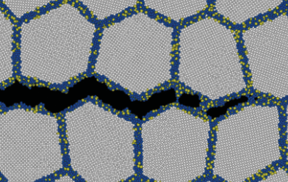
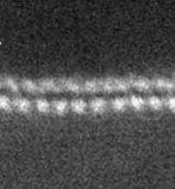
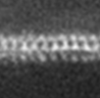
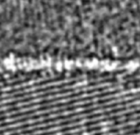
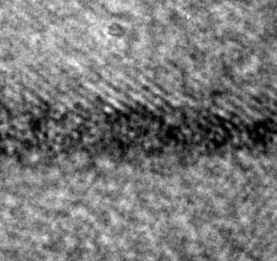
Re-appraisal of GB Embrittlement Mechanisms
for high-T’s and/or high dopant/impurity activities?
Classical GB Embrittlement Models
Built on Langmuir-McLean Adsorption
Beyond Monolayer?
Ni-S (Indirect Evidence)
Reduction of cohesion due to:
Electronic effect (weakening the bonds);
Atomic size (strain) effect; or
Changing relative γ’s (the Rice-Wang Model)
S induced
GB “melting”
S segregation
GB “melting” if C_{S}^{GB} > 15%
GB Embrittlement
Atomistic Simulation: Chen et al., PRL 2010
Auger: Heuer et al., J. Nuclear Mater. 2002
Discrete Thickness
Nanometer “Equilibrium” Thickness
1 nm
1 nm
2 nm
2 nm
Ni-Bi
Ni-Bi
W-Ni
Mo-Ni
Science 2011
Acta Mater. 55, 3131 (2007)
APL 94, 251908 (2009)

Slide 8
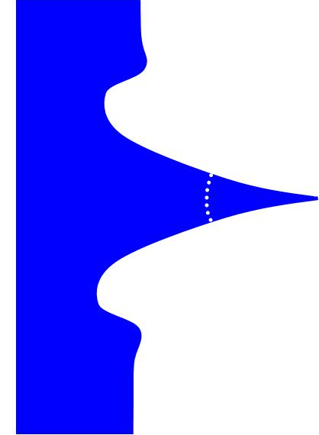
Liquid Metal Embrittlement
Intrinsically ductile metals, such as Al, Cu and Ni, are prone to catastrophic brittle intergranular fracture at unusually low stress levels when exposed to certain liquid metals, such as Bi, Ga, Zn and Pb.
Solid Polycrystal
φ
Liquid Metal
L ≈ 10² μm
Macroscopically-long (often > 100 L) -- This is the embrittled region!
Model Systems: Ni-Bi, Cu-Bi & Al-Ga
Technological Relevance: hot dip galvanizing; welding; safe uses of liquid metal in as coolants in nuclear reactors or spallation target systems for nuclear waste incineration
Must related to GB adsorption at GB in front of the liquid tips
Atomic-level mechanism is a subject of scrutiny & debate for ~100 yrs
B. Joseph et al., The European Physical Journal: Appl. Phys; 5 (1999) 19-31.

Slide 9
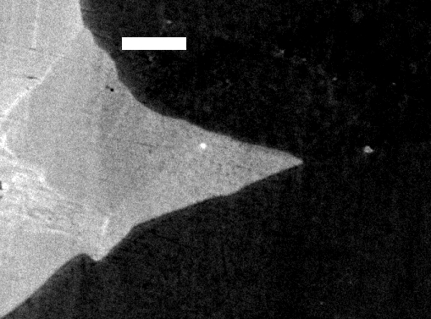
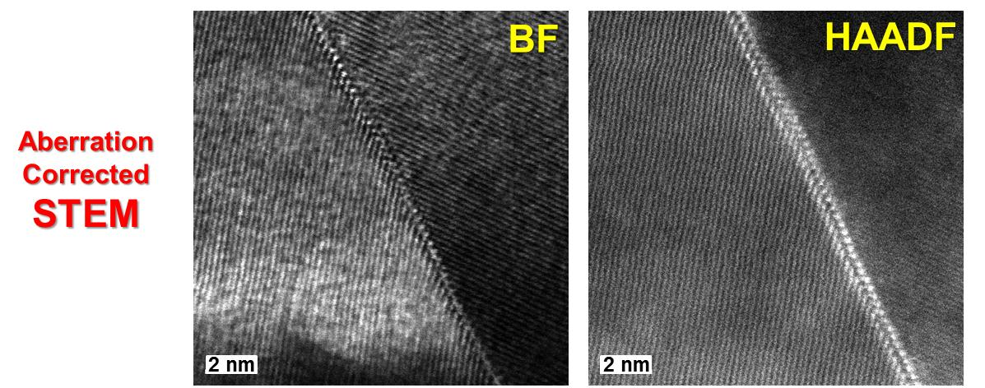
Characterization of a Model System: Ni-Bi
Science 2011
HRTEM
2 nm
5 μm
Ni
Grain Boundary
Bi-Ni
φ
FIB
Quenched from
700 °C
Ni

Slide 10
The Bilayer Interfacial Phase
Science 2011
Fractured during TEM
(between the two layers)
specimen preparation?

Slide 11
Compositional Analysis
Science 2011

Slide 12
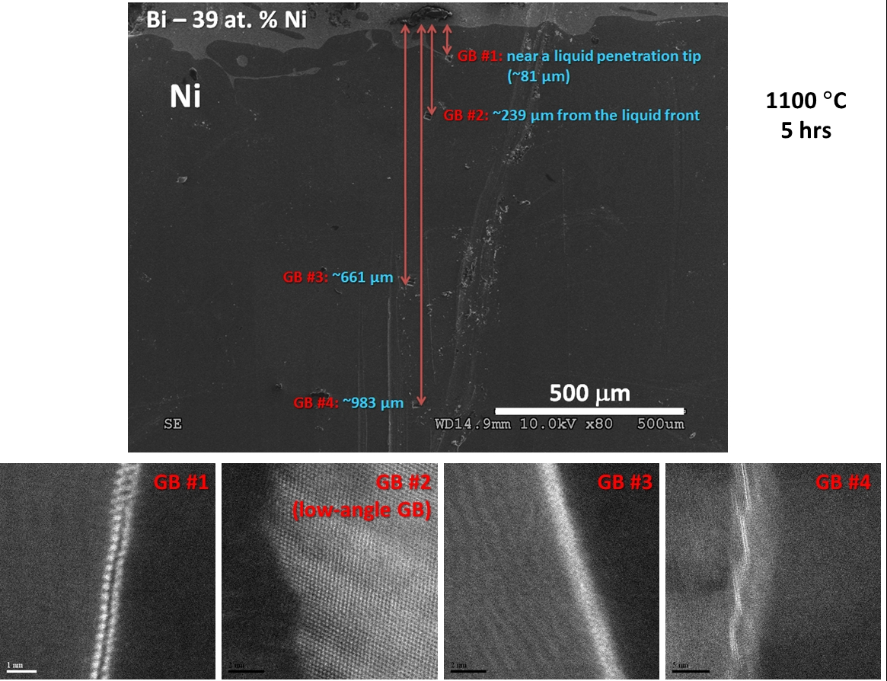
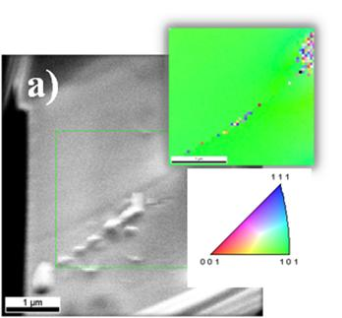
Multiple Locations in the Same Specimen
Science 2011

Slide 13
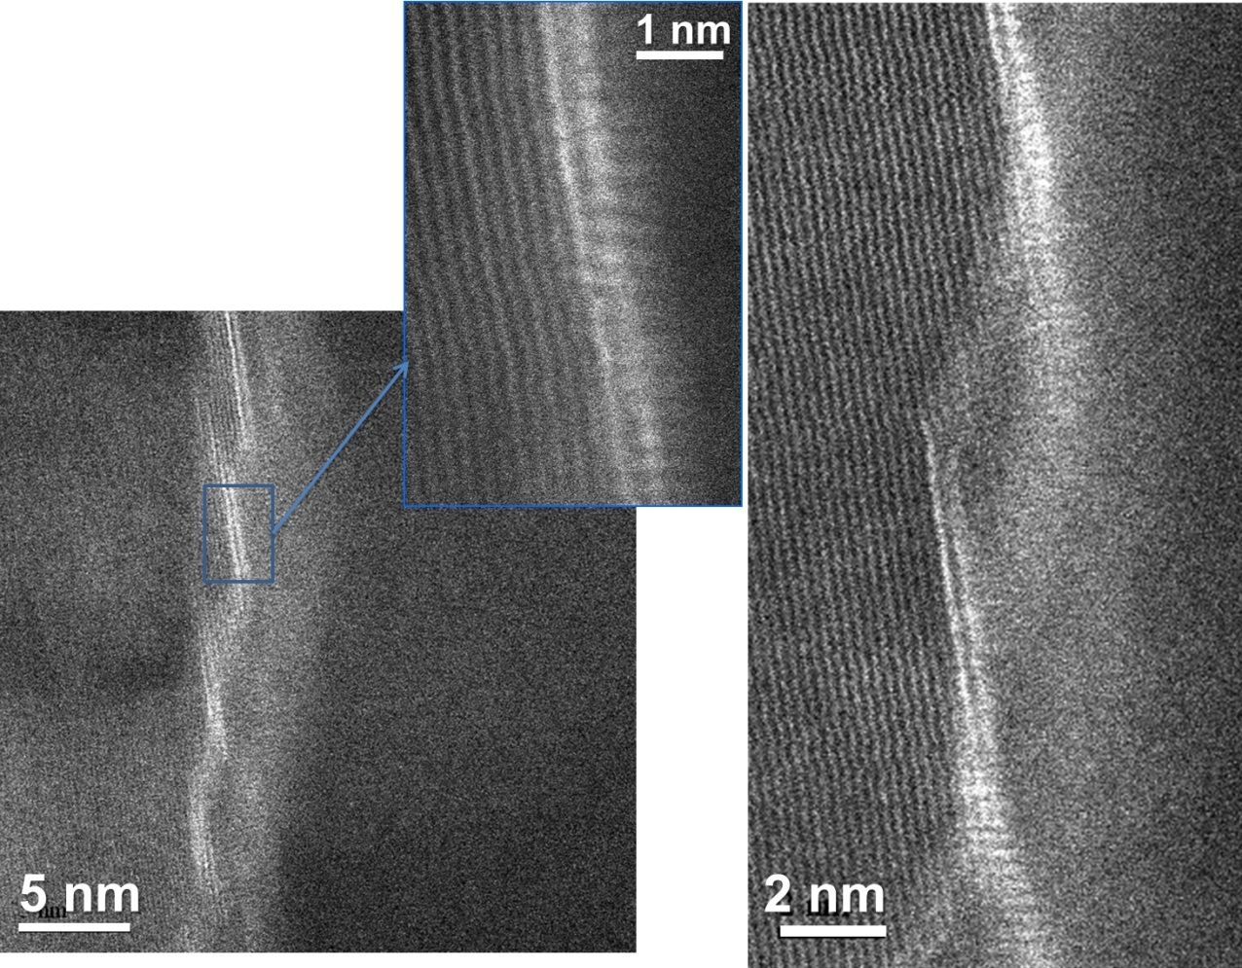
Bilayers on a Faceted GB
Science 2011

Slide 14
Schematic Summary of Key Observations
Science 2011

Slide 15
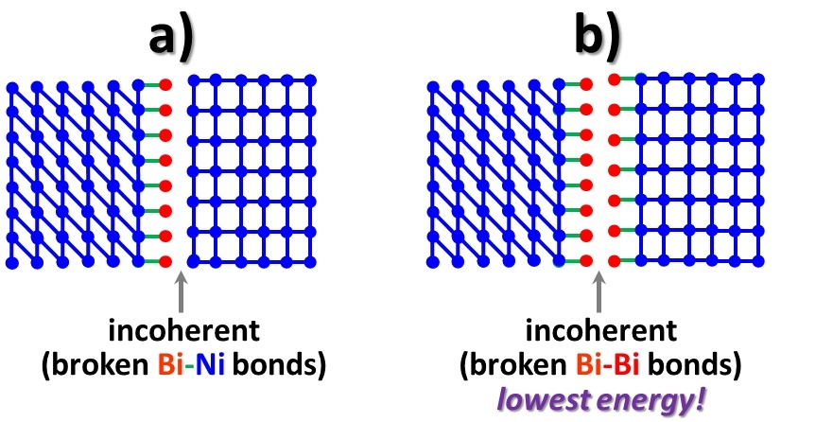
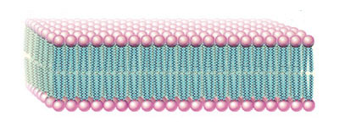
Why Bilayer?
Science 2011
The Miedema Model: Formation enthalpy for a Bi_{0.5}Ni_{0.5} alloy = -3.7 kJ/mol
Strong Ni-Bi: ½|E_{Ni-Ni}| + ½|E_{Bi-Bi}| < |E_{Ni-Bi}|
Weak Bi-Bi: |E_{Bi-Bi}| << |E_{Ni-Ni}|
Structural Frustration
“High-Temperature Lipids”?

Slide 16
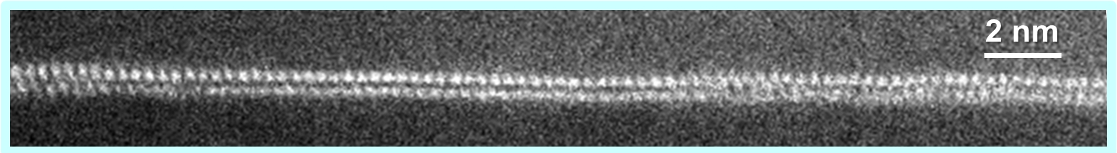
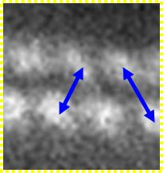
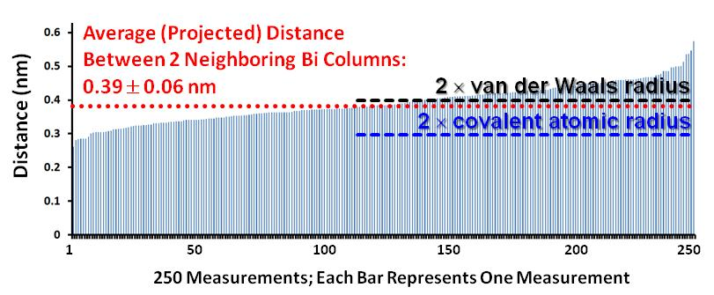
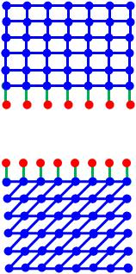
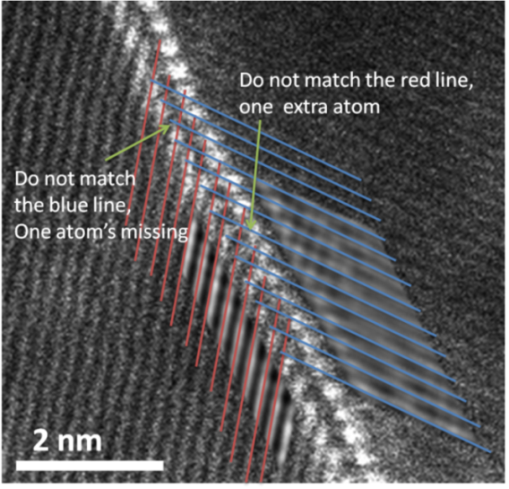
Ni grain
Adsorbed Bi
Ni grain
Adsorbed Bi
Bilayer Structure
→ Embrittlement
Verified by HAADF STEM
Energetically
The Most Favored!
Virtually no relaxation
Some Bi-Bi vdW bonds?
Strong Ni-Bi: ½|E_{Ni-Ni}| + ½|E_{Bi-Bi}| < |E_{Ni-Bi}|
Weak Bi-Bi: |E_{Bi-Bi}| << |E_{Ni-Ni}|
Each Bi layer coherently adsorbed on the adjacent Ni grain
Incoherent between the 2 Bi layers

Slide 17

1 Bilayer ≠ 2 Identical Monolayers
As the editor noted This Week in Science: “The bismuth atoms penetrated along nickel grain boundaries and formed single-layer complexes on either side of the boundary. The bismuth atoms then bonded to the nickel much more strongly than to each other, causing the nickel to become brittle.”
Why different intensities (sometimes)?
..because the two grain surfaces of a “general GB” have different “densities” of adsorption sites…

Slide 18
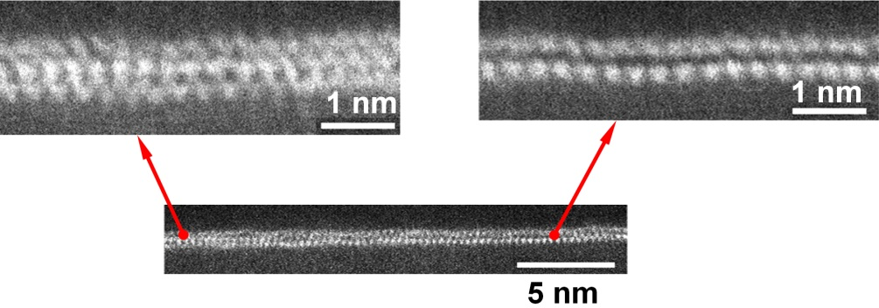
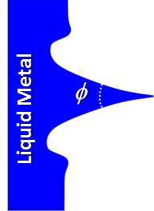
A Single Observation of a Trilayer…
Science 2011
A possible GB (Phase) transition?
The transition to a “clean” GB?
May be a metastable phase “motivated” by a local tensile generated by liquid penetration…
[L. Klinger, E. Rabkin, Script Mater. 2010.]
More conclusive assessments are unwarranted with a single observation…

Slide 19
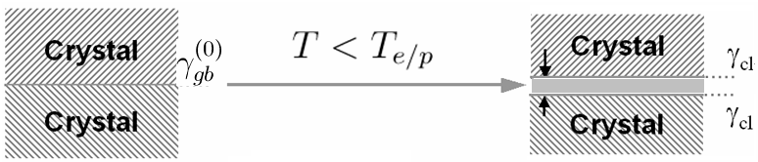

Phenomenological Interfacial Thermodynamic Model:
Sharp-Interface Premelting/Prewetting Type Model
h
not uniform;
neither true “liquid” nor fully crystalline…
Combining
The excess free energy:
Interfacial forces
Interfacial coefficient
Consider ordering & gradients here…
Equilibrium thickness (h_{EQ}):
Thermodynamically… one interface, NOT two…
2γ_{cl} well defined if h → ∞

Slide 20
An Alternative Way …
Strong Ni-Bi: ½|E_{Ni-Ni}| + ½|E_{Bi-Bi}| < |E_{Ni-Bi}|
Weak Bi-Bi: |E_{Bi-Bi}| << |E_{Ni-Ni}|
Virtually no relaxation
Some Bi-Bi vdW bonds?
γ_{s}^{(mono-Bi)}
-B (“binding energy”)
γ_{s}^{(mono-Bi)}
Small…
Further first-principle calculations & atomistic simulations will help to quantify

Slide 21
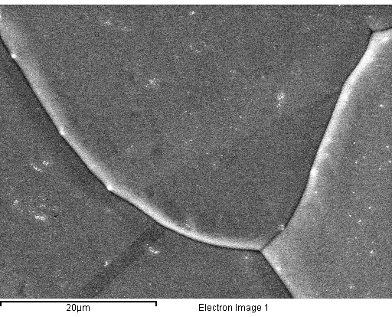
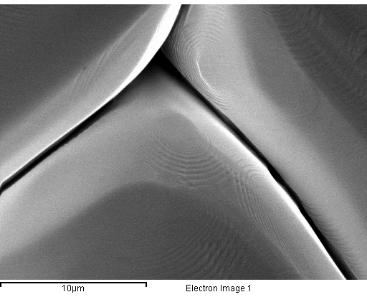
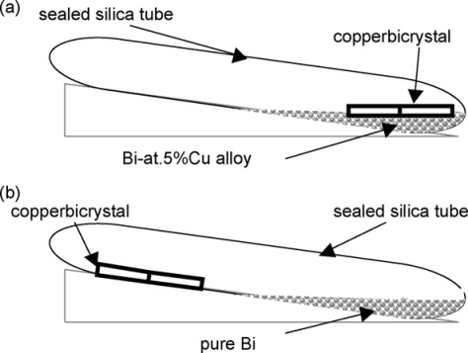
CMU Experiments on a Second Set of Specimens…
The Effect of Bi on the Surface Morphology of Ni
Ni, 700 °C × 15 h (without Bi)
Ni, 700 °C × 15 h in Bi vapor
A prior study by Wolski & Laporte [MSEA 495 (2008) 138] showed that annealing in contact with Bi liquid and Bi vapor led to similar GB chemistries (measured by Auger), at least for Cu bicrystals)
Two distinct features:
Bi adsorption → faceting
Some extremely deep grooves
Both can be well explained by the model discussed previously

Slide 22
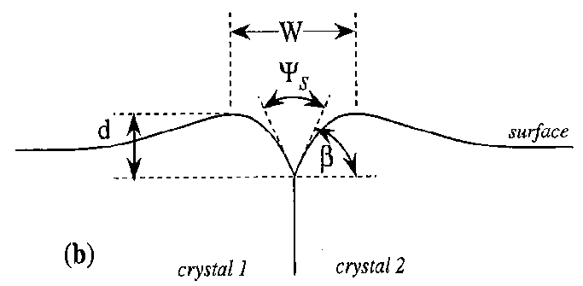
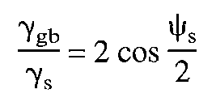
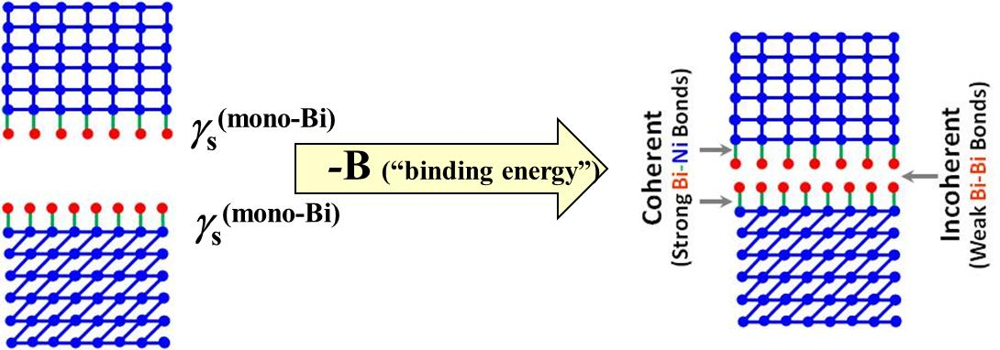
CMU Experiments on a Second Set of Specimens …
Two Distinct Features – Explained by Our Model
1) Bi adsorption → faceting
Ni, 700 °C × 15 h in Bi vapor
Strong Ni-Bi: ½|E_{Ni-Ni}| + ½|E_{Bi-Bi}| < |E_{Ni-Bi}|
Weak Bi-Bi: |E_{Bi-Bi}| << |E_{Ni-Ni}|
Bi serves as a “surfactant”
Closed-packed surface orientations are stabilized because they allow more Bi adsorption to reduce γ → faceting
2) Deep grooves
(= small ψ_{S})
Binding energy
between 2 Bi layers
Virtually no relaxation
Some Bi-Bi vdW bonds?
Small!
Ignore
Anisotropy:

Slide 23
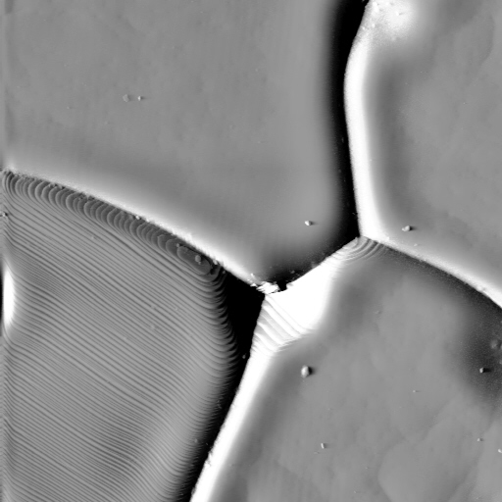
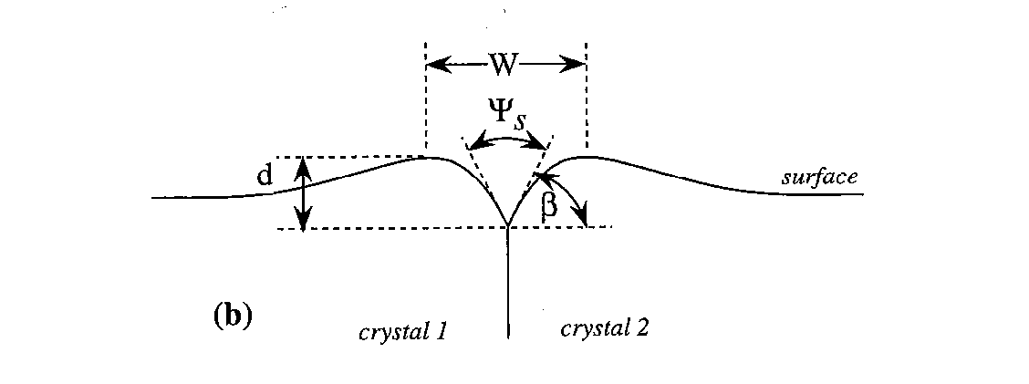
CMU Experiments on a Second Set of Specimens …
Atomic Force Microscopy (AFM)
Using the AFM: determine the relative energy of the grain boundaries
Measure the width and depth of the grain boundary, infer the dihedral angle and the relative grain boundary energy by the equation
D.M. Saylor and G.S. Rohrer, J. Amer. Ceram. Soc. 82 (1999) 1529.

Slide 24
CMU Experiments on a Second Set of Specimens
Measured γ_{gb}/γ_{s}
Binding Energy
Virtually no relaxation
Some Bi-Bi vdW bonds?
1
.
0
0
.
9
Undoped Ni
Mean = 0.2523
Median = 0.2628
Min = 0.06
Max = 0.71
0
.
8
0
.
7
0
.
6
Cumulative Probability
Bi-doped Ni
Mean = 1.04
Median = 1.08
Min = 0.27
Max = 1.61
0
.
5
0
.
4
0
.
3
0
.
2
0
.
1
0
.
0
0
.
0
0
.
5
1
.
0
1
.
5
2
.
0
γ_{gb}/γ_{s}
Ignore anisotropy:

Slide 25
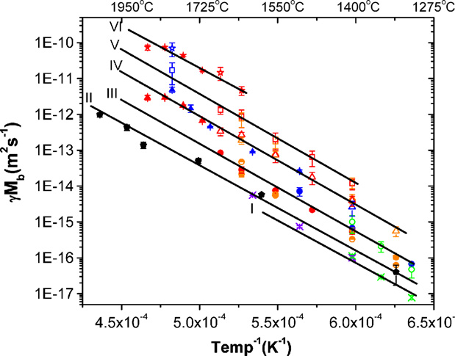

Bilayers: Promote or Inhibit Grain Growth (GG)?
Some Background & Motivations…
On one hand…
On the other hand…
Stabilization of Nanocrystralline Metals via Doping
Concept/Model:
  Weissmuller (1994)
  Liu & Kirchheim (2002)
Pd-Zr
Fe-Zr
Ni-P:
  Kirchheim et al. (2000)
Ni-W:
  Yamasaki (2000)
  Schuh group (~2007ff)
Ni-Cu
  Pellicer et al., 2011
  Cu-Bi (atomistic modeling)
  Mayr et al.
  Millett et al.
Al₂O₃
Wetting
Nano IGF
Intrinsic
Trilayer
Bilayer
Monolayer
Dillon, Tang, Carter & Harmer
Acta Mater. 2007
Mayr & Bedorf
PRB 2007

Slide 26
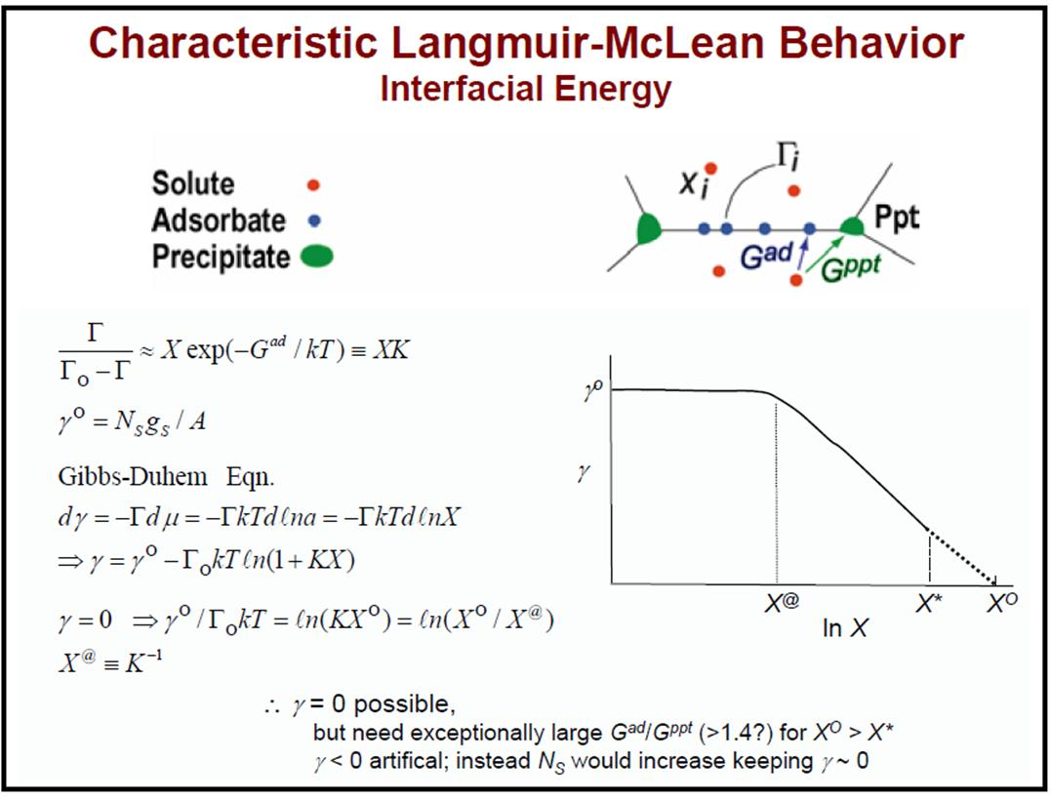
Stabilization of Nanocrystralline Metals via Doping
The Theories
Kinetic Stabilization
Solute drag
Second phase pinning
Chemical ordering
…
The complexion theory argued that segregation induced interfacial disordering can increase GB mobiles (demonstrated in Al₂O₃, Al-Ga etc.)
competing
Thermodynamic Stabilization (reducing γ_{GB} to ~ 0?)
A slide from the late
Dr. Rowland Cannon
(2004 GRC)
A GB “phase” transition
(beyond monolayer)?

Slide 27
Bi Bilayer Adsorption → Significant Reduction of γ_{GB} (Reducing the Driving Force for Grain Growth)
Miedema-Type Statistical Models
Average general Ni (“clean”)
Experimental: 0.92 J/m²
(700 °C, 99.999 wt. % Ni)
Interfacial energy (Ni & Bi-Ni liquid)
(700 °C)
But NOT complete wetting because…
Gibbs Isothermal
Decrease to ~1/4 due to bilayer adsorption of Bi
Measured average dihedral angle
44.7° (at 700 °C)
φ
Bi-Ni Liquid
First-principle calculations & atomistic simulations will help to confirm…

Slide 28
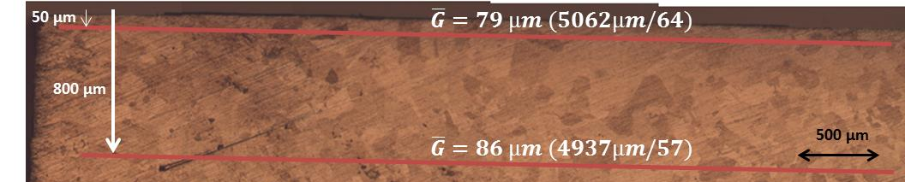
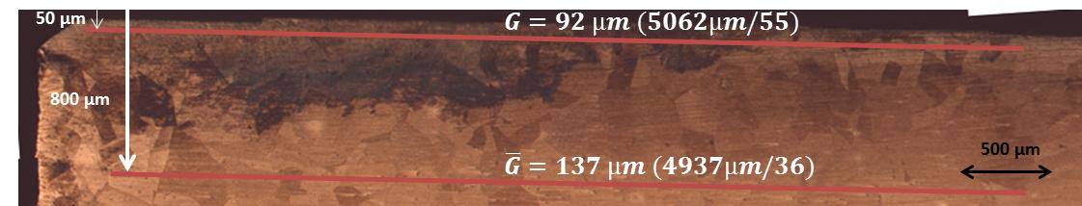
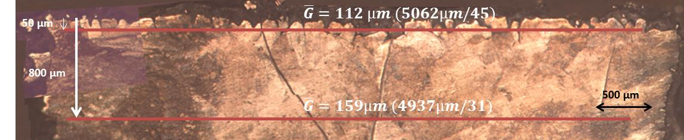
Bi Bilayers Appear to Promote Grain Growth (Slightly)
Despite a Reduction of the Driving Force (γ_{GB}) by ~4X
Ni foil –
as-received
Ni foil
annealed
without Bi
(1100 °C, 5 hrs)
Ni foil annealed
in contact with a Bi-Ni liquid
(1100 °C, 5 hrs)
Verified independently by CMU w/ specimens annealed in Bi vapor (later slides)
Consistent with Dillon and Harmer’s observations/theory for Al₂O₃.

Slide 29
On-Going Work… Specimens Prepared at Clemson →
EBSD/GBCD Characterization in Progress at CMU
(initial) grain size: ~75μm
Bi-39 at. % Ni liquid
Annealed at 1100 °C, for 5 hrs
in 5 % H₂ balanced by Ar
Ni (free-standing foil, sit on a crucible)
~2 mm
> 2 cm
Then…
Remove the extra solidified Bi-Ni
Cut the unexposed part
Polish off the top layer of ~ 300 μm
Ni foil
Glue it
A ridge substrate

Slide 30
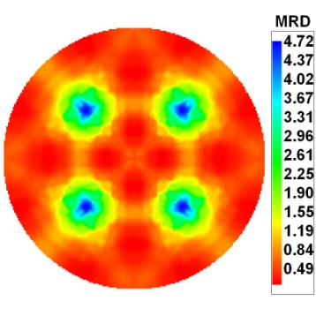



CMU Experiments on a Second Set of Specimens…
Microstructure & GBCD Evolution in Pure Ni
700 °C for 15 h (pure Ni)
<g> = 19 μm
930 °C for 3 h (pure Ni)
<g> = 36 μm
6577 measured grains
22,965 line segments
8950 measured grains
25,749 line segments
No change in GBCD with grain size. Strong anisotropy and preference for {111} GB type because of coherent twins.

Slide 31


CMU Experiments on a Second Set of Specimens…
The Effects of Bi Adsorption on Grain Growth
Ni, 930 °C × 3 h (without Bi)
Ni, 930 °C × 3 h in Bi vapor
<g> = 36 μm
Promote GG
<g> = 57 μm
No abnormal grain growth (presumably because bilayers form at virtually all general GBs…) – Mesoscale simulations may help clarify…
Consistent with observations made in Clemson specimens using liquid Bi-Ni
Bi bilayers promote grain growth despite a reduction of the driving force (γ_{GB})
  Increase the mobility substantially despite solute-drag & apparent ordering…
Consistent with Dillon and Harmer’s observations/theory for Al₂O₃.

Slide 32



CMU Experiments on a Second Set of Specimens…
The Effects of Bi Adsorption on GBCD
Ni, 930 °C × 3 h (without Bi)
Ni, 930 °C × 3 h in Bi vapor
Decrease in anisotropy of GBCD with doping: less {111} planes than in pure Ni
The General Trend…
The GB population is inversely proposed to γ_{GB}.
Thus, adsorption reduce the differences in γ_{GB} → reduce the anisotropy in GB plane distribution because
E.g., {111} twins may NOT exhibit bilayers
With a GB Transition…
Clean GB
Bilayer
No bilayers for special GB,
e.g., small-angle GBs or {111} twins

Slide 33


Specimens Prepared at Clemson → HAADF-STEM at Lehigh (Bilayer Observed)
→ GB Diffusivities Measured at UIUC
bilayer observed by HAADF-STEM
(at this exact GB)
Bi-doped Cu (details in the next talk)
in progress…

Slide 34


Promote vs. Inhibit Grain Growth?
Some More Background …
Ni-W?

Slide 35

Comparison: Ni-Bi vs. Ni-W
Miedema Model:
ΔH_{mix}^{(50%Ni-50%Bi)} = -3.7 kJ/mol
ΔH_{mix}^{(50%Ni-50%W)} = -4.67 kJ/mol
1100 °C
Bi
Ni
W
Ni
Low melting;
Strong segregation
High melting;
Weak segregation
Inhibit GG?
Hypothesis?
Promote GG?

Slide 36



Ni-W:
Electrodeposited Specimens Made at Clemson
10um
Thickness : 45 µm
H2O 500mL
NiSO₄·6H₂O 7.89g (0.06M)
Na₃C₆H₅O₇·2H₂O 44g (0.3M)
NaBr 7.725g (0.15M)
Na₂WO₄ · 2H₂O 23.25g (0.14M)
NH₄Cl 13.25g (0.5M)
  Similar to the Yamasaki (2000) recipe
HanSeung Park & Jian Luo

Slide 37
Ni-W:
Electrodeposited Specimens Made at Clemson
0.3
0.3
S. D.
 | at.% W | FWHM | 2-theta | XRD Grain Size
Pure Ni film | 0% | 1.1138 | 44.68 | 7.7nm
0.07M Na₂WO₄·2H₂O | 15.6% | 2.2640 | 43.70 | 3.7nm
0.14M Na₂WO₄·2H₂O | 22.47% | 3.3043 | 44.36 | 2.5nm
0.21M Na₂WO₄·2H₂O | 20.3% | 3.3820 | 44.00 | 2.5nm
HanSeung Park & Jian Luo

Slide 38

Nanocrystalline Ni + ~20%W – Thermal Stability
 | FWHM | 2-theta | XRD Grain Size
As-deposited | 3.3043 | 44.36 | 2.5nm
400 °C, 6 hrs | 1.4329 | 43.76 | 5.9nm
600 °C, 6 hrs | 0.4330 | 43.62 | 19.7nm
Currently On-Going Tasks
(Preliminary Characterizations)
HAADF-STEM at Lehigh
GBCD at CMU
Worthy to be investigated further?
HanSeung Park & Jian Luo

Slide 39
Concluding Remarks
The observations of bilayers (and a trilayer) in Ni-Bi fills a critical knowledge gap to support the generality of the new complexion theory
Phenomenological interfacial thermodynamic models can be used to explain and justify all observations…
  Yet, further first-principle calculations, atomistic modeling and mesoscale simulation are needed and in progress…
The observation of Ni-Bi, along with several other earlier reports, calls for a re-appraisal of the classical GB embrittlement (and liquid metal embrittlement) models to consider structural transitions and adsorption beyond the Langmuir-McLean model.
The roles of “GB interphases” (segregation) in controlling grain growth and microstructure evolution in Ni and other metals (including the possibility of stabilizing nanocrystalline metals via doping and the mechanism of abnormal grain growth) should also be scrutinized.
We should consider the “big picture” beyond one system and one dopant to develop general models extendable to a wide range of materials systems.

Slide 40
Backup and Additional Slides

Slide 41
Exclude Imaging Artifacts…
Science 2011
A series of images were obtained at different defocus values to ensure that the observed bilayers are NOT monolayer adsorbates on an atomic step.
Since this bilayer interfacial phase was observed at 6 GBs from different specimens (11 faceted GB segments), it is unlikely that each random GB exhibits a zigzag structure or has exactly one atomic step.
The epitaxial analysis (shown later) also indicate that the observed bi-layer adsorption is not an artifact.
Through-Focus Series

Slide 42
Multiple Specimens…Multiple GBs
Science 2011
Characterized
7 independent GBs
in 4 specimens;
12 independent facets in total
Only 1 low-angle GB does not exhibit a bilayer…
Specimen A (700°C × 1 hour);
Specimen B (700 °C × 5 hours);
Specimen C (1100 °C × 5 hours);
Specimen D (1100 °C × 5 hours; GB #1, near a tip);
Specimen D (1100°C × 5 hours; GB #3, ~661 μm away from the liquid front); and
Specimen D (1100 °C × 5 hours; GB #4, ~983 μm away from the liquid front).

Slide 43


CMU Experiments on a Second Set of Specimens …
Nickel and Bi-doped Ni Surfaces
facet
Undoped Ni
Bi-doped Ni

Slide 44


GBCD in Pure Ni and Bi doped Ni
λ(n) Distribution of grain boundary planes
Ni <g> = 36 μm
Bi doped Ni <g> = 57 μm
Decrease in anisotropy of GBCD with doping: Fewer {111} planes than in pure Ni

Slide 45

The Effect of Chemistry on the Relative Grain Boundary Energy
Bi doped Ni
Max = 6 x Min
Undoped Ni
Max = 12 x Min

Slide 46


Ni & NiBi
Sample Ni #7A (950C)
Sample NiBi #5 (950C)

Slide 47
Pure Ni, Population and Energy from 3D EBSD

Slide 48






Grain Texture in Pure Ni and Bi-Ni
[001]
Ni 700C, ~19.6 um
Ni 950C, ~35.6 um
NiBi 950C ~57 um
RD (100)
Grain orientation textures are consistent with the section plane for OIM analysis

Slide 49




Distribution of GB planes and energies in the crystal reference frame
(a)
(b)
Population, MRD
Energy, a.u.
(111) planes have the highest population and the lowest relative energy
Li et al., Acta Mater. 57 (2009) 4304
26
Notes:
Results for the Ni sample are illustrated here.
We can also look at specific misorientations

Slide 50




Distribution of GB planes and energies in the bicrystal reference frame
Σ3 – Grain Boundary
(a)
(b)
[010]
[100]
ln(λ(n|60°/[111]), MRD)
γ(n|60°/[111]), a.u.
Li et al., Acta Mater. 57 (2009) 4304
27
Notes:
These are the relative areas and energies of all of the grain boundary planes with the sigma 3 misorientation
We have done this for several materials and one general trend emerges

Slide 51




Distribution of GB planes and energies in the bicrystal reference frame
Σ9 – Grain Boundary
(a)
[110]
(b)
[010]
[100]
tilts
λ(n|38.9°/[110]), MRD
γ(n|38.9°/[110]), a.u.

Slide 52








Distribution of GB planes and energies in the bicrystal reference frame
Σ5 – Grain Boundary
(a)
(b)
[010]
[100]
λ(n|36.9°/[100]), MRD
γ(n|36.9°/[100]), a.u.
Σ7 – Grain Boundary
(c)
(d)
λ(n|38.2°/[111]), MRD
γ(n|38.2°/[111]), a.u.

Slide 53



Σ3 GB energies in Ni: simulation & experiment
Σ3 Grain Boundaries
Experimental
all Σ3 data:
R_{U} = 0.71, R_{W} = 0.95
exclude two outliers:
R_{U} = 0.80, R_{W} = 0.98
γ(n|60°/[111]), a.u.
EAM calculated
Rohrer et al., Acta Mater., 58 (2010) 5063.
γ(n|60°/[111]), J/m²
Notes:
The group at Sandia has computed the energies of 388 grain boundaries and the comparison very encouraging.
Here I am plotting the observed energies (a.u.) v. the EAM calculated energies for Ni for only the S3 GBs
(these are the GBs we have the most data on)
I think that there is an obvious positive correlation. Outliers associated with max in experiments, which are questionable.
We measure the relative areas better than the energies.
Extremely good correlation

Slide 54

Fig. S10. a) and b) SEM micrographs of fractured surfaces indicating the precipitation of isolated small Bi particles and the occurrence of triple line wetting. c) STEM HAADF micrograph of a nanoscale Bi precipitate at a GB. d) Cross-sectional SEM micrograph showing a gap in the penetrating liquid Bi film along a Ni GB.

