Slide 1
MURI Program Review, December 2012 Grain Boundary Character Distribution & Abnormal Grain Growth Carnegie Mellon University
Stephanie Bojarski, grad student
William Frazier, grad student
Greg Rohrer
Tony Rollett
Also: Sudipto Mandal, grad student

Slide 2
Outline
Motivation to Study Complexion Transition Kinetics
Results
- Relationship between boundary energy and complexion transition nucleation in Alumina
- Comparison of GBCD between Cu and Bi-Cu - Monte Carlo Modeling of Abnormal Grain Growth (AGG) - 2D - 3D - Hot Pressed Alumina - SPS Alumina - Nano-Ni - 3D Microstructures in Al-Mg for Corrosion Study w/ NRL

Slide 3
Motivation for Studying Complexion Transition Kinetics and Boundary Populations
COMPLEXIONS:
Are chemically and structurally distinct from the bulk material;
Have their own thermodynamic properties;
Cannot exist in bulk and must exist at an interface;
Like phases, can interconvert between each other;
Typically measured to have lower energy than normal grain boundaries, which is reflected in the relative boundary populations;
Often exhibit exceptionally high boundary mobility, enabling abnormal grain growth to occur.

Slide 4
Study relations between GB energy and complexion transition nucleation in Alumina
Experimental concept
Low (average) energy grain boundaries
High (average) energy grain boundaries
Consolidate samples by SPS
Evaluate average GB energies from thermal grooves
Allow grain growth to occur
Hypothesis is that the complexion transition (marked by larger grains) will nucleate on highest energy GBs
Al₂O₃(h’k’I’l’)
Al₂O₃ (hkil)
Al₂O₃(h’k’I’l’)
Al₂O₃ (hkil)
Heat, time

Slide 5
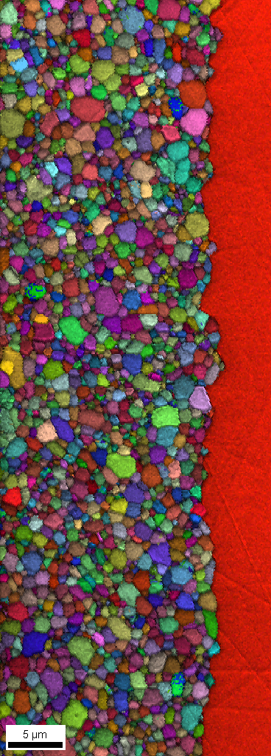
500 ppm Y-doped alumina via SPS
Groove 12 hour at 1300°C
A-Plane:
min: 0.29
max: 1.29
mean: 0.57
median: 0.52
std: 0.23
C
A
C-plane:
min: 0.15
max: 1.69
mean: 0.74
median: 0.68
std: 0.35
MRD
Thermal grooves indicate that the GBs defined by the c-plane have the higher energy
Consistent with GBCD (populations results)
Prediction is that large grains will nucleate on these interfaces
0.80 0.85 0.90 0.95 1.00 1.05 1.10 1.15 1.20
5μm 10μm
Low pop. High E
[010] IPF maps
High pop. Low E

Slide 6
500 ppm Y-doped alumina, SPS, anneal 1500 °C for 8h
Groove 12 hour 1300°C
C
A
[010] IPF maps
In this case, observations consistent with the hypothesis!

Slide 7
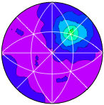
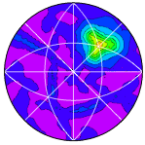
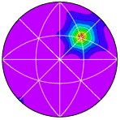
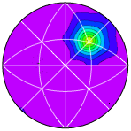
Comparison of GB populations in Cu and Bi-Cu
Grain boundary population is useful as a proxy for inverse grain boundary area
Pure Cu, 900 °C anneal
Cu-Bi, 900 °C anneal
Σ7 = 38.2 ° around [111]
Relatively high energy GBs increase in relative population with Bi adsorption
Σ3 = 60 ° around [111]
Lowest energy GBs decrease in relative population with Bi adsorption. Note different intensity scale.

Slide 8
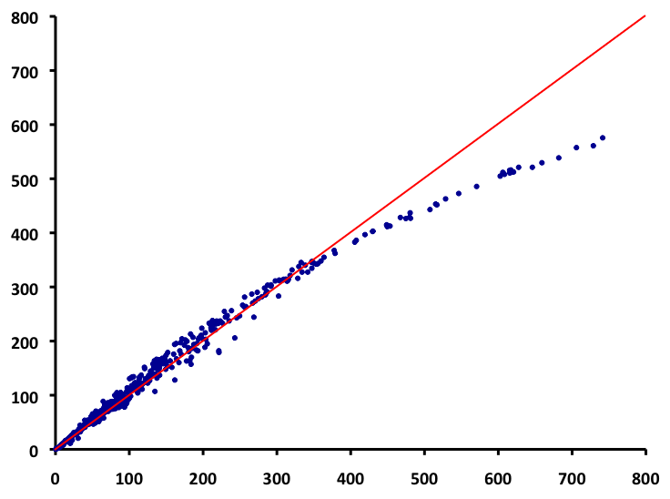
Comparing GBCD of Cu and Cu-Bi
Perfect correlation
GBs which have relatively higher energies in pure Cu appear more frequently in Cu-Bi, implying a reduced energy
Σ3 GBs, presumably clean, apparent decrease in population due to normalization
grain boundary relative area, Cu 900 °C, MRD
Follow-up: compute the segregation and boundary energy based on EAM potentials and/or 1st principles for a few representative types, e.g. Σ3 and Σ5
grain boundary relative area, Cu-Bi 900 °C, MRD
Results strongly suggest that Bi complexions in Cu GBs reduce boundary energy and compress the range of energies.

Slide 9
Methods for Studying Complexion Transition Kinetics
Examine changes in Grain Size Distribution (GSD) over time.
Examine changes in the size distribution of abnormal grains over time.
Examine AGG as a transformation/recrystallization process that can be described by Johnson-Mehl-Avrami-Kolmogorov (JMAK) kinetic analysis.

Slide 10
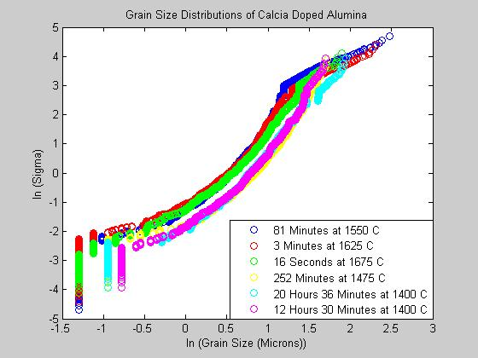
Results: Hot Pressed Ca-Doped Alumina

Slide 11
Monte Carlo Results – 2D

Slide 12
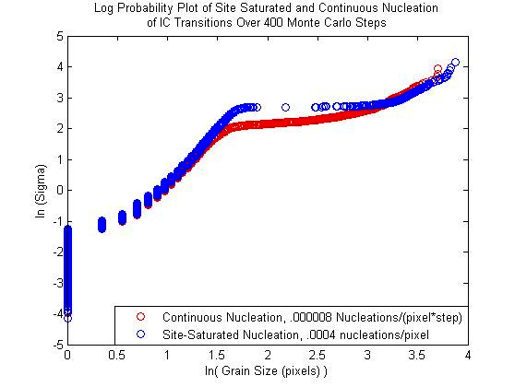
2D Monte Carlo Results – The Extreme Cases Log-Probability Plots of GSDs

Slide 13
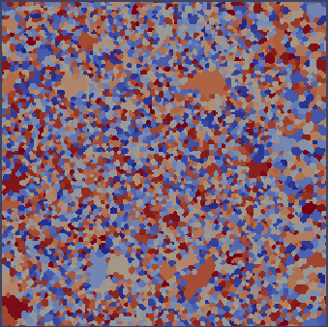
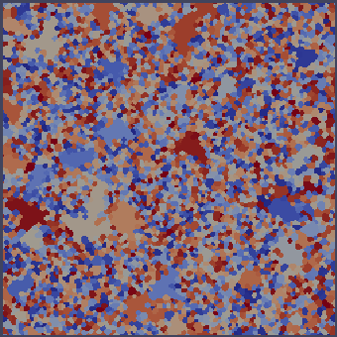
2D Monte Carlo Results – Continuous vs. Site-Saturated
Continuous, 500 Abnormal spins
Site Saturated, 500 Abnormal Spins

Slide 14
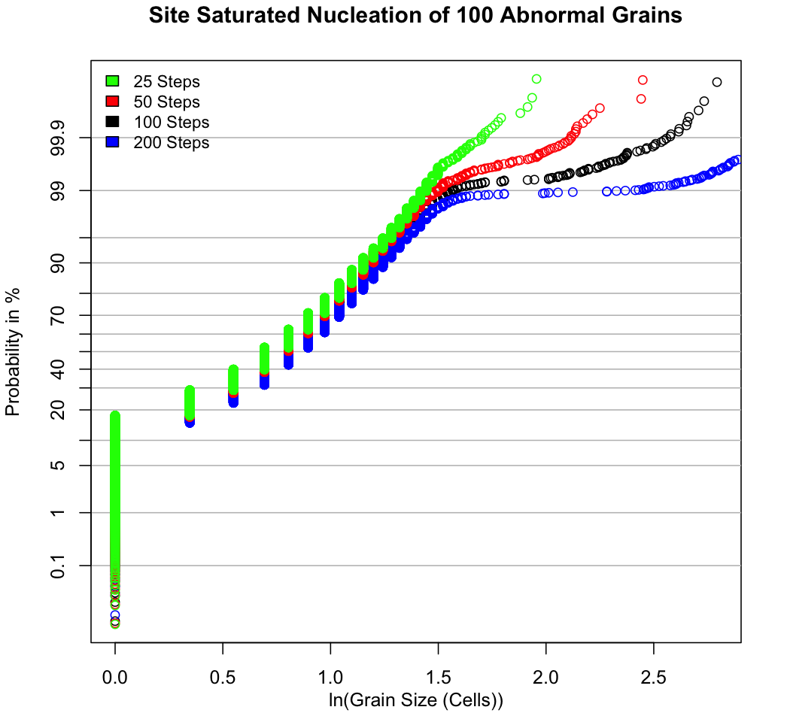
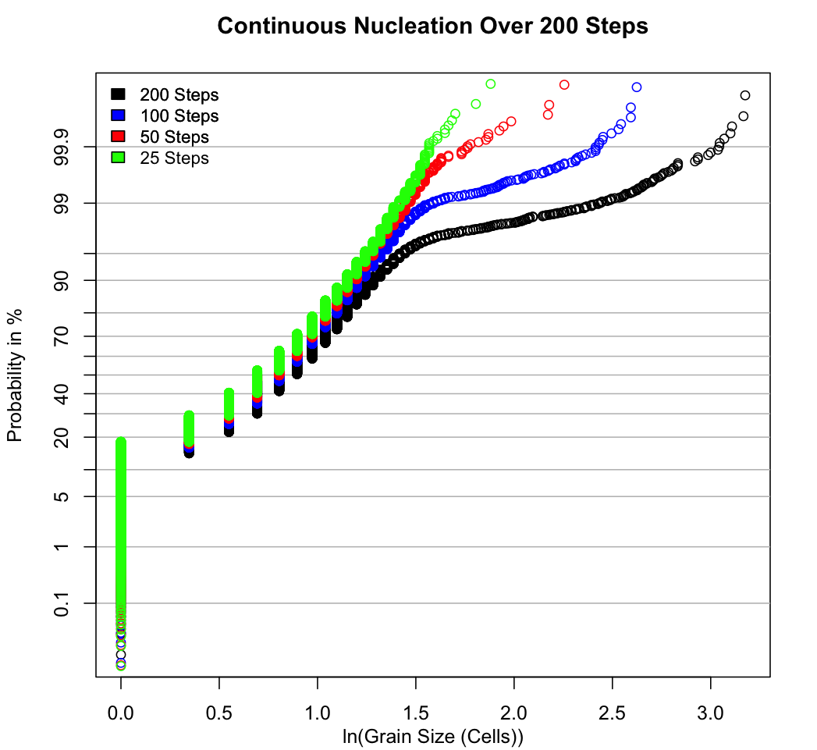
2D Monte Carlo Results – AGG Over Time
4*10⁻⁴ Nucleations/Pixel
8*10⁻⁶ Nucleations/(Pixel*Step)
time
time

Slide 15
Monte Carlo Results – 3D

Slide 16
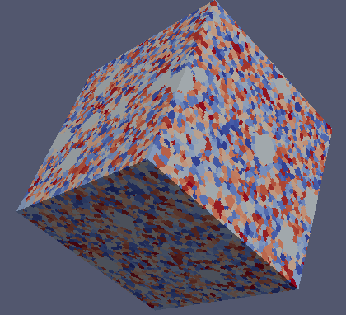
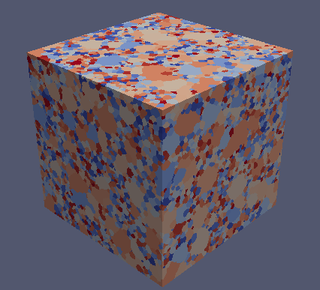
3D Monte Carlo Models – Continuous vs. Site-Saturated
Conclusion: the images do not directly reveal the difference in kinetics
Continuous Nucleation
Site-Saturated Nucleation

Slide 17
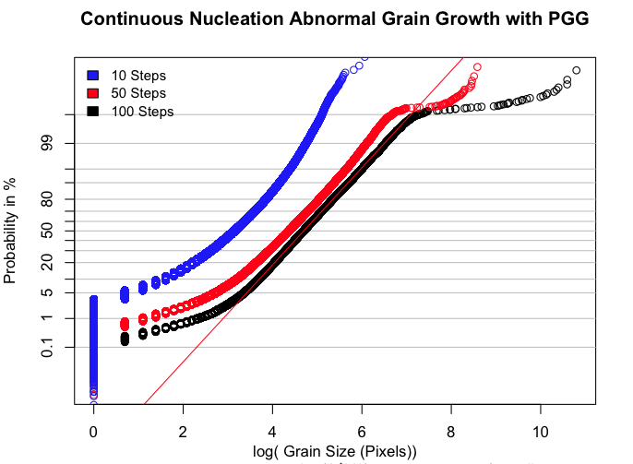
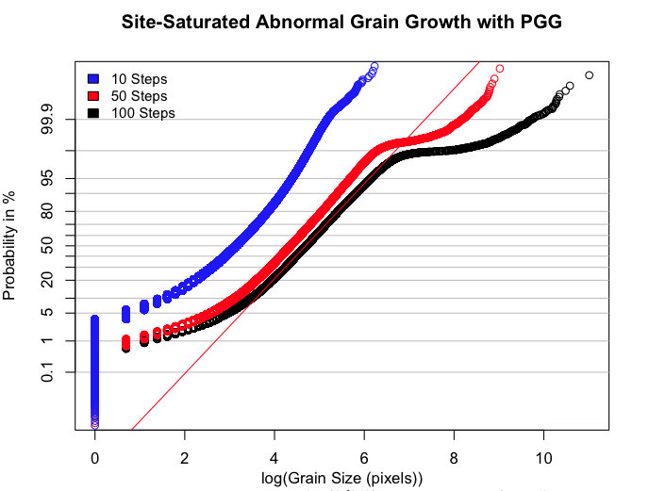
3D Monte Carlo Models – Continuous vs. Site-Saturated
.00001 Spins Nucleate/10 Steps
.01 % of 100000 Spins Nucleate
Conclusion: the grain size distributions do not show obvious differences.
This implies that we will need transformation kinetics, i.e. JMAK analysis.

Slide 18
Experimental Results - Alumina

Slide 19
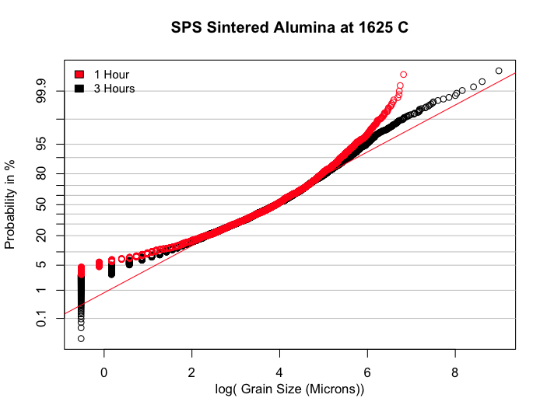
Results – SPS Ca-Doped Alumina
Direction: performing experiments to obtain an isothermal annealing series in order to obtain GSDs and JMAK analysis

Slide 20
Experimental Results – Nano-Ni

Slide 21
Nano-Ni: Surface Nucleation
Abnormal grains nucleate on the free surfaces of the sample
This explains the trouble obtaining a planar section of abnormal grains
If sample is not mounted flat, then we get a gradient of the surface
Even with surface-linked nucleation, the JMAK exponent should be ~2. Suggests diffusion control of the reaction.

Slide 22
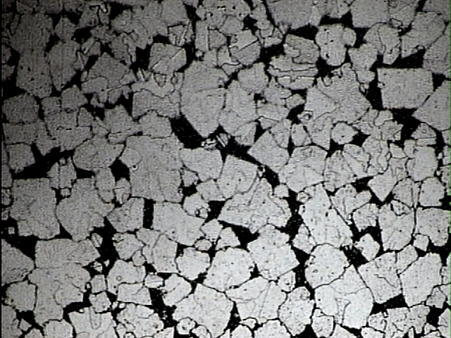
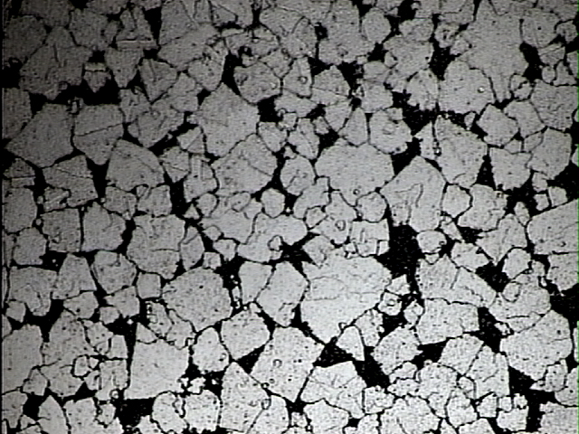
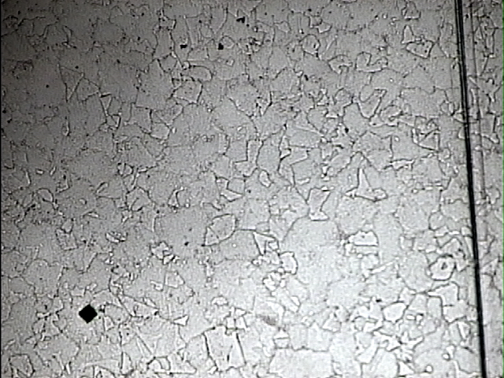
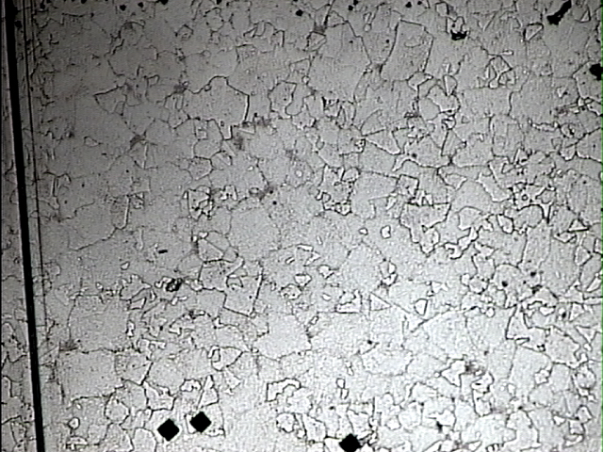
Nano-Ni: Evolution
Recrystallization-like behavior
Time = t
Time = t + ∆t

Slide 23
JMAK Analysis of AGG in Nano-Ni
JMAK fit indicates a range of n ~0.5. The value is not consistent with either 2D Site-Saturated (2.0) or Continuous Nucleation (3.0) transformation. It suggests reaction control by fugitive impurity.
ln(time)
ln(-ln(1-X))
JMAK = Johnson-Mehl-Avrami-Kolmogorov Data Adapted From Cheng and Hibbard; similar results for data from by Randle and Coleman

Slide 24
JMAK Analysis of AGG in Nano-Ni
ln(time)
JMAK fit indicates a range of n between ~0.25 and ~0.50. This suggests reaction control by fugitive impurity.
ln(-ln(1-X))
JMAK = Johnson-Mehl-Avrami-Kolmogorov Data Adapted From Randle and Coleman; similar results for data from by Cheng and Hibbard

Slide 25
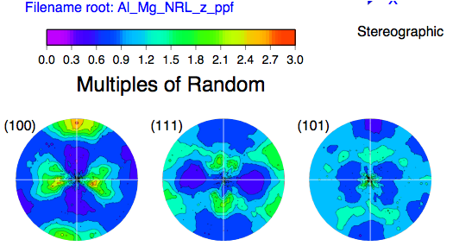
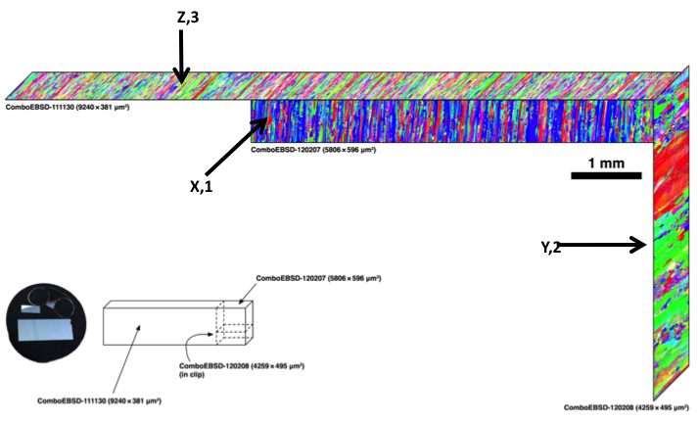
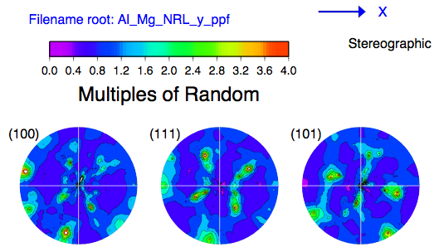
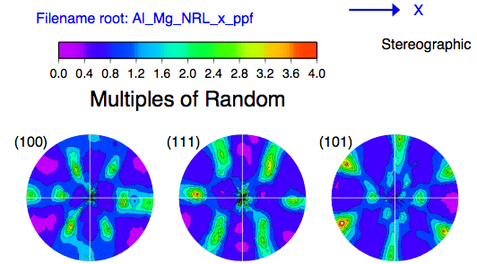
Al-Mg sample from NRL: Pole Figures
CMU previously reported on an analysis of the GBCD, corrected for the moderate texture present in the sample.

Slide 26
3D Synthetic Aluminum Microstructure
NRL_5083.ang file used as input
Aluminum (8761 grains)
Ratio of A:B:C is 100:10:1
Sigma spread of Axis ODF s=2
Prebuilt pipeline in Dream.3D used (Synthetic single phases)
Voxel dimensions 100X100X100 used

Slide 27
Summary
2D modeling of abnormal grain growth suggests measurable differences between continuous and site-saturated nucleation.
3D modeling, however, suggests minimal differences in terms of evolving grain size distributions.
Since the abnormal grains are strongly different in size from the matrix, the evolution is equivalent to recrystallization, therefore we will apply JMAK analysis to Ca-doped alumina.
New series of Ca-doped alumina generated (spark plasma sintered) and annealing started.
AGG occurs in nano-Ni – suggestive of a complexion transition. AGG only occurs near the specimen surface; JMAK analysis suggests dependence on fugitive impurity.
GBCD analysis performed on Al-Mg; also 3D synthetic microstructures built.

Slide 28
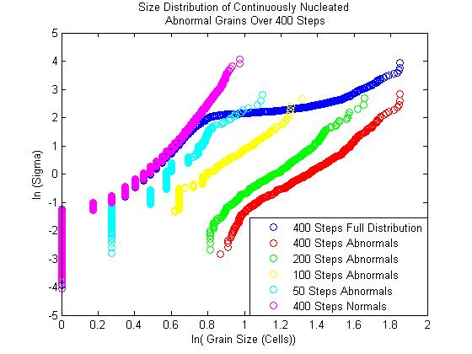
The Size Distributions of Abnormal Grains Over Time
8*10⁻⁶ Nucleations/(Pixel*Step)

Slide 29
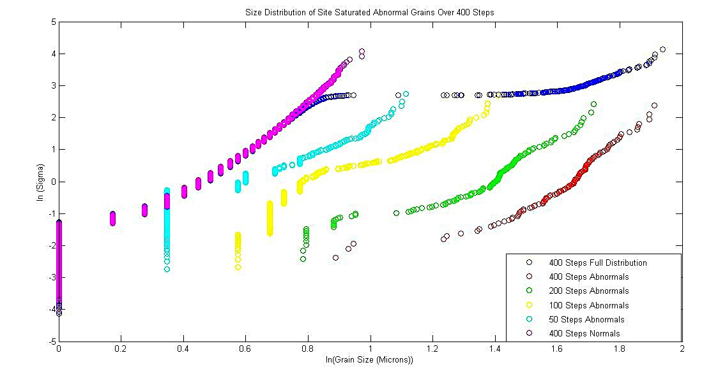
The Size Distributions of Abnormal Grains Over Time
4*10⁻⁴ Nucleations/Pixel

Slide 30
3D Monte Carlo Models – Continuous vs. Site-Saturated
.01 % of 100000 Spins Nucleate

