Slide 1

MURI Program Review
“Tailoring of Atomic-Scale Interphase Complexions for Mechanism-Informed Material Design”
Office of Naval Research, 875 N Randolph Street, Room 603, Arlington, VA 22203
Tuesday, 18 DEC 2012

Slide 2
Metal Complexionized Ceramics
H.M. Chan
Dept. Materials Science & Engineering
Lehigh University
Goals
Identify complexions with metallic character in alumina
Exploit to form novel materials/property combinations

Slide 3
Outline
Novel alumina-based systems
1. Al₂O₃-ITO (indium tin oxide) (Y. Wang)
2. Cu, Ti and Cu-Ti codoped alumina (ppm levels) (A. Lawrence)
Increasing Cu content
Alumina/Cu₂O/CuAlO₂ (bulk) (M. Kracum)
Decreasing pO₂

Slide 4
Alumina-ITO System
Background
ITO: Composition - 90wt% In₂O₃, 10wt% SnO₂
Melting Point: 1800-2200K
High electrical conductivity ∼10⁴ Ω⁻¹cm⁻¹
cf. (Metal~10⁶-10⁷ Ω⁻¹cm⁻¹)
High optical transparency (>80%)
Composition
Alumina- 10 wt.% (15.8 vol.%) ITO

Slide 5
Processing: Alumina – 10 wt.% ITO
Starting powders:
alumina powder (AKP-HP, 99.995%, 0.45um)
ITO (Alfa Aesar, 99.99%, 44um)
Processing
Ball milling with ethanol
Dry powder in chemical hood
Press powder before sintering
Sinter powder at 1600ºC (1-5 h) air

Slide 6
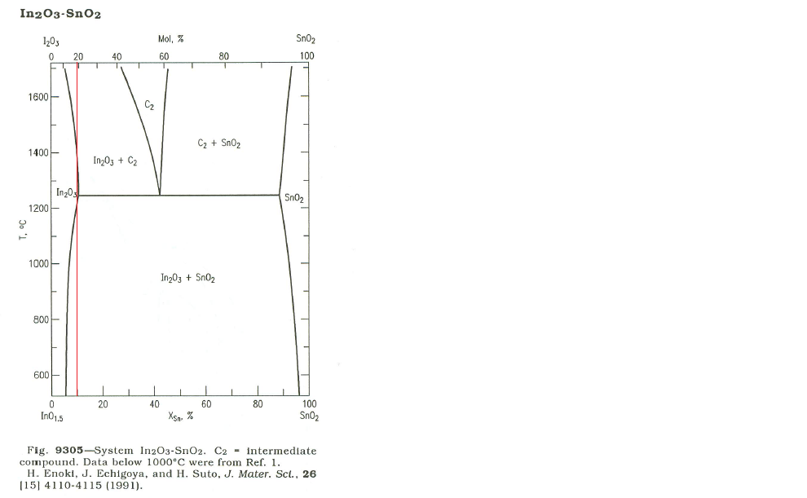
In₂O₃ – SnO₂ Phase Diagram

Slide 7
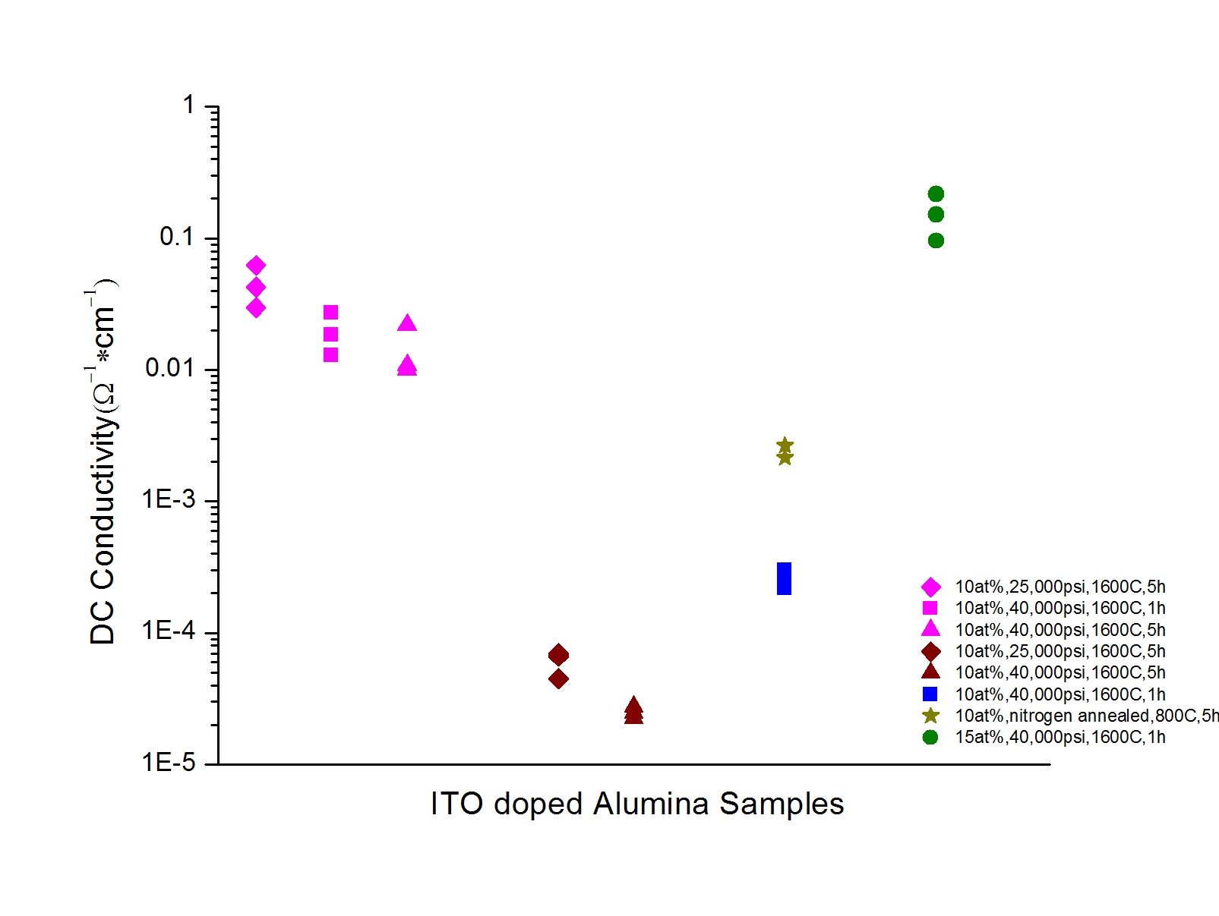
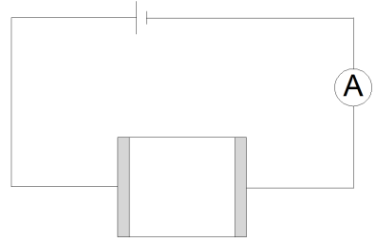
DC Conductivity –Alumina 10at% ITO (1h, 5h 1600 ºC)
For nominally identical processing conditions -
Large variation ( ~ 4000 x) in DC conductivity values!

Slide 8
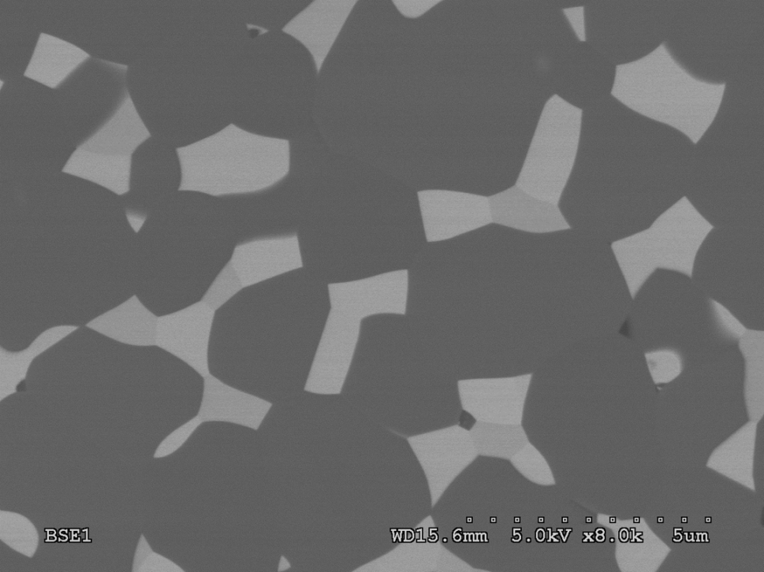
Alumina-15.8vol% ITO
20 μm
3 distinct phases
2μm
High conductivity
Low conductivity

Slide 9
Alumina-15.8vol% ITO
P
Q
Al₂O₃
2μm

Slide 10
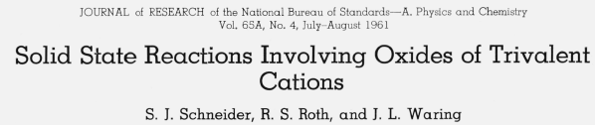
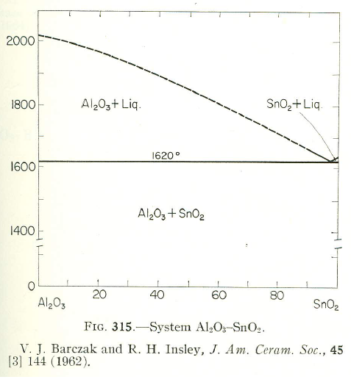
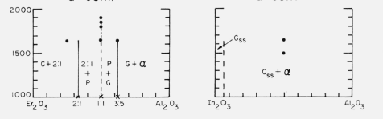
Phase Relationships
In₂O₃ – Alumina
Alumina- SnO₂
Not consistent with observed microstructures – new phase(s)?

Slide 11
Alumina-15.8vol% ITO
200 μm
High conductivity
Low conductivity
Microstructures inhomogeneous at macro level
Variation in conductivity due to variations in percolation of conducting phase(s) ?

Slide 12
DC Conductivity –Alumina 15at% ITO (1h, 1600 ºC)
15 at.% ITO

Slide 13
MCC’s: Low Cu concentrations
Compositions: 1000 ppm Cu, 1000 ppm Ti,
600 Cu- 400 Ti, undoped
Processing
Precursors: titanium isopropoxide and copper acetate (in ethanol)
Spark plasma sintering
  Heating and cooling rates of 150 °C/min,
  20 min at 1200 °C, 50 MPa
Grain growth:
Temperature: 1300, 1480, 1750 ºC
Time: 1h, 5h, 10h, 20h
Atmosphere (N₂-5% H₂)
Two different furnaces – Centorr and M60

Slide 14
M60 Furnace: Grain Growth

Slide 15
Grain Boundary Mobilities vs. Temp (M60)
1750°C
1480°C
Grain growth constant k, calculated and averaged for each temperature group
1300°C
Decreasing mobility: Ti -> Cu -> Cu-Ti

Slide 16
Grain Boundary Mobilities vs. Temp
1750°C
1480°C
1300°C
M60
Centorr
Data falls into two regimes corresponding to furnace

Slide 17
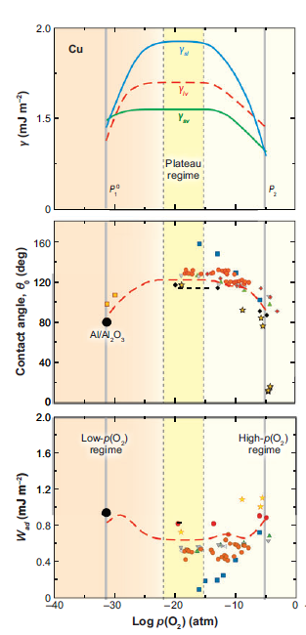
Wetting of Cu on Alumina: Effect of pO₂
Enhanced wetting of Cu on alumina at extremes of pO₂ values (Saiz et al)
Suggestion that atmosphere in M60 more reducing
Installation of monitor sensitive to very low pO2 values
Saiz, Cannon and Tomsia, Ann. Rev. Mater. Res. 38 (2008) 197-226

Slide 18
Doped Sapphire Tri-Crystals (Ongoing)
Dope- Ti
Dope- Cu
Section to expose interfaces
Anneal- 1300°C 5h
Anneal- 1000°C 5h
SPS
SEM/TEM
SEM/TEM
Three alumina single crystals (a, c, r planes) embedded in polycrystalline matrix
  Interfaces immersed in concentrated solution of dopant salt in ethanol
  Sequential process for Ti-Cu co-doping

Slide 19
MCC’s High Metal Concentrations
Approach 1
Alumina + CuO --------> alumina-Cu composite
Target compositions: Al₂O₃: 0.5, 5, 10 vol.% Cu
Processing
Alumina powder (99.999%)+ CuO (purity 99.995%)
Ball-milled in ethanol for 12 hours
Powder is dried and transferred to a graphite SPS die
CuO reduced in-situ (2 h at 700 ºC, 5%H₂-95%N₂)
SPS 1000 - 1300ºC for 25min in the range of 40-60MPa
SPS

Slide 20
Alumina-0.5 vol % Cu
BSE
Cu
5 μm

Slide 21
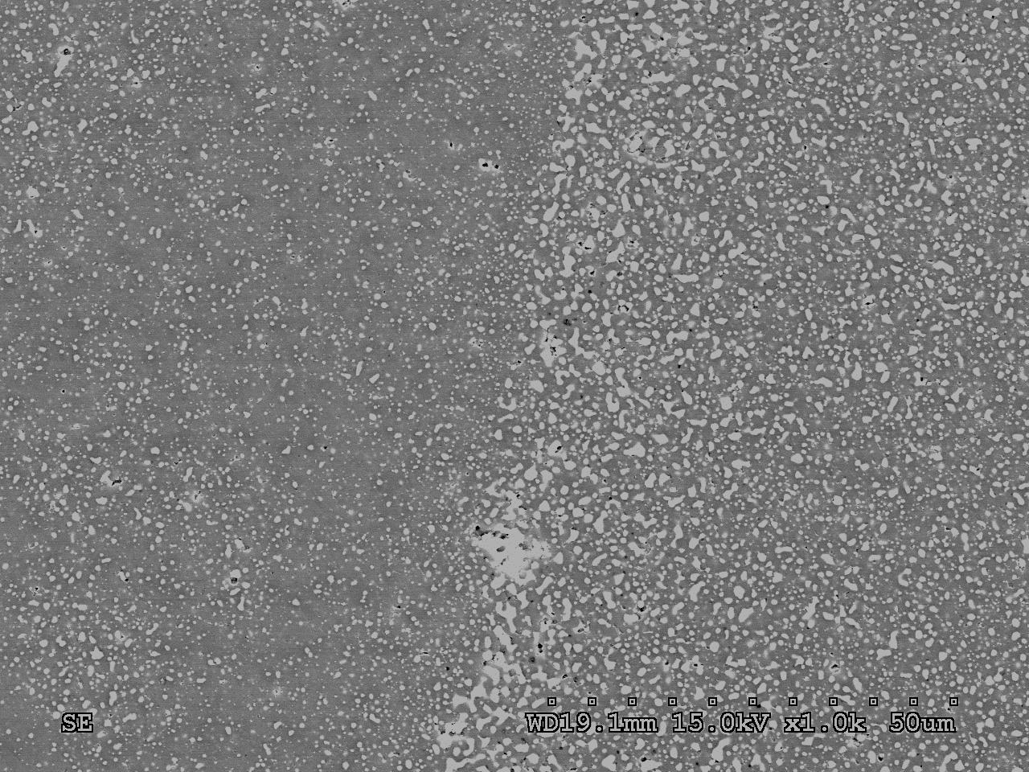
Alumina 5 vol% Cu : reducing atm.
25 μm

Slide 22
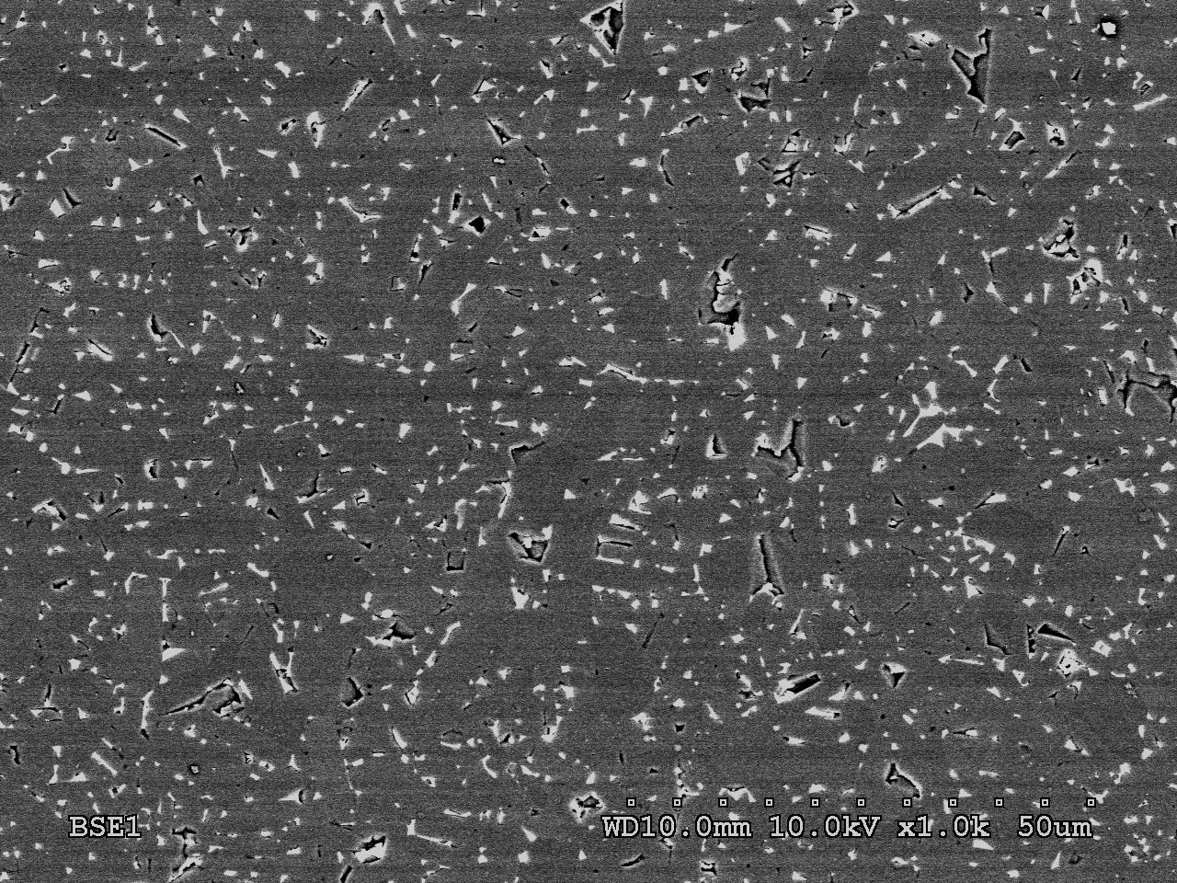
Transition in wetting behavior
Cu
1 μm
Alumina – “10 vol % Cu”
25 μm
At higher wt.% CuO (equivalent to 10 vol% Cu) transition in wetting behavior
Role of trace impurites in graphite foil?
Samples prepared with embedded graphite foil showed no microstructural differences.

Slide 23
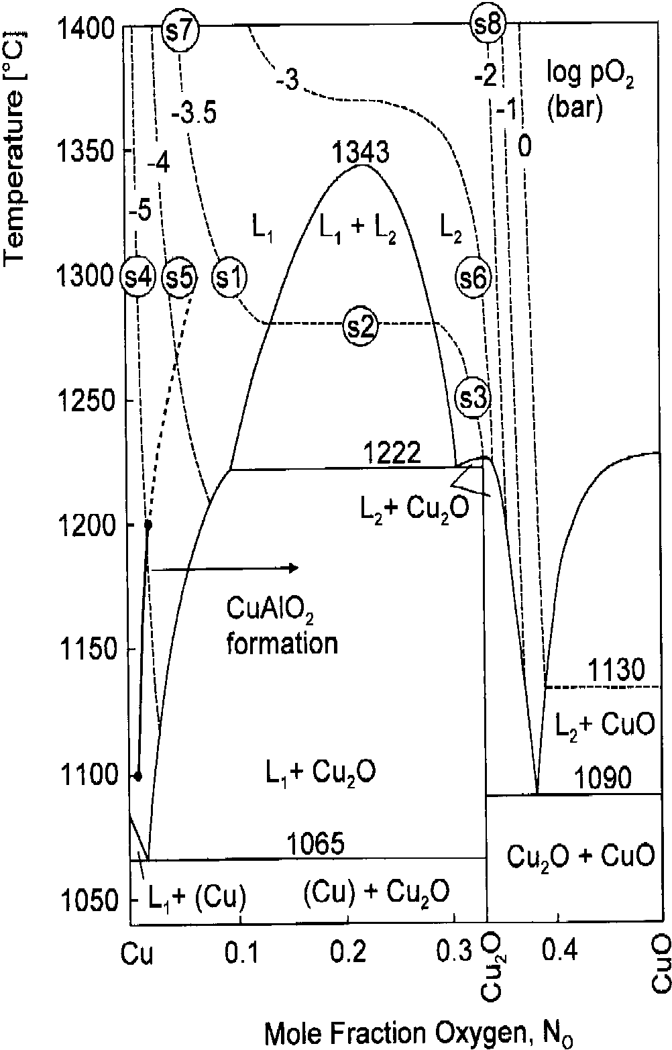
Role of CuAlO₂
Working Hypothesis
Larger volume fraction of CuO allowed retention of Cu₂O and reaction to CuAlO₂
Approach #2
2- step heat-treatment
Alumina-Cu₂O starting powders
1. Sinter in oxidizing atmosphere (air)
2. Reduce to Alumina-Cu (Centorr)
- Interest in monolithic CuAlO₂
Diemer et al
JACerSoc 82 (1999) 2825-32

Slide 24
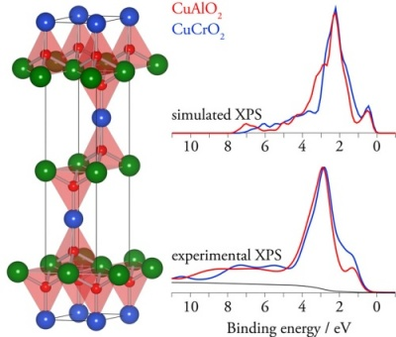
CuAlO₂ - delafossite
ABO₂ : Stacking sequence of
A⁺ and BO₂ layers
Rhombohedral
Transparent p-type semiconductor
thin films- displays, solar cells
Negative coefficient of expansion
Few studies on bulk CuAlO₂
Cu⁺
Al³⁺
http://www.tcd.ie/Chemistry/staff/people/gww/gw_new/research/TCOs/p-type/

Slide 25
Alumina – 21 wt% Cu₂O (Air)
6h at 1300 ºC
Al₂O₃
CuAlO₂
Cu₂O
5 μm
Multiple phases present: Cu₂O, CuAlO₂, Al₂O₃
CuAlO₂ wetting

Slide 26
Cored Structure
Alumina-17wt%Cu₂O (1300ºC for 24hr, air)
5 μm
5 μm
CuAlO₂
Cu₂O
Al₂O₃
Peritectic reaction: L + Al₂O₃ ---> CuAlO₂
Baldwin et al 1994

Slide 27
Novel Alumina-Cu Microstructures
6h at 1300 ºC (air)
Al₂O₃
Cu
Al₂O₃
CuAlO₂
Reduction
2 μm
5 μm
5 μm
Reduction heat-treatment
2CuAlO₂ ----- > 2Cu + Al₂O₃ + ½ O₂
Novel alumina-Cu microstructures

Slide 28
Alumina-17wt%Cu₂O (1300ºC for 24hr, air)
CuAlO₂
Al₂O₃
Cu₂O
CuAlO₂
2 μm
CuAlO₂
FIB section from cored region
(C. Marvel, Q. Wu)

Slide 29
Atomic Resolution Microscopy - JEM-ARM200F
CuAlO₂
Al₂O₃
Al₂O₃
CuAlO₂
CuAlO₂
Al₂O₃
Al₂O₃
ABF
Boundary inclined- no indication of continuous Cu-rich layer

Slide 30
Sub-angstrom imaging of the Al₂O₃ lattice (Z. Yu)
(3522)
93.6pm
[2201]
High Angle Annular Dark Field
HAADF
Fast Fourier Transform
FFT
Resolution 0.094 nm (sub- angstrom)!

Slide 31
Summary and Future Directions
Alumina with Cu (Ti) addition
Strong effect of pO₂ on gb behavior at both high and low metal contents regimes
Establish temperature and pO₂ regimes that delineate transitions in wetting/microstructure
Installation of ultra low pO₂ sensor on M60 furnace
Input from modeling to identify most plausible complexion schemes
Measure electrical and thermal conductivity of Cu/Ti containing aluminas
Fabrication of nano-MCCs by decomposition of CuAlO₂
ARM of grain boundaries

Slide 32
Thank you!
Any Questions?

