Slide 1
Tailoring of Atomic-Scale Interphase Complexions for Mechanism-Informed Material Design
Office of Naval Research Multidisciplinary University Research Initiative Project
Review Meeting, Tuesday, December 18, 2012
ONR Topic Chief: David Shifler
Martin P. Harmer
18th Month Program Review
Notes:
Overview - Emphasize team interactions and capabilities and show how the individual elements of the program are being successfully integrated into a unified single coherent program. This will also be reinforced in the subsequent presentations in which the details of the specific research accomplishments are given by individual team members in the following presentations.

Slide 2
AGENDA
AGENDA

Slide 3
Meetings

Slide 4
New Complexion Discovery

Slide 5
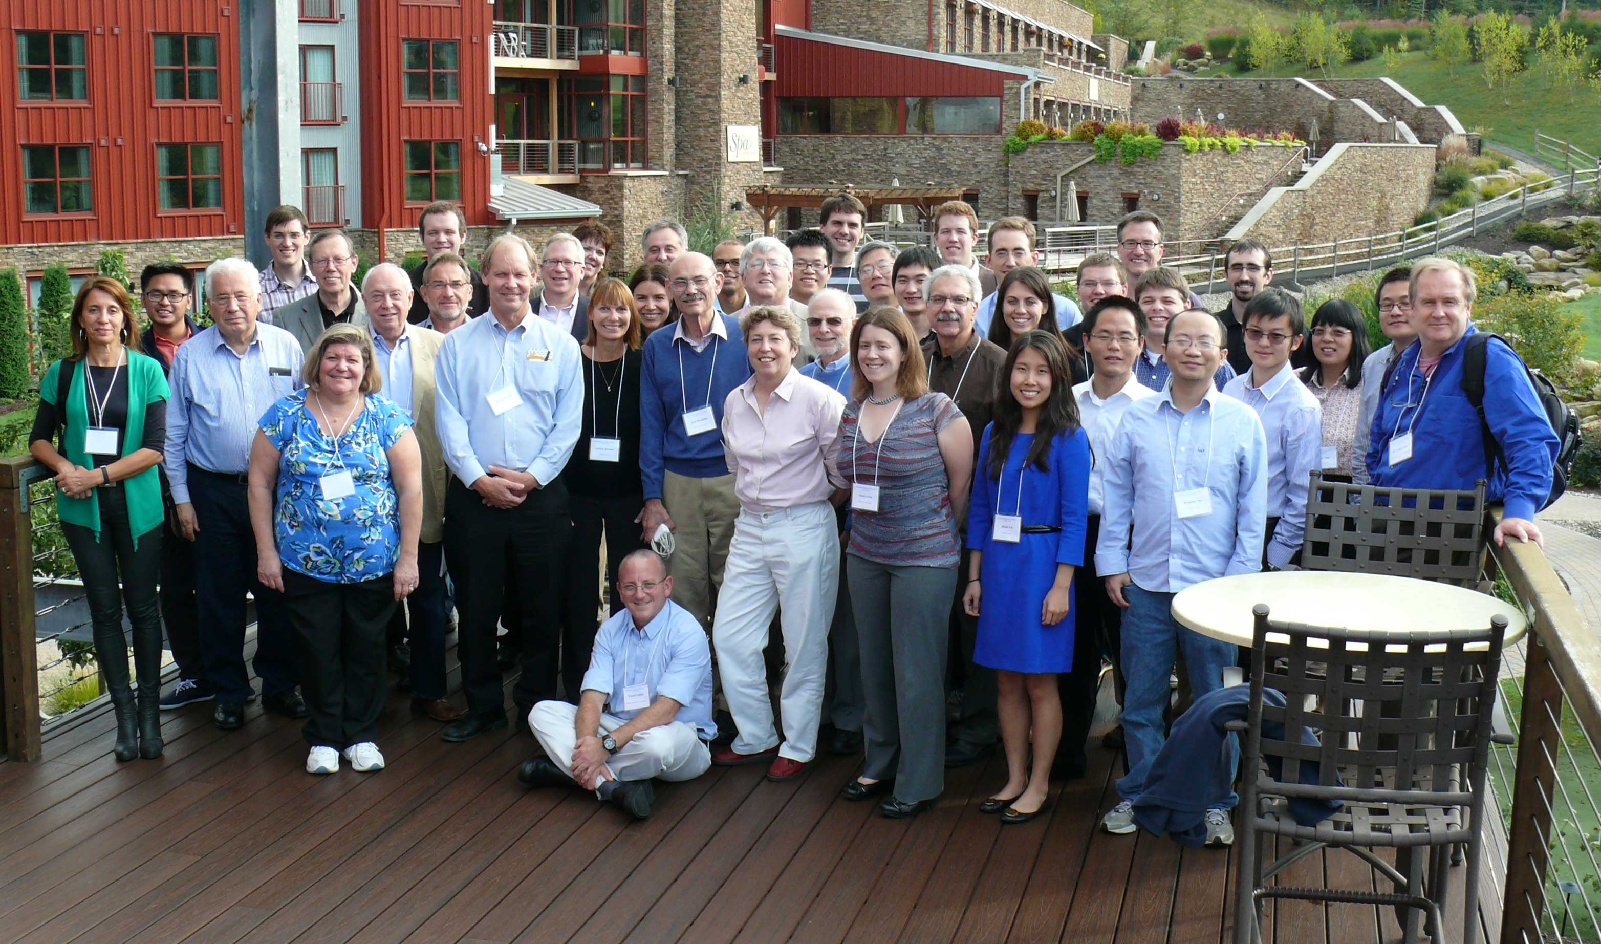
“… Finally, I want to thank you profusely for introducing me to Martin Harmer and suggesting that he extend an invitation to participate in the Bear Creek workshop. The three days we spent together provided some of the most enlightening, productive and enjoyable scientific discussions that I've had the privilege of experiencing over the past five years! If other conferences were only half as good as the Bear Creek workshop, we'd probably double the rate of progress in our community. “
International Workshop on Interfaces at Bear Creek
October 2–5, 2012

Slide 6
Complexion Concept is Catching On!

Slide 8
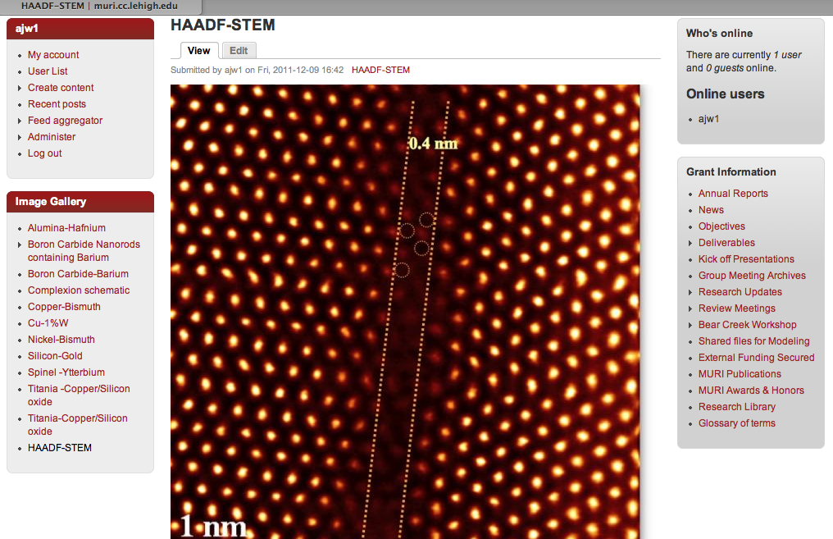
MURI GBC Facilitation of Communication
Collective database of review meeting presentations, research updates, Bear Creek interactions, publications, and awards associated with MURI_GBC project, up to date
Cumulative research library of information informing the study of complexions_RefWorks (BC meeting refs to be added Sp13 by student librarian, K. Muto)
Glossary of research terms added
Image gallery enhanced
Future work:
Student-requested wiki for complexions education
Public website to promote research interactions

Slide 9
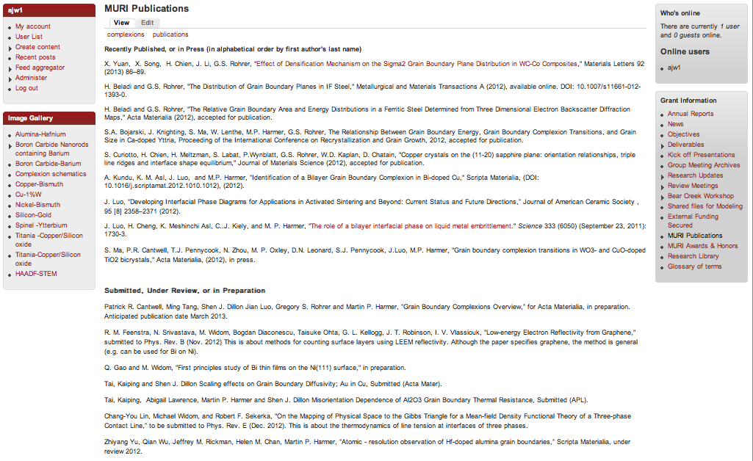
MURI Publications to Date

Slide 10
Publications: Recently Published, or in Press
X. Yuan, X. Song, H. Chien, J. Li, G.S. Rohrer, "Effect of Densification Mechanism on the Sigma-2 Grain Boundary Plane Distribution in WC-Co Composites,," Materials Letters 92 (2013) 86–89.
H. Beladi and G.S. Rohrer, "The Distribution of Grain Boundary Planes in IF Steel," Metallurgical and Materials Transactions A (2012), DOI: 10.1007/s11661-012-1393-0.
H. Beladi and G.S. Rohrer, "The Relative Grain Boundary Area and Energy Distributions in a Ferritic Steel Determined from Three Dimensional Electron Backscatter Diffraction Maps," Acta Materialia (2012), accepted for publication.
S.A. Bojarski, J. Knighting, S. Ma, W. Lenthe, M.P. Harmer, G.S. Rohrer, “The Relationship Between Grain Boundary Energy, Grain Boundary Complexion Transitions, and Grain Size in Ca-doped Yttria,” Proceeding of the International Conference on Recrystallization and Grain Growth, 2012, accepted for publication.
S. Curiotto, H. Chien, H. Meltzman, S. Labat, P.Wynblatt, G.S. Rohrer, W.D. Kaplan, D. Chatain, "Copper crystals on the (11-20) Sapphire Plane: Orientation Relationships, Triple Line Ridges and Interface Shape Equilibrium," Journal of Materials Science (2012), accepted for publication.
A. Kundu, K. M. Asl, J. Luo, and M.P. Harmer, "Identification of a Bilayer Grain Boundary Complexion in Bi-doped Cu," Scripta Materialia, (DOI: 0.1016/j.scriptamat.2012.1010.1012), (2012).
J. Luo, "Developing Interfacial Phase Diagrams for Applications in Activated Sintering and Beyond: Current Status and Future Directions, " Journal of American Ceramic Society , 95 [8] 2358–2371 (2012).
J. Luo, H. Cheng, K. Meshinchi Asl, C..J. Kiely, and M. P. Harmer, "The Role of a Bilayer Interfacial Phase on Liquid Metal Embrittlement," Science 333 (6050) (September 23, 2011): 1730-3.
S. Ma, P.R. Cantwell, T.J. Pennycook, N. Zhou, M. P. Oxley, D.N. Leonard, S.J. Pennycook, J.Luo, M.P. Harmer, "Grain Boundary Complexion Transitions in WO₃- and CuO-doped TiO₂ Bicrystals," Acta Materialia, (2012), in press.

Slide 11
Publications:Submitted, Under Review, or in Preparation
Patrick R. Cantwell, Ming Tang, Shen J. Dillon Jian Luo, Gregory S. Rohrer and Martin P. Harmer, "Grain Boundary Complexions Overview," for Acta Materialia, in preparation. Anticipated publication date March 2013.
R. M. Feenstra, N. Srivastava, M. Widom, Bogdan Diaconescu, Taisuke Ohta, G. L. Kellogg, J. T. Robinson, I. V. Vlassiouk, "Low-energy Electron Reflectivity from Graphene," submitted to Phys. Rev. B (Nov. 2012) This is about methods for counting surface layers using LEEM reflectivity. Although the paper specifies graphene, the method is general (e.g. can be used for Bi on Ni).
Q. Gao and M. Widom, "First principles study of Bi thin films on the Ni(111) surface," in preparation.
Tai, Kaiping and Shen J. Dillon, "Scaling effects on Grain Boundary Diffusivity; Au in Cu," Submitted (Acta Mater).
Tai, Kaiping, Abigail Lawrence, Martin P. Harmer and Shen J. Dillon, "Misorientation Dependence of Al₂O₃ Grain Boundary Thermal Resistance," Submitted to Applied Physics Letters
Chang-You Lin, Michael Widom, and Robert F. Sekerka, "On the Mapping of Physical Space to the Gibbs Triangle for a Mean-field Density Functional Theory of a Three-phase Contact Line," to be submitted to Phys. Rev. E (Dec. 2012). This is about the thermodynamics of line tension at interfaces of three phases.
Zhiyang Yu, Qian Wu, Jeffrey M. Rickman, Helen M. Chan, Martin P. Harmer, "Atomic - resolution observation of Hf-doped alumina grain boundaries," Scripta Materialia, under review 2012.
W. Cao, A. Kundu, Z.Yu, M.P. Harmer, and R. P. Vinci, " Direct correlations between fracture toughness and grain boundary segregation behavior in Magnesium Aluminate Spinels," to be submitted to Applied Physics Letters

Slide 12
Awards
2nd
1st
TEM category in the Ceramographic Awards at the MS & T conference in Pittsburgh, Oct. 2012

Slide 13
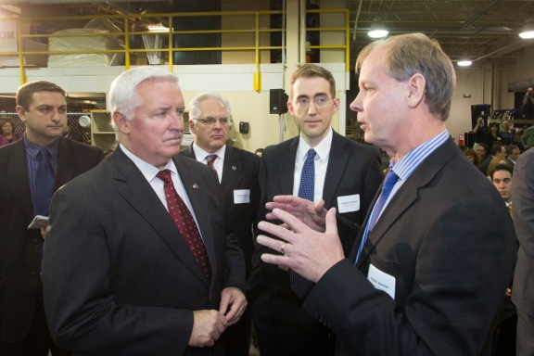
Leveraging the MURI: Additive Manufacturing
http://namii.org/2012/12/04/pennsylvania-governor-tom-corbett-announces-ramp-award-winners-at-namii-special-event/
Notes:
RAMP awards announced on December 4th
RAMP = Research for Advanced Manufacturing in Pennsylvania
Joint project between Lehigh and Paramount Industries on TiO2-polymer nanocomposites, to improve mechanical properties and thermal conductivity
Complexion engineering will be used to make TiO2 compatible with polymer

Slide 14
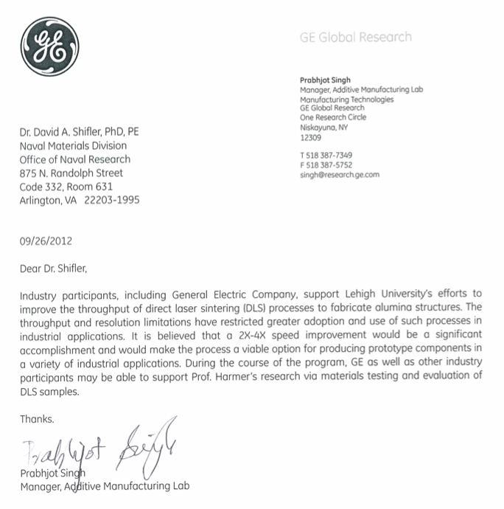
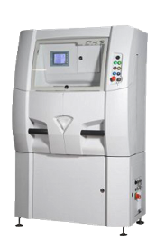
Leveraging the MURI: Additive Manufacturing
2013 DURIP
“A Powder Bed Additive Manufacturing System for Direct Laser Sintering”
Phenix Systems PXS Additive Manufacturing System
Collaboration with GE to increase speed of DLS ceramics
Complexions engineering may hold the key to DLS of ceramics
Phenix Systems PXS
Notes:
The PXS is a research-scale direct laser sintering system
We plan to study the kinetics of laser sintering
We will apply “complexions engineering” to increase the speed of this important manufacturing method
GE parternship/collaboration

Slide 15
Leveraging the MURI: Partnerships
U.S. Army ARDEC
Nanocrystalline W for penetrators
Paramount Industries
Additive manufacturing (RAMP/NAMII)
Almatis
Al₂O₃ powder development
General Electric
Additive Manufacturing (DURIP, possibly NAMII)
Advanced cutting tool and coating manufacturing
Advanced alloy development
Notes:
Top 4 = CURRENT partnerships
Bottom 2 = POTENTIAL partnership

Slide 16
Materials Systems and Rationale
Binary Metal Alloys | Ni-Bi | Model systems (Liquid metal embrittlement, Establishing theoretical framework)
 | Cu-Bi
 | Fe-Bi
 | Ni-W, Ni-Ti | Nano-grained high strength nickel alloys*
 | Al-Mg/(X) | High strength, corrosion resistance, weldable alloy
Metal - Ceramics | Al₂O₃-Cu/Ti | High Strength and toughened, conducting ceramics, metal-complexionized ceramics
 | Al₂O₃-Cu/AgO
Alumina | Al₂O₃-CaO Al₂O₃-Y₂O₃ Al₂O₃-In₂O₃ Al₂O₃-Fe₂O₃ | Model systems for establishing theoretical framework
Exploratory Materials | WC-M | Stronger and tougher carbide composites
 | YBZ | Proton Conductor
* Christopher Schuh’s research work at MIT
Notes:
The choice of systems represents a balance of several factors –, hosts with different types of bonding (metals vs ceramics) and strengths of bonding (Ni vs Cu) suitability to characterization (e.g. high Z) and atomistic modeling (need potentials), favor classes of systems which can represent a wide range of behaviors of engineering relevance to the Navy. Based upon that the primary systems which will be studied most comprehensively will be Ni and Cu based alloys and alumina based composites. Other systems will be studied but not as comprehensively. Will conduct exploratory studies on new classes of systems – investigate prospects for creating materials with new/improved properties (B4C).
4 metal systems, 3 ceramic systems, 2 ceramic/metal systems

Slide 17
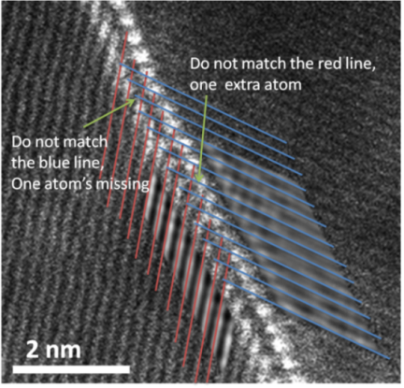
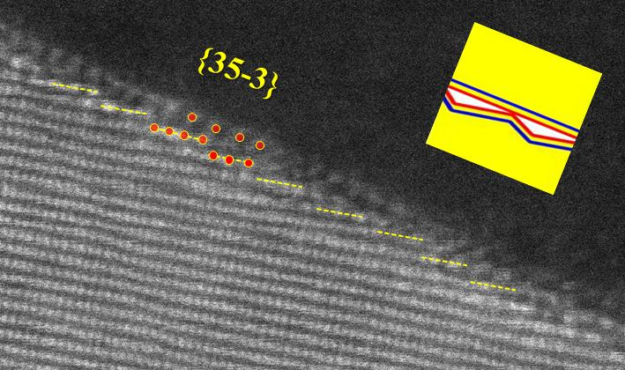
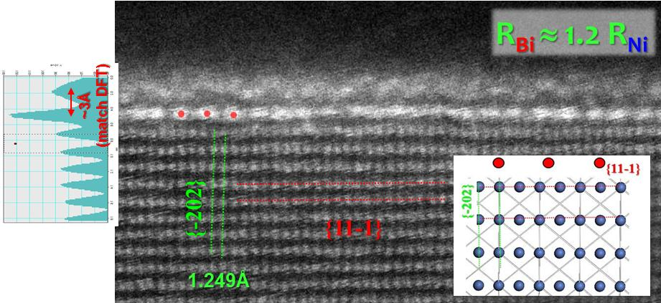
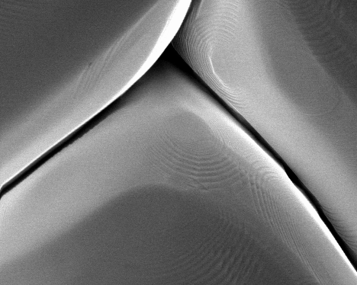
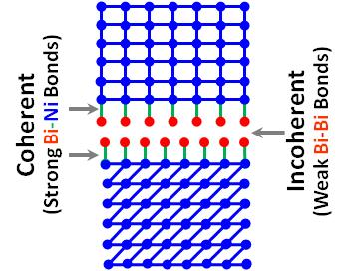
Liquid Metal Embrittlement: Ni-Bi
Strong Ni-Bi: ½|E_{Ni-Ni}| + ½|E_{Bi-Bi}| < |E_{Ni-Bi}|
Weak Bi-Bi: |E_{Bi-Bi}| << |E_{Ni-Ni}|
2 adsorbed Bi layers are weakly bonded
Deep Groove
Sample Preparation/Thermodynamic Modelling: Clemson University
Electron Microscopy: Lehigh University
AFM: Carnegie Mellon University

Slide 18
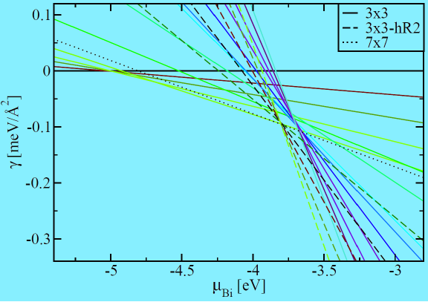
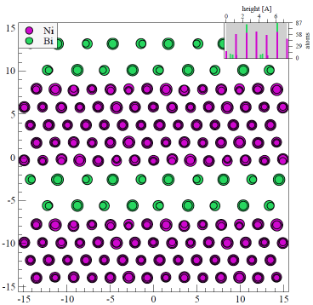
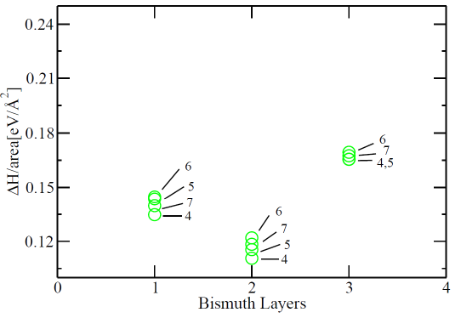
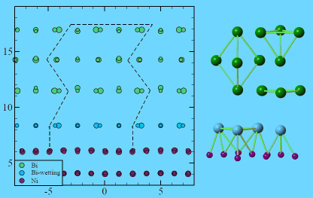
First Principles Calculation
Bismuth Films on Ni (111) Surface: Carnegie Mellon University
Bismuth Films in Bulk Nickel: Carnegie Mellon University

Slide 19
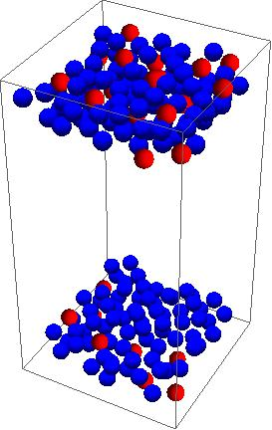
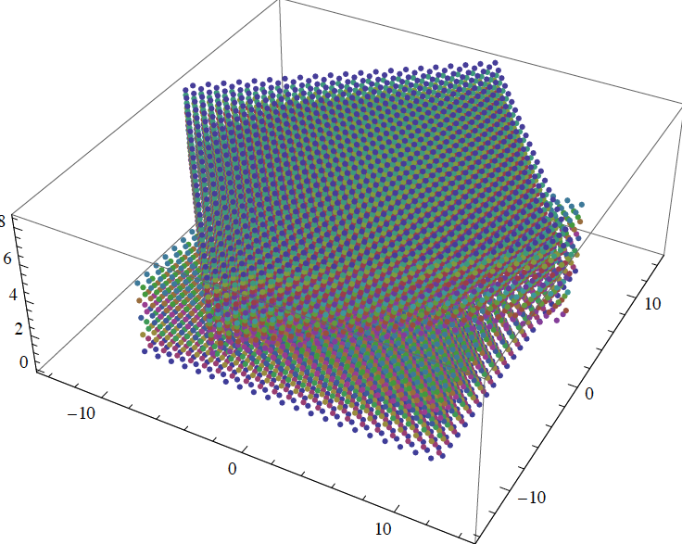
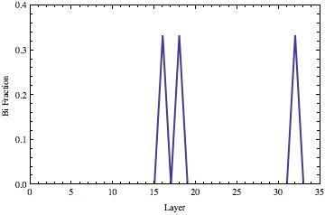
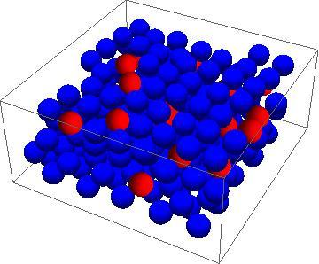
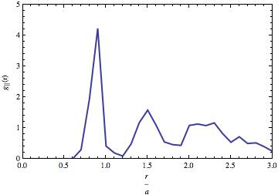
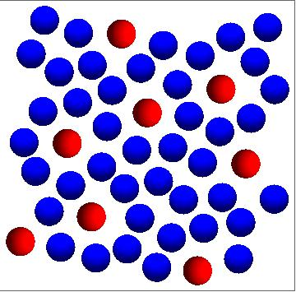
Atomic Level Modelling & Simulations
Σ5 Grain Boundary (Ni) 36.9⁰ twist boundary
Σ5 GB plane
Grain Boundary Modelling: Lehigh University

Slide 20
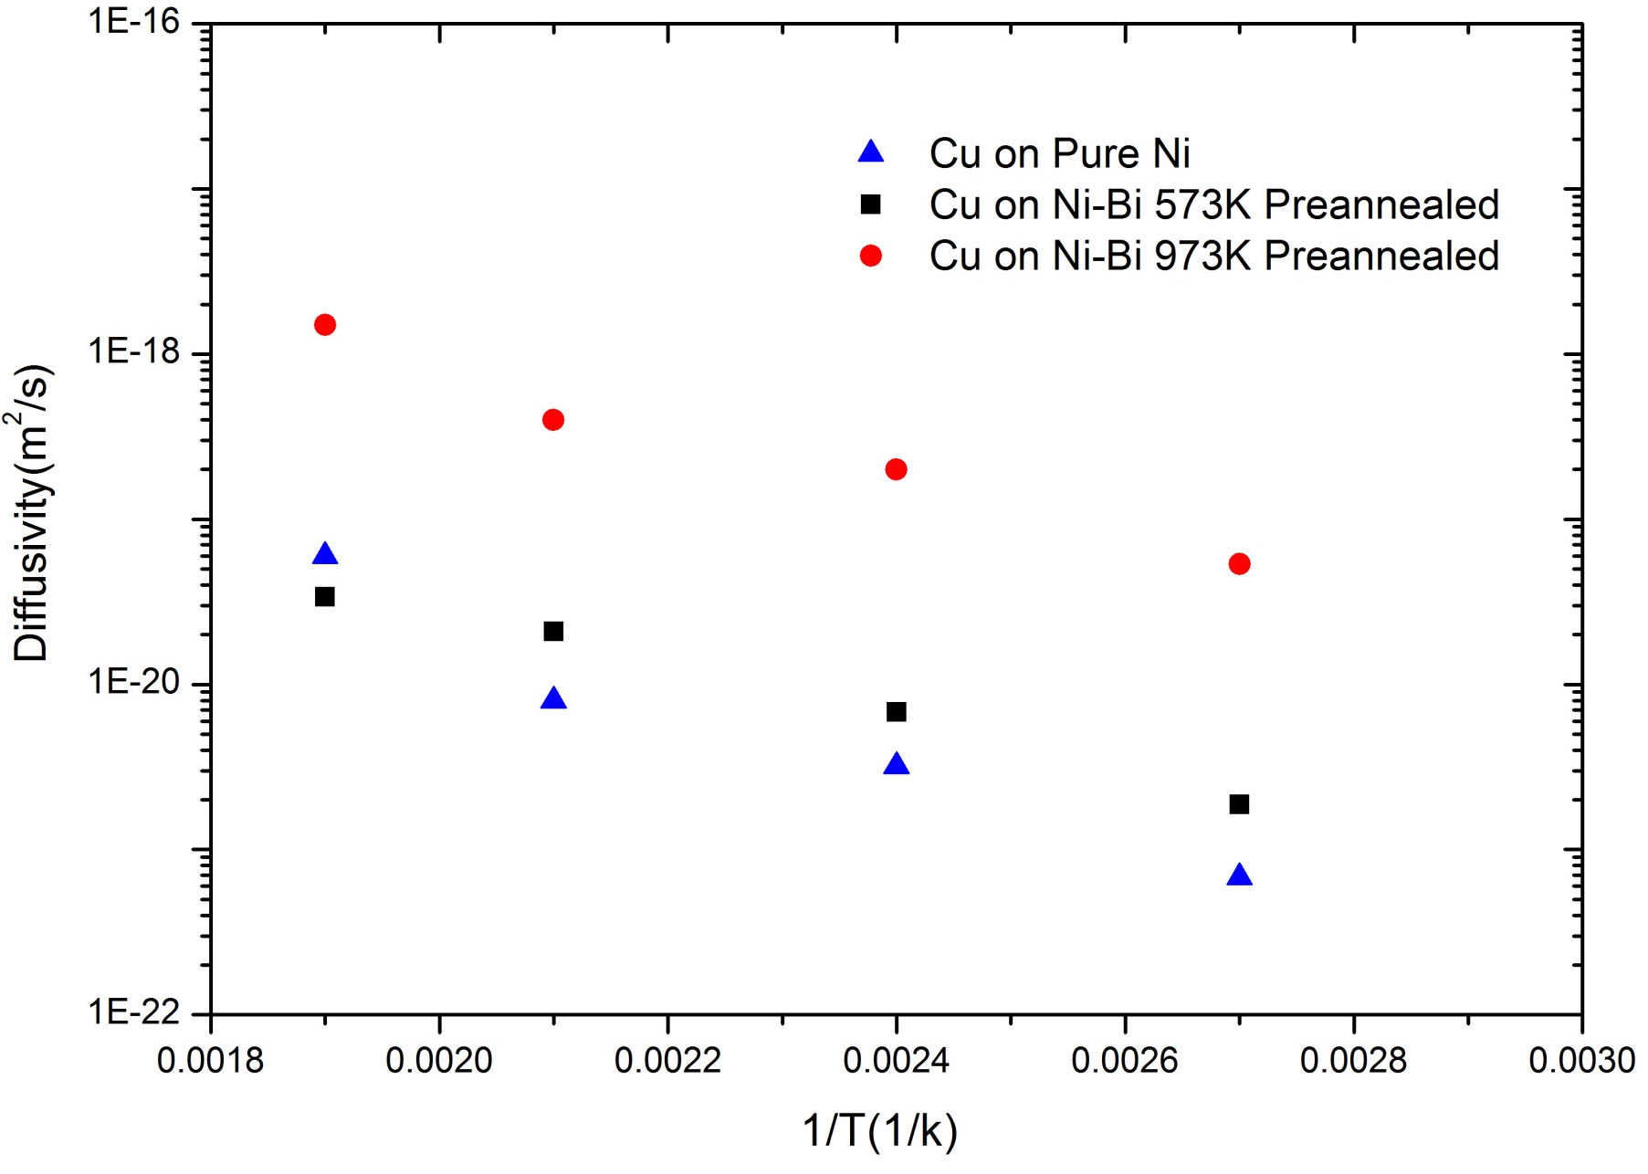
Diffusion in Ni-Bi
Bi/Ni(counts) = 0.009
ΔS~4k (assuming all entropy)
Bi/Ni(counts) = 0.003
Grain Boundary Diffusion: University of Illinois at Urbana-Champaign
Notes:
Older work… We have measured similar data for Cu-Bi and Ni-Bi and have compared our thin film Ni samples with Jian’s bulk Ni samples (reasonably consistent results). An approximation of entropy contribution is included here.

Slide 21
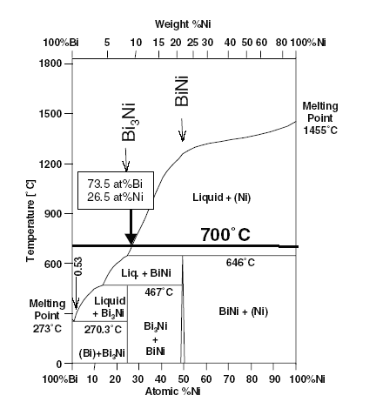
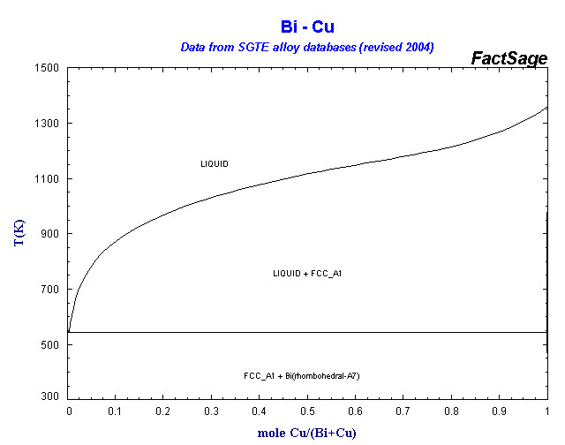
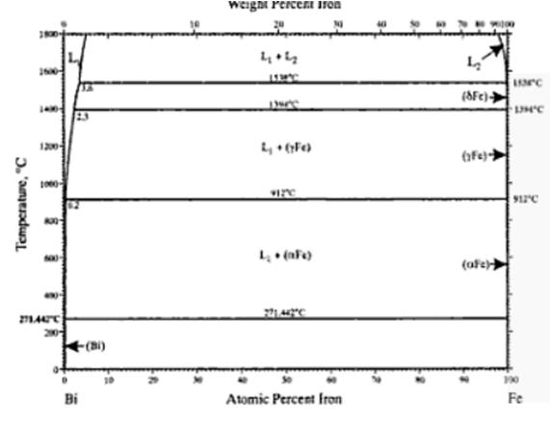
Theoretical Prediction
Ni-Bi
Cu-Bi
Fe-Bi
Decreasing Bilayer Stability
Ω_{Ni-Bi} = -14.8 kJ/mol Ω_{Cu-Bi} = +14.2 kJ/mol Ω_{Fe-Bi} = +72.3 kJ/mol
DFT (CMU ); Ω = 4ΔH^{mix}_{0.5}
Miedema Model (CU)
Ω_{Ni-Bi} = -16.4 kJ/mol Ω_{Cu-Bi} = +34.8 kJ/mol Ω_{Fe-Bi} = +91.6 kJ/mol
Notes:
Interaction parameter for regular solution;

Slide 22
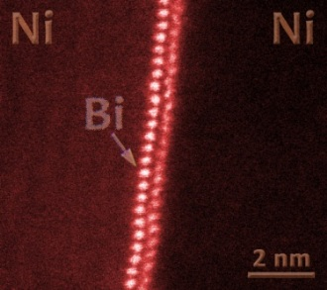
Summary: Ni-Bi vs. Cu-Bi vs. Fe-Bi
Ni-Bi
Bilayers ubiquitous
Bilayer
Cu-Bi
Bilayers observed,
but in a narrow window
Bilayer
Fe-Bi
Clean Boundaries
Bilayer NOT observed

Slide 23
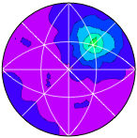
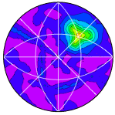
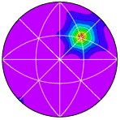
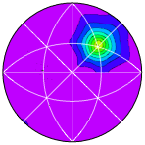
Comparison of GB populations in Cu and Bi-Cu
Σ7 = 38.2 ° around [111]
Relatively high energy GBs increase in relative population with Bi adsorption
Σ3 = 60 ° around [111]
Changes in the GBCD strongly suggest that Bi complexions in Cu GBs reduce boundary energy
Pure Cu, 900ºC anneal
Cu-Bi, 900ºC anneal
Lowest energy GBs decrease in relative population with Bi adsorption
Grain Boundary Character Distribution: Carnegie Mellon University

Slide 24
Alumina: Fundamental Studies
1. Bulk solid solubility and Complexion Nucleation
2. Energetics of Complexion Transition Nucleation in Alumina
3. Influence of Grain Boundary Energy on Thermal Resistance
4. Metal - Complexionized Alumina
Fe⁺³
69/79 pm
In⁺³
94 pm
Y⁺³
104 pm
R. D. Shannon, Acta Crystallographica A32: 751–767 (1976).

Slide 25
GB Energy and Complexion Transition Nucleation in Alumina
Hypothesis:
Complexion transition will nucleate on highest energy GBs
Low (average) energy grain boundaries
High (average) energy grain boundaries
Al₂O₃ (hkil)
Al₂O₃ (hkil)
Al₂O₃(h’k’I’l’)
Al₂O₃(h’k’I’l’)
Heat, time

Slide 26
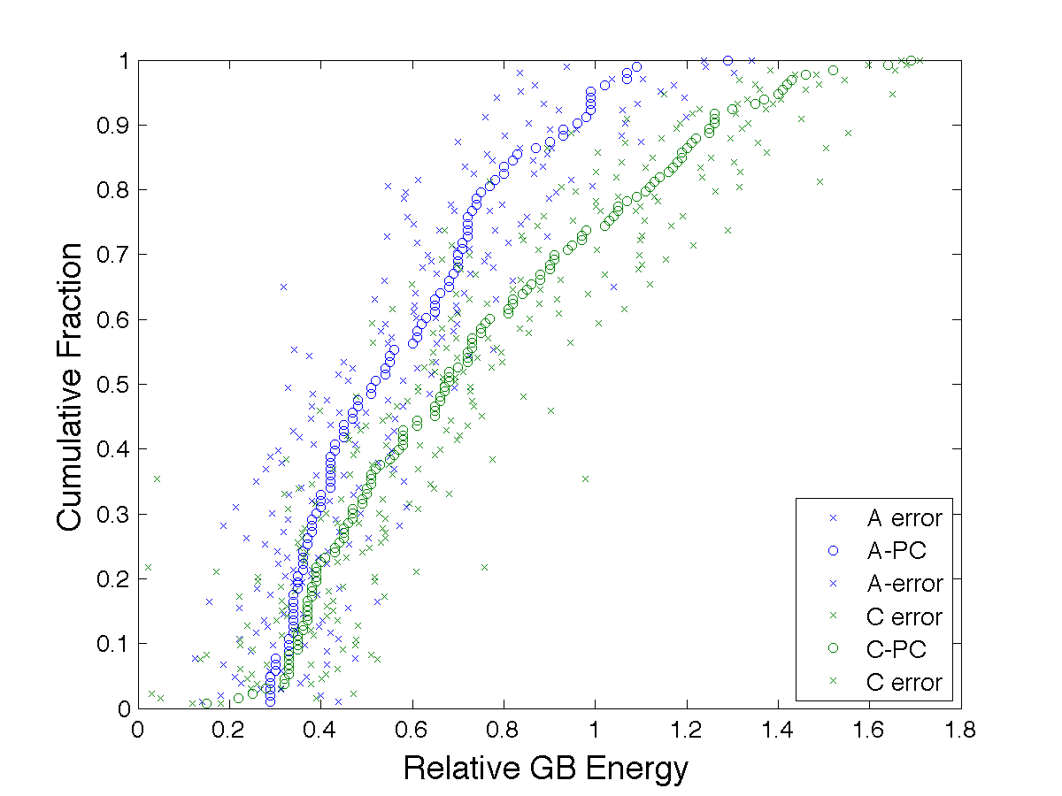
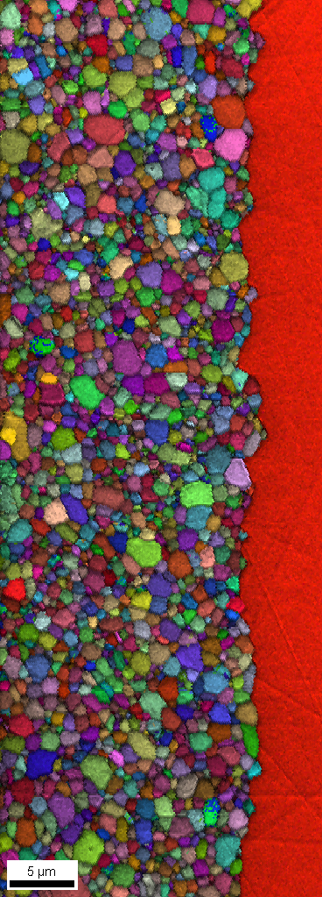
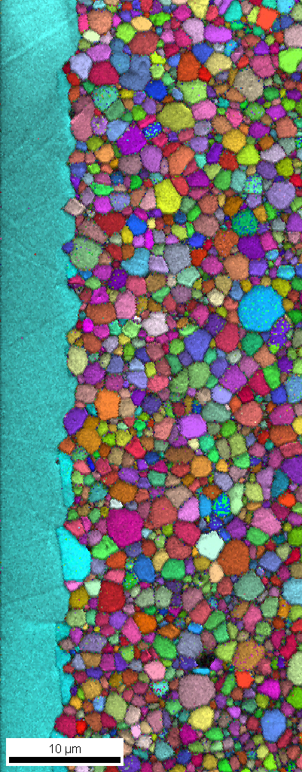
Results: 500 ppm Y-doped alumina as pressed
Groove 12 hour 1300ºC
A-Plane:
min: 0.29
max: 1.29
mean: 0.57
median: 0.52
std: 0.23
C
A
[010] IPF maps
C-plane:
min: 0.15
max: 1.69
mean: 0.74
median: 0.68
std: 0.35
MRD
5 µm
10 µm
0.80 0.85 0.90 0.95 1.00 1.05 1.10 1.15 1.20
Thermal grooves indicate that the GBs defined by the c-plane has the higher energy
Consistent with GBCD (populations results)

Slide 27
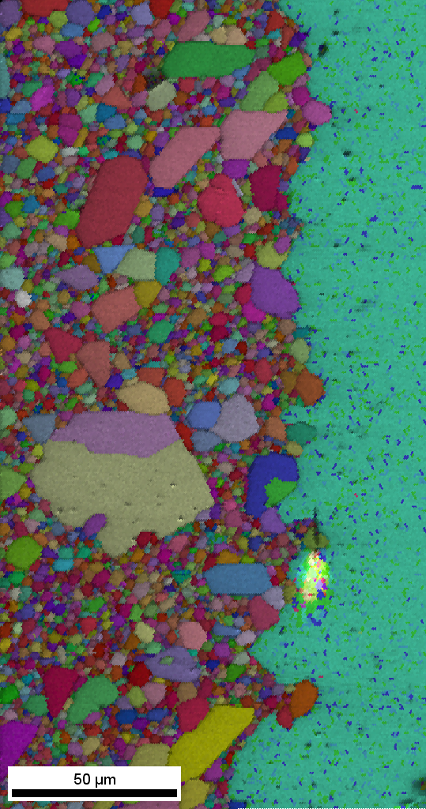
Results: 500 ppm Y-doped alumina, anneal 1500°C, 8h
Groove 12 hour 1300ºC
C
A
[010] IPF maps
In this case, observations consistent with the hypothesis!

Slide 28
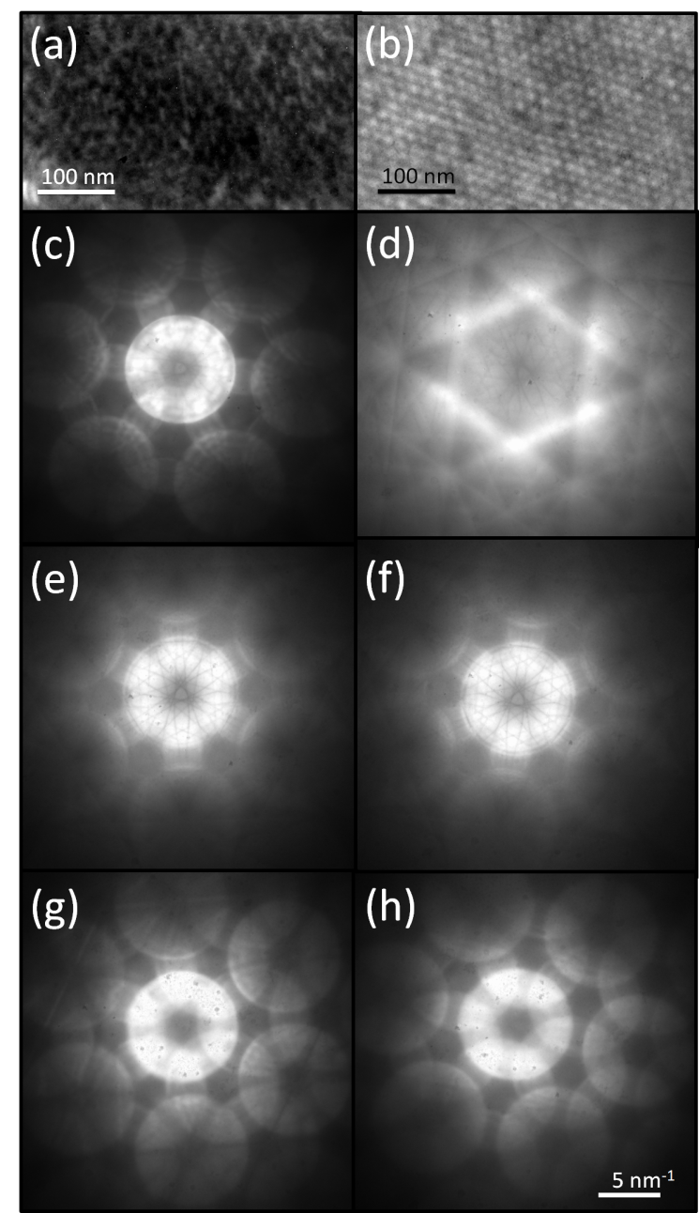
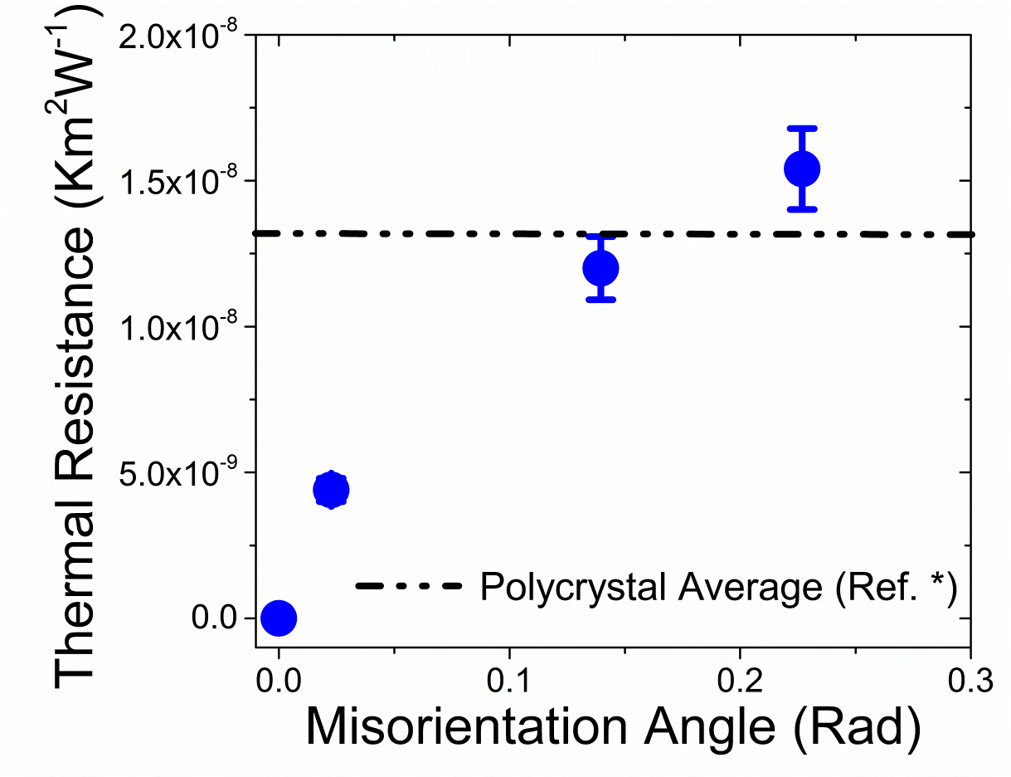
Misorientation Dependent Thermal Resistance
Bicrystals
K. Tai, A. Lawrence, M. Harmer, S. Dillon, Submitted
Notes:
Electron diffraction from bicrystals measuring misorientation, schematic of test set-up (3-omega), and results. This is new data for the literature, sample fabrication and prep is the major challenge here, our approach is providing some new insights into GB thermal conductivity.

Slide 29
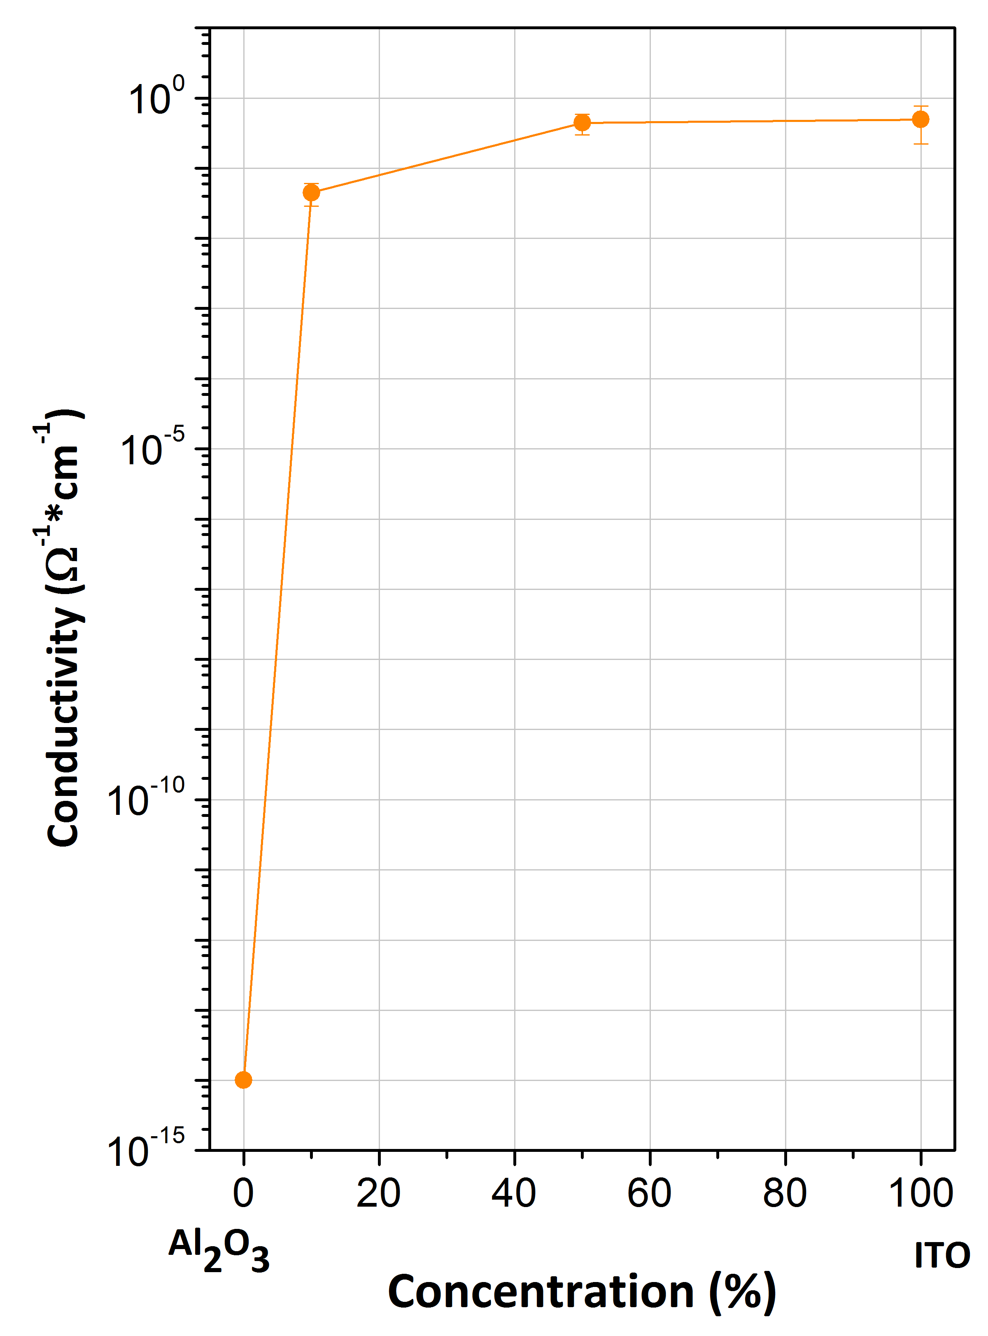
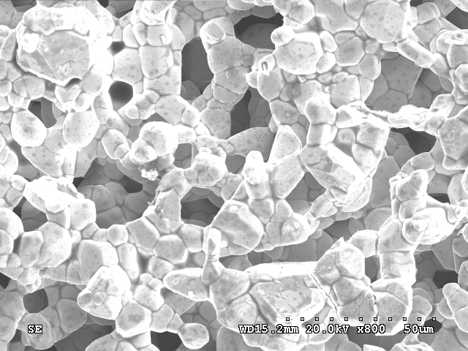
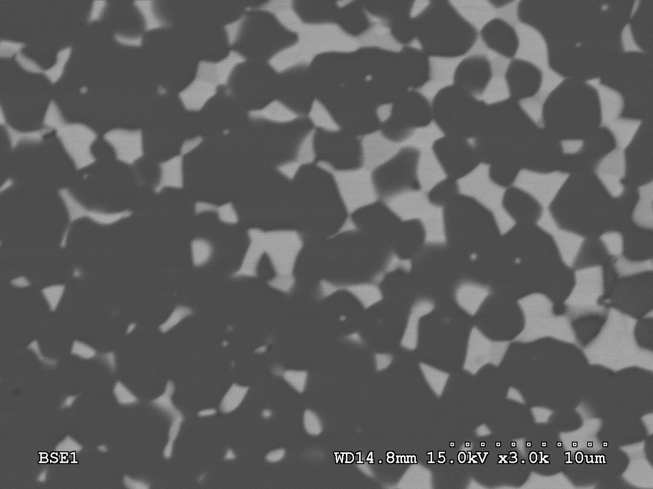
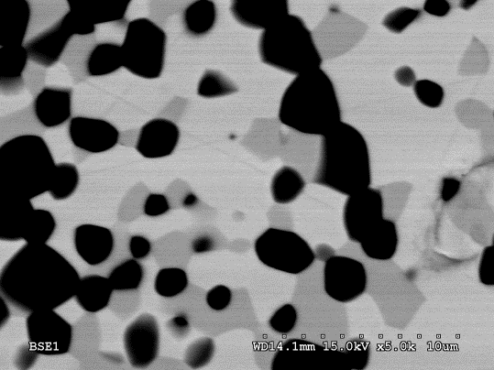
Alumina-ITO
Bulk Conductivity Annealing Temperature (°C) | Conductivity (Ω⁻¹cm⁻¹)
1600 | 5.30E-5
1500 | 2.47E-5
Alumina: 1E-14 Ω⁻¹cm⁻¹, ITO: ∼10⁴ Ω⁻¹cm⁻¹

Slide 30
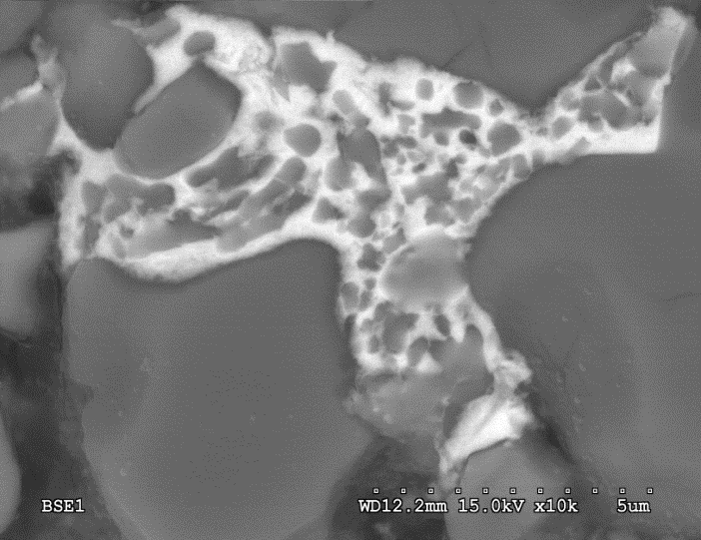
Alumina - Cu/Ti
Al₂O₃ – 21 wt% Cu₂O (Reduced)
Al₂O₃ – 21 wt% Cu₂O (Air)
Copper Content
5 μm
CuAlO₂
1 μm
Al₂O₃
pO₂
Metal Complexionized Ceramics
Reduced gb mobility (m²/s)

Slide 31
Nanocrystalline Behavior in Metals
Influence of grain size in D_{gb}?
Nanocrystalline Thermal Stability
Nanocrystalline Grain Size Tailoring

Slide 32
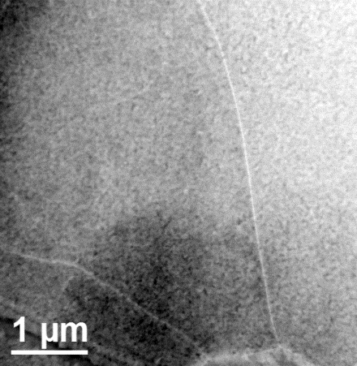
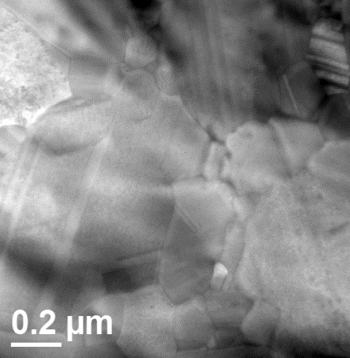
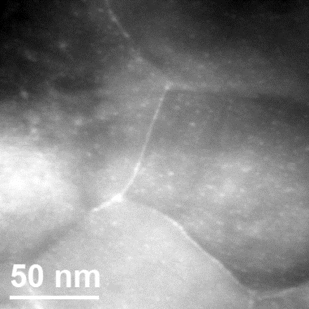
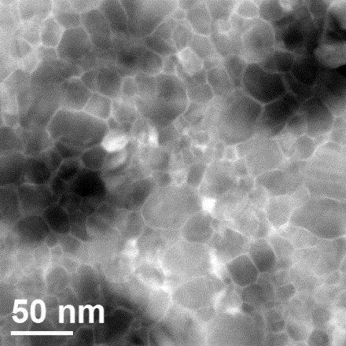
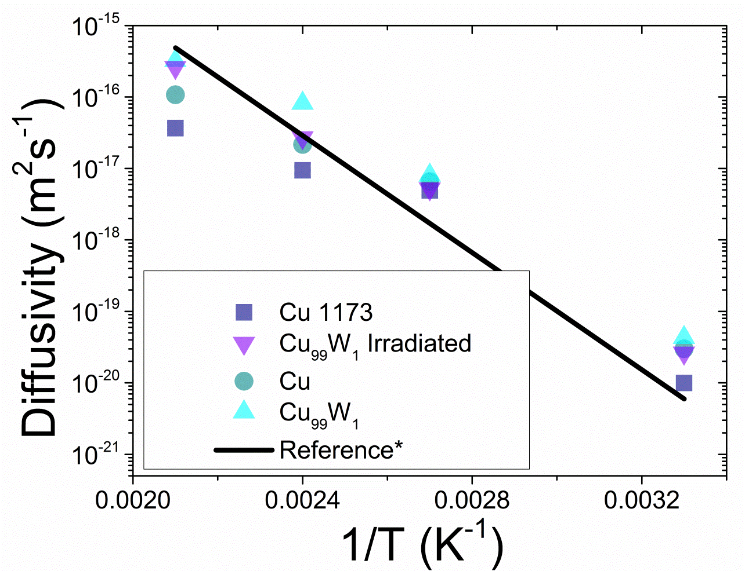
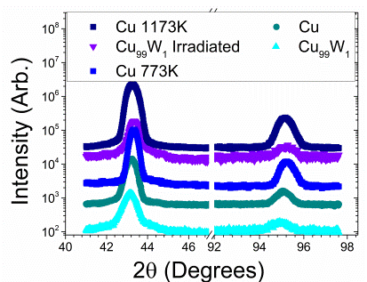
Size Dependent G.B. Diffusivity
K. Tai, S. Dillon, Acta Mater. (Accepted)
Notes:
Older work.. Measured effect of grain size on GB diffusivity. Limited effect relative to other reports in literature (we believe our analysis is more thorough and better founded). Small difference could relate to different models used and some contribution from triple lines.

Slide 33
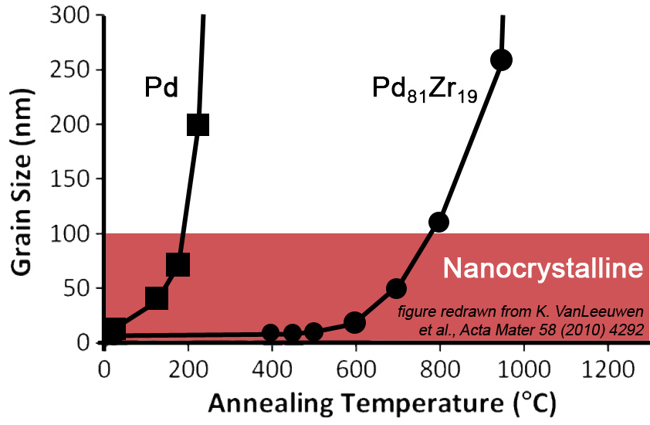
Nanocrystalline Thermal Stability
Nanocrystalline materials are unstable against grain growth at elevated temperatures
Binary alloying can increase thermal stability dramatically (e.g. PdZr, at right: VanLeeuwen et al Acta Mater 58 (2010) 4292)
WHY?
A (solvent) and B (solute) atoms
B atoms segregrate preferentially to grain boundary…
Notes:
First, talk about THERMAL STABILITY…
Then, talk about TAILORING GRAIN SIZE…

Slide 34
Nanocrystalline Thermal Stability
What mechanism best explains the thermal stability of nanocrystalline alloys?
Option #1 - Thermodynamics
Option #2 – Kinetics + Thermo
Notes:
First, talk about THERMAL STABILITY…
Then, talk about TAILORING GRAIN SIZE…

Slide 35
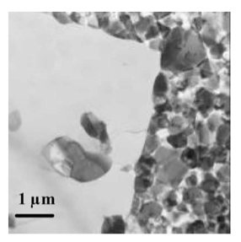
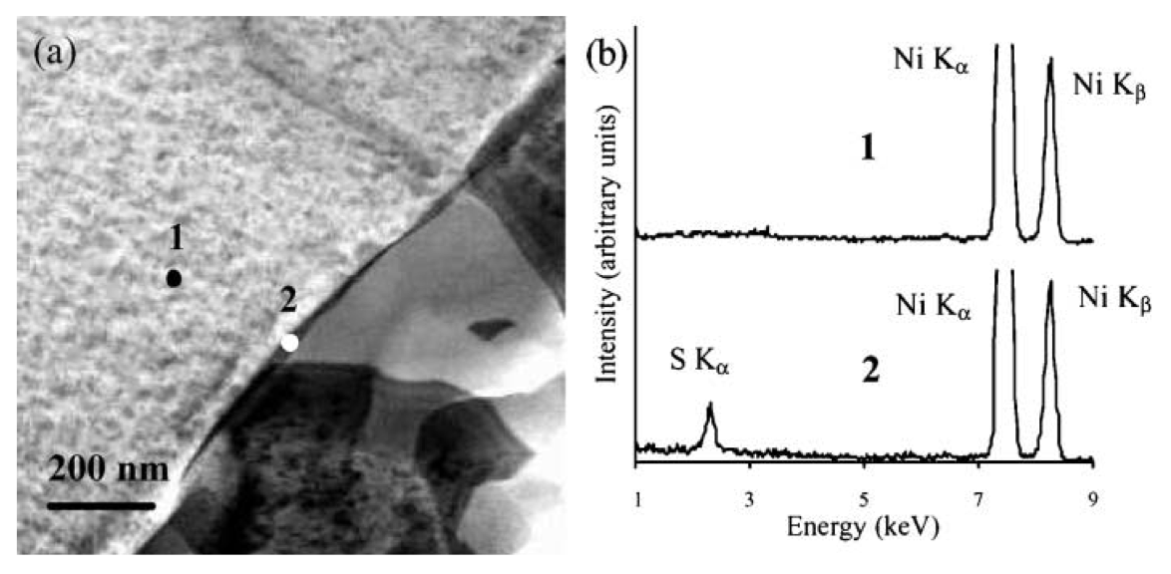
Evidence of Complexions in Nanocrystalline Ni
G.D. Hibbard et al., Scripta Mat. 47 (2002) 83-87
Destabilization of nanocrystallinity correlated with GB phase
Sulfur is a common impurity in electroplated Ni
Abnormal grains (high GB mobility) have complexion-like S-rich grain boundary phase (G.D. Hibbard et al., Scripta Mat 47 (2002) 83-87)
Notes:
Evidence implicating role of complexions in nanograin destabilizing mechanism

Slide 36
A Possible New Complexion in Ni-W (Following Wynblatt et al.’s Multilayer GB Segregation Model)
Nanocrystalline Thermal Stability
To verify/disapprove this prediction:
Specimens made at Clemson
STEM Characterization current in progress at LU
Ni-W (made by electrodeposition)
Supersaturated with W
Heat Treatment: 700ºC, 4hrs + 400ºC, 24hrs
Inhibit grain growth
No severe embrittlement
Notes:
Dangling bonds
(incoherent interface)
High-energy W broken bonds
→ W depletion at the very core?

Slide 37
Nanocrystalline Thermal Stability
Electroplated NiW (Luo et al.)
Annealed at 700ºC/400ºC
New results from ARM200F suggest W segregation at GBs (Zhiyang Yu)
HAADF
ABF
Sputtered NiW (Harmer et al.)
Sputtering in progress!
Results coming soon…
W segregation at GB
HAADF
ABF
Zhiyang Yu

Slide 38
Nanocrystalline Grain Size Tailoring
There is an “equilibrium grain size” that can be “chosen” by selecting a specific binary alloy composition
We make predictions for FeZr and NiBi grain size (next slide)
experiment
model
F. Liu and R. Kirchheim, J. Cryst. Growth 264 (2004) 385
J. R. Trelewicz and C. A. Schuh, Physical Review B 79, 094112 (2009)

Slide 39
Nanocrystalline Grain Size Tailoring
Fe-Zr
Ni-Bi
Predictions by Luo et al. using Wynblatt GB model + bulk CalPhaD

Slide 40
Experimental Tools: JEM-ARM200F
Sub-angstrom imaging of the Al₂O₃ lattice!
HAADF
[2201]
Zhiyang Yu
Operating voltage | 60-200kV
Probe diameter | 0.06nm (200kV),
Capabilities | EDS (Silicon Drift Detector), EELS, Annular BF, HAADF
Notes:
ARM200F is now up and running at Lehigh!

Slide 41
Computational Tools: Quantitative Electron Microscopy

Slide 42
Computational Tools: Quantitative Electron Microscopy Contd.
La-Hf co-doped Alumina

Slide 43
Experimental Tools: Nano-Mill
Argon Ion Beam
Operating voltage | 50-2000eV
Resolution | < 2µm
Notes:
NanoMill is now up and running at Lehigh!

Slide 44
Experimental Tools: In-situ Hot Stage
Max Temperature: 1200°C
Ramp Rates: 10⁶ °C/sec

Slide 45
Thank you

Slide 47
Content
Organization
meetings, web site, team players
Goals and Broad Objectives
central scientific issues, technical capabilities of team
Material Systems and Rationale
Achievements
Exploratory Studies
Future Meetings
Notes:
Emphasize team interactions and how the elements of the program are being successfully integrated into a unified single coherent program. This will also be apparent from the subsequent presentations.

Slide 48
Experimental Tools: TEM OIM
Orientation map of a Copper film with a 110 nm average grain size
A. D. Darbal et al., Microscopy and Microanalysis, 2012, Submited.

Slide 49
Experimental Tools: JEM-ARM200F
Operating voltage | 60-200kV
Probe diameter | 0.06nm (200kV),
Capabilities | EDS (Silicon Drift Detector)
 | EELS
 | Annular Bright Field Detector
 | High Angle Annular Dark Field Detector
GaAs
001 projection
Notes:
Ga: 31, As: 33

Slide 50
Experimental Tools: Nano-Mill
Argon Ion
Operating voltage | 50-2000eV
Resolution | < 2µm

Slide 51
Experimental Tools: In-situ Hot Stage
Max Temperature: 1200°C
Ramp Rates: 10⁶ °C/sec

Slide 52
Computational Tools: Quantitative Electron Microscopy
xHREM
Image Simulation
DFT calculation
Hf on Alumina (11-20) Surface

Slide 53
Exploratory Systems: WC-M
WC-Stainless Steel
Fe rich binder phase
Ana Senos, University of Aveiro, Portugal

Slide 54
Exploratory Systems: B₄C Nanofibers
Crystal
1100°C
Injected
Barium
Interphases
(001)
Crystal
Crystal
1200°C
(001)
Crystal
(001)
Crystal
1300°C
Crystal
(001)
Crystal
1400°C
Crystal
Crystal
Amorphous layer
1500°C
(001)
Crystal

Slide 55
Bear Creek Meeting, October 2nd -6th, 2012
Manfred Ruehle
Chris Schuh
Dominique Chatain
Michael Finnis
Wayne Kaplan
Alan Ardell
Paul Wynblatt
Reiner Kirchheim
Ming Tang
Carl Krill
Andrew Rappe
W. Craig Carter
Michael Baurer
Michael Hoffman
Andrea Hodge

Slide 56
KU
Facilitation of Communications
CU
Sample Fabrication
Thermodynamic Modeling
Grain Growth Kinetics
Impedance
Measurements
LU
AC STEM
Sample Fabrication
Novel Processing Approaches
Atomistic Modeling
CMU
UIUC
GBCD, GBED
Mesoscale Modeling
First Principles
Calculations
Sample Fabrication
Diffusion Measurements
Thermal Property Measurements

Slide 58
Nickel - Bismuth

Slide 59
Nickel - Bismuth
Different bismuth Bi-layer segregation Behavior
{-202}
{11-1}

Slide 60
Bi-layer Thermodynamic Stability
Strong Ni-Bi: ½|E_{Ni-Ni}| + ½|E_{Bi-Bi}| < |E_{Ni-Bi}|
Weak Bi-Bi: |E_{Bi-Bi}| << |E_{Ni-Ni}|
Ω_{Ni-Bi} = -14.8 kJ/mol
Jian Luo, Huikai Cheng, Kaveh Meshinchi Asl, Christopher J. Kiely, and Martin P. Harmer, Science 23 September 2011: 1730-1733.

Slide 61
Validation Experiments
 | Annealing temperature (°C) | T_{anneal}/T_{melt}
Ni-Bi | 700 | 0.56
Cu-Bi | 492 | 0.56
Fe-Bi | 746 | 0.56

Slide 62
Atomistic Modeling
Surface
Low Σ Boundaries
High Angle Boundaries
Energies, Diffusivities (f[composition, temperature, stress])

Slide 63
First Principle Calculations: Ni-Bi
Σ3 GB (111):
γ = 0.028 eV/Å² = 0.045 J/m²
Bare surface (111):
γ = 0.117 eV/Å² = 1.87 J/m²
Bi on Ni surface (111)
Bi in Ni
Grain Boundaries
Bi/Ni swap in bulk Ni: ΔH (Bi in Ni) = 0.85 eV
Layer spacings:
Bi-Bi: 3.0Å
Ni-Bi: 2.2Å
Ni-Ni: 2.0 Å
Bi monolayer in bulk Ni:
5Ni: B-A-Bi-B-A-C- ΔH = 0.158 eV/Å²
Monolayer most stable
Bilayer is unstable
(Monolayer → trilayer)
Bi bilayer in bulk Ni:
5Ni: B-A-Bi-Bi-B-A-C- ΔH = 0.125 eV/Å²
Bilayer is more stable than monolayer and trilayer
Notes:
4 atoms→ 1 monolayer

Slide 64
GB Complexions – MC Simulation
-Ni-Bi system
Finnis-Sinclair potential
semi-grand canonical MC simulation
Σ5 twist boundary, (001) planes

Slide 65
Measuring G.B. Diffusivity in Metals
Grain Boundary Diffusion vs. Complexions Types in Metals
Quantifying ‘nanoscale effect’ on G.B. diffusion
Scaling effect?
AGG in thin films effect on D_{GB}?
Characterizing G.B. diffusion in Bi-doped Cu
D_{GB}
?
10⁰
10²
10⁴
10⁶
Grain Size (nm)
Constant Source Au Diffusion into Cu
Au
Cu
Si-Substrate
w/ native SiO₂

Slide 66
Variation in Nano G.B. Diffusion Results
Kolobov et al. Russian J. Phys. (2008)
Wurschum, Herth, Brossmann, Advanced Engineering Materials (2003)

Slide 67
Results: Au G.B. Diffusion in Cu
1%W-Cu, 200 ºC, 30nm
*Lit. Cu D_{GB}
Pure Cu, 200 ºC, 20µm
Cu, 900°C, 20 µm
Cu as prepared, 150 nm
Cu-W as-deposited, 30 nm
Cu-W irradiated, 80 nm
1/T (K⁻¹)
*Ref. Surholt, Mishin, Herzig, Phys. Rev. B (1994).

Slide 68
Cu-Bi vs. Ni-Bi
Au diffusion in Cu-Bi
Cu diffusion in Ni-Bi _
Cu, 900°C
Cu-Bi, 500°C
Cu-Bi, 900°C
1/T (K⁻¹)

Slide 69
Metal-Complexionized Ceramics
Hypothesis
All-metal complexions can be thermodynamically stabilized within defined limits of extremely low oxygen partial pressures.
The oxygen partial pressure limits are adjustable by temperature and alloying
(Cu/Al).
-40
log pO₂
0
Eduardo Saiz

Slide 70
Alumina: Comparison of gb mobility
1000 ppm Cu,
1000 ppm Ti,
600 ppm Cu – 400 ppm Ti)
M60
Centorr

Slide 71
Transition in wetting behavior
Cu
Starting: Alumina + Cu₂O
SPS
1300 ºC, 25 min, 60 MPa
1 μm
Alumina – 5 vol % Cu
25 μm
Alumina – 10 vol % Cu
Change in Cu morphology correlates with greater grain growth and tabular grain morphology
Cu
25 μm

Slide 72
The Role of Complexions in Thermal Stability of Nanocrystallinity
The GB Energy Theory:
Binary alloying reduces GB energy
If reduced to zero, grain growth stops
In theory, GB energy can go to 0 if segregation excess and energy of segregation large enough
First proposed by J. Weissmuller (1993)
However…
In practice, 2x-3x reduction reported
If chemical interactions are considered, GB energy does not always theoretically go to zero
Is nanocrystalline stability related to GB energy or mobility (complexion transition)?
GB segregation in nanocrystalline material
A.J. Detor and C.A. Schuh, Acta Materialia 55 (2007) 371-379
Notes:
MIT group has been studying a very interesting series of alloys (Ni-W in this example) which show enhanced stability in bulk nanograin form. They are typically made by electrodeposition. Mechanism is unclear and the role of complexions has not been considered, therefore making this an interesting topic for research.

Slide 73
Evidence of Complexions in Nominally Pure Nanocrystalline Ni
G.D. Hibbard et al., Scripta Mat. 47 (2002) 83-87
Destabilization of nanocrystallinity correlated with GB phase
Sulfur is a common impurity in electroplated Ni
Abnormal grains (high GB mobility) have complexion-like S-rich grain boundary phase (G.D. Hibbard et al., Scripta Mat 47 (2002) 83-87)

Slide 74
Preliminary Ni-W Results: 5 Phases!
STEM-HAADF
Ni-W Specimen Info
Electroplated Ni-W
Nominally 20 wt. % W
Annealed 700ºC 4 hr Ar-H₂
Initial STEM-EDS indicates 5 phases:
Expected phases:
Ni-W (Ni-rich) – 30 nm grains
Ni-W (W-rich) – abnormal grains
Unexpected phases:
WO_{x} – abnormal grains
FeO_{x} – abnormal grains
WC – periodic rows of 10 nm nanoparticles
(STEM-HAADF images only)
NiW (Ni-rich)
NiW (W-rich)
FeO_{x}
WO_{x}
WC
500 nm

Slide 75
MURI Website

Slide 76
MURI Website

Slide 77
MURI Website

Slide 78
Research Capabilities
State-of-Art Characterization
-- Atomic resolution AC-STEM (ARM200F) [LU]
-- Nano EBSD (TEM) [CMU]
-- In-situ Hot stage [LU]
-- NanoMill [LU]
Quantitative Multi-scale Modeling
-- First Principles Calculations [CMU]
-- Molecular Dynamics [LU]
-- Mesoscale Modeling (MC, Phase Field) [CMU]
-- Thermodynamic Modeling [CU]
-- Quantitave Electron microscopy [LU]
Properties
-- Grain Boundary Diffusion [UIUC]
-- Thermal Conductivity [UIUC]
-- Electrical Conductivity [CU]
Notes:
Emphasize real boundaries

