Slide 1
Tailoring of Atomic-Scale Interphase Complexions for Mechanism-Informed Material Design
Office of Naval Research
Multidisciplinary University Research Initiative Project Review Meeting
December 18, 2012
ONR Topic Chief: David Shifler
Developing Predictive Thermodynamic Models …and Validation Experiments
Presented by Jian Luo
On Behalf of the MURI Team

Slide 2
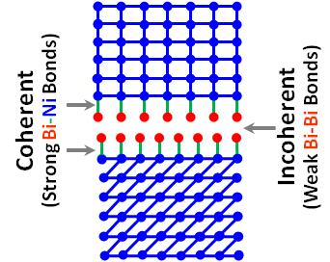
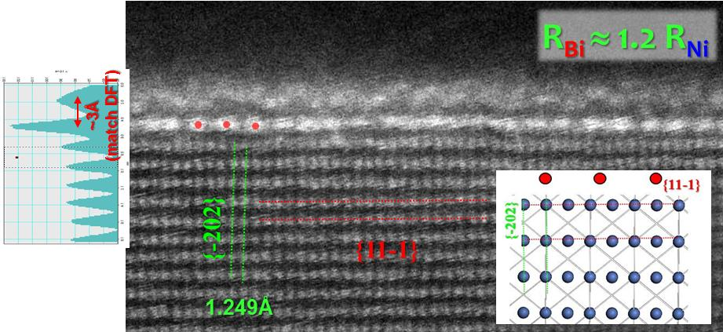
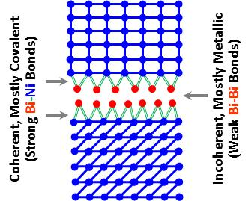
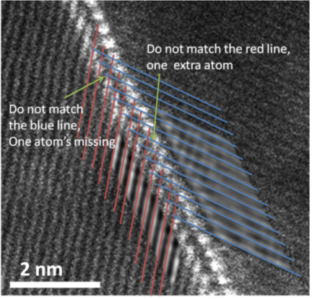
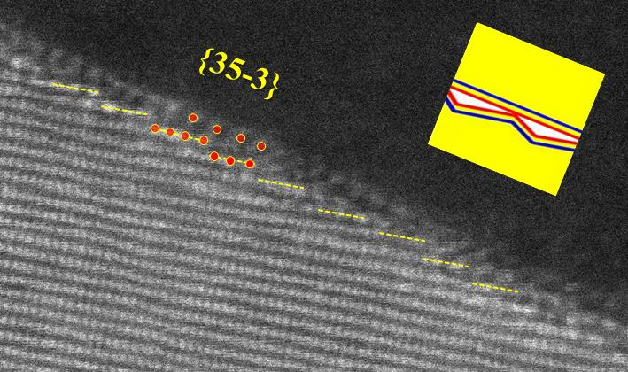
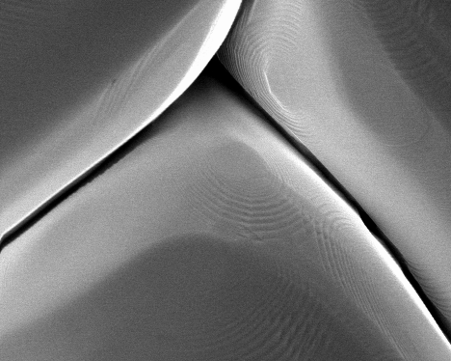

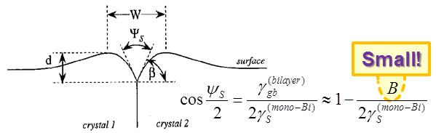
Based on the Feedbacks from DFT Calculations and STEM…
A Revised Thermodynamic Description of Bilayers?
Original
Suggested by DFT
(@CMU)
Specific Bilayer Structure ~ Orientation
DFT (CMU)
Bi on Ni (111)
“4 on 9”
reconstruction
Reconstruction
(NOT 1 on 1)
Coherent?
A “Coarse-Grained” Description
Ni Layer
Ni Layer
Ni Layer
Coherent Interface
Strong Bi-Ni Bonds
Bi Layer
Incoherent Interface
Weak Bi-Bi Bonds
Atomic Steps
Bi Layer
Ni Layer
Ni Layer
Deep Groove
Ni Layer
Experimental Evidence
2 adsorbed Bi layers are weakly bonded
Bilayer Stability (The Key Idea unchanged):
Strong Ni-Bi (Measured by Ω_{Ni-Bi})
Weak Bi-Bi
CMU:
Ni annealed in Bi vapor

Slide 3
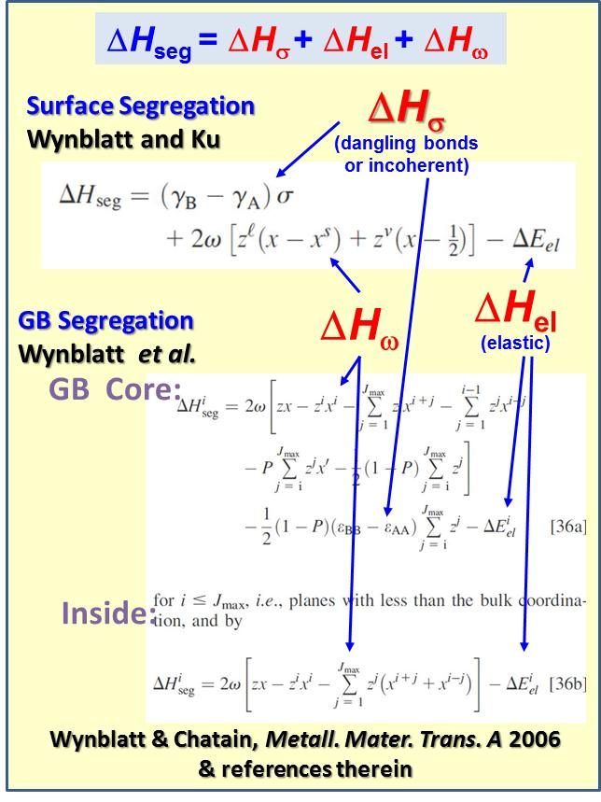
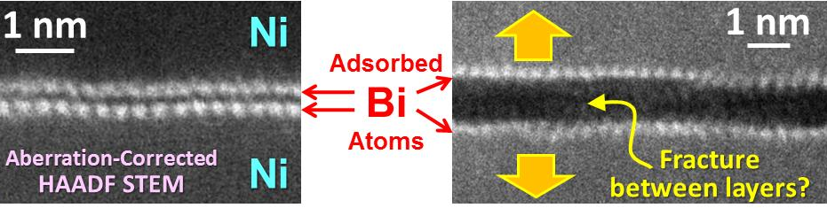
Key Parameters for Prediction?
Segregation driving forces in metals:
ΔE_{elastic} = f(R_{B}/R_{A})
ΔH_{σ} ∝ |E_{B-B}| - |E_{A-A}|
ω ≡ E_{A-B} - ½(E_{A-A} + E_{B-B}); Ω ≡ zNω
Wynblatt & Chatain
Metall. Mater. Trans. A 2006
Strong Ni-Bi
Weak Bi-Bi
Science, 333: 1730 (2011)

Slide 4
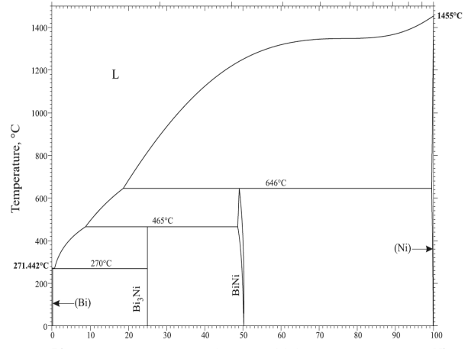
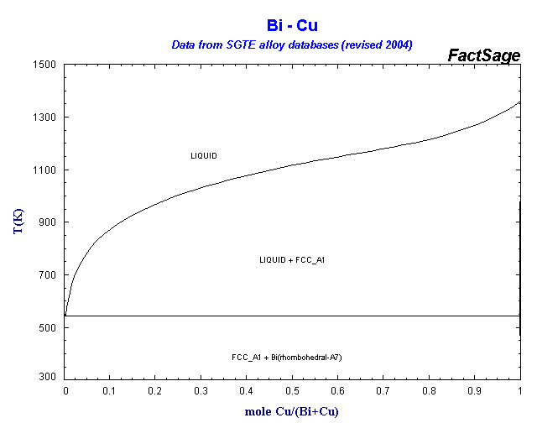
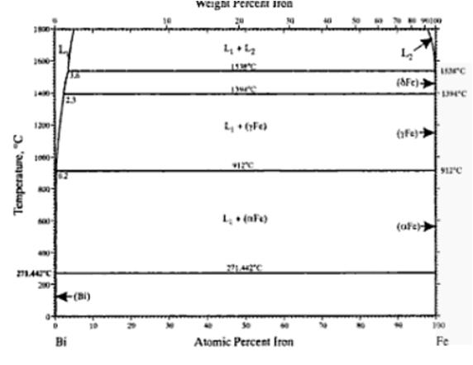
To Predict Bilayer Stability…
Large ΔE_{elastic}
Large |E_{B-B}| - |E_{A-A}|
Varying Ω_{A-B} ∝
E_{A-B} - ½(E_{A-A} + E_{B-B})
Bi doped Ni
Bi doped Cu
Bi doped Fe
Bi
Ni
Bi
Cu
Bi
Fe
Miedema:
Ω_{Ni-Bi} = -14.8 kJ/mol
Ω_{Cu-Bi} = +14.2 kJ/mol
Ω_{Fe-Bi} = +72.3 kJ/mol
DFT (CMU):
Ω_{Ni-Bi} = -16.4 kJ/mol
Ω_{Cu-Bi} = +34.8 kJ/mol
Ω_{Fe-Bi} = +91.6 kJ/mol
Gao & Widom
(Ω ≡ 4ΔH^{mix}_{0.5})
Reducing Bilayer Stability Predicted…
An experiment designed in Feb. 2012 (@ a MURI meeting at TMS)
Subsequently, specimens were made at Clemson and characterized at Lehigh; we observed that:
observed, but in a narrow window
Bilayers are…
ubiquitous
NOT observed

Slide 5
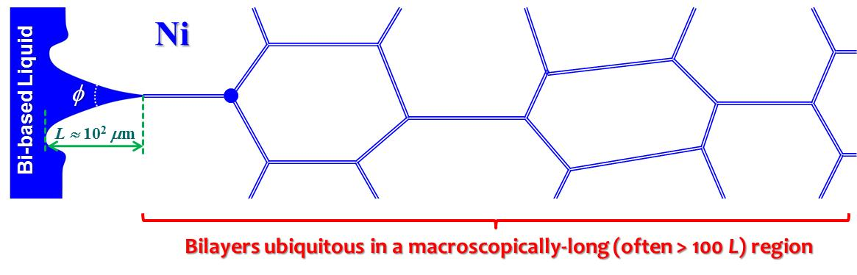
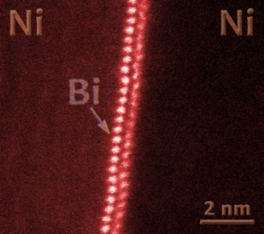
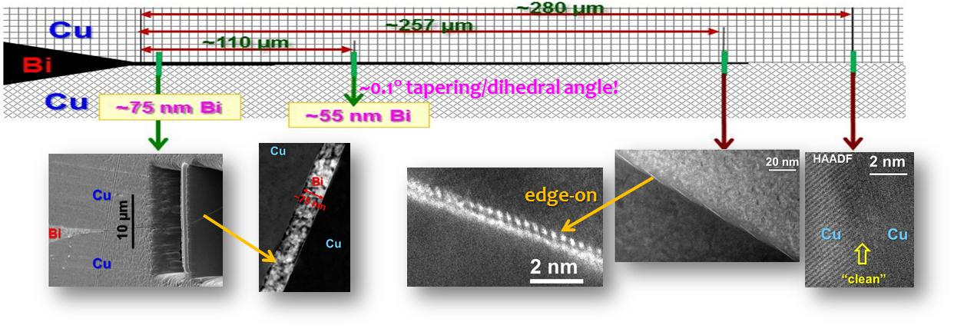
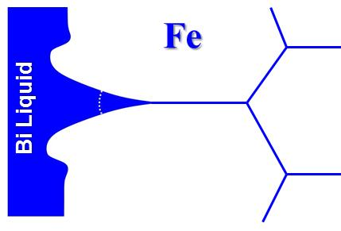
Ni-Bi
Ω_{Ni-Bi} = -16.4 kJ/mol
(DFT, Gao & Widom)
Science 2011
Cu-Bi
Ω_{Cu-Bi} = 34.8 kJ/mol
(DFT, Gao & Widom)
Scripta Mater. 2013
Fe-Bi
Fe
“Clean”
Ω_{Fe-Bi} = 91.6 kJ/mol
(DFT, Gao & Widom)
Fe

Slide 6
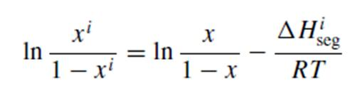
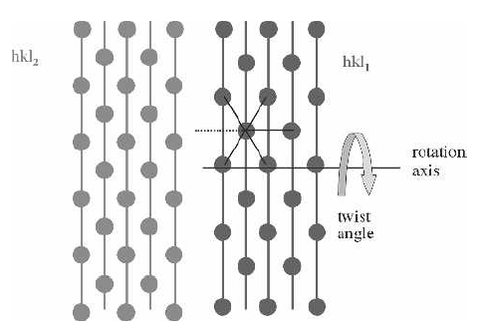
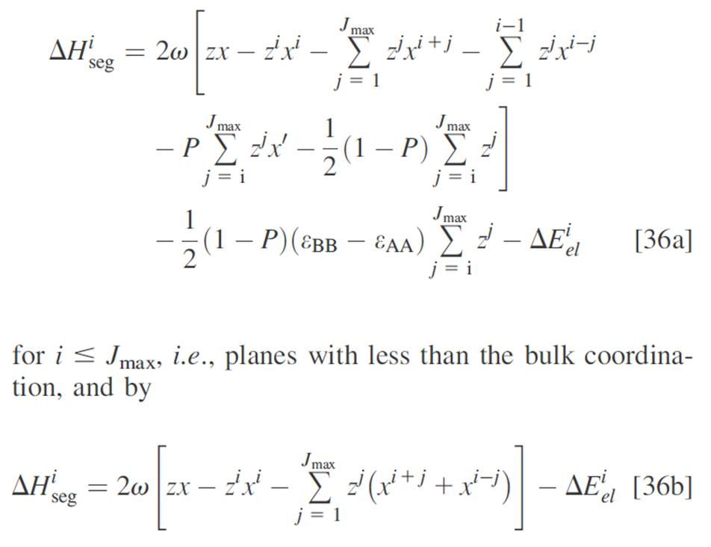
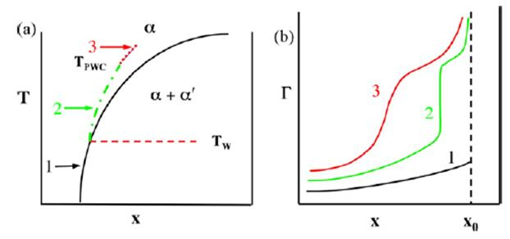
Wynblatt et al.’s Multilayer GB Segregation Model
Wynblatt, Chatain et al. [JMS 2005; 2006, MMA 2006]
Same Crystal Structure
Segregation Enthalpy
GB Core:
Weak Segregation Systems?
Inside:
“Solid-State” Complexion Transition

Slide 7
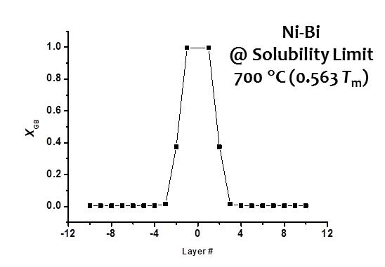
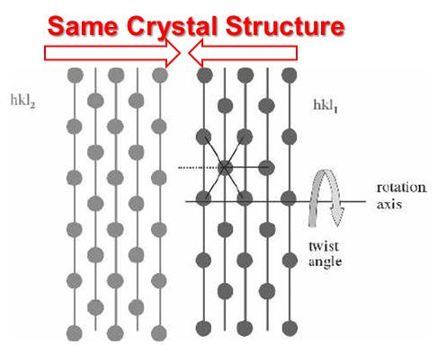
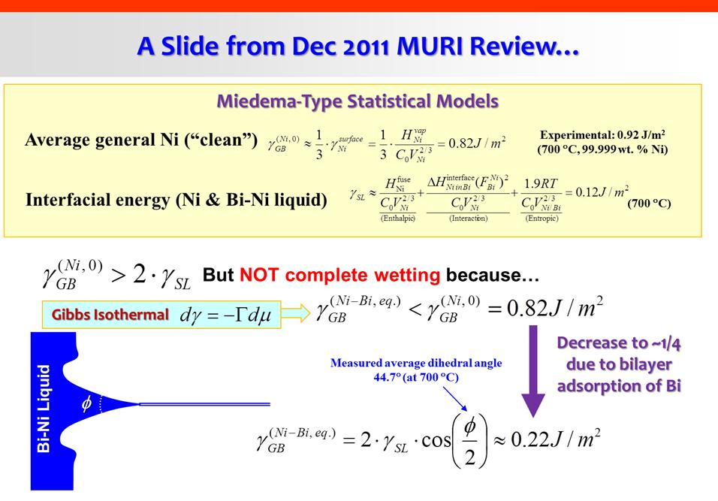
The Most Recent Modeling Results using the Wynblatt Model
[See the description of the Model: Wynblatt & Chatain, Metall. Mater. Trans. A 2006]
The Wynblatt Model
DFT
para.
(CMU)
CalPhaD
(111)_{FCC} or (110)_{BCC} high-angle (low-symmetry) twist GBs
T/T_{m} =0.563
Fe-Bi
Cu-Bi
Ni-Bi
Approx.
Solid
Solubility
Limit
10⁻⁶ 10⁻⁵ 10⁻⁴ 10⁻³ 10⁻²
X_{Bi}
X_{Bi}⁽⁰⁾
(Fe-Bi)
X_{Bi}⁽⁰⁾
(Cu-Bi)
X_{Bi}⁽⁰⁾
(Ni-Bi)
Consistent
with
Experiment
X_{Bi}⁽⁰⁾
(Ni-Bi)
In the Meta-Stable Supersaturated Region:
Effective γ_{GB} → 0
⇒ “Equilibrium” Grain Size
(Weissmuller, Johnson, Kirchheim, Schuh et al.)
10⁻⁶ 10⁻⁵ 10⁻⁴ 10⁻³ 10⁻²
X_{Bi}

Slide 8
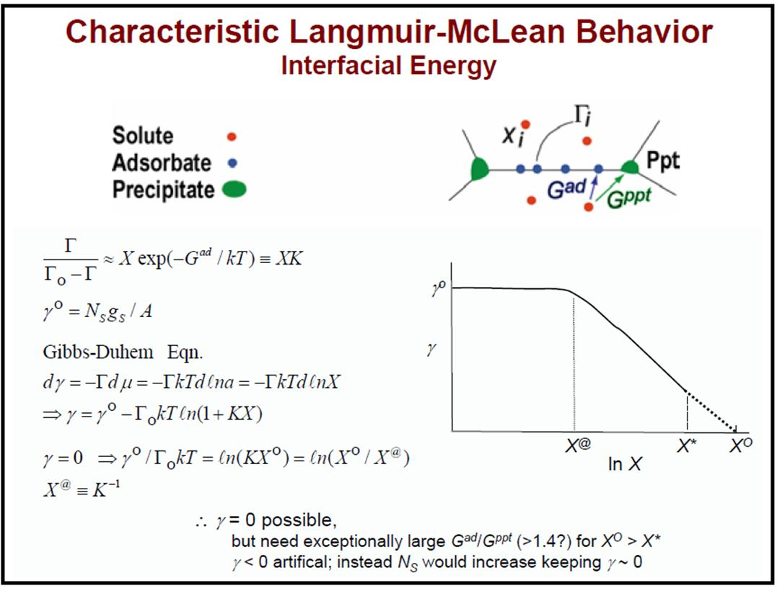
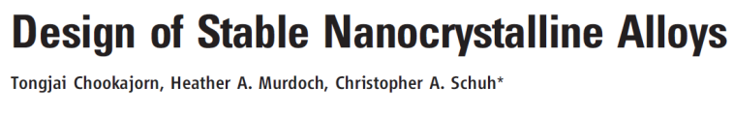
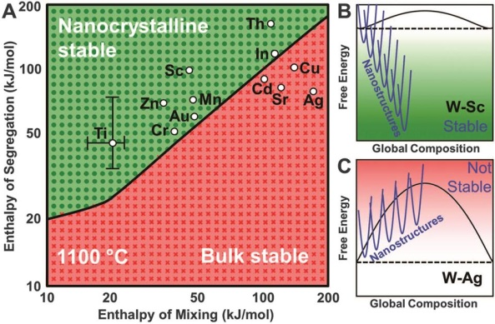
Stabilization of Nanocrystralline Alloys via GB Segregation (a.k.a. Complexion)
Kinetic Stabilization
Solute drag
Second phase pinning
Chemical ordering
…
New Insight: The complexion theory argued that segregation induced interfacial disordering can increase GB mobiles (demonstrated in Al₂O₃, Al-Ga etc.)
competing
This MURI revealed (for Ni-Bi)…
Bi adsorption reduce γ_{GB} of Ni significantly (not yet 0)
Bi inhibits Ni GG at low T, but Promote GG at high T!
Thermodynamic Stabilization
(reducing γ_{GB}, ideally to ~ 0?)
Schuh & co-workers’ recent work (Science 2012)
Show the importance of simultaneously evaluating bulk and GB thermodynamics
A GB
transition?
Can we pursue a more quantitative
“CalPhaD for Nanocrystalline Alloys”
From the late
Dr. Rowland Cannon (2004 GRC)

Slide 9
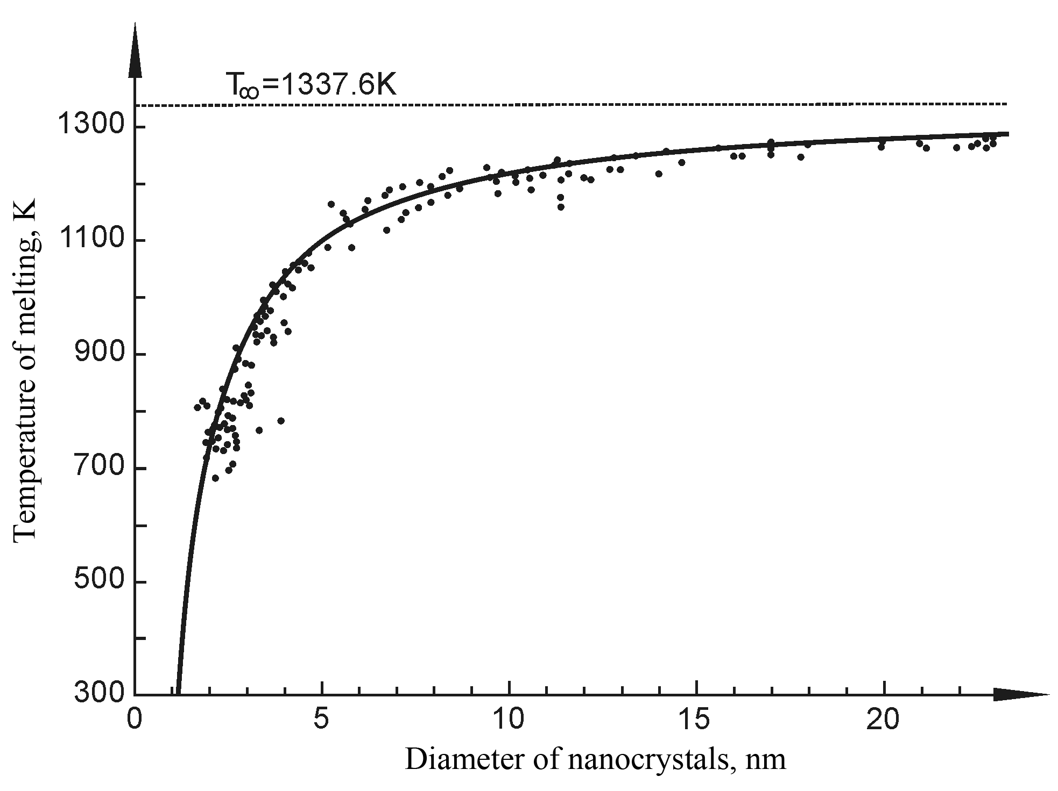
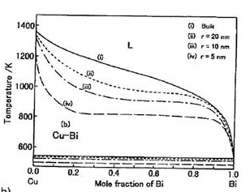
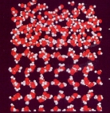
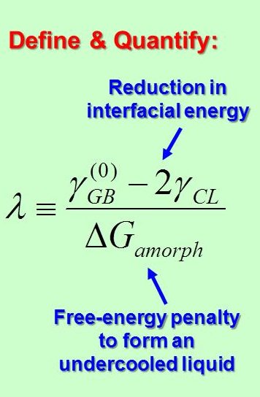
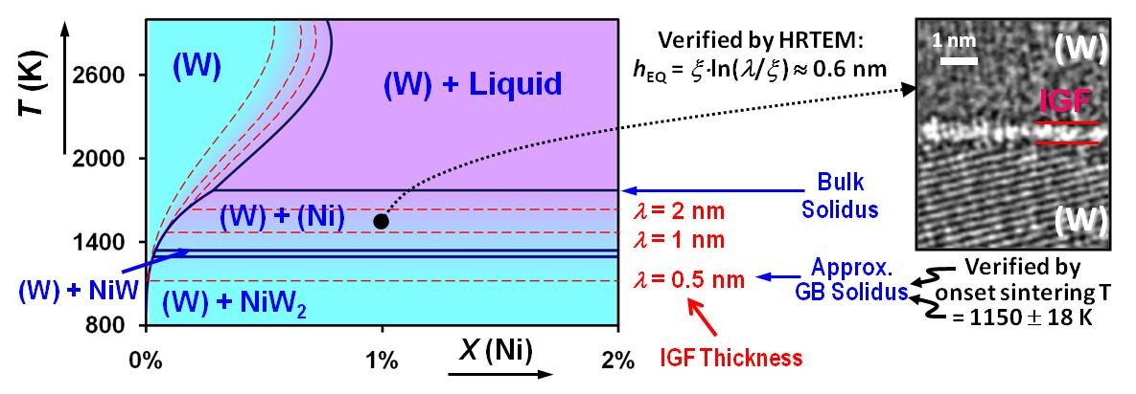
Background: Developing Design Tools for the Materials Genome Initiative
CalPhaD for “Complexions” & “Nano-Phases”
Related, but different phenomena
2 related but different tasks
T. Tanaka et al. 2001
Binary
Melting T for
Au Nanoparticles
Premelting
(Complexion)
A Successful Example of Predictive Modeling (AFOSR Project)
To predict the stabilization of nanoscale quasi-liquid intergranular films (complexions)

Slide 10
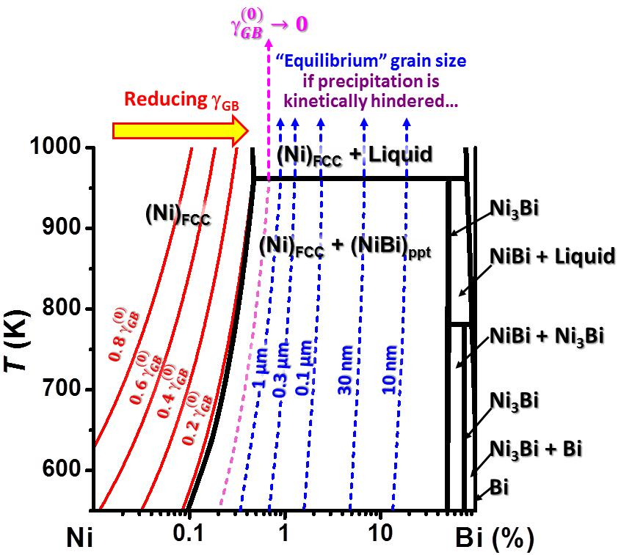
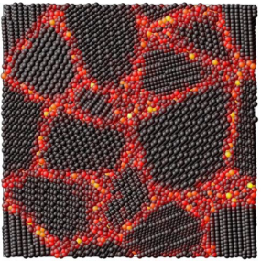
Developing A New “Materials Genome” Tool for Designing Nanocrystalline Alloys?
“CalPhaD for Nanocrystalline Alloy” Diagram
GB Complexion Model
(Wynblatt model for this case)
Metastable nanocrystalline alloys possible, but probably impractical for Ni-Bi…
Consistent
with
Experiment
+
Bulk CalPhaD
(Computational Thermodynamics)
Cu-Bi
Mayr & Bedorf
Phys. Rev. B 2007

Slide 11
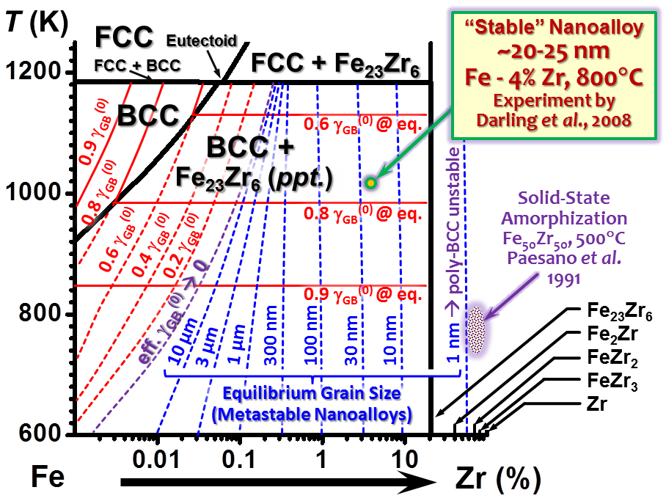
A More Practical Case
“CalPhaD for Nanocrystalline Alloy” Diagram for Fe-Zr Consistent with Prior Experiments
No fitting/free parameters used other than the CalPhaD data obtained in literature!

Slide 12
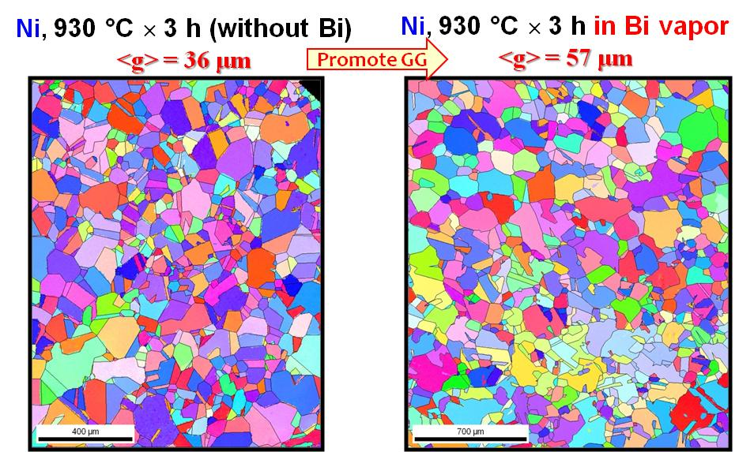
Grain Growth (GG): Intriguing Results
Bi inhibits GG at low T’s?
Bi promote GG (no AGG) at high T’s
Clemson Electrodeposited Ni & Ni-W
Isothermally annealed w/ or w/o Bi vapor, 4 hrs
CMU High-Purity Ni (930°C)
?
~40 μm
XRD,
confirmed by SEM
~20 μm
SEM
Confirmed
Clemson High-Purity Ni (1100°C)
Pure Ni: 137 μm
Ni (+ Bi liquid): 159 μm
Current Explanation:
At low T’s: Bi inhibits grain growth due to the reduction of driving force (γ_{GB}/γ_{GB}⁽⁰⁾ = ¼) and solute drag (given the large adsorption amount)
At high T’s: Bilayers become more “liquid-like” → the kinetic effect due to disorder overwhelms the thermodynamic stabilization and solute drag
UIUC GB diffusion measurements showed the consistent trends earlier…
STEM in progress at UIUC & Lehigh

Slide 13
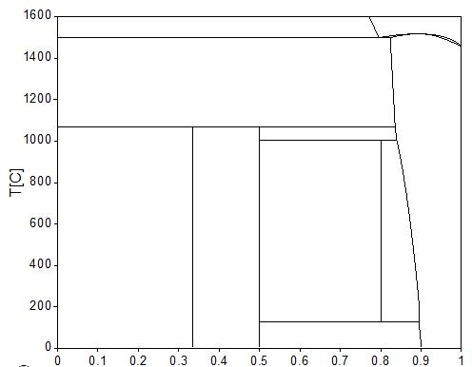
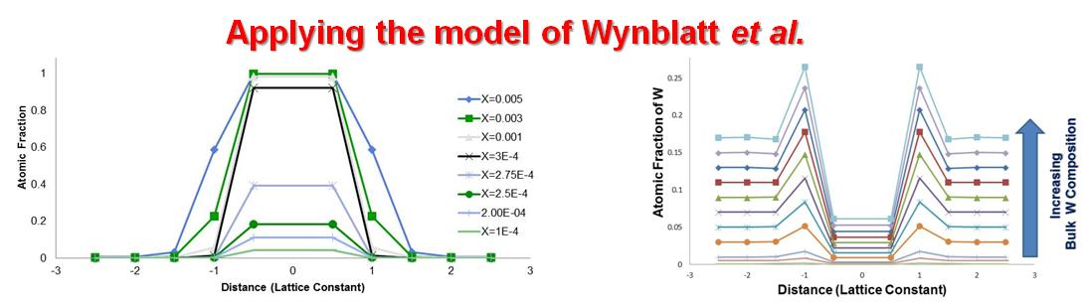
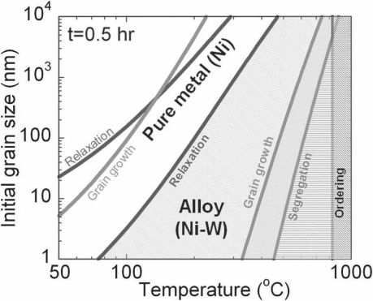
Bi doped Ni
W doped Ni
R_{Bi} = 1.78Å
R_{Ni} = 1.25Å
R_{W} = 1.39Å
R_{Ni} = 1.25Å
Strong Segregation
Limited Solubility
Weak Segregation
Large Solubility
ΔH_{σ} ∝ |E_{Bi-Bi}| - |E_{Ni-Ni}| < 0
Ω: small negative
ΔE_{el} big R_{B}/R_{A} = 1.42
ΔH_{σ} ∝ |E_{W-W}| - |E_{Ni-Ni}| > 0
Ω: small negative
ΔE_{el} moderate R_{B}/R_{A} = 1.11
Bi
Ni
W
Ni
Reduce γ_{GB} significantly
Promote GG at high T; inhibit GG at low T
Severe embrittlement
Reduce γ_{GB} moderately
Stabilize nano grain size
Good mechanical properties
Nanocrystalline W-Ni
(Schuh et al. & others)

Slide 14

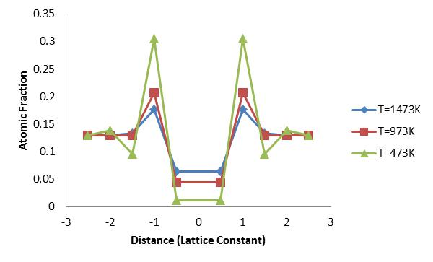
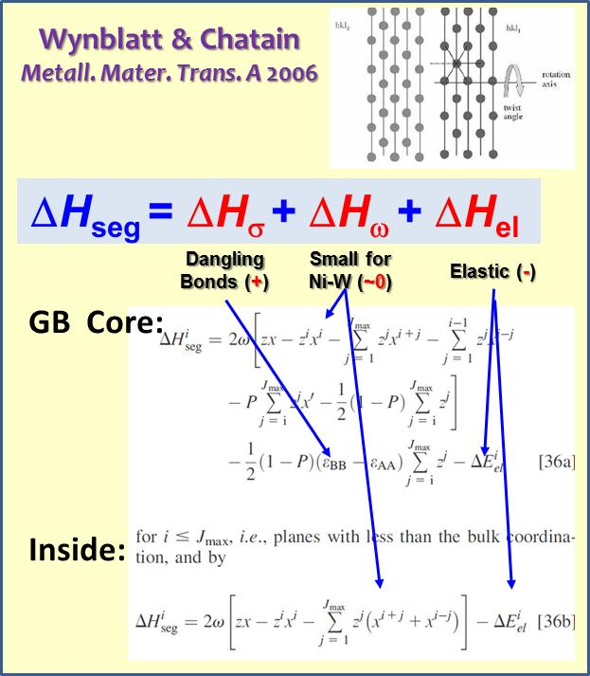
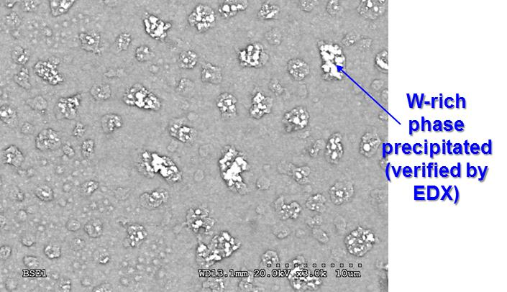
Possible Complexion Structure in Ni-W
(Following Wynblatt et al.’s Multilayer GB Segregation Model)
Inhibit grain growth
No severe embrittlement
To verify/disapprove this prediction:
Specimens made at Clemson
STEM Characterization current in progress at Lehigh…
ΔH_{σ} = 0
ΔH_{el} = -0.05
(eV/atom)
ΔH_{σ} = +0.3
ΔH_{el} = -0.2
(eV/atom)
Ni-W (made by electrodeposition)
Supersaturated with W
Heat Treatment:
700°C for 4 hrs + 400°C for 24 hrs
Dangling bonds
(incoherent interface)
High-energy W broken bonds
→ W depletion at the very core?
Non-equilibrium W segregation possible during electrodeposition

Slide 15
Concluding Remarks
“Simple” thermodynamic models can predict useful trends
  Predicted decreasing bilayer stability in Ni-Bi, Cu-Bi and Fe-Bi verified by experiments
  DFT (and atomistic) calculations are useful for providing thermodynamic parameters (particularly in cases where experimental data are not available)
A new “CalPhaD for Nanocrystalline Alloys” method has been developed – in the spirit of the “Materials Genome” initiative?
  Combining complexion models & bulk CalPhaD
  Initial validation with literature data & our experiments
An Intriguing New Discovery
  Bi inhibits the grain growth of Ni at low T, but promotes grain growth at high T.

Slide 16
Backup Slides

Slide 17
Electrodeposited Ni specimens, annealed at 900 °C, 4 hrs
Ni
Grain Size Increases
Ni
in Bi vapor

