Slide 1
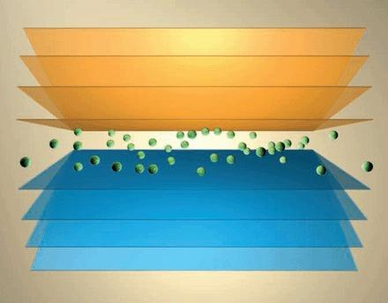


Simulational Studies of Complexions in the
Ni-Bi System
ONR – MURI program
J. M .Rickman
Materials Science and Engineering and Physics
Lehigh University
E. B. Webb III
Mechanical Engineering and Mechanics
Lehigh University
M. Widom
Dept. of Physics
Carnegie Mellon University
Students
Qin Gao
Denise Yin

Slide 2
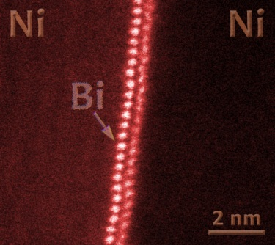
Outline
I. Atomistic Simulation
Finnis-Sinclair potential
semi-grand canonical ensemble
GB composition and structure
segregation and structure
II. First-Principles Calculations
- free-standing Bi film
Bi on Ni (111) surface
Bi film in bulk Bi
courtesy J. Luo
III Closing the Loop
potential development
transport properties (mass and thermal)

Slide 3
Multiscale Modeling
First-Principles Calculations
Atomistic Simulation
Continuum Description

Slide 4

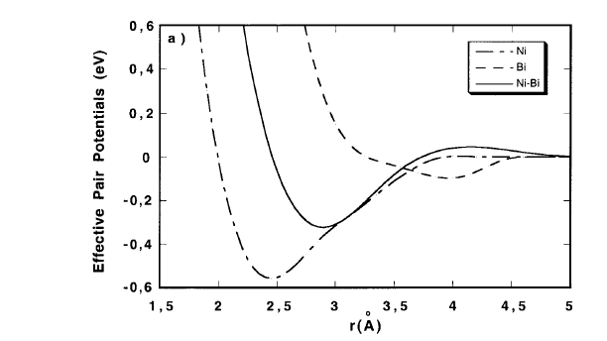


Many-Body Interatomic Potential
Landa et al. (1998,1999)
Finnis-Sinclair potential
Cubic spline fit
Atomic Radii
Ni: 1.24 Angstroms
Bi: 1.56 Angstroms

Slide 5

Methodology
Semi-grand canonical ensemble (Kofke & Glandt, 1987)
Fixed total number of particles
Legendre transforms
σ_{zz}
T

Slide 6
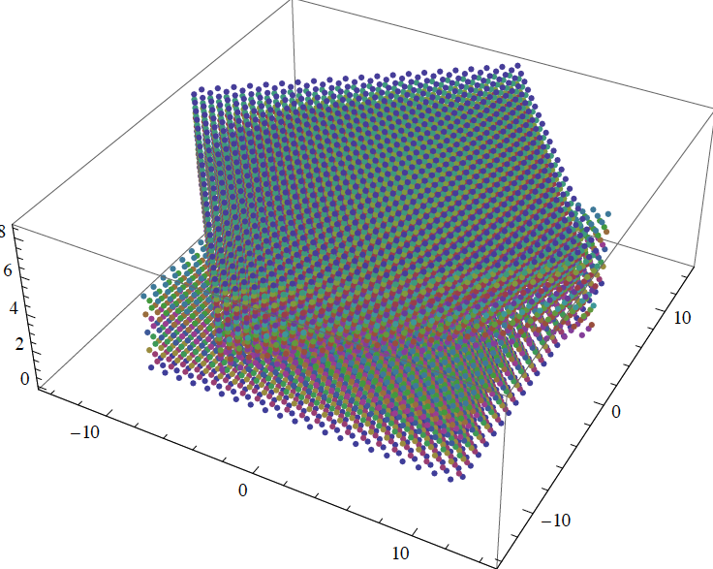
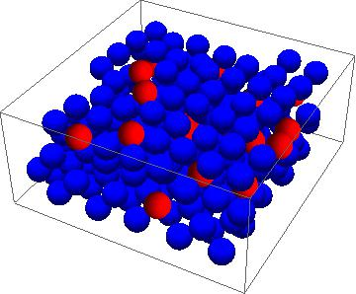
Constructing a Grain Boundary
1.) Σ5 Grain Boundary (Ni)
36.9⁰ twist boundary
2.) Σ13 Grain Boundary (Ni)
22.6⁰ twist boundary
Bicrystal
Σ5

Slide 7
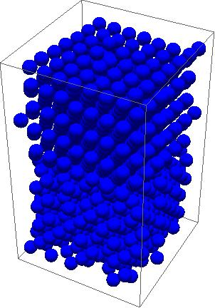
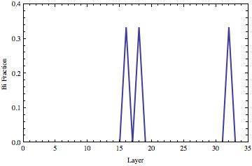
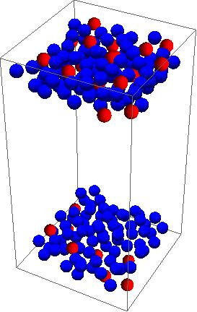
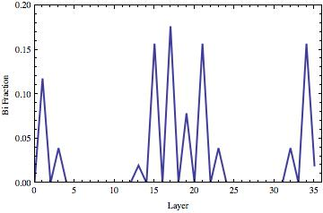
Varying the Chemical Pot. Difference - Layering
z
Δμ = -1.8 eV
Σ5 bicrystal
Δμ = -2.0 eV

Slide 8
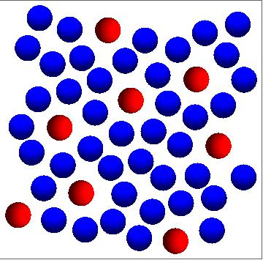
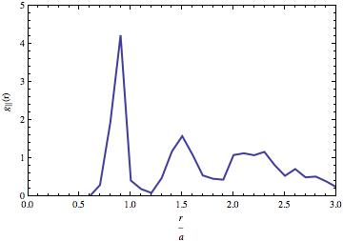
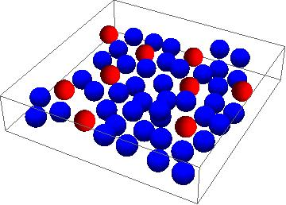
Interfacial Chemistry and Structure
Bi atom
radial distribution function
Δμ = -1.8 eV
Δμ = -1.9 eV

Slide 9
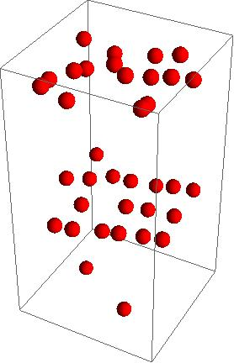


Segregation Enthalpy
Σ5 Boundary
ΔH = 1.25 eV
perform swap (Bi -> Ni) & relax
** Large ΔH due, in part, to relaxation of elastic energy.

Slide 10
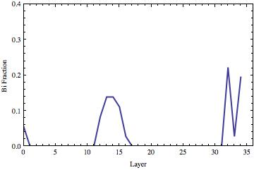
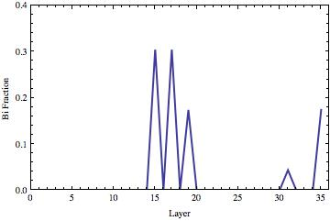
Impact of Stress
Δμ = -1.9 eV
No Stress
Compressive
Uniaxial Stress: 160 MPa

Slide 11
First-Principles Studies of Bi in Ni
Bulk alloy phases
Pure Ni surface and grain boundary energies
Bi hcp and hR2 films on bare Ni (111)
Bi atoms and films in pure Ni

Slide 12
Motivation
Quantum size effect of Bi on Ni (111) surface
Bi Segregation on Ni GB
Experiment:
3,5,7 layer stable films
hexagonal AB stacking (Bollmann etc., PRL, 2011)
Experiment:
Bi bilayers at Ni GB’s
(Luo etc., Science, 2011)

Slide 13
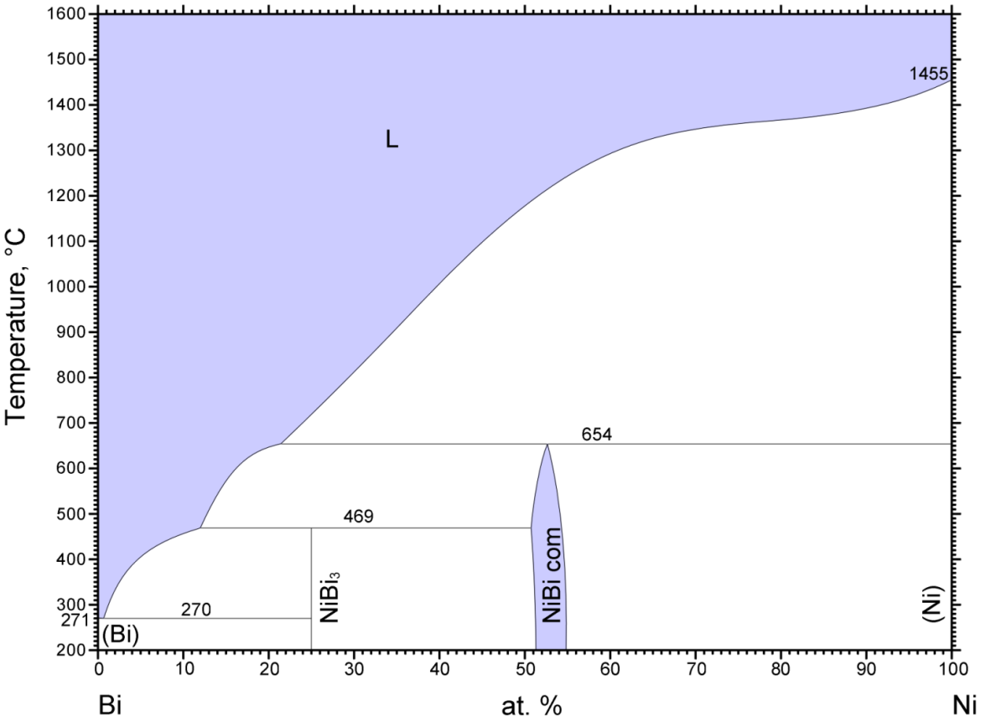
First-Principles Methods
- First-Principles Density Functional Theory Calculations
- Vienna Ab initio simulation package (VASP)
- projector-augmented-wave potentials, PBE generalized - gradient approximation, spin polarization (collinear), relaxed atomic positions and cell parameters
Validation with Bulk Alloy Phases
(Our Result)
(Expt.)

Slide 14
Pure Ni Surface and Grain Boundary Energies
Bare surface (111):
γ = 0.119 eV/Å²
γ = 0.149 eV/Å² (Expt., Tyson, 1977)
Coherent Σ3 GB (111):
γ = 0.028 eV/Å²
γ = 0.027 eV/Å² (Expt., L.Murr, 1975)
Σ3 (111)

Slide 15
Stability Due to Quantum Confinement
First brillouin zone of bulk hcp (Wiki)
States cross Fermi level periodically
Projected band structure of hcp Bi
Energy ocillation of freestanding Bi films

Slide 16
Bi hcp films on Ni (111)
(3x3) structure
Relative Surface Energy
[3-112] structure
1ML
1ML

Slide 17
Stable Bi hR2 films on Ni (111)
1ML

Slide 18
Bi Films in Bulk Ni
Enthalpy of Mixing
ΔH=E_{Bi-Ni} - N_{Bi}E_{Bibulk} - N_{Ni}E_{Nibulk}
4Ni: B-A-(Bi)-A-C-
5Ni: B-A-(Bi)-B-A-C-
6Ni: B-A-(Bi)-C-B-A-C-
7Ni: B-A-(Bi)-A-C-B-A-C-

Slide 19
Atomistic Simulation:
Potential Refinement and Transport

Slide 20
Review: Optimizing Ni/Bi Model
DFT Classical Classical
(original) (modified)
“Bulk Substitution”
(Ni₁₀₇Bi) 2.83 eV 4.58 eV 2.83 eV
Bi on Ni(111)
“valley” -4.91 eV -2.94 eV -4.62 eV
Bi on Ni(111)
“bridge” -4.85 eV -2.81 eV -4.48 eV
Bi on Ni(111)
“top” -4.31 eV -2.15 eV -4.01 eV
Collaborative efforts at CMU (Widom, et al.) and LU (Webb, et al.) advanced an optimized classical force field for complexion phase systems being studied experimentally.
This effort has continued to more closely investigate the Bi-Bi part of the classical potential.

Slide 21
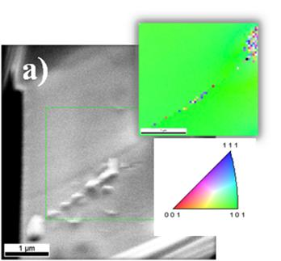
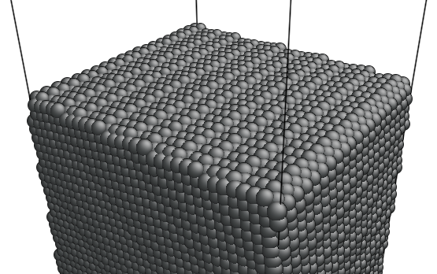
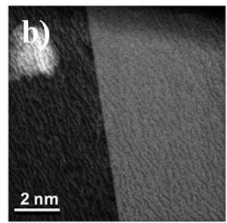
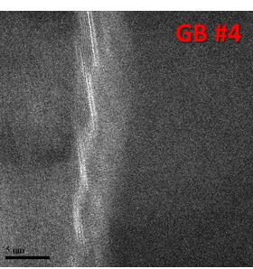
Vicinal Surfaces / General GBs
The capability to implement arbitrary (i.e. “general”) GB structures in the classical molecular dynamics simulations has been advanced for the Ni/Bi system.
Simulations
The images at left were taken from Luo, et al. wherein they used EBSD to characterize a GB in the Ni/Bi system at which no complexion phase was observed.
For this boundary, experiments reported a 7.5° misorientation from a low index direction perpendicular to [101] (i.e. associated with the vicinal [0 -13 -18] plane).
[0 -13 -18]
The bottom image at left was taken from the same material but shows a GB with pronounced faceting and Bi complexion phase formation.
The image above and at right is from Ni surface simulations en route to preparing models of the experimental GBs at left. Note roughness in the relaxed surface structure).
Depending upon the orientation of the second crystal used to form our bicrystal GB simulation models, we can now form either faceted or low misorientation boundaries.
Experiments

Slide 22
Model Predictions – Mass Transport
A goal of the molecular dynamics simulation research is to advance our first predictions about transport properties of complexion phases ahead of corresponding experiments. We will collaborate with Dillon, et al., to ensure predictions made can be tested via experiment.
    Mass transport calculations will reveal diffusivity as a function of complexion phase, grain boundary type (Ni/Bi), and stress.
Webb’s group is already performing mass transport calculations for Bi atoms at model Ni GBs equilibrated by Rickman’s group (Σ5 GB). We are now embarking on similar calculations for more general GBs.
(R(Δt))²
Diffusivity D_{2D} =
4Δt
By averaging over trajectories for all Bi atoms in the simulation, we compute a transport quantity that can be compared to experiment.
We will also compute D and grain boundary width δ as a function of T; note mass flux scales with the product Dδ.
R(Δt)

Slide 23
Model Predictions – Thermal Transport
A goal of the molecular dynamics simulation research is to advance our first predictions about transport properties of complexion phases ahead of corresponding experiments. We will collaborate with Dillon, et al., to ensure predictions made can be tested via experiment.
    Thermal transport calculations will reveal phonon interfacial thermal resistance for varying complexion phases and grain boundary type (Ni/Bi).
Thermal Flux J = GΔT = σ_{K}ΔT
If a constant heat flux J is applied across a boundary, a discontinuity in the otherwise linear temperature profile ΔT will manifest; the magnitude of ΔT for a given J determines interfacial thermal conductance G or what some call Kapitza conductance σ_{K}.
GB
~
Heat
In
Heat
Out
~
GB (Periodic)
GB (Periodic)
100s of nanometers … classical simulations only!

Slide 24
Thermal Transport Caveat Emptor
J = σ_{K}ΔT
Classical MD simulations will reveal the phonon contribution to Kapitza conductace; we will be able to compare σ_{K} for clean Ni GBs to complexion phase occupied Ni GBs; we can also compute differences in σ_{K} for different complexion phases.
In the absence of modification, classical MD cannot capture the electronic contribution to σ_{K} and for the Ni/Bi system, the electronic contribution may be non-trivial.
One possibility is that trends in phononic thermal transport properties will be similar to trends in electronic components of thermal transport; as such, a baseline shift may exist between simulation results and experiment.
Two temperature models exist to rectify the omission of electronic DOFs from classical MD models but these have not been investigated for the Ni/Bi system.
Simulation based predictions made for oxide systems (i.e. clean and complexioned Al₂O₃ GBs) should robustly compare to corresponding experimental measurements because such systems’ thermal transport properties will be dominated by phonon behavior.

Slide 25
Some More on Kapitza Conductance
J = σ_{K}ΔT
1
δn(ω_{λk},T)
δω_{λk}
σ_{K}(T) = Σ ħω_{λk} α_{λk}
Ω
δT
δk_{z}
δn(ω_{λk},T)
δT
Bose occupation factor (number of phonons at a given energy and wave vector)
δω_{λk}
Relevant component of group velocity
δk_{z}
α_{λk}
Energy transmission coefficient
Phonon wave packet simulations can be used to compute contributions to σ_{K}(T) for different GBs and complexion phases (Schelling et al, Appl. Phys Lett 80, 2484 (2003)).

Slide 26
Summary and Ongoing Work
1.) Layer Stability
- first-principles results for Σ1 and Bi on Ni (111)
- layering of Bi at Σ5 twist boundary
2.) Impact of Stress on Layer Stability
3.) Thermal and Mass Transport
-GB diffusion
- Kapitza resistance and complexions

Slide 27
Bi Segregation and Layering
Σ5 GB plane
Bi at GB’s
Bi atom
layer formation

Slide 28
Stable Bi Films on Ni (111) – from First Principles
Structures
Energetics

Slide 29
Bi Films in Bulk Ni
Structure
Energetics

