Slide 1
Investigation of Nucleation Mechanisms for Intergranular Complexion Transitions and Abnormal Grain Growth by Monte Carlo Modeling
William Frazier
Carnegie Mellon University Advisors: Anthony D. Rollett and Gregory S. Rohrer
March 5th, 2013
TMS 2013, San Antonio, TX
Supported by the Office of Naval Research under grant N00014-11-1-0678

Slide 2
Original Approach to Understanding Grain Boundaries
Grain Boundary Structure
Solute Content
Properties

Slide 3
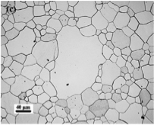
Abnormal Grain Growth
Results from some grain boundaries having a mobility advantage over others.
This occurs for a variety of reasons.
Characterized by a multimodal grain size distribution.
S.J. Dillon, M. Tang, W.C. Carter and M. Harmer, “Complexion: a New Concept for Kinetic Engineering in Materials Science,” Acta Materialia, 55, 6208-18 (2007).
S.J. Dillon, M. Tang, W.C. Carter and M. Harmer, “Complexion: a New Concept for Kinetic Engineering in Materials Science,” Acta Materialia, 55, 6208-18 (2007).

Slide 4
Solute Drag Theory
Impurities reduce grain boundary mobility.
The most mobile grains are those containing the least solute.
Grain boundaries that break free of their “solute cloud” approach the mobility of completely clean boundaries, causing AGG.
This does not explain experimental observations of the effects of dopant on grain boundary mobility
Examples: - Calcia-doped Alumina - Yttria-doped Alumina - Fe-Si alloys - Al-Ga alloys

Slide 5
New Approach to Understanding Grain Boundaries
Solute Content
Grain Boundary Structure
Properties

Slide 6
Complexions…
Are chemically and structurally distinct from the bulk material.
Have their own thermodynamic properties.
Do not have volumes distinguishable from the bulk material.
Like phases, can interconvert between one another.

Slide 7
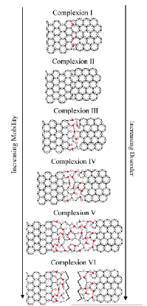
Explaining AGG with Complexions
Complexions have varying degrees of order.
As complexion approaches complete wetting, order decreases.
The decrease in order increases entropy, decreasing the free energy of diffusion across the grain boundary.
The decrease in free energy also increases the concentrations of vacancies at the grain boundary required for diffusion.
This increases grain boundary mobility!
Conclusion: grain boundaries convert to complexions closer to wetting and have a mobility advantage over the noncomplexionized, causing AGG.
S.J. Dillon, M. Tang, W.C. Carter and M. Harmer, “Complexion: a New Concept for Kinetic Engineering in Materials Science,” Acta Materialia, 55, 6208-18 (2007).
S.J. Dillon, M. Tang, W.C. Carter and M. Harmer, “Complexion: a New Concept for Kinetic Engineering in Materials Science,” Acta Materialia, 55, 6208-18 (2007).

Slide 8
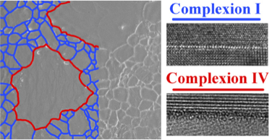
Evidence of Complexion Effect in AGG on Doped Aluminas
S.J. Dillon, M. Tang, W.C. Carter and M. Harmer, “Complexion: a New Concept for Kinetic Engineering in Materials Science,” Acta Materialia, 55, 6208-18 (2007).
S.J. Dillon, M. Tang, W.C. Carter and M. Harmer, “Complexion: a New Concept for Kinetic Engineering in Materials Science,” Acta Materialia, 55, 6208-18 (2007).

Slide 9
How do Complexion Transitions Nucleate?
Controlling microstructure will require quantitative knowledge of how IC transitions form and grow.
Site Saturated – Nucleation extremely fast at energetically favored sites.
Continuous – Nucleation occurs over a longer period.

Slide 10
Monte Carlo Modeling of AGG
Initially random grid of IDs which describe orientation.
Probability of changing IDs an exponential function of mobility, grain boundary energy, temperature and energy associated with the spin “flip.”
Boundaries with abnormal spins assigned mobilities 50x more mobile and 60% the energy of normal boundaries.
Abnormal spins assigned by determining which boundaries in the grid have the highest energies.
Simulations conducted in 2D, on a 250-by-250 cell grid.
Site-Saturated nucleation assigns all abnormal spins at the start of AGG.
Continuous nucleation assigns n abnormal spins every m steps after the start fo AGG.

Slide 11
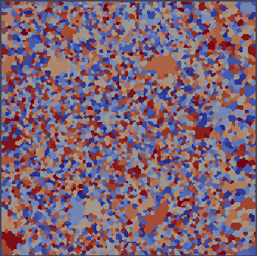
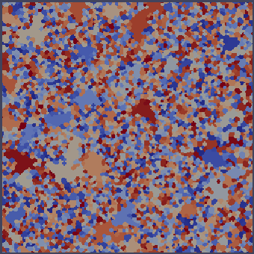
Monte Carlo Results
Continuous, 500 Abnormal spins
Site Saturated, 500 Abnormal Spins

Slide 12
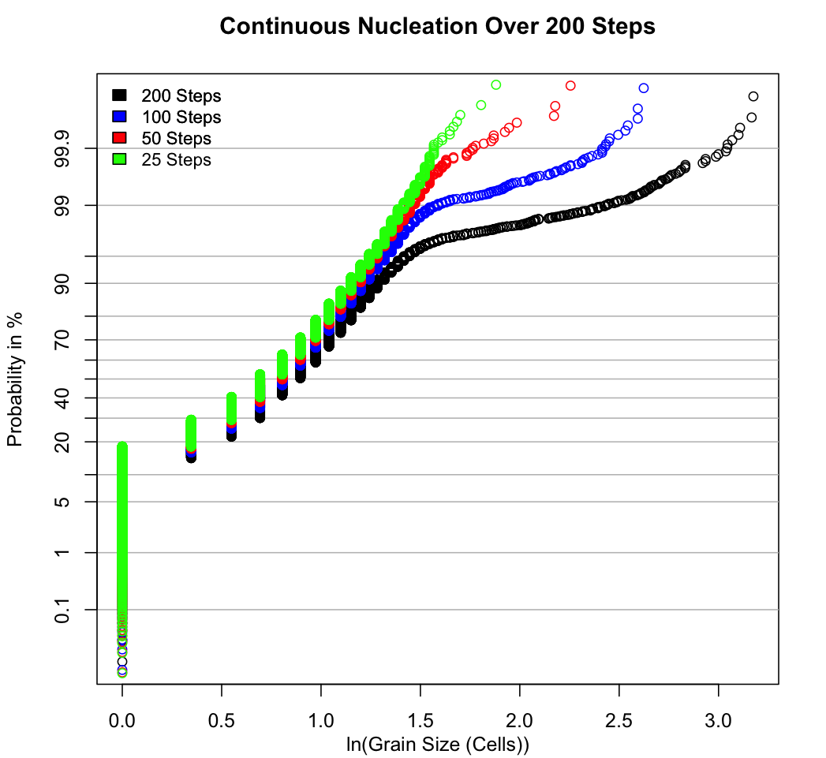
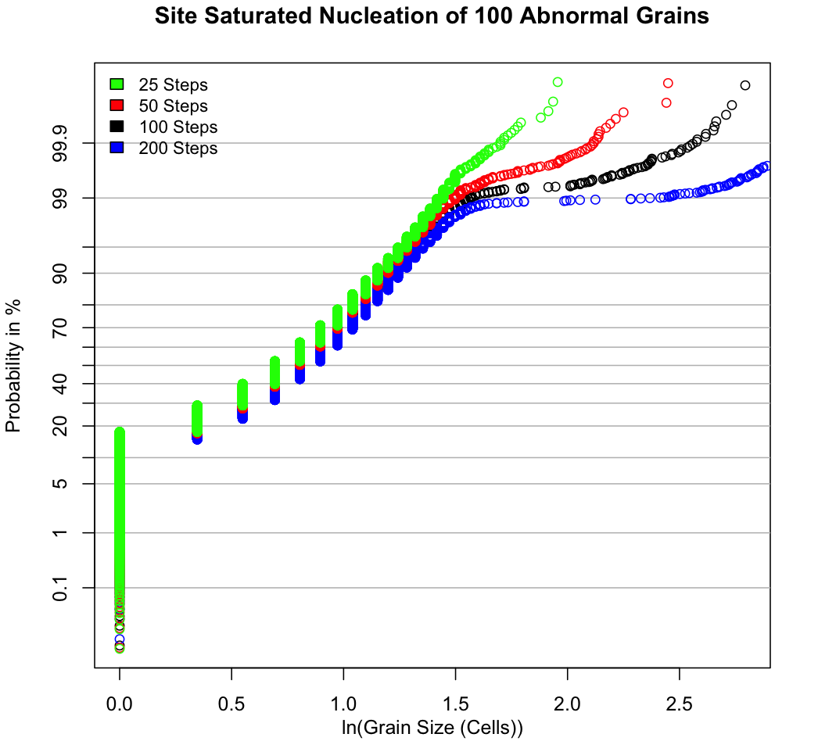
Monte Carlo Results – Log-Probability Plots
8*10⁻⁶ Nucleations/(Pixel*Step)
4*10⁻⁴ Nucleations/Pixel

Slide 13
Conclusions from Monte Carlo Modeling
AGG in the site-saturated case will show a “break away” behavior where the abnormal grains grow much larger than the normal grains.
In the continuous case, this behavior will not appear.
A grain with complexionized boundaries will not always appear to be an “abnormal” grain.

Slide 14
Experimental Methods
Two systems studied: - Ca-doped Alumina - Nano-Ni
Ca-Doped Alumina made via Spark Plasma Sintering (SPS), then sintered at 1625 C in air for periods between 0 and 48 hours.
GSD collected by OIM.
Nano-Ni annealed at 500 C in Hydrogen Atmosphere for periods between 10 and 90 minutes.
Area Fraction of Abnormal Grains determined with a light microscope.
Kinetics of AGG in Nano-Ni interpreted through use of a Johnson-Mehl-Avrami-Komogorov (JMAK) fit.

Slide 15
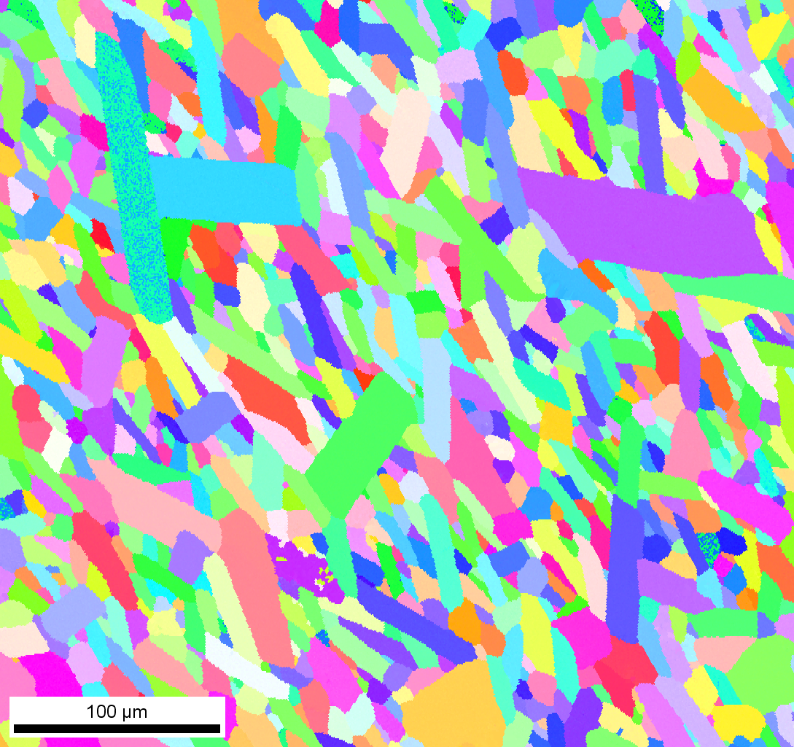
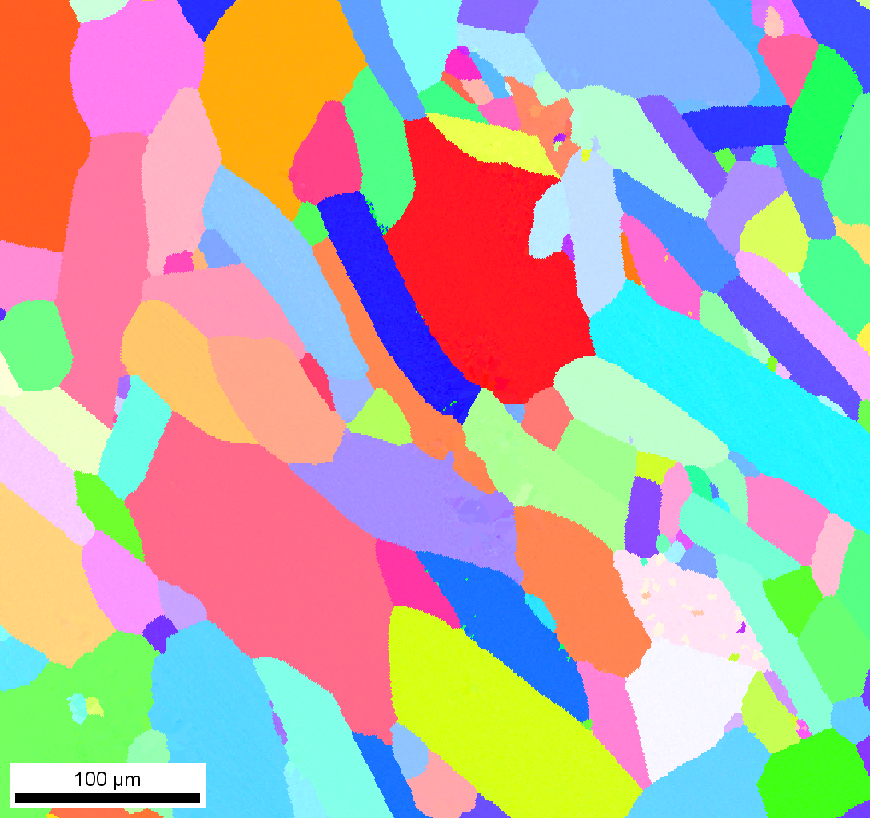
Results – Ca-Doped Alumina At 1625 C
As SPS’d
Five Hours
48 Hours

Slide 16
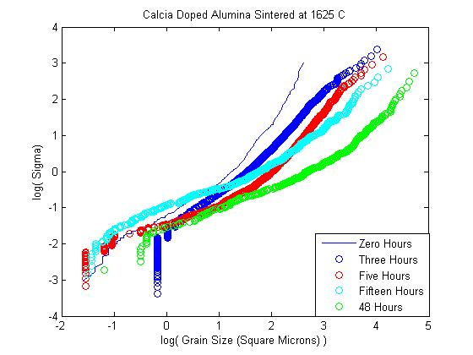

Slide 17
Conclusions from SPSd Ca-Doped Alumina
At 1625 C, the complexion transition occurs in less than an hour.
Abnormal Grain Growth not necessarily present.
Grain morphology must be taken into account to accurately predict size distributions.

Slide 18
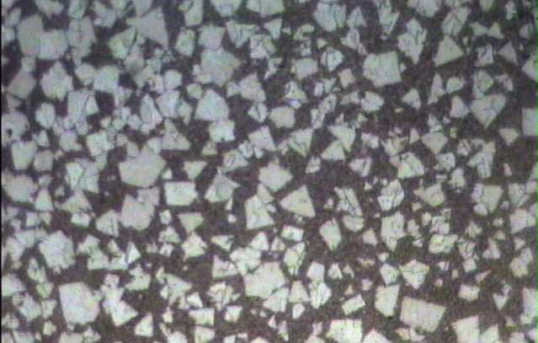
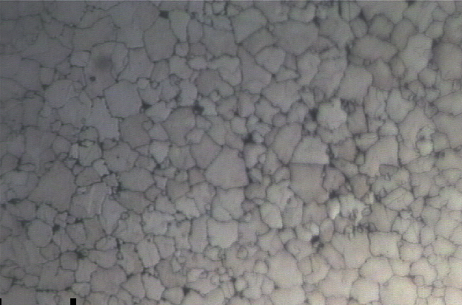
Results – Nano-Ni Annealed At 500 C
10 Minutes
30 Minutes
90 Minutes

Slide 19
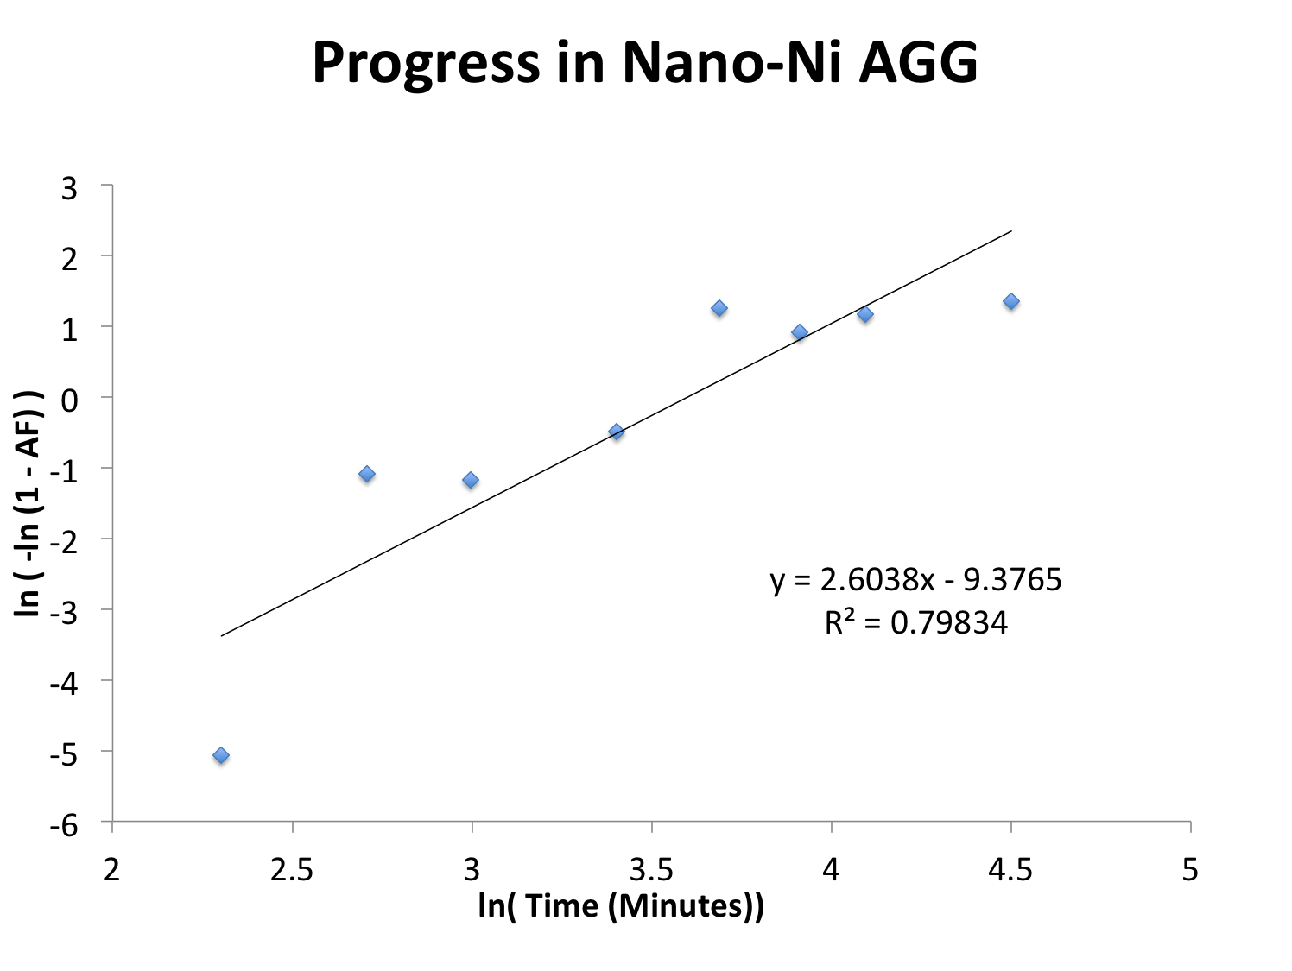

Slide 20
Grain Size Distribution of a Nano-Ni Sample

Slide 21
Conclusions from Nano-Ni
Nano-Ni appears to exhibit the “break away” behavior predicted by Monte Carlo modeling for a site-saturated complexion transition.
AGG occurs faster than observed in literature. Possible explanations: - Use of a hydrogen atmosphere. - AGG occurs as a surface effect.
The JMAK constant of AGG in Nano-Ni was close to that predicted for site-saturated nucleation.

Slide 22
Acknowledgements
This work at Carnegie Mellon University was supported by the Office of Naval Research under grant N00014-11-1-0678

Slide 23
Thank You!

